Slide 1
NGS interpretation and reporting: in the view of pathologists
Jun Kang

Slide 2
Contents
Allele frequency
Variant pathogenecity
Questions
Somatic vs germline
False positive or false negative (cut-off)
Driver vs passenger (ultra-hypermutation, POLE)
Tier
Questions
Can we determine whether the variant is germline or somatic using allele frequency and tumor percentage in tumor only test?
class: center # Variant allele frequency in clinical tumor sample
$$Allele \space frequency \approx Read \space count \space proportion$$
class: center # Somatic variant, Two copy, Tumor cellularity 50%

Slide 3
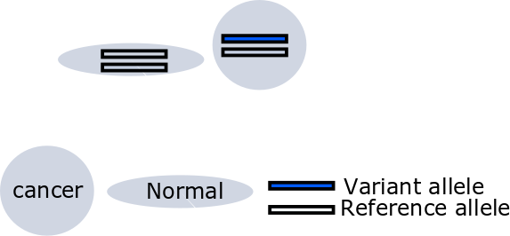

Slide 4
Variant allele frequency?
class: center ## Germline variant, Heterozigosity, Two copy, Tumor cellularity 50%

Slide 5
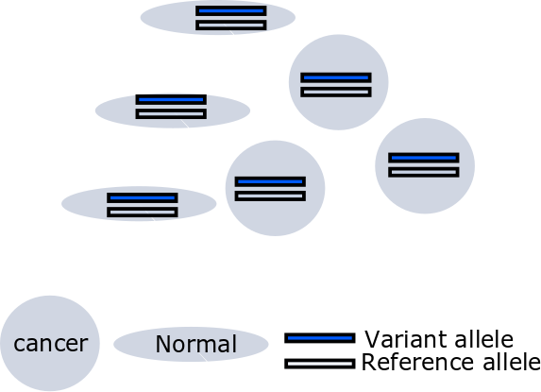

Slide 6
Variant allele frequency?
class: center # Germline variant, Heterozigosity, One copy, LOH, Tumor cellularity 50%

Slide 7
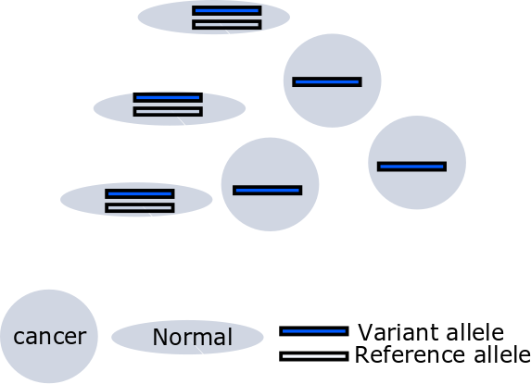

Slide 8
Variant allele frequency?
class: center # Somatic variant, One copy, LOH, Tumor cellularity 50%

Slide 9
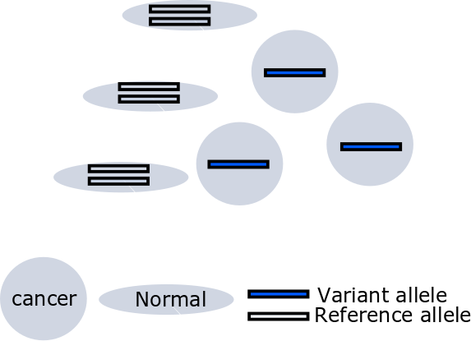

Slide 10
Variant allele frequency?

Slide 11
Variant allele frequency in clinical tumor sample
Germline vs somatic
Tumor cell proportion
Loss of heterozygosity
Copy number

Slide 12
Allele frequency fomulas [1]
$AF_{germline}$ $=$ ${pV+1-p} \over {pC+2(1-p)}$ $AF_{somatic}$ $=$ $pV \over pC+2(1-p)$
Given copy number (C)
Variant allele count (V)
Sample purity (p)
Variant status (somatic or germline)

Slide 13
Allele frequency
BRCA1 mutation: Positive - p.Glu649Ter (c.1945G>T)
Variant allele frequency 63.84%
Tumor cell percentage: 70% -> 80%
Somatic (supposed)
LOH (supposed)
One copy (supposed)

Slide 14
Allele frequency
BRCA1 mutation: Positive - p.Glu649Ter (c.1945G>T)
Variant allele frequency 63.84%
Tumor cell percentage: 70% -> 60%
Germline (supposed)
LOH (supposed)
One copy (supposed)

Slide 15
Strand bias
$$Allele \space frequency \not\approx Read \space count \space proportion$$

Slide 16
Question
76/M, Lung adenocarcinoma
NM_000059.3(BRCA2):c.5683G>A (p.Glu1895Lys)
class: my-one-page-font

Slide 17
Standards and Guidelines for the Interpretation of Sequence Variants
To describe variants identified in Mendelian disorders
American College of Medical Genetics and Genomics (ACMG)
ENIGMA BRCA1/2 Gene Variant Classification Criteria
International Agency for Research on Cancer (IARC)

Slide 18
Let’s guess the evidences

Slide 19
Segregation data (BS1, PP1)
Caveat: linkage disequilibrium
Penetration rate
Difficult statistical evaluation

Slide 20
Population data
5%: benign stand alone (BA1)
0.5-5% (BS1)
Wow! The first time observed variant! (Absent in population DB, PM2)

Slide 21
Computational (in silico) data
PolyPhen2, SIFT, MutationTaster, etc
Mutational hot spot and/or critical and wellestablished (PM1)
Protein length changes due to in-frame deletions/insertions and stop losses functional domain (PM4 BP3)
Novel missense at the same position (PM5)

Slide 22
Evidences of interpretation
Population data
Computational data
Functional data
Segregation data
De novo data
Allele data
Other databases
Other data
class: small-font # Characteristics of BRCA1/2
LOF known mechanism of disease (for PVS1)
Mode of inheritance (for PM3/BP2)
AD/AR (BRCA2)
Missense pathogenic (for PP2/BP1)
BRCA2 1%
Hot spot or critical/well-established functional domain (for PM1)
BRCA2, Helical (2479-2667), OB (2670-2799 and 3052-3190), Tower (2831-2872)
Characteristics of varant (NM_000059.3(BRCA2):c.5683G>A (p.Glu1895Lys))
ClinVar (Uncertain significance (Last evaluated: Nov 1, 2015)) (PP5, BP6)
Population AF: $8.29e^{−06}$ (PM2, BA1, BS1)
Insilico SIFT 1.0, phyloP -0.72, PolyPhen-2 0.004 BP4
class: my-one-page-font
This sequence change replaces glutamic acid with lysine at codon 1895 of the BRCA2 protein (p.Glu1895Lys). The glutamic acid residue is weakly conserved and there is a small physicochemical difference between glutamic acid and lysine. This variant is present in population databases (rs146351301, ExAC 0.009%). This variant has been reported in individuals affected with breast cancer (PMID: 25682074, 20104584, 27257965, 28664449). In the literature, this variant is also known as 5911G>A. ClinVar contains an entry for this variant (Variation ID: 142307). Algorithms developed to predict the effect of missense changes on protein structure and function output the following: SIFT: “Tolerated”; PolyPhen-2: “Benign”; Align-GVGD: “Class C0”. The lysine amino acid residue is found in multiple mammalian species, suggesting that this missense change does not adversely affect protein function. These predictions have not been confirmed by published functional studies and their clinical significance is uncertain. In summary, the available evidence is currently insufficient to determine the role of this variant in disease. Therefore, it has been classified as a Variant of Uncertain Significance.
Sherloc Invitae

Slide 23
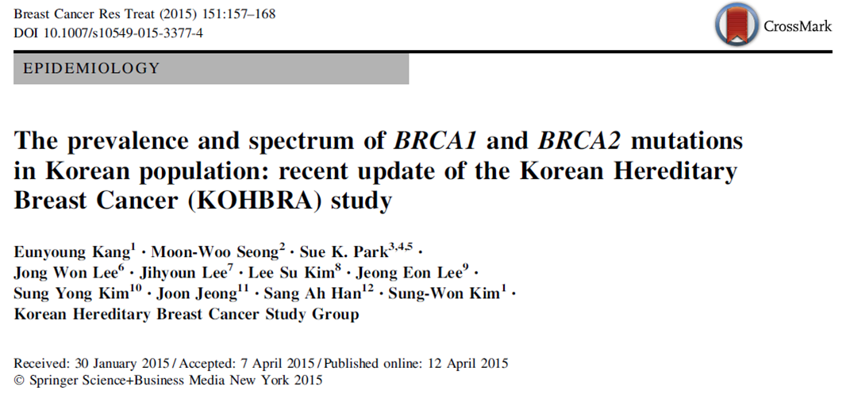
KOBRA [2]

Slide 24
HUMAN MUTATION Mutation in Brief 31: E 1200-E1240 (2010) Online
Finally, three sequence variants – BRCA2 c.9976A>T (BIC: K3326X), c.10095delCins11 (BIC: 10323delCins11) and c.10150C>T (BIC: R3384X) predicted to result in protein truncation were ruled as exceptions that could not be classified because of their location near the 3´-end and possibly dispensable part of the gene.

Slide 25
Conclusions
Allele frequency
ACMG guideline

Slide 26
class: my-one-page-font # References
[1] J. X. Sun, Y. He, E. Sanford, et al. “A computational approach to distinguish somatic vs. germline origin of genomic alterations from deep sequencing of cancer specimens without a matched normal”. En. In: PLOS Computational Biology 14.2 (2018), p. e1005965. ISSN: 1553-7358.
[2] E. Kang, M. Seong, S. K. Park, et al. “The prevalence and spectrum of BRCA1 and BRCA2 mutations in Korean population: recent update of the Korean Hereditary Breast Cancer (KOHBRA) study”. En. In: Breast Cancer Res Treat 151.1 (5. 2015), pp. 157-168. ISSN: 1573-7217.

