Slide 1
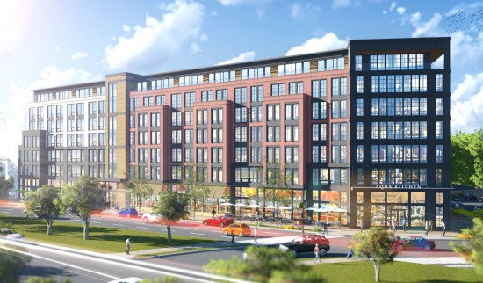
Planned Unit Development in a single structure.
Residential
Retail

Slide 2
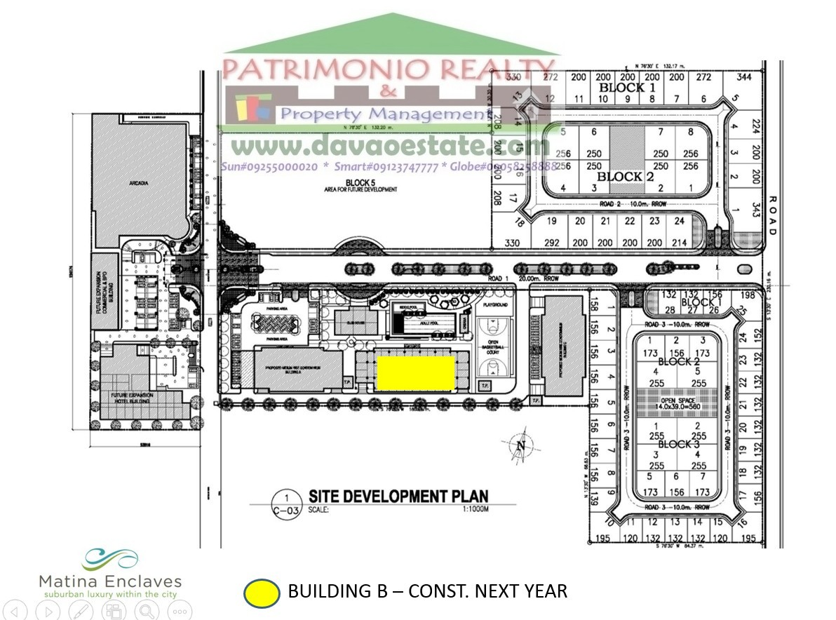
Planned Unit Development
as a site development.
Undeveloped
Residential
Commercial
Elementary school
Residential

Slide 3
You have a parcel of land that is 95' x 145'
Local zoning requires set backs of 25 feet in the front
15 feet at the rear of the property and 12 feet at the sides.
EExercise 5
145'
95'

Slide 4
You have a parcel of land that is 95' x 145'
Local zoning requires set backs of 25 feet in the front
15 feet at the rear of the property and 12 feet at the sides.
15'
Exercise 5
145'
25'
95'

Slide 5
You have a parcel of land that is 95' x 145'
Local zoning requires set backs of 25 feet in the front
15 feet at the rear of the property and 12 feet at the sides.
12'
12'
15'
Exercise 5
145
25'
95'

Slide 6
You have a parcel of land that is 95' x 145'
Local zoning requires set backs of 25 feet in the front
15 feet at the rear of the property and 12 feet at the sides.
12'
12'
Exercise 5
15'
71' x 105' = 7,455
145
-25'
-15'
105' Buildable Depth
25'
95'
-12'
-12'
71' Buildable Width

Slide 7
12'
12'
15'
House
25'

Slide 8
12'
12'
15'
House
25'
Ramp

Slide 9
Quiz #4
70'
#30
110'
Answer C

Slide 10
Quiz #4
70'
#30
15'
110'
20'
Answer C

Slide 11
Quiz #4
70'
#30
15'
110'
-20'
-15'
75'
20'
Answer C

Slide 12
Quiz #4
70'
10'
10'
#30
15'
110'
-20'
-15'
75'
20'
Answer C

Slide 13
Quiz #4
70'
-10'
-10'
50'
10'
10'
#30
15'
110'
-20'
-15'
75'
50' x 75' = 3,750
20'
Answer C

Slide 14
Quiz #4
70'
-10'
-10'
50'
10'
10'
#30
15'
110'
-20'
-15'
75'
50' x 75' = 3,750
20'
Answer C

Slide 15
Appurtenant
Quiz #4
Easement
#26 & 27
Servient Dominant
A
B
Encumbrance to Lot A

