Slide 1
Evaluating Scrum-Agile for the SNHU Travel Project
ChadaTech Pilot Implementation
Justin Khamphady
CS-250
Southern New Hampshire University

Slide 2


Scrum Framework and Roles
Scrum is an Agile framework that organizes work into short, iterative cycles called sprints.
Product Owner – Manages and prioritizes the product backlog
Scrum Master – Facilitates Scrum events and removes obstacles
Development Team – Designs, builds, and tests product increments
(Asana, 2026; GeeksforGeeks, 2025a)

Slide 3
Agile Phases Within the SDLC
Agile integrates traditional SDLC phases into iterative cycles:
Requirements – Maintained in a prioritized backlog
Design – Completed during sprint planning and refinement
Development – Executed during the sprint
Testing – Continuous throughout development
Deployment – Incremental release of working features
(Mendix, 2025)

Slide 4
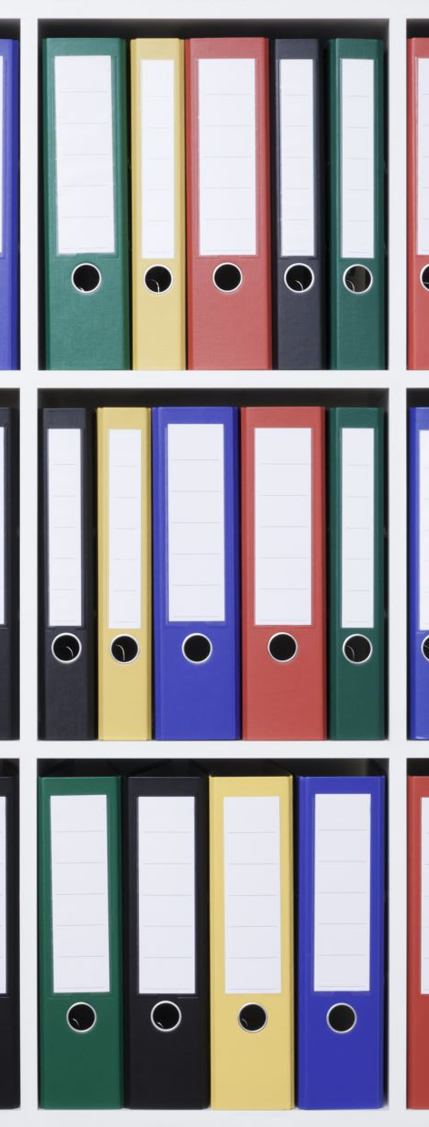
Waterfall Model Characteristics
Waterfall is a sequential development methodology:
Requirements defined upfront
Distinct linear phases
Heavy documentation
Testing occurs after development
Limited flexibility once development begins
(GeeksforGeeks, 2025b)

Slide 5

Comparison: Waterfall vs Agile
Flexibility – Waterfall: Low | Agile: High
Stakeholder Feedback – Waterfall: Late | Agile: Continuous
Risk Management – Waterfall: Late discovery | Agile: Early mitigation
Change Adaptation – Waterfall: Costly | Agile: Managed via backlog reprioritization
(GeeksforGeeks, 2025a; 2025b; Mendix, 2025)

Slide 6
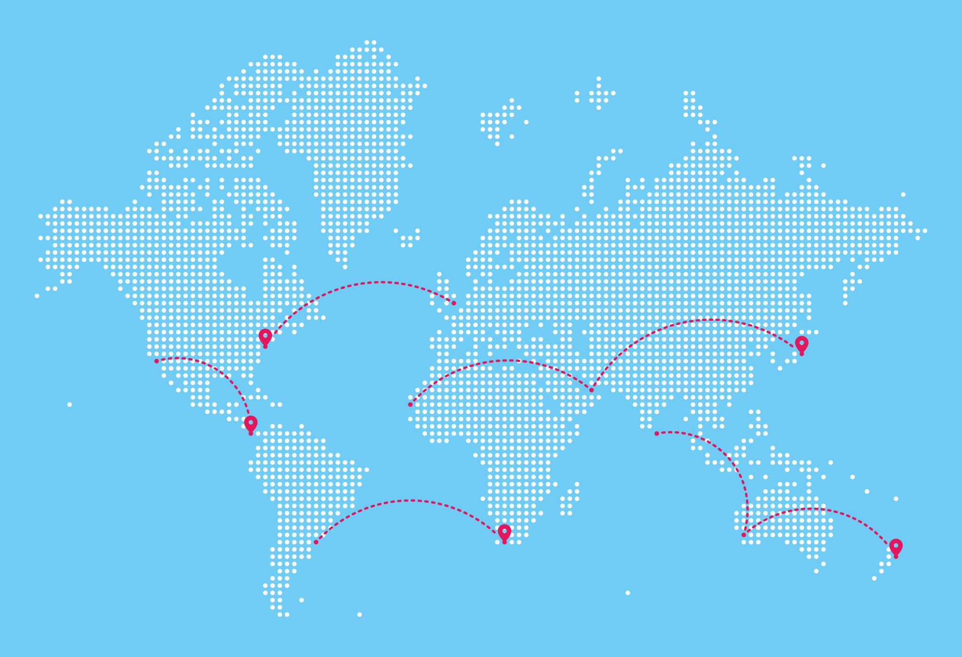
Evaluation for SNHU Travel Project
The SNHU Travel application required:
Evolving feature requirements
Frequent stakeholder feedback
Incremental testing and refinement
Adaptability to scope changes
Conclusion: Scrum-Agile was the most appropriate methodology for this project.
(Asana, 2026; Mendix, 2025)

Slide 7
References
Asana. (2026). What is Scrum? Retrieved from https://asana.com/resources/what-is-scrum
GeeksforGeeks. (2025a). Scrum software development. Retrieved from https://www.geeksforgeeks.org/software-engineering/scrum-software-development/
GeeksforGeeks. (2025b). Waterfall model. Retrieved from https://www.geeksforgeeks.org/software-engineering/waterfall-model/
Mendix. (2025). Agile framework: What it is & how it works. Retrieved from https://www.mendix.com/agile-framework/

