Slide 1
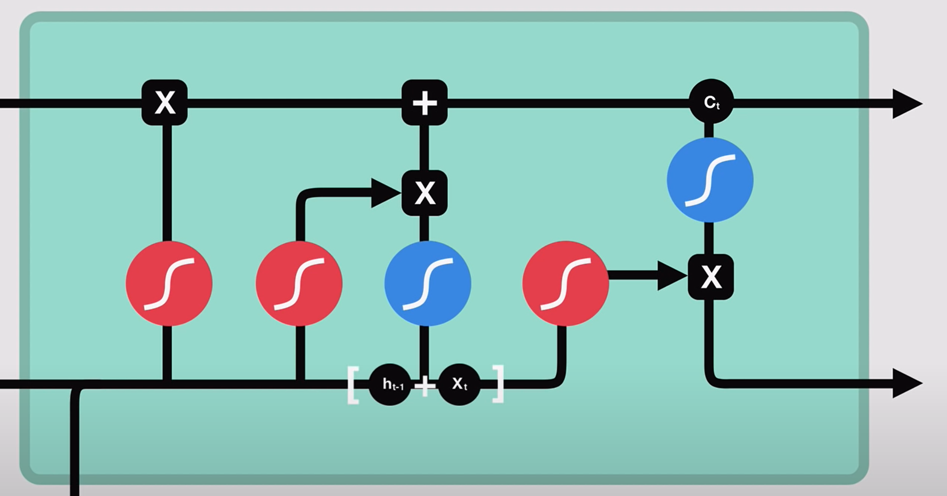



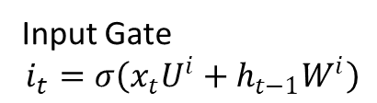

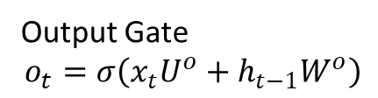



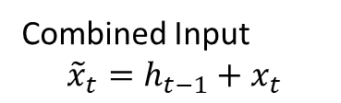




Previous Cell
State $C_{t−1}$
Elementwise Multiply $∘$
Add
Cell State $C_{t}=f_{t}∘C_{t−1}+i_{t}∘g_{t}$
Input Gate
$$i_{t}=σ\left(x_{t}U^{i}+h_{t−1}W^{i}\right)$$
Forget Gate
$$\begin{aligned}f_{t}=σ(x_{t}U^{f}+ \\ h_{t−1}W^{f})\end{aligned}$$
Candidate
$$g_{t}=tanh\left(x_{t}U^{g}+h_{t−1}W^{g}\right)$$
Sigmoid $σ$
0 = Forget
1 = Retain
Elementwise Multiply $∘$
$\tanh{ }$
Previous Hidden
State $h_{t−1}$
Regulates
Input to [-1, 1]
New hidden state
$$h_{t}=\tan{C_{t}}∘o_{t}$$
Combined Input
$${\tilde{x}}_{t}=h_{t−1}+x_{t}$$
Output Gate
$$o_{t}=σ\left(x_{t}U^{o}+h_{t−1}W^{o}\right)$$
Input Vector $x_{t}$

