Slide 1
Swagger PHP Library
using LARAVEL
By JAVERIA

Slide 2
INTRODUCTION
API Documentation
By reading your API Structure, automatically builds an Interactive API Documentation
Interactive UI
Provides UI Representation to your RESTFUL APIs
Client Libraries
Automatically generates client libraries and SDKs for API in many languages

Slide 3
Why to Document API?
1
2
3
4
5
What are the endpoint URLs?
What method to be Used?
What Data to be Passed?
What are manedatory and Optional Params?
Is Authentication required?

Slide 4
SWAGGER COMPONENTS
Swagger Editor
Swagger UI
Swagger Codegen
browser-based editor where you can write and edit API documentation
displays OpenAPI specifications as interactive API documentation
generates server stubs, client SDKs, and client libraries from an OpenAPI specification

Slide 5


How Web API Works
Requests (API Method + Endpoint URL + Parameters )
Response in JSON or XML {value1, value2}
Client
Server
http://localhost:8080/api/values
Processes Request

Slide 6


How Swagger Works
Requests (API Method + Endpoint URL + Parameters )
API Server
UI
Response (JSON/XML)
Swagger.json
Client
Server
http://localhost:8080/api/values
Processes Request

Slide 7
SWAGGER PHP
What is swagger-php ?
swagger-php is a library that extracts API metadata from your PHP source code files.

Slide 8
ANNOTATIONS
/**
* @OA\OpenApi(
* @OA\Info(
* version="1.0",
* title=“API Title",
* description=“API Description",
* )
* )
*/
General Information about the API

Slide 9
ANNOTATIONS
/**
* @OA\Get(
* tags={“Collection Name“},
* path=“/api/products",
* summary="list products",
* @OA\Response(
* response=200,
* description="A list with products"
* ),
* @OA\Response(
* response=404,
* description="an unexpected error"
* )
* )
*/
Endpoints Information about the API

Slide 10
ANNOTATIONS / PARAMETERS
Parameter Types:
path parameters, such as /users/{id}
query parameters, such as /users?role=admin
header parameters, such as X-MyHeader: Value
cookie parameters, which are passed in the Cookie header, such as Cookie: debug=0; csrftoken=BUSe35dohU3O1MZvDCU
Ex.
* @OA\Parameter(
* in="path",
* name="id",
* required=true,
* @OA\Schema(type=“number")
* ),

Slide 11
ANNOTATIONS / MEDIA TYPES
Media Types: a format of a request or response body data.
application/json
application/xml
application/x-www-form-urlencoded
multipart/form-data
text/plain
text/html
application/pdf
image/png

Slide 12
ANNOTATIONS / REQUEST AND RESPONSE BODY
Request Body: Typically used with “create” and “update” operations (POST, PUT, PATCH)
Schema: Schema mainly defines the structure of the data. A schema can define:
an object or an array — typically used with JSON and XML APIs
a primitive data type such as a number or string – used for plain text responses
a file
Response Body: An API specification needs to specify the responses for all API operations. Each operation must have at least one response defined, usually a successful response. A response is defined by its HTTP status code and the data returned in the response body and/or headers.
HTTP Status Codes: Under responses, each response definition starts with a status code, such as 200 or 404. An operation typically returns one successful status code and one or more error statuses.

Slide 13
ANNOTATIONS / REQUEST BODY EXAMPLE
* @OA\RequestBody(
* @OA\MediaType(
* mediaType="application/json",
* @OA\Schema(
* @OA\Property(
* type="object",
* @OA\Property(
* property="title",
* type="string"
* ),
* @OA\Property(
* property="content",
* type="string"
* )
* ),
* example={
* "title":"example title",
* "content":"example content"
* }
* )
* )

Slide 14
ANNOTATIONS / RESPONSE BODY EXAMPLE
* @OA\Response(
* response=200,
* description="success",
* @OA\JsonContent(
* @OA\Property(property="id", type="number", example=1),
* @OA\Property(property="title", type="string", example="title"),
* @OA\Property(property="content", type="string", example="content"),
* @OA\Property(property="updated_at", type="string", example="2021-12-11T09:25:53.000000Z"),
* @OA\Property(property="created_at", type="string", example="2021-12-11T09:25:53.000000Z"),
* )
* ),
* @OA\Response(
* response=400,
* description="invalid",
* @OA\JsonContent(
* @OA\Property(property="msg", type="string", example="Unable to Add ToDo List"),
* )
* )
* )

Slide 15
Steps To Setup Swagger-PHP Library for Laravel8
1
Install Library
composer require "darkaonline/l5-swagger"
Publish Provider
2
php artisan vendor:publish --provider "L5Swagger\L5SwaggerServiceProvider"
3
Generate swagger.json file
php artisan l5-swagger:generate
4
Run your Project and hit the Swagger UI URL
http://127.0.0.1:8000/api_documentation URL

Slide 16
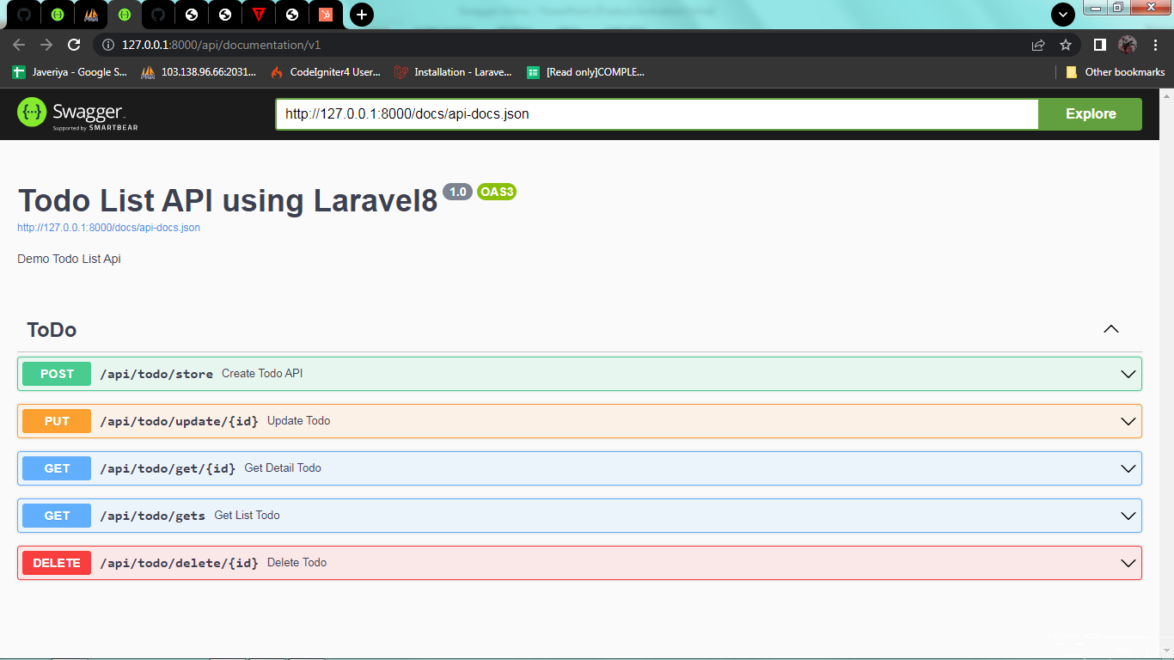
Swagger UI

Slide 17
THANK YOU

