Slide 1
Final Exam Reviews

Slide 2
L11. Influential Diagram

Slide 3
Introduction
Bayesian Network + Decision node + Utility node = Decision network (Influential Diagram)
make rational decisions based on a probabilistic model and utility function
Treat ?
$$T$$
Disease ?
$$D$$
$$U$$
$${ O}^{1}$$
$${ O}^{2}$$
$${ O}^{3}$$
Results from diagnostic tests
A chance node corresponds to a random variable
A decision node corresponds to each decision to be made
A utility node corresponds to an additive utility component

Slide 4
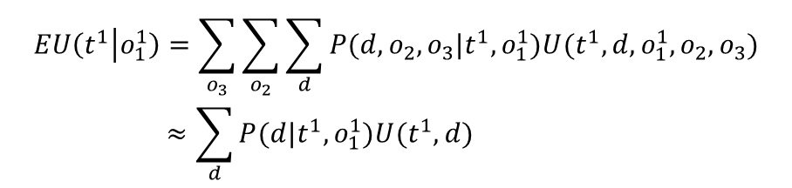
Decision Network
Assume we only have a single observation ${{ O}^{1}=1(=o}_{1}^{1})$ from test 1
Treat ?
$$T$$
Disease ?
$$D$$
$$U$$
$${ O}^{1}$$
$${ O}^{2}$$
$${ O}^{3}$$
Results from diagnostic tests
$$EU\left(t^{1} | o_{1}^{1}\right)=\sum_{o_{3}}{\sum_{o_{2}}{\sum_{d}{P(d,o_{2}, o_{3}|t^{1}, o_{1}^{1}})U(t^{1},d,o_{1}^{1}, o_{2}, o_{3})}}$$
$$≈\sum_{d}{P(d|t^{1}, o_{1}^{1}})U(t^{1},d)$$
Can be computed using many inference methods
Compare $EU\left(t^{0} | o_{1}^{1}\right)$ and $EU\left(t^{1} | o_{1}^{1}\right)$ and chose the treatment that lead maximum EU

Slide 5
Value of Information
It may be beneficial to administer additional diagnostic tests to reduce the uncertainty about the decease. Then, how to choose a test type to be conducted?
Expected utility of optimal action given observation $o$ :
$$EU^{∗}\left(o\right)=\underset{a}{argmax}{EU(a|o)}$$
The value of information (VPI) about new variable $O^{new}$ (unobserved) given the current observation $o$ (observed):
$$VOI\left(O^{new}|o\right)=\left(\sum_{o^{new}}{P(o^{new}|o})EU^{∗}\left(o^{new},o\right)\right)−EU^{∗}\left(o\right)$$
The value of information about a variable is the increase in expected utility with the observation of that variable
VPI can only captures the increase in expected utility→ need to consider the cost associated with observing the new information

Slide 6
L12. Bandit Problem

Slide 7
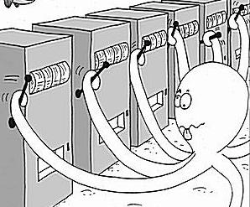

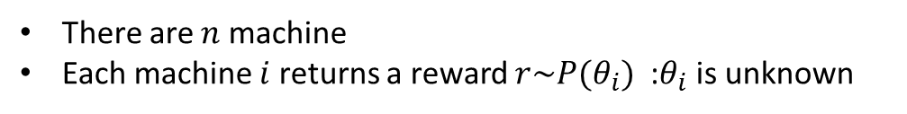

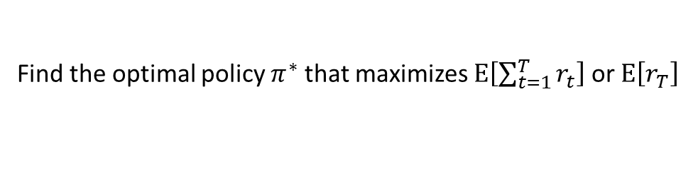
An $n$-Armed Bandit Problem
There are $n$ machine
Each machine $i$ returns a reward $r\sim P(θ_{i})$ :$θ_{i}$ is unknown
$a_{t}∈\{1,…,n\}$ : the choice of machine at time $t$
$r_{t}$ : the reward at time $t$
Policy $π$ maps all the history to new action:
$$π: \left[\left(a_{1},r_{1}\right), \left(a_{2},r_{2}\right),…, \left(a_{t−1},r_{t−1}\right)\right]→a_{t}$$
Find the optimal policy $π^{∗}$ that maximizes $E\left[\sum_{t=1}^{T}{r_{t}}\right]$ or $E\left[r_{T}\right]$
Acquiring new information
(exploration)
capitalizing on the information
available so far
(exploitation)
trade-off
Internet add : Advertising showing strategy for users
Finance : Portfolio optimization under unknown return profiles (risk vs mean profit)
Health care : Choosing the best treatment among alternatives
Internet shopping : Choosing the optimum price (sales v.s. profits)
Experiment design : Sequential experimental design (or sequential simulation parameter)

Slide 8


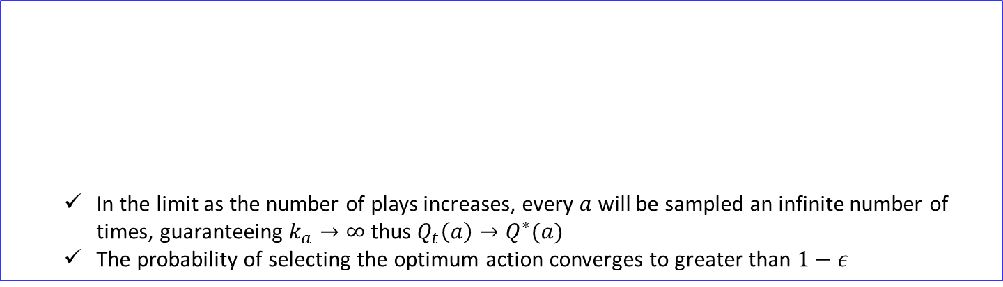



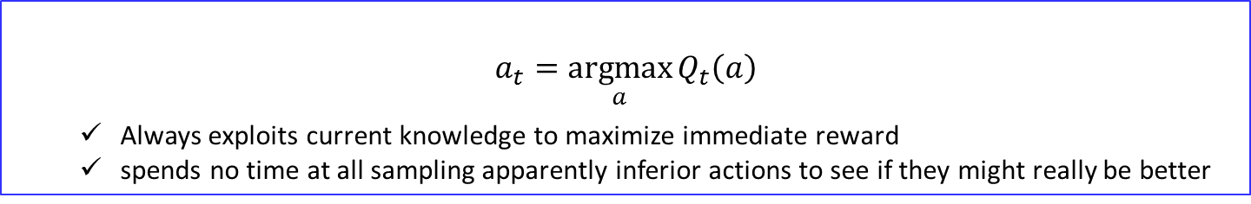


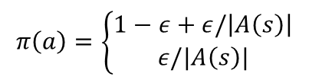
Action-Value Methods
If at $t$th play, action $a$ has been chosen $k_{a}$ times prior to $t$, yielding rewards, $r_{1}, r_{2}, …,r_{k_{a}}$, the estimated action value for $a$ is defied as
$$Q_{t}\left(a\right)=\frac{r_{1}+r_{2}+⋯+r_{k_{a}}}{k_{a}}$$
If $k_{a}=0$, $Q_{t}\left(a\right)=0$
If $k_{a}=∞$, $Q_{t}\left(a\right)→Q^{∗}(a)$
$greedy$ action selection rule
$$a_{t}=\underset{a}{argmax}{Q_{t}\left(a\right)}$$
Always exploits current knowledge to maximize immediate reward
spends no time at all sampling apparently inferior actions to see if they might really be better
$ε−greedy$ action selection rule
In the limit as the number of plays increases, every $a$ will be sampled an infinite number of times, guaranteeing $k_{a}→∞$ thus $Q_{t}\left(a\right)→Q^{∗}(a)$
The probability of selecting the optimum action converges to greater than $1−ε$
$$π\left(a\right)=\left\{\begin{aligned}1−ε+ε/\left|A\left(s\right)\right| \\ ε/|A\left(s\right)|\end{aligned}\right.$$
If $a=a∗$
If $a≠a∗$
$$\left(1−ε+\frac{ε}{\left|A\left(s\right)\right|}\right)×1+\frac{ε}{\left|A\left(s\right)\right|}\left(\left|A\left(s\right)\right|−1\right)=1$$

Slide 9
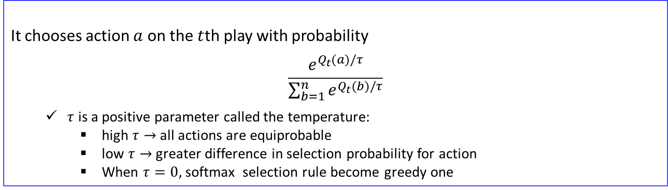
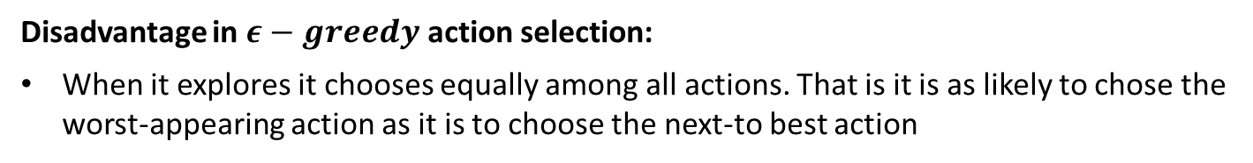
Softmax Action Selection
Disadvantage in $ε−greedy$ action selection:
When it explores it chooses equally among all actions. That is it is as likely to chose the worst-appearing action as it is to choose the next-to best action
Solution:
Vary the action probabilities as a graded function of estimated value
The greedy action is still given the highest selection probability, but all the others are ranked and weighted according to their values estimates
Softmax action selection rule
It chooses action $a$ on the $t$th play with probability
$$\frac{e^{Q_{t}(a)/τ}}{\sum_{b=1}^{n}{e^{Q_{t}(b)/τ}}}$$
$τ$ is a positive parameter called the temperature:
high $τ→$ all actions are equiprobable
low $τ→$ greater difference in selection probability for action
When $τ=0,$ softmax selection rule become greedy one
Whether softmax action selection or greedy action selection rule is better is unclear and may depend on the task and on human factors (i.e., setting $τ$ and $ε)$

Slide 10

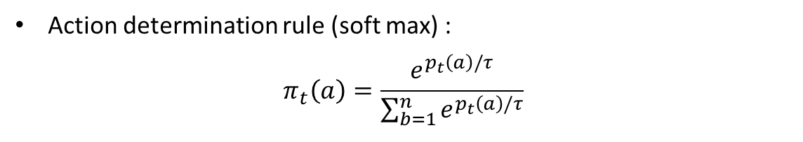
Reinforcement Comparison
Reinforcement Comparison algorithm
$p_{t}(a)$ : The preference for each action at time $t$ (not an actual action value)
Action determination rule (soft max) :
$$π_{t}\left(a\right)=\frac{e^{p_{t}\left(a\right)/τ}}{\sum_{b=1}^{n}{e^{p_{t}\left(a\right)/τ}}}$$
After selecting action and observing reward, the preference $p_{t}(a)$ is updated :
$p_{t+1}\left(a_{t}\right)=$ $p_{t}\left(a_{t}\right)+β\left[r_{t}−{\overline{r}}_{t}\right]$
High rewards should increase the probability of reselecting the action taken
$β$ is a positive step-size parameter
The reference reward ${\overline{r}}_{t}$ (i.e., average reward) is updated using all recently received rewards whichever actions were taken:
$${\overline{r}}_{t+1}={\overline{r}}_{t}+α\left[r_{t}−{\overline{r}}_{t}\right]$$
Reinforcement comparison method can be very effective sometimes outperforming $ε−greedy$ method

Slide 11
Relationship with model based approach
Only
Exploitation
Exploration
vs
Exploitation
Model is known
Model is unknown
Single state
Optimization
Bandit
Optimum
action
Contextual Bandit
Optimum
policy
Multiple state
Dynamic
Programing
Reinforcement learning
We going to learn Dynamic Programming approach first, and move to Reinforcement learning

Slide 12
L13. Markov Decision Process
(Formulation)

Slide 13
From MDP to RL
Parametric representation
ADP
Supervised learning
RL
No model
Local learning :
Learn only around we are interested
Approximate solution
Model based
MDP
DP
Exact solution
Usually Tabular representation
For special case, DP can be used for solving a MDP with continuous space and action
All other methods can be viewed as attempts to achieve much the same effect as DP, only with less computation and without assuming a perfect model of the environment

Slide 14
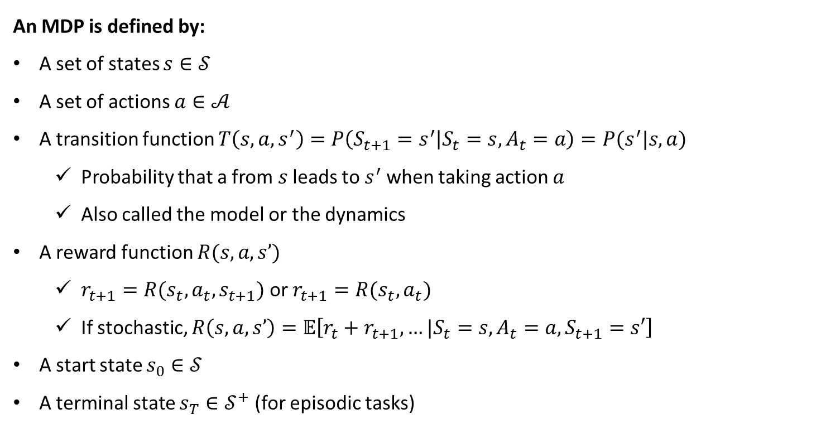
Markov Decision Processes
Finite Markov Decision Process (MDP) :The state and action space are finite
An MDP is defined by:
A set of states $s∈𝒮$
A set of actions $a∈𝒜$
A transition function $T\left(s,a,s^{′}\right)=P\left(S_{t+1}=s^{′} | S_{t}=s, A_{t}=a\right)=P(s^{′}|s,a)$
Probability that a from $s$ leads to $s^{′}$ when taking action $a$
Also called the model or the dynamics
A reward function $R(s, a, s’)$
$r_{t+1}=R(s_{t},a_{t},s_{t+1})$or $r_{t+1}=R(s_{t},a_{t})$
If stochastic, $R\left(s, a, s’\right)=𝔼\left[r_{t}+r_{t+1},…|S_{t}=s, A_{t}=a,S_{t+1}=s′\right]$
A start state $s_{0}∈𝒮$
A terminal state $s_{T}∈𝒮^{+}$(for episodic tasks)

Slide 15
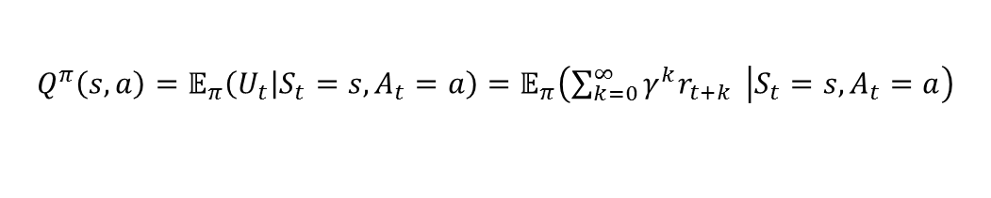

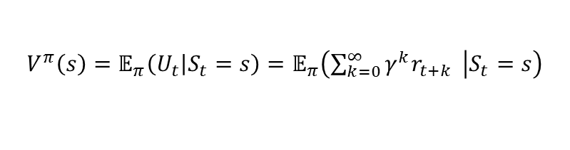

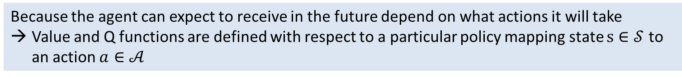
Value Function & Q function
Value function (state value function for $π$)
“How good it is for the agent to be in a given state”
$V^{π}\left(s\right)$ : The expected utility received by following policy $π$ from state $s$
$$V^{π}\left(s\right)=𝔼_{π}\left(U_{t} | S_{t}=s\right)=𝔼_{π}\left(\sum_{k=0}^{∞}{γ^{k}r_{t+k} } | S_{t}=s\right)$$
$𝔼_{π}$ : not expectation over policy $π$ but all stochastic state transitions associated with $π$
Q-function (action-value function for $π$)
“How good it is for the agent to perform a given action in a given state”
$Q^{π}\left(s, a\right)$ : The expected utility of taking action $a$ from state $s$, and then following policy $π$
$$Q^{π}\left(s,a\right)=𝔼_{π}\left(U_{t} | S_{t}=s,A_{t}=a\right)=𝔼_{π}\left(\sum_{k=0}^{∞}{γ^{k}r_{t+k} } | S_{t}=s,A_{t}=a\right)$$
Because the agent can expect to receive in the future depend on what actions it will take
Value and Q functions are defined with respect to a particular policy mapping state $s∈𝒮$ to an action $a∈𝒜$

Slide 16
















The Bellman Equation for Value Function
Recursive Formulation (The Bellman equation)
$$V^{π}\left(s\right)$$
$$=𝔼_{π}\left(\sum_{k=0}^{∞}{γ^{k}r_{t+k} } | S_{t}=s\right)$$
$${=𝔼}_{π}\left(r_{t}+γ\sum_{k=0}^{∞}{γ^{k}r_{t+1+k} } | S_{t}=s\right)$$
$$=\sum_{s′}{T(s,π(s),s^{′})\left\{R\left(s,π(s),s^{′}\right)+γ𝔼_{π}\left(\sum_{k=0}^{∞}{γ^{k}r_{t+1+k} } | S_{t+1}=s′\right)\right\}}$$
$$=\sum_{s′}{T(s,π(s),s^{′})\left\{R\left(s,π(s),s^{′}\right)+γV^{π}\left(s′\right)\right\}}$$
The value of the start state must equal the (discounted) value of the expected next state, plus the reward expected along the way
$$V^{π}(s^{′}=s_{1})$$
$$V^{π}(s)$$
$$T(s,a_{2},s_{1})$$
$$R\left(s,a_{2},s_{1}\right)$$
$$s_{1}$$
$$s$$
$$a_{2}=π(s)$$
$$s,a_{2}$$
$$T(s,a_{2},s_{2})$$
$$s_{2}$$
$$R\left(s,a_{2},s_{2} \right)$$
$$V^{π}(s^{′}=s_{2})$$
state node
chance node
$$T(s,π\left(s\right),s′)$$

Slide 17



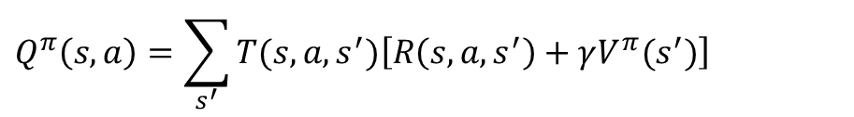













Summary for Value function and Q function
$$Q^{π}(s,a)$$
$$V^{π}(s^{′}=s_{1})$$
$$V^{π}(s)$$
$$T(s,a,s_{1})$$
$$R\left(s,a,s_{1} \right)$$
$$s_{1}$$
$$s$$
$$a=π(s)$$
$$s,a$$
$$T(s,a, s_{2})$$
$$s_{2}$$
$$R\left(s,a,s_{2} \right)$$
$$V^{π}(s^{′}=s_{2})$$
$$V^{π}\left(s\right)=\sum_{s′}{T(s,π(s),s^{′})\left\{R\left(s,π(s),s^{′}\right)+γV^{π}\left(s′\right)\right\}}$$
$$Q_{ }^{π}\left(s,a\right)=\sum_{s^{′}}{T(s,a,s^{′})\left[R\left(s,a,s^{′}\right)+γV^{π}(s^{′})\right]}$$
$$V^{π}\left(s\right)=Q_{ }^{π}\left(s,π(s)\right)$$

Slide 18























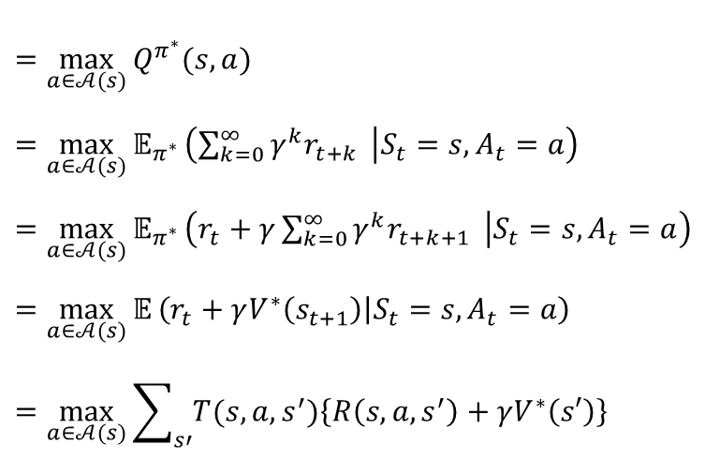

Bellman Optimality Equation for State-Value Function
Bellman optimality equation for $V^{∗}(s)$
$$Q^{π^{∗}}(s,a_{1})$$
$$s_{1}$$
$$V^{∗}(s^{′}=s_{1})$$
$$s,a_{1}$$
$$a_{1}$$
$$s_{2}$$
$$V^{∗}(s^{′}=s_{1})$$
$$Q^{π^{∗}}(s,a_{2})$$
$$s_{1}$$
$$s$$
max
$$a_{2}$$
$$s,a_{2}$$
$$V^{∗}(s)$$
$$s_{2}$$
$$a_{3}$$
$$Q^{π^{∗}}(s,a_{3})$$
$$s_{1}$$
$$s,a_{3}$$
$$=\max_{a∈𝒜(s)}{Q^{π^{∗}}(s,a)}$$
$$=\max_{a∈𝒜(s)}{𝔼_{π^{∗}}}\left(\sum_{k=0}^{∞}{γ^{k}r_{t+k} } | S_{t}=s, A_{t}=a\right)$$
$$=\max_{a∈𝒜(s)}{𝔼_{π^{∗}}}\left(r_{t}+γ\sum_{k=0}^{∞}{γ^{k}r_{t+k+1} } | S_{t}=s, A_{t}=a\right)$$
$$=\max_{a∈𝒜(s)}{𝔼}\left(r_{t}+γV^{∗}\left(s_{t+1}\right) | S_{t}=s, A_{t}=a\right)$$
$$=\max_{a∈𝒜(s)}{\sum_{s′}{T(s,a,s^{′})\left\{R\left(s,a,s^{′}\right)+γV^{∗}\left(s′\right)\right\}}}$$
$$V^{∗}\left(s\right)$$
$$s_{2}$$
$𝔼$ is over transitions associated with $π^{∗}$
$𝔼$ is over transitions
First take optimum action and follow the optimum policy

Slide 19


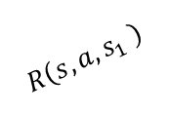


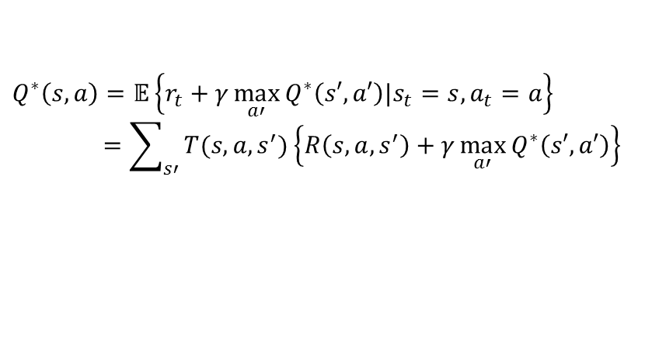


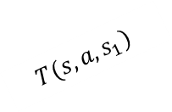


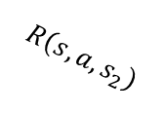








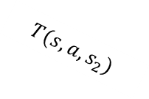





Bellman Optimality Equation for State-Action Value Function
Bellman optimality equation for $Q^{∗}(s,a)$
$$S^{′}$$
$$A^{′}$$
$$a_{1}$$
$$s_{1},a′$$
$$Q^{∗}\left(s_{1},a′\right)$$
$$s_{1}$$
max
$$T(s,a,s_{1})$$
$$a_{2}$$
$$s_{1},a′′$$
$$R\left(s,a,s_{1} \right)$$
$$Q^{∗}\left(s_{2},a′′\right)$$
$$Q^{∗}(s,a)$$
$$s,a$$
$$T(s,a,s_{2})$$
$$a_{1}$$
$$s_{2},a′$$
$$Q^{∗}\left(s_{1},a′\right)$$
$$R\left(s,a,s_{2}\right)$$
$$s_{2}$$
max
$$a_{2}$$
$$s_{2},a′′$$
$$Q^{∗}\left(s_{2},a′′\right)$$
$$Q^{∗}\left(s,a\right)=𝔼\left\{r_{t}+γ\max_{a′}{Q^{∗}\left(s′,a′\right)|s_{t}=s, a_{t}=a}\right\}$$
$$=\sum_{s′}{T(s,a,s^{′})\left\{R\left(s,a,s^{′}\right)+γ\max_{a′}{Q^{∗}\left(s′,a′\right)}\right\}}$$
$𝔼$ is over transitions $s^{′}→s^{′}$
First transits by transition probability and take the optimum action for each consequent states

Slide 20
L14. Markov Decision Process
(Dynamic Programming Approach)

Slide 21
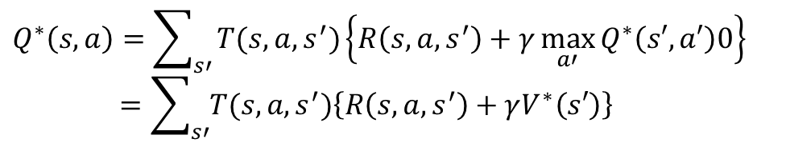

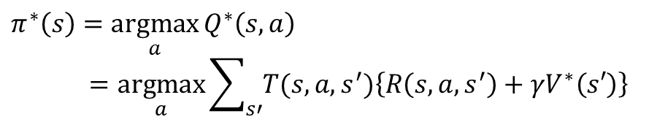

Dynamic Programming
The term dynamic programming (DP) refers to a collection of algorithms that can be used to compute optimal polices given a perfect model of the environment as a Markov decision process (MDP)
The key idea of DP (and reinforcement learning) is the use of value functions to organize and structure the search for good policies
Optimal policies can be derived from the optimal value functions that satisfy the Bellman optimality equations
$$V^{∗}\left(s\right)=\max_{a∈𝒜(s)}{\sum_{s′}{T(s,a,s^{′})\left\{R\left(s,a,s^{′}\right)+γV^{∗}\left(s′\right)\right\}}}$$
$$Q^{∗}\left(s,a\right)=\sum_{s′}{T(s,a,s^{′})\left\{R\left(s,a,s^{′}\right)+γ\max_{a′}{Q^{∗}\left(s′,a′\right)0}\right\}}$$
$$=\sum_{s′}{T(s,a,s^{′})\left\{R\left(s,a,s^{′}\right)+γV^{∗}\left(s′\right)\right\}}$$
$${∵V}^{∗}\left(s′\right)=\max_{a′}{Q^{∗}\left(s′,a′\right)}$$
Optimal policy
$$π^{∗}\left(s\right)=\underset{a}{argmax}{Q^{∗}\left(s,a\right)}$$
$$=\underset{a}{argmax}{\sum_{s′}{T(s,a,s^{′})\left\{R\left(s,a,s^{′}\right)+γV^{∗}\left(s′\right)\right\}}}$$

Slide 22
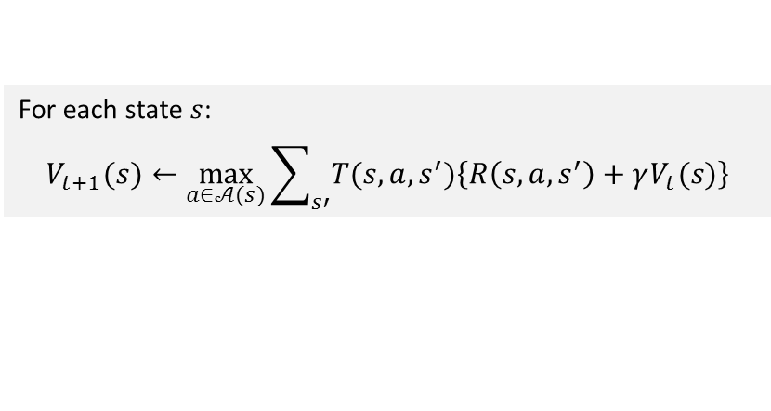
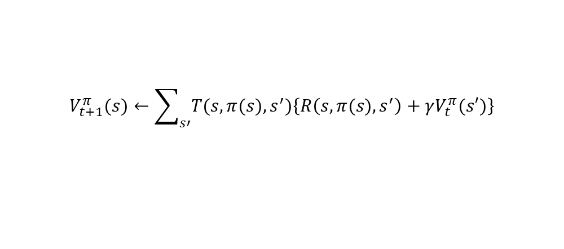


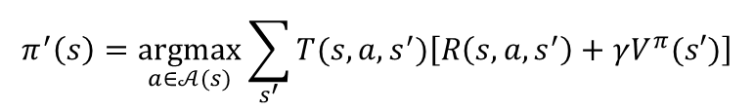

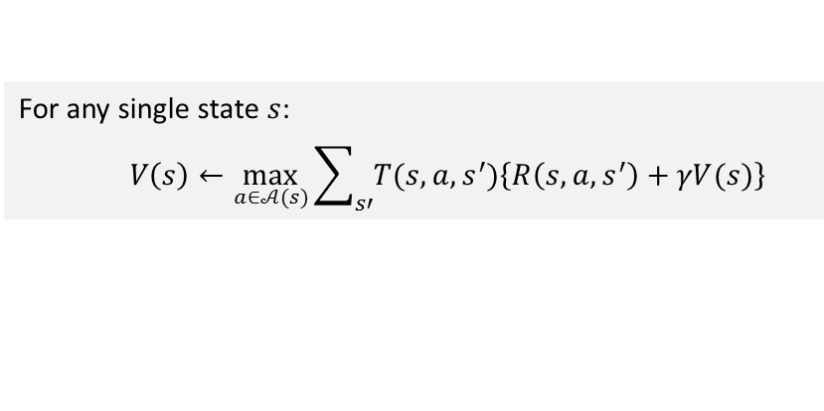
DP Approaches
Policy Evaluation
For $t=1,…$
For each state $s$:
$$V_{t+1}^{π}(s)←\sum_{s′}{T(s,π(s),s^{′})\left\{R\left(s,π(s),s^{′}\right)+γV_{t}^{π}(s′)\right\}}$$
Policy Iteration
Policy Improvement
For each state $s$:
$$π^{′}\left(s\right)=\underset{a∈𝒜(s)}{argmax}{\sum_{s^{′}}{T(s,a,s^{′})\left[R\left(s,a,s^{′}\right)+γV^{π}(s′)\right]}}$$
Value Iteration
For each state $s$:
$$V_{t+1}(s)←\max_{a∈𝒜(s)}{\sum_{s′}{T(s,a,s^{′})\left\{R\left(s,a,s^{′}\right)+γV_{t}(s)\right\}}}$$
Asynchronous Value iteration
For any single state $s$:
$$V\left(s\right)←\max_{a∈𝒜(s)}{\sum_{s′}{T(s,a,s^{′})\left\{R\left(s,a,s^{′}\right)+γV(s)\right\}}}$$
As long as both processes continue to update all states, the ultimate result is typically the same-convergence to the optimal value function and an optimal policy

Slide 23

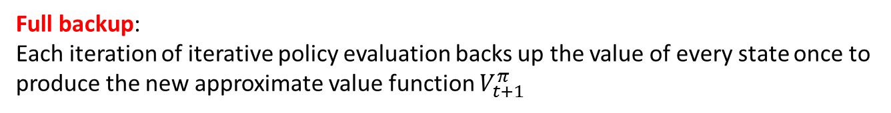
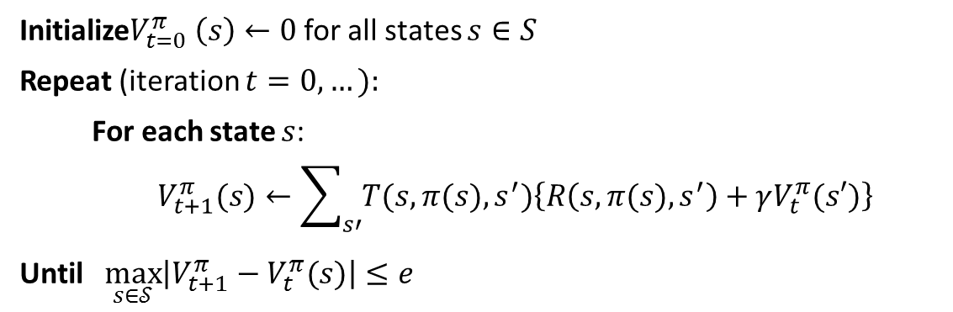
Policy Evaluation
Policy evaluation :
A method to compute the state-value function $V^{π}(s)$ for an arbitrary policy $π:𝒮→𝒜$
$$V^{π}(s)=\sum_{s′}{T(s,π(s),s^{′})\left\{R\left(s,π(s),s^{′}\right)+γV^{π}(s′)\right\}}$$
A system of $\left|𝒮\right|$ simultaneous linear equations in $\left|𝒮\right|$ unknown
Algorithm
Initialize$V_{t=0}^{π} \left(s\right)←0$ for all states $s∈S$
Repeat (iteration $t=0,…):$
For each state $s$:
$$V_{t+1}^{π}(s)←\sum_{s′}{T(s,π(s),s^{′})\left\{R\left(s,π(s),s^{′}\right)+γV_{t}^{π}(s′)\right\}}$$
Until $\max_{s∈𝒮}\left|V_{t+1}^{π}−V_{t}^{π}(s)\right|≤e$
Full backup:
Each iteration of iterative policy evaluation backs up the value of every state once to produce the new approximate value function $V_{t+1}^{π}$

Slide 24

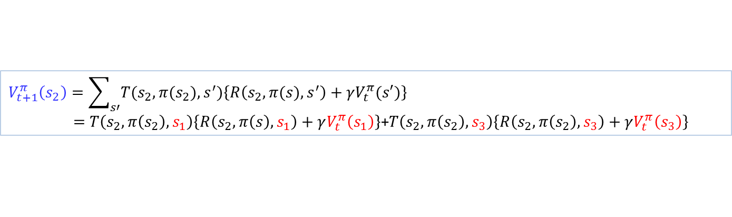





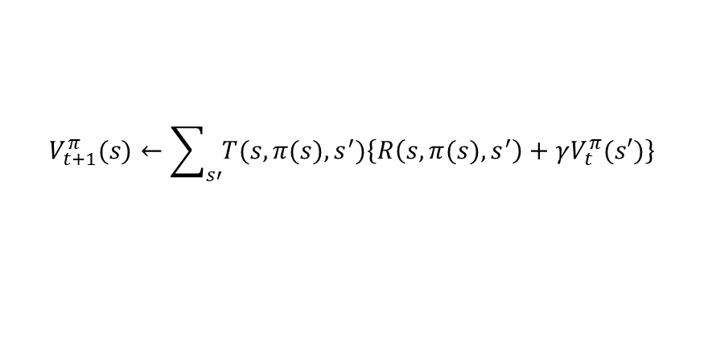









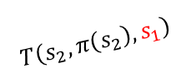







Policy Evaluation
$$V_{t+1}^{π}(s)←\sum_{s′}{T(s,π(s),s^{′})\left\{R\left(s,π(s),s^{′}\right)+γV_{t}^{π}(s′)\right\}}$$
Example:
$$V_{t+1}^{π}\left(s_{2}\right)=\sum_{s′}{T(s_{2},π(s_{2}),s^{′})\left\{R\left(s_{2},π(s),s^{′}\right)+γV_{t}^{π}(s′)\right\}}$$
$=T\left(s_{2},π\left(s_{2}\right),s_{1}\right)\left\{R\left(s_{2},π\left(s\right),s_{1}\right)+γV_{t}^{π}\left(s_{1}\right)\right\}$+$T\left(s_{2},π\left(s_{2}\right),s_{3}\right)\left\{R\left(s_{2},π\left(s_{2}\right),s_{3}\right)+γV_{t}^{π}\left(s_{3}\right)\right\}$
“Two-arrays” update
“In place” update
$$V_{t+1}^{π}\left(s\right)$$
$$V_{t}^{π}\left(s\right)$$
$$V_{t+1}^{π}\left(s\right)$$
$$s_{1}$$
$$T\left(s_{2},π\left(s_{2}\right),s_{1}\right)$$
$$s_{1}$$
$$s_{1}$$
$$T\left(s_{2},π\left(s_{2}\right),s_{1}\right)$$
$$R\left(s_{2},π\left(s_{2}\right),s_{1}\right)$$
$$R\left(s_{2},π\left(s_{2}\right),s_{1}\right)$$
$$s_{2}$$
$$s_{2}$$
$$s_{2}$$
$$s_{3}$$
$$T\left(s_{2},π\left(s_{2}\right),s_{3}\right)$$
$$s_{3}$$
$$s_{3}$$
$$T\left(s_{2},π\left(s_{2}\right),s_{3}\right)$$
$$R\left(s_{2},π\left(s_{2}\right),s_{3}\right)$$
$$R\left(s_{2},π\left(s_{2}\right),s_{3}\right)$$
$$s_{N}$$
$$s_{N}$$
$$s_{N}$$
Usually faster!
Less memory

Slide 25
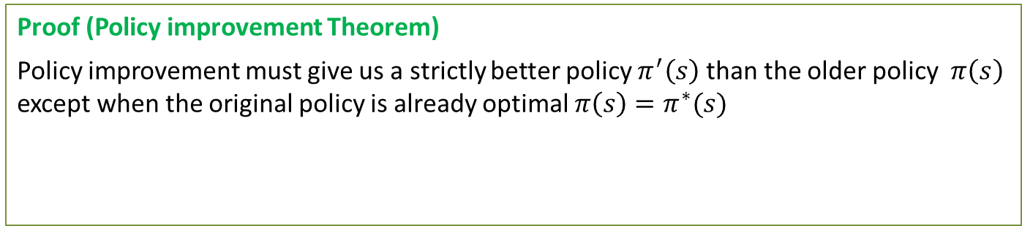

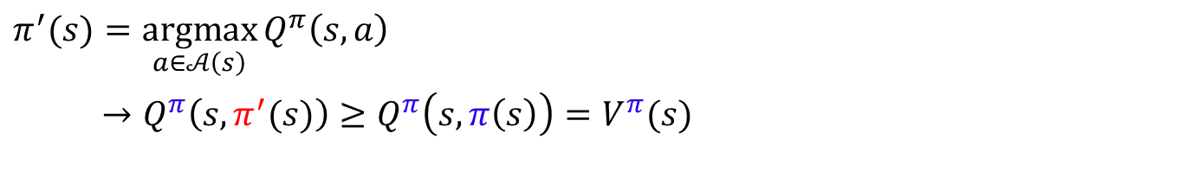
Policy Improvement
$$π^{′}(s)=\underset{a∈𝒜\left(s\right)}{argmax}{Q_{ }^{π}\left(s,a\right)}$$
$→Q_{ }^{π}\left(s,π^{′}(s)\right)≥Q_{ }^{π}\left(s,π\left(s\right)\right)=V^{π}(s)$
$$x^{∗}=\underset{x}{argmax}{f(x)}$$
$→f(x^{∗})≥f(x)$ for all $x$
Improvement criterion =
Expected reward provided by changing one step action and following the original policy
Proof (Policy improvement Theorem)
Policy improvement must give us a strictly better policy $π^{′}\left(s\right)$ than the older policy $π\left(s\right)$ except when the original policy is already optimal $π\left(s\right)=π^{∗}(s)$
$Q^{π}\left(s,π^{′}\left(s\right)\right)≥V^{π}\left(s\right) →{ V}^{π^{′}}\left(s\right)≥V^{π}(s)$ for all states $s∈𝒮$
$$π^{′}≥π$$

Slide 26

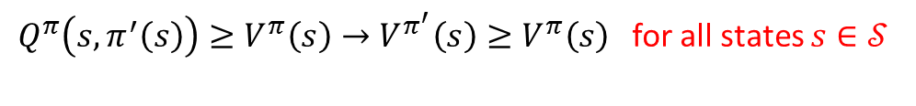
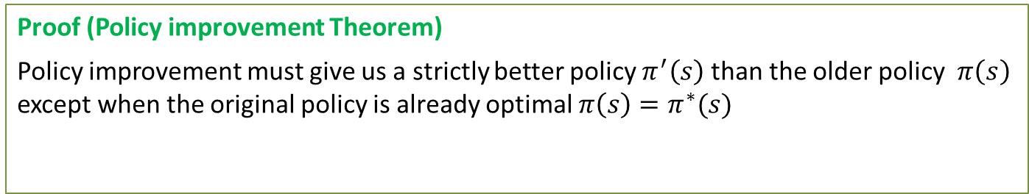

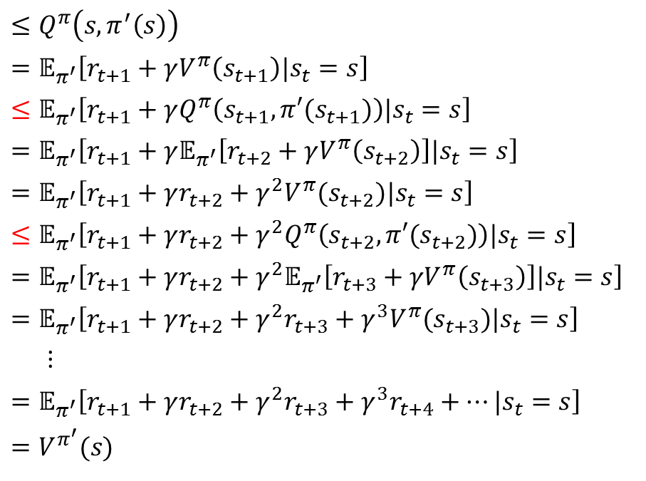

Policy Improvement
Proof (Policy improvement Theorem)
Policy improvement must give us a strictly better policy $π^{′}\left(s\right)$ than the older policy $π\left(s\right)$ except when the original policy is already optimal $π\left(s\right)=π^{∗}(s)$
$Q^{π}\left(s,π^{′}\left(s\right)\right)≥V^{π}\left(s\right)→V^{π^{′}}\left(s\right)≥V^{π}\left(s\right)$for all states $s∈𝒮$
$$V^{π}(s)$$
$$≤Q^{π}\left(s,π^{′}\left(s\right)\right)$$
$$=𝔼_{π^{′}}\left[r_{t+1}+γV^{π}\left(s_{t+1}\right)|s_{t}=s\right]$$
$$≤𝔼_{π^{′}}\left[r_{t+1}+γQ^{π}\left(s_{t+1},π′(s_{t+1})\right)|s_{t}=s\right]$$
$$=𝔼_{π^{′}}\left[r_{t+1}+γ𝔼_{π^{′}}\left[r_{t+2}+γV^{π}\left(s_{t+2}\right)\right]|s_{t}=s\right]$$
$$=𝔼_{π^{′}}\left[r_{t+1}+γr_{t+2}+γ^{2}V^{π}(s_{t+2})|s_{t}=s\right]$$
$$≤𝔼_{π^{′}}\left[r_{t+1}+γr_{t+2}+γ^{2}Q^{π}\left(s_{t+2},π′(s_{t+2})\right)|s_{t}=s\right]$$
$$=𝔼_{π^{′}}\left[r_{t+1}+γr_{t+2}+γ^{2}𝔼_{π^{′}}\left[r_{t+3}+γV^{π}\left(s_{t+3}\right)\right]|s_{t}=s\right]$$
$$=𝔼_{π^{′}}\left[r_{t+1}+γr_{t+2}+γ^{2}r_{t+3}+γ^{3}V^{π}(s_{t+3})|s_{t}=s\right]$$
$$⋮$$
$$=𝔼_{π^{′}}\left[r_{t+1}+γr_{t+2}+γ^{2}r_{t+3}+γ^{3}r_{t+4}+…|s_{t}=s\right]$$
$$=V^{π^{′}}(s)$$
Given
$𝔼_{π^{′}}$ is expectation over $s_{t+1}$ induced by $π^{′}$
$${∵V}^{π}\left(s_{t+1}\right) ≤Q^{π}\left(s_{t+1},π^{′}\left(s_{t+1}\right)\right)$$
Thus, $π≤π′$

Slide 27
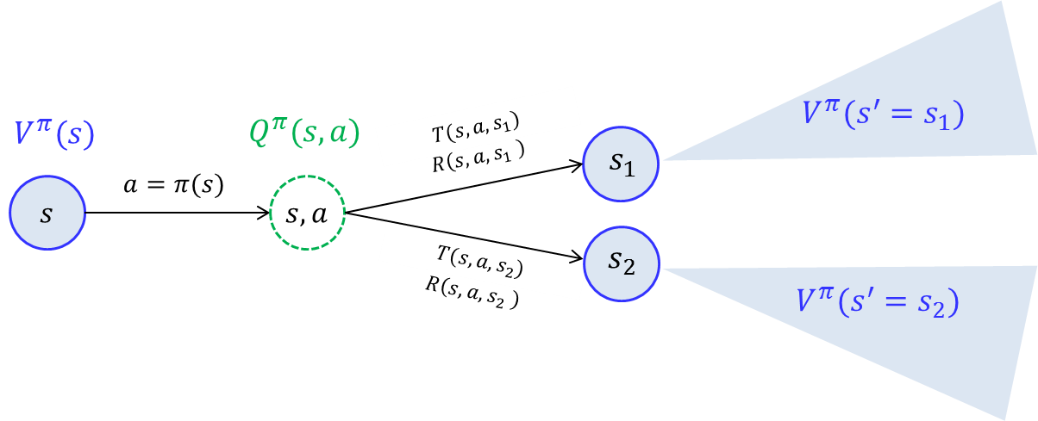
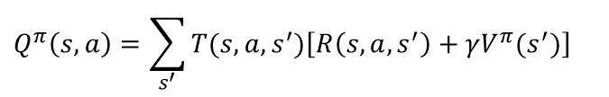
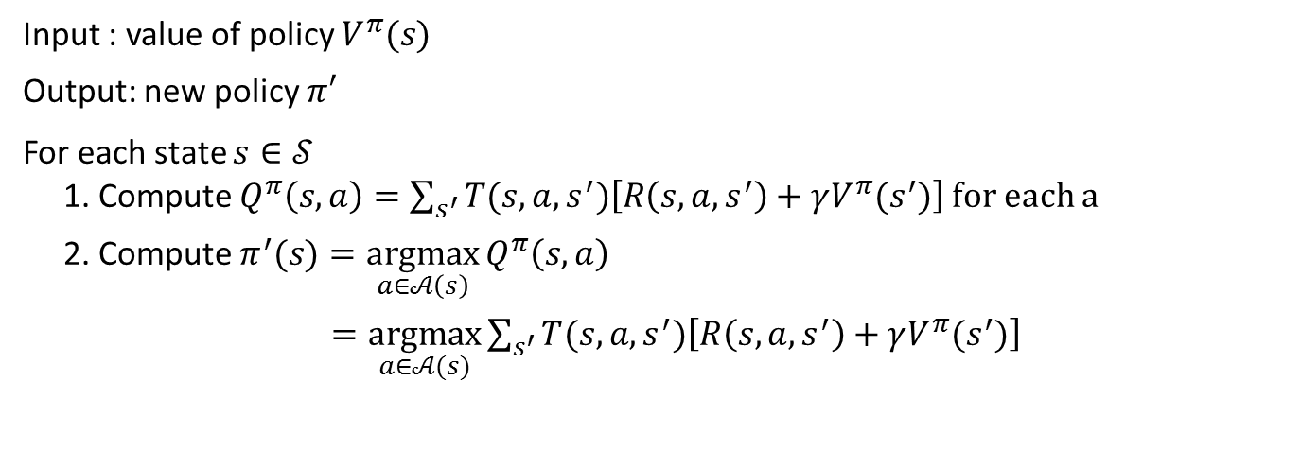
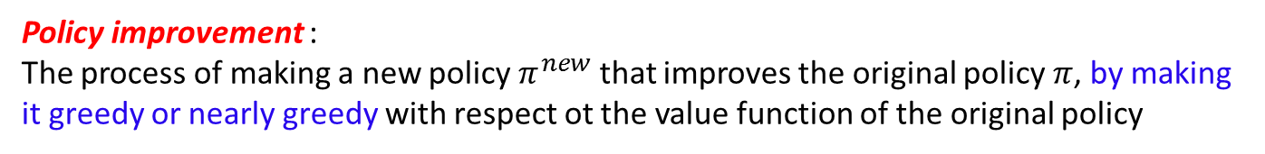
Policy Improvement
Policy improvement :
The process of making a new policy $π^{new}$ that improves the original policy $π$, by making it greedy or nearly greedy with respect ot the value function of the original policy
Recall:
$$Q_{ }^{π}\left(s,a\right)=\sum_{s^{′}}{T(s,a,s^{′})\left[R\left(s,a,s^{′}\right)+γV^{π}(s^{′})\right]}$$
Algorithm
Input : value of policy $V^{π}(s)$
Output: new policy $π′$
For each state $s∈𝒮$
1. Compute $Q_{ }^{π}\left(s,a\right)=\sum_{s^{′}}{T(s,a,s^{′})\left[R\left(s,a,s^{′}\right)+γV^{π}(s^{′})\right]}$ for each a
2. Compute $π^{′}(s)=\underset{a∈𝒜\left(s\right)}{argmax}{Q_{ }^{π}\left(s,a\right)}$
$=\underset{a∈𝒜(s)}{argmax}{\sum_{s^{′}}{T(s,a,s^{′})\left[R\left(s,a,s^{′}\right)+γV^{π}(s^{′})\right]}}$

Slide 28


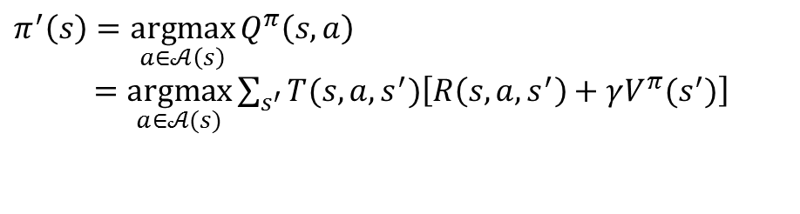


Policy Iteration
Policy iteration :
Iterative way of finding the optimum policy through sequence of policy evaluation and policy improvement
For $t=0,…$until convergence
For each state $s$:
Iteration
$$V_{t+1}^{π}(s)←\sum_{s′}{T(s,π(s),s^{′})\left\{R\left(s,π(s),s^{′}\right)+γV_{t}^{π}(s′)\right\}}$$
Converged state value function $V^{π}(s)$
For each state $s$:
$$π^{′}\left(s\right)=\underset{a∈𝒜\left(s\right)}{argmax}{Q_{ }^{π}\left(s,a\right)}$$
$=\underset{a∈𝒜(s)}{argmax}{\sum_{s^{′}}{T(s,a,s^{′})\left[R\left(s,a,s^{′}\right)+γV^{π}(s^{′})\right]}}$

Slide 29
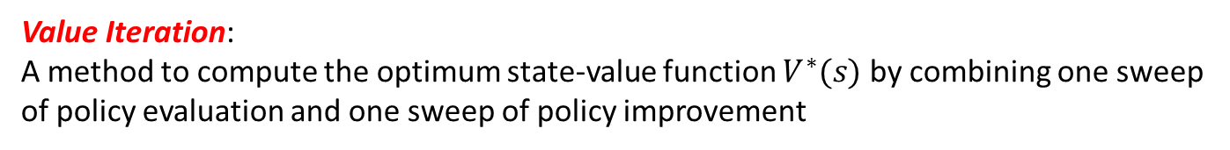

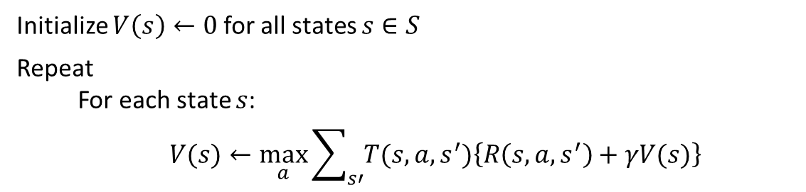
Value Iteration
Value Iteration:
A method to compute the optimum state-value function $V^{∗}(s)$ by combining one sweep of policy evaluation and one sweep of policy improvement
Algorithm
Initialize $V\left(s\right)←0$ for all states $s∈S$
Repeat
For each state $s$:
$$V(s)←\max_{a}{\sum_{s′}{T(s,a,s^{′})\left\{R\left(s,a,s^{′}\right)+γV(s)\right\}}}$$
Until $\max_{s∈S}\left|V_{t}\left(s\right)−V_{t−1} (s)\right|≤e$
Optimum policy can be obtained from the converged $V^{∗}(s)$:
$$π^{∗}\left(s\right)=\underset{a∈𝒜(s)}{argmax}{\sum_{s′}{T(s,a, s^{′})\left\{R\left(s,a,s^{′}\right)+γV^{∗}\left(s\right)\right\}}}$$

Slide 30
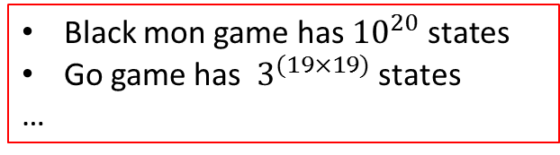










Asynchronous DP Algorithms
A major drawback to the DP methods is that they involve operations over the entire state set of the MDP
$$V^{π}\left(s\right)$$
$$V^{π}\left(s\right)$$
$$s_{1}$$
Black mon game has ${10}^{20}$ states
Go game has $3^{(19×19)}$ states
…
$$s_{1}$$
$$s_{2}$$
$$s_{2}$$
$$s_{3}$$
$$s_{3}$$
sweep
Take forever to sweep all states
Does not improve policy until value functions are full backed up
$$s_{N}$$
$$s_{N}$$
Conventional DP Algorithms
Asynchronous DP Algorithms
Back up the values of states in any order whatsoever, using whatever values of other states happen to be available
Allow great flexibility in selecting states to which backup operations are applied
Make it easier to intermix computation with real-time interaction: To solve a given MDP, we can run iterative DP algorithm at the same time that an agent is actually experiencing the MDP (Reinforcement Learning !!!!)

Slide 31


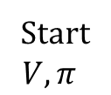
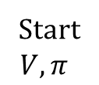




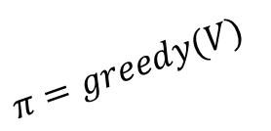

Generalized Policy Iteration
Generalized Policy Improvement (GPI)
Dynamic Programming
“full backup”
Asynchronous
Dynamic Programming
$$V=V^{π}$$
$$V=V^{π}$$
Solution of policy evaluation
Solution of policy evaluation
$$V^{∗}$$
$$V^{∗}$$
Start
$$V, π$$
$$π^{∗}$$
Start
$$V, π$$
$$π^{∗}$$
Solution of policy improvement
Solution of policy improvement
$$π=greedy(V)$$
$$π=greedy(V)$$
Asynchronous Dynamic Programming is a core concept in Reinforcement learning

Slide 32
L15. Reinforcement Learning
(Monte Carlo Methods)

Slide 33



From MDP to Reinforcement Learning
Markov Decision Process (Offline)
Have mental model of how the world works
Find policy to collect the maximum rewards
Solve $Q_{ }^{∗}\left(s,a\right)=\sum_{s^{′}}{T(s,a,s^{′})\left[R\left(s,a,s^{′}\right)+γV^{∗}(s^{′})\right]}$
Find $π^{∗}\left(s\right)=\max_{a}{Q_{ }^{∗}\left(s,a\right)}$
Reinforcement Learning (Offline & Online)
Don’t know how the world works
Perform a sequence of actions in the world to maximize the rewards
$s_{1}, a_{1}, r_{1};s_{2}, a_{2}, r_{2}$; $s_{3}, a_{3}, r_{3}$; $…$; $s_{T}, a_{T}, r_{T}→Q_{ }^{∗}\left(s,a\right)→π^{∗}(s)$
Reinforcement learning is really the way humans work:
we go through life, taking various actions, getting feedback.
We get rewarded for doing well and learn along the way.

Slide 34




Reinforcement Learning Template
Agent
action $a$
Environment
or
Simulator
New state $s′$, reward $r$
$s_{1}, a_{1};r_{2},s_{2}, a_{2}$;$r_{3},s_{3}, a_{3}$; $…$;$r_{T},s_{T}$
Template for Reinforcement Learning
For $t=1, 2, 3,…$
Choose action $a_{t}=π\left(s_{t}\right)$ (how?) : Decision making
Receive reward $r_{t+1}$ and observe new state $s_{t+1}$ (Environment)
Update parameters associated with $V(t)$, $Q(s,a)$ (how?) : Learning

Slide 35
Road Map
Monte Carlo Method (Sutton & Barto Ch.5)
Model-Based Monte Carlo method
Model-free Monte Carlo method
Policy Evaluation
Policy Improvement
Policy Iteration (Monte Carlo control)
On-policy
Off-policy
Temporal Difference Learning (Sutton & Barto Ch.6)
SARSA
Q-Learning

Slide 36



Road Map
Model-Based Reinforcement learning
Estimate
$T(s, a, s^{′})$
$$R(s, a, s^{′})$$
Data
$s_{1}, a_{1}, r_{1};s_{2}, a_{2}, r_{2}$; $s_{3}, a_{3}, r_{3}$; $…$; $s_{T}, a_{T}, r_{T}$
Solve
MDP
Model-FREE Reinforcement learning
How to estimate $V^{∗}(s)$ and $Q^{∗}(s,a)$
Monte Carlo method
Temporal Difference methods
Non-Bootstrap
Bootstrap
On-policy
On-policy
Monte Carlo Control
SARSA
How to
explore ?
Off-policy
Off-policy
Monte Carlo Control
Q-Learning
Episodic based
Single-data-point based

Slide 37

Model-Free Monte Carlo Based Methods
How to estimate $V^{∗}(s)$ and $Q^{∗}(s,a)$
Monte Carlo method
Temporal Difference methods
Non-Bootstrap
Bootstrap
On-policy
On-policy
Monte Carlo Control
SARSA
How to
explore ?
Off-policy
Off-policy
Monte Carlo Control
Q-Learning
Episodic based
Single-data-point based

Slide 38








Monte Carlo Policy Evaluation
Key Idea : Monte Carlo Policy Evaluation
Learn the state-value function $Q^{π}(s,a)$ for a given policy $π$
The value of action-state is the expected utility - expected accumulative future reward starting from $s$ and following the policy $π$
$s_{t}∈𝒮=\left\{s^{1},s^{2},s^{3}\right\}$,${ a}_{t}∈𝒜=\left\{a^{1},a^{2},a^{3}\right\}$
$\left(State,Action,Reward \right)$ pairs generated by policy $π$
$(s^{1}, a^{2}, 1);(s^{3}, a^{1}, 5)$; $\left(s^{2}, a^{3}, 3\right),(s^{1}, a^{3}, 10)$, $\left(s^{2}, a^{2}, 2\right)$
$(s^{1}, a^{1}, 5)$; $\left(s^{2}, a^{2}, 2\right);\left(s^{1}, a^{2}, 1\right);\left(s^{2}, a^{3}, 3\right),(s^{1}, a^{3}, 10)$
$\left(s^{2}, a^{3}, 3\right);(s^{1}, a^{2}, 1);(s^{3}, a^{1}, 5)$;$(s^{1}, a^{3}, 10)$, $\left(s^{2}, a^{2}, 2\right)$
Episode 1:
Episode 2:
Episode 3:
$$(γ=1)$$
Episode 1:
$Q^{π}\left(s^{1},a^{2}\right)=1+5+3+10+2=21$
Episode 2:
$$Q^{π}\left(s^{1},a^{2}\right)=1+3+10=14$$
First visit to $s$
Episode 3:
$$Q^{π}\left(s^{1},a^{2}\right)=1+5+10+2=19$$
$Q^{π}\left(s^{1},a^{2}\right)=$ average of accumulated reward over all episodes
$=$ $\frac{21+14+19}{3}=14.6$

Slide 39




















Monte Carlo Control
Key Idea : Monte Carlo Control
Idea of generalized policy iteration (GPI)
Monte Carlo Policy Evaluation + Policy improvement
Evaluation
$$Q→Q^{π}$$
$$π$$
$$Q$$
Improvement
$$π→greedy(Q)$$
- Infinite number of episodes
- Exploring starts
$$E$$
$$I$$
$$E$$
$$I$$
$$E$$
$$I$$
$$E$$
$$π_{0}$$
$$Q^{π_{0}}$$
$$π_{1}$$
$$Q^{π_{1}}$$
$$π_{2}$$
$$…$$
$$π_{∗}$$
$$Q^{∗}$$
Policy Evaluation
The value function is repeatedly altered to more closely approximate the value function for the current policy $π$
Policy Improvement
The policy is repeatedly improved with respect to the current action value function $Q$

Slide 40

Monte Carlo control algorithm assuming exploring starts
Algorithm : Monte Carlo ES Control
Initialize, for all $s∈S, a∈A(s)$
$Q\left(s, a\right)←$ arbitrary
$π(s)$ $←$ arbitrary
$$U\left(s, a\right)← \text{empty} \text{list}$$
Repeat forever:
Generate an episode using exploring starts and $π$
For each pair $\left(s,a\right)$ appearing in the episode:
$U$ $←$ utility following the first occurrence of $s,a$
Append $U$ to $U\left(s, a\right)$
$Q\left(s, a\right)←$ average($U\left(s, a\right)$)
(c) For each $s$ in the episode:
$π(s)$ $←\underset{a}{argmax}{Q(s,a)}$
Policy evaluation
Policy improvement
In an single episode, both Policy evaluation and policy improvement proceeds together

Slide 41



On-policy Monte Carlo Control
Algorithm : $ε−soft$ On-Policy Monte Carlo Control
Initialize, for all $s∈𝒮, a∈𝒜(s)$
$Q\left(s, a\right)←$ arbitrary
$π←$ an arbitrary $ε−soft$ policy
$U\left(s, a\right)←$ empty list
Repeat forever:
Generate an episode using $π$
For each pair $\left(s,a\right)$ appearing in the episode:
$U$ $←$ utility following the first occurrence of $s,a$
Append $U$ to $U\left(s, a\right)$
$Q\left(s, a\right)←$ average($U\left(s, a\right)$)
(c) For each $s$ in the episode:
$$a^{∗}←\underset{a∈𝒜(s) }{argmax}{Q(s,a)}$$
For all$a∈𝒜(s)$
$$π\left(s, a\right)=\left\{\begin{aligned}1−ε+ε/\left|A\left(s\right)\right| \\ ε/|A\left(s\right)|\end{aligned}\right.$$
Policy evaluation
Policy improvement
If $a=a∗$
If $a≠a∗$

Slide 42
Model-Free Monte Carlo Based Methods
How to estimate $V^{∗}(s)$ and $Q^{∗}(s,a)$
Monte Carlo method
Temporal Difference methods
Non-Bootstrap
Bootstrap
On-policy
On-policy
Monte Carlo Control
SARSA
How to
explore ?
Off-policy
Off-policy
Monte Carlo Control
Q-Learning
Episodic based
Single-data-point based

Slide 43

Off-policy Monte Carlo Control
Key Idea : Off-policy algorithm
Follows the behavior policy while learning about and improving the estimation policy
Behavior policy $π′(s,a)$
The policy used to generate behavior
Requires that the behavior policy have a nonzero probability of selecting all actions that might be selected by the estimation policy (e.g., $ε−soft$ policy )
Estimation policy $π(s,a)$
The policy that is evaluated and improved
$π$can be deterministic
$π$ can be the greedy policy with respect to $Q$ (an estimation $Q^{π}$)
Disadvantages
→ Learning can be slow

Slide 44
Model-Free Monte Carlo Based Methods
How to estimate $V^{∗}(s)$ and $Q^{∗}(s,a)$
Monte Carlo method
Temporal Difference methods
Non-Bootstrap
Bootstrap
On-policy
On-policy
Monte Carlo Control
SARSA
How to
explore ?
Off-policy
Off-policy
Monte Carlo Control
Q-Learning
Episodic based
Single-data-point based

Slide 45


Introduction
Dynamic Programming (DP) Methods
Monte Carlo (MC) Methods
pros: Update estimates based in part on other learned estimates, without waiting for a final outcome (bootstrap)
pros: Learn directly from raw experience without a model
cons: Need explicit model
cons: Need to wait until the end of episode to observe expected reward
Temporal-Difference (TD) Learning
pros: Learn directly from raw experience without a model
Model free
MC
$$+$$
On line
Incremental
pros: Update estimates based in part on other learned estimates, without waiting for a final outcome (bootstrap)
DP
TD Generalized Policy iteration for
On-Policy TD Control (SARSA)
TD Policy Evaluation
$$+$$
TD Policy Improvement
Off-Policy Q-learning Control

Slide 46


Recall : Value function
$$V^{π}\left(s\right)$$
$$=𝔼_{π}\left(U_{t} | s_{t}=s\right)$$
$$=𝔼_{π}\left(r_{t+1}+γr_{t+2}+γ^{2}r_{t+3 }+… | s_{t}=s\right)$$
$$=𝔼_{π}\left(\sum_{k=0}^{∞}{γ^{k}r_{t+k+1} } | s_{t}=s\right)$$
$$=𝔼_{π}\left(r_{t+1}+γ\sum_{k=0}^{∞}{γ^{k}r_{t+k+2} } | s_{t}=s\right)$$
$$=𝔼_{π}\left(r_{t+1}+γV^{π}(s_{t+1}) | s_{t}=s\right)$$
Complete episode
Bootstrapping

Slide 47





Temporal Difference Policy Evaluation
$$V^{π}\left(s\right)$$
$$=𝔼_{π}\left(U_{t} | s_{t}=s\right)$$
$$=𝔼_{π}\left(\sum_{k=0}^{∞}{γ^{k}r_{t+k+1} } | s_{t}=s\right)$$
$$=𝔼_{π}\left(r_{t+1}+γ\sum_{k=0}^{∞}{γ^{k}r_{t+k+2} } | s_{t}=s\right)$$
$$=𝔼_{π}\left(r_{t+1}+γV^{π}(s_{t+1}) | s_{t}=s\right)$$
Bootstrapping
Temporal Difference Policy Evaluation ;$TD\left(0\right)$:
After visiting $s_{t}$ and transiting to $s_{t+1}$ with a singe reward $r_{t+1}$
$$V\left(s_{t}\right)←V\left(s_{t}\right)+α\left[r_{t+1}+γV\left(s_{t+1}\right)−V(s_{t})\right]$$
Target
Bootstrapping: the TD method updates the state value using the previous estimations
The TD target is an estimate because
it uses the current estimate of $V\left(s_{t}\right),$
it samples the expected value
$$𝔼_{π}\left(r_{t+1}+γV^{π}(s_{t+1}) | s_{t}=s\right)$$

Slide 48


Temporal Difference Policy Evaluation
Algorithm : Tabular $TD\left(0\right)$ for estimating $V^{π}$
Initialize $V\left(s\right)$ arbitrarily, $π$ to the policy to be evaluated
Repeat (for each episode):
Initialize $s$
Repeat (for each step of episode)
$a←$ action given by $π$ for $s$
Take action $a;$ observe reward $r$ and next state $s′$
$V(s)$ $←V\left(s\right)+α\left[r+γV\left(s^{′}\right)−V(s)\right]$
s $←$s’
Until $s$ is terminal
Simple backups (MC method and TD methods) : Use a single sample success state
Recall:
Full Backups (DP approach) : Use complete distribution of all possible successors
$$V^{π}(s)=\sum_{s′}{T(s,π(s),s^{′})\left\{R\left(s,π(s),s^{′}\right)+γV^{π}(s′)\right\}}$$

Slide 49








Temporal Difference Policy Evaluation for Q function
As we estimate state value $V\left(s\right)$, we can estimate $Q\left(s,a\right)$ using a TD method
$${ s}_{t}$$
$$r_{t+1}$$
$${ s}_{t+1}$$
$${ s}_{t+2}$$
$${ s}_{t}, a_{t}$$
$${ s}_{t+1}, a_{t+1}$$
$${ s}_{t+2}, a_{t+2}$$
Temporal Difference Policy Evaluation for $Q(s,a)$ function
On each$(s_{t},a_{t},r_{t+1},s_{t+1},a_{t+1})$ for a single episode:
$$Q\left(s_{t},a_{t}\right)←Q\left(s_{t},a_{t}\right)+α\left[r_{t+1}+γQ\left(s_{t+1}, a_{t+1}\right)−Q(s_{t}, a_{t})\right]$$
Note that the action taken is given as data
Target
Current estimate

Slide 50
Model-Free Monte Carlo Based Methods
How to estimate $V^{∗}(s)$ and $Q^{∗}(s,a)$
Monte Carlo method
Temporal Difference methods
Non-Bootstrap
Bootstrap
On-policy
On-policy
Monte Carlo Control
SARSA
How to
explore ?
Off-policy
Off-policy
Monte Carlo Control
Q-Learning
Episodic based
Single-data-point based

Slide 51


Sarsa: On-Policy TD Control
SARSA Algorithm
Initialize $Q(s,a)$ arbitrarily
Repeat (for each episode):
Initialize $s$
Choose $a$ from $s$ using policy derived from $Q$ (e.g., $ε−greedy$)
Repeat (for each time step of episode):
Take action $a$ given $s$, observe $r$, $s^{′}$
Choose $a′$ from $s′$ using policy derived from $Q$ (e.g., $ε−greedy$)
$Q_{π}\left(s,a\right)←Q_{π}\left(s,a\right)+η\left(r+γQ_{π}\left(s′,a′\right)−Q_{π}\left(s,a\right)\right)$
${s←s}^{′}$; ${a←a}^{′}$;
Until $s$ is terminal
Behavioral policy
Estimation policy
=
As in all on-policy methods, we continually estimate $Q^{π}$ for the behavioral policy, and the same time change $π$ toward greediness with respect to $Q^{π}$
Converges with
All state-action pairs are visited an infinite number of times
The policy converges in the limit to the greedy policy (i.e., $ε−greedy$ with $ε=1/t)$

Slide 52















Sarsa: On-Policy TD Control
$$S_{t}$$
$$A_{t}$$
$$R_{t+1}$$
$$S_{t+1}$$
$$A_{t+1}$$
$$S_{t+2}$$
$$a^{1}$$
$$s^{0}$$
$$a^{2}$$
$$a^{3}$$
Choose $a_{t}$ from $s_{t}=s^{0}$ using current $Q$
$$a_{t}=\left\{\begin{aligned}\underset{a}{argmax}{Q(s_{t}=s^{0},a)} \\ random action\end{aligned}\right.$$
with prob $1−ε$
with prob $ε$
Assume $a^{2}$ is chosen

Slide 53













Sarsa: On-Policy TD Control
$$S_{t}$$
$$A_{t}$$
$$R_{t+1}$$
$$S_{t+1}$$
$$A_{t+1}$$
$$S_{t+2}$$
$$s^{1}$$
$$s^{0},a^{1}$$
$$a^{1}$$
$$s^{2}$$
$$r_{t+1}$$
$$s^{1}$$
$$s^{0}$$
$$a^{2}$$
$$s^{0},a^{2}$$
$$a^{3}$$
$$s^{2}$$
$$s^{1}$$
$$s^{0},a^{3}$$
$$s^{2}$$
Take action $a_{t}=a^{2}$ given $s_{t}=s^{0}$ and observe $r_{t+1}$ and $s_{t+1}=s^{1}$

Slide 54













Sarsa: On-Policy TD Control
$$S_{t}$$
$$A_{t}$$
$$R_{t+1}$$
$$S_{t+1}$$
$$A_{t+1}$$
$$S_{t+2}$$
$$s^{1}$$
$$s,a^{1}$$
$$a^{1}$$
$$s^{2}$$
$$s^{1},a^{1}$$
$$a^{1}$$
$$r_{t+1}$$
$$s^{1}$$
$$a^{2}$$
$$s^{1},a^{2}$$
$$s^{0}$$
$$a^{2}$$
$$s,a^{2}$$
$$a^{3}$$
$$s^{2}$$
$${ s}^{1},a^{3}$$
$$a^{3}$$
$$s^{1}$$
$$s,a^{3}$$
$$s^{2}$$
Choose $a_{t+1}$ from $s_{t+1}=s^{1}$ using current $Q$
$$a_{t+1}=\left\{\begin{aligned}\underset{a}{argmax}{Q(s_{t+1}=s^{1},a)} \\ random action\end{aligned}\right.$$
with prob $1−ε$
with prob $ε$
Assume $a^{1}$ is chosen

Slide 55




Sarsa: On-Policy TD Control
$$S_{t}$$
$$A_{t}$$
$$R_{t+1}$$
$$S_{t+1}$$
$$A_{t+1}$$
$$S_{t+2}$$
$$s^{1}$$
$$s^{0},a^{1}$$
Estimation
$$a^{1}$$
$$s^{2}$$
$$s^{1},a^{1}$$
$$Q\left(s^{1}, a^{1}\right)$$
$$a^{1}$$
$$r_{t+1}$$
$$s^{1}$$
$$a^{2}$$
$$s^{1},a^{2}$$
$$s^{0}$$
$$a^{2}$$
$$s^{0},a^{2}$$
$$a^{3}$$
$$s^{2}$$
$${ s}^{1},a^{3}$$
$$a^{3}$$
$$s^{1}$$
$$s^{0},a^{3}$$
$$s^{2}$$
Update $Q$ function with the estimation $Q\left(s_{t+1}, a_{t+1}\right)$
$$Q\left(s_{t},a_{t}\right)←Q\left(s_{t},a_{t}\right)+α\left[r_{t+1}+γQ\left(s_{t+1}, a_{t+1}\right)−Q(s_{t}, a_{t})\right]$$
$$→Q\left(s^{0},a^{2}\right)←Q\left(s^{0},a^{2}\right)+α\left[r_{t+1}+γQ\left(s^{1}, a^{1}\right)−Q(s^{0},a^{2})\right]$$

Slide 56






Sarsa: On-Policy TD Control
$$S_{t}$$
$$A_{t}$$
$$R_{t+1}$$
$$S_{t+1}$$
$$A_{t+1}$$
$$S_{t+2}$$
$$s^{1}$$
$$s,a^{1}$$
$$s^{1}$$
$$a^{1}$$
$$s^{2}$$
$$s^{1},a^{1}$$
$$r_{t+2}$$
$$a^{1}$$
$$s^{2}$$
$$r_{t+1}$$
$$s^{1}$$
$$a^{2}$$
$$s^{1},a^{2}$$
$$s^{0}$$
$$a^{2}$$
$$s,a^{2}$$
$$a^{3}$$
$$s^{2}$$
$${ s}^{1},a^{3}$$
$$a^{3}$$
$$s^{1}$$
$$s,a^{3}$$
$$s^{2}$$
Take action $a_{t+1}=a^{1}$ given $s_{t+1}=s^{1}$ and observe $r_{t+2}$ and $s_{t+2}=s^{2}$

Slide 57



Why Q-learning is considered as Off-Policy method
$$π\left(s\right)$$
$$π\left(s′\right)$$
$$\left(s,a,r,s^{′},a^{′}\right)$$
$$Q\left(s,a\right)←Q\left(s,a\right)+η\left(r+γQ(s^{′},a′)−Q_{π}\left(s,a\right)\right)$$

Slide 58
Classification of RL
How to estimate $V^{∗}(s)$ and $Q^{∗}(s,a)$
Monte Carlo method
Temporal Difference methods
Non-Bootstrap
Bootstrap
On-policy
On-policy
Monte Carlo Control
SARSA
How to
explore ?
Off-policy
Off-policy
Monte Carlo Control
Q-Learning
(SARSmaxA)
Episodic based
Single-data-point based

Slide 59

Q-Learning: Off-Policy TD Control
On-Policy TD Control (SARSA)
Choose $a′$ from $s′$ using policy derived from $Q$ (e.g., $ε−greedy$)
$$Q\left(s,a\right)←Q\left(s,a\right)+η\left(r+γQ\left(s′,a′\right)−Q\left(s,a\right)\right)$$
Off-Policy TD Control (Q-learning)
$$Q\left(s,a\right)←Q\left(s,a\right)+η\left(r+γ\max_{a^{′}}{Q\left(s′,a′\right)}−Q\left(s,a\right)\right)$$
The max over $a$ rather than taking the $a$ based on the current policy is the principle difference between Q-learning and SARSA.
The learned action-value function $Q$ directly approximates $Q^{∗}$independent of the policy being followed
Converges with
All state-action pairs are visited an infinite number of times
The policy converges in the limit to the greedy policy (i.e., $ε−greedy$ with $ε=1/t)$

Slide 60

Q-Learning: Off-Policy TD Control
Q learning
Initialize $Q(s,a)$ arbitrarily
Repeat (for each episode):
Initialize $s$
Repeat (for each time step of episode):
Choose $a$ from $s$ using policy derived from $Q$ (e.g., $ε−greedy$)
Take action $a$, observe $r$, $s′$
$Q\left(s,a\right)←Q\left(s,a\right)+η\left(r+γ\max_{a^{′}}{Q\left(s^{′},a′\right)}−Q\left(s,a\right)\right)$
${s←s}^{′}$
Until $s$ is terminal
Behavioral policy
Estimation policy
(Always try to estimate the optimal policy)
-Estimation can be greedy)
$a^{∗}=\underset{a^{′}}{argmax}{Q\left(s′,a\right)}$ is not used in the next state!!!
At the next state $s′,$ Choose $a$ using policy derived from $Q$ (e.g., $ε−greedy$)

Slide 61



Q-Learning: Off-Policy TD Control
$$S_{t}$$
$$A_{t}$$
$$R_{t+1}$$
$$S_{t+1}$$
max$A_{t+1}$
$$S_{t+2}$$
$$a^{1}$$
$$s^{0}$$
$$a^{2}$$
$$a^{3}$$
Choose $a_{t}$ from $s_{t}=s^{0}$ using current $Q$
$$a_{t}=\left\{\begin{aligned}\underset{a}{argmax}{Q(s_{t}=s^{0},a)} \\ random action\end{aligned}\right.$$
with prob $1−ε$
with prob $ε$
Assume $a^{2}$ is chosen

Slide 62
Q-Learning: Off-Policy TD Control
$$S_{t}$$
$$A_{t}$$
$$R_{t+1}$$
$$S_{t+1}$$
max$A_{t+1}$
$$S_{t+2}$$
$$s^{1}$$
$$s^{0},a^{1}$$
$$a^{1}$$
$$s^{2}$$
$$r_{t+1}$$
$$s^{1}$$
$$s^{0}$$
$$a^{2}$$
$$s^{0},a^{2}$$
$$a^{3}$$
$$s^{2}$$
$$s^{1}$$
$$s^{0},a^{3}$$
$$s^{2}$$
Take action $a_{t}=a^{2}$ given $s_{t}=s^{0}$ and observe $r_{t+1}$ and $s_{t+1}=s^{1}$

Slide 63



Q-Learning: Off-Policy TD Control
$$S_{t}$$
$$A_{t}$$
$$R_{t+1}$$
$$S_{t+1}$$
max$A_{t+1}$
$$S_{t+2}$$
$$s^{1}$$
$$s^{0},a^{1}$$
$$a^{1}$$
$$s^{2}$$
$$s^{1},a^{1}$$
$$max$$
$$r_{t+1}$$
$$s^{1}$$
$$s^{1},a^{2}$$
$$\max_{a^{′}}{Q\left(s^{1},a^{′}\right)}$$
$$s^{0}$$
$$a^{2}$$
$$s^{0},a^{2}$$
$$s^{2}$$
$${ s}^{1},a^{3}$$
$$a^{3}$$
$$s^{1}$$
For Estimation policy
$$s^{0},a^{3}$$
$$s^{2}$$
Update $Q$ function with the $\max_{a^{′}}{Q\left(s^{1},a′\right)}$
$$Q\left(s_{t},a_{t}\right)←Q\left(s_{t},a_{t}\right)+α\left[r_{t+1}+γ\max_{a^{′}}{Q\left(s,a′\right)}−Q(s_{t}, a_{t})\right]$$
$$→Q\left(s^{0},a^{2}\right)←Q\left(s^{0},a^{2}\right)+α\left[r_{t+1}+γ\max_{a′}{Q\left(s^{1},a′\right)}−Q(s^{0},a^{2})\right]$$

Slide 64

Q-Learning: Off-Policy TD Control
$$S_{t}$$
$$A_{t}$$
$$R_{t+1}$$
$$S_{t+1}$$
max$A_{t+1}$
$$S_{t+2}$$
$$s^{1}$$
$$s,a^{1}$$
$$a^{1}$$
$$s^{2}$$
$$s^{1},a^{1}$$
$$a^{1}$$
$$r_{t+1}$$
$$s^{1}$$
$$a^{2}$$
$$s^{1},a^{2}$$
$$s^{0}$$
$$a^{2}$$
$$s,a^{2}$$
$$a^{3}$$
$$s^{2}$$
$${ s}^{1},a^{3}$$
$$a^{3}$$
$$s^{1}$$
For Behavioral policy
$$s,a^{3}$$
$$s^{2}$$
Choose $a_{t+1}$ from $s_{t+1}=s^{1}$ using current $Q$
$$a_{t+1}=\left\{\begin{aligned}\underset{a}{argmax}{Q(s_{t+1}=s^{1},a)} \\ random action\end{aligned}\right.$$
with prob $1−ε$
with prob $ε$
Assume $a^{1}$ is chosen

Slide 65
Q-Learning: Off-Policy TD Control
$$S_{t}$$
$$A_{t}$$
$$R_{t+1}$$
$$S_{t+1}$$
max$A_{t+1}$
$$S_{t+2}$$
$$s^{1}$$
$$s,a^{1}$$
$$s^{1}$$
$$a^{1}$$
$$s^{2}$$
$$s^{1},a^{1}$$
$$r_{t+2}$$
$$a^{1}$$
$$s^{2}$$
$$r_{t+1}$$
$$s^{1}$$
$$a^{2}$$
$$s^{1},a^{2}$$
$$s^{0}$$
$$a^{2}$$
$$s,a^{2}$$
$$a^{3}$$
$$s^{2}$$
$${ s}^{1},a^{3}$$
$$a^{3}$$
$$s^{1}$$
$$s,a^{3}$$
$$s^{2}$$
Take action $a_{t+1}=a^{1}$ given $s_{t+1}=s^{1}$ and observe $r_{t+2}$ and $s_{t+2}=s^{2}$

