Slide 1
Holography

Slide 2
History of Holography
‘Holos’, greek word, means complete and ‘graph’ means message
Invented in 1948 by Dennis Gabor for use in electron microscopy, before the invention of the laser.
Leith and Upatnieks (1962) applied laser light to holography and introduced an important off-axis technique to make holograms.
After the invention of laser by Meman in 1960, the importance of holographs was evident. Gabor received Nobel prize in 1971 for his work.

Slide 3
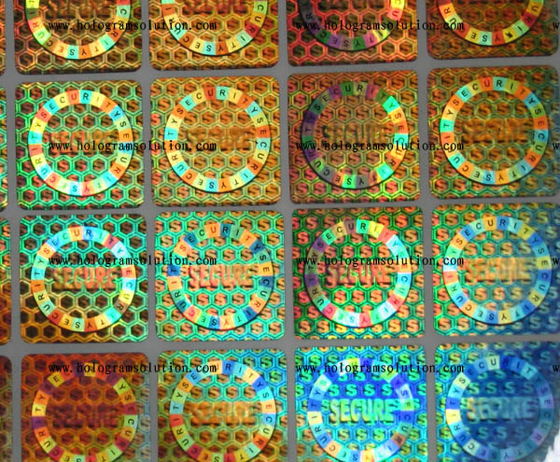

Slide 4
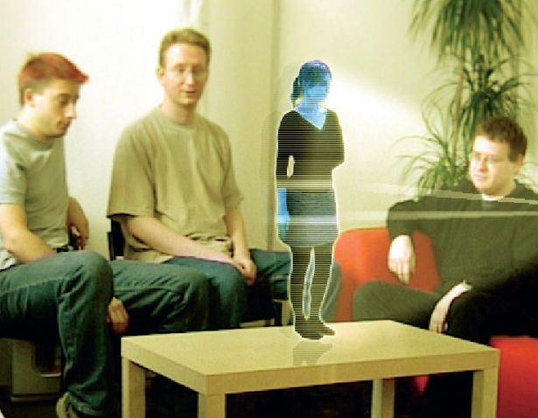

Slide 5
Conventional vs. Holographic photography
Conventional:
  2-d version of a 3-d scene.
  Photograph lacks depth perception.
  Film sensitive only to radiant energy (intensity distribution).
  Phase relation (i.e. interference) are lost so the information of the depth.

Slide 6
Conventional vs. Holographic photography
Hologram:
  Freezes the complex wavefront of light that carries all the visual information of the scene (intensity distribution as well as phase information).
  To view a hologram, the wavefront is reconstructed.
  View what we would have seen if present at the original scene through the window defined by the hologram.
  Provides depth perception.

Slide 7
Conventional vs. Holographic photography
Hologram:
  Converts phase information into amplitude information (in-phase - maximum amplitude, out-of-phase – minimum amplitude).
  Interfere wavefront of light from a scene (object beam) with a reference wave.
  The hologram is a complex interference pattern of microscopically spaced fringes. It’s a kind of diffraction grating.

Slide 8
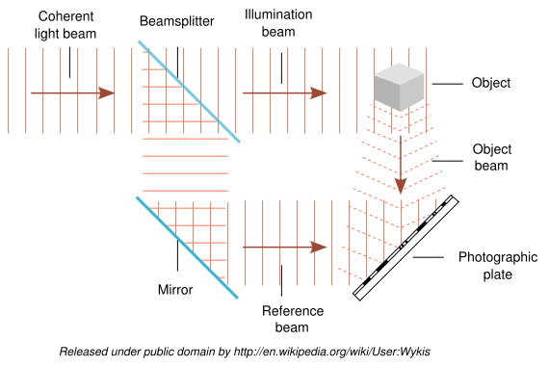

Slide 9
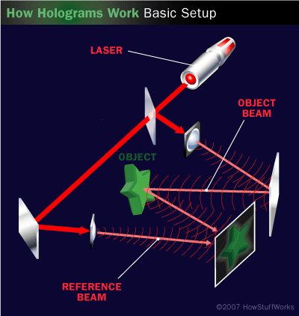

Slide 10
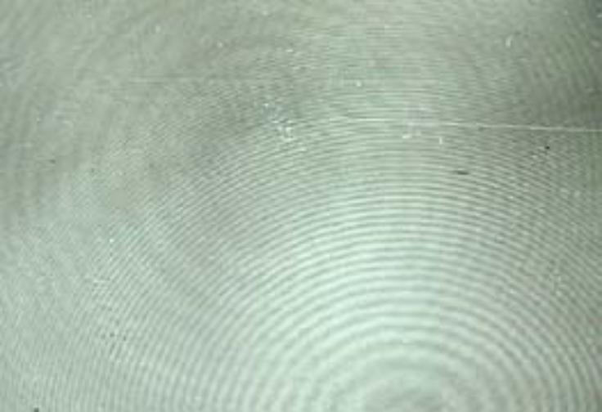
Pattern left on media
Real picture of a hologram

Slide 11
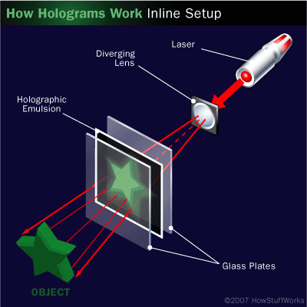
RECONSTRUCTION

Slide 12
Direct wave: corresponds to zeroth order grating diffraction pattern
Object wave: gives virtual image of the object (reconstructs object wavefront) – first order diffraction
Reference wave
Object wave
Direct wave
Virtual image

Slide 13
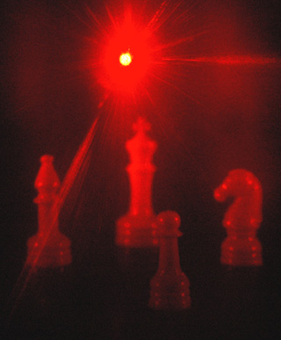
The hologram was illuminated
from behind by a helium-neon
laser which has been passed
through a diverging lens to
spread the beam over the
hologram.

Slide 14
Necessities for Holography - 1
The object and the reference beams must be able to produce an interference pattern that is stable during the time in which the holographic recording is made. To do this, they must have the same frequency and the same relative phase during this time, that is, they must be mutually coherent.
In addition, the medium used to record the fringe pattern must be able to resolve the fringe patterns. The spacing of the fringes depends on the angle between object and reference beam. For example, if this angle is 45°, and the wavelength of the light is 0.5μm, the fringe spacing is about 0.7μm or 1300 lines/mm.

Slide 15
Necessities for Holography - 2
Mechanical stability is also very important when making a hologram. Any relative phase change between the object and reference beams due to vibration or air movement will cause the fringes on the recording medium to move. Recording time can be several seconds or more, and given that a phase change of π is equivalent to a movement of λ/2 this is quite a stringent stability requirement.
Generally, the coherence length of the light determines the maximum depth in the scene of interest that can be recorded holographically. A good holography laser will typically have a coherence length of several meters, ample for a deep hologram.

Slide 16
Necessities for Holography - 3
The objects must have optically rough surfaces so that they scatter light over a wide range of angles. A specularly reflecting (or shiny) surface reflects the light in only one direction at each point on its surface. The light scattered from objects with a rough surface forms a pattern that has random amplitude and phase.
To reconstruct the object exactly from a transmission hologram, the reference beam must have the same wavelength, and must illuminate the hologram at the same angle as the original reference beam. Departure from any of these conditions will give a distorted reconstruction. While nearly all holograms are recorded using lasers, a narrow-band lamp or even sunlight is enough to recognize the reconstructed image.

Slide 17
Properties of Holography - 1
The reconstructed hologram is enlarged if the light used to reconstruct the hologram has a higher wavelength. This initially generated some interest since it seemed to be possible to use X-rays to make holograms of molecules and view them using visible light. However X-ray holograms have not been created to date.
Exact reconstruction is achieved in holographic interferometry where the holographically reconstructed wavefront interferes with the live wave front, to map out any displacement of the live object, and gives a null fringe if the object has not moved.

Slide 18
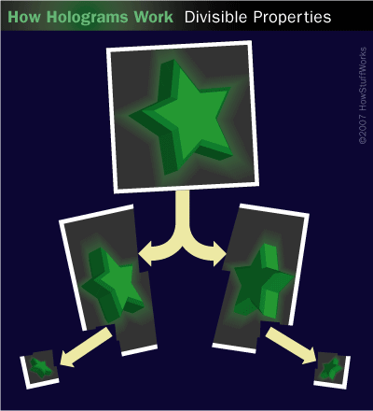
Properties of Holography - 2
Destruction of a portion of a photographic image results in an irreparable loss of information corresponding to a part of the object. Here Holographs are of much advantage.
Since each point in the hologram contains light
from the whole of the original scene, the whole
scene can, in principle, be reconstructed from an
arbitrarily small part of the hologram. To
demonstrate this concept, the hologram can be
broken into small pieces and the entire object
can still be seen from each small piece. So Every
piece of a Hologram is a Complete hologram In
itself. It helps to make large number of copies of
any Hologram after a single take!

Slide 19
Properties of Holography - 3
Another supremacy over photographs: A hologram may contain a number of consecutively recorded scenes that can be recorded independently, each time changing the angle at which the reference wave is incident on the holographic plate. Reconstruction of a specific scene only requires that the hologram be properly oriented with respect to the read out wave.
This property provides very high storage capacity, holographic memory can store up to 1 Tb(1000 GB) in a storage medium of the size of a sugar cube crystal. This is the easiest & fastest way to access the data. It provides high data transfer rates (1-10 GB per second).

Slide 20
Applications
Holographic Microscopy: Conventional microscope has a small depth of field (range of depth over which the object is in focus). Biological specimen are generally suspended in a fluid and move about, becoming in and out of the focus of the microscope. This motion can be freezed in a hologram taken through the microscope. The reconstructed 3D image can then be studied at leisure.
Holographic Interferometry: Holography can be used for testing stresses, strains and surface deformations. The original object after deformation are recorded in two successive holograms on the same plate. When the images are reconstructed, interference effect will occur if the object has changed in any way. Thus any disorder of the object will appear in the form of fringes.
It can also be used in display and memories (discussed earlier).

