Slide 1
(TCC 213) COMPUTER SYSTEM SOFTWARE APPLY SYSTEM RESTORE POINT, DEVICE MANAGER, AND WINDOWS SECURITY (MANUAL GUIDE) Submitted By: Group 5 BSIT-2A Jhunde Kyle Taghoy Submitted To: Quennie Marie S. Edicto

Slide 2
RESTORE POINT
MANUAL GUIDE

Slide 3
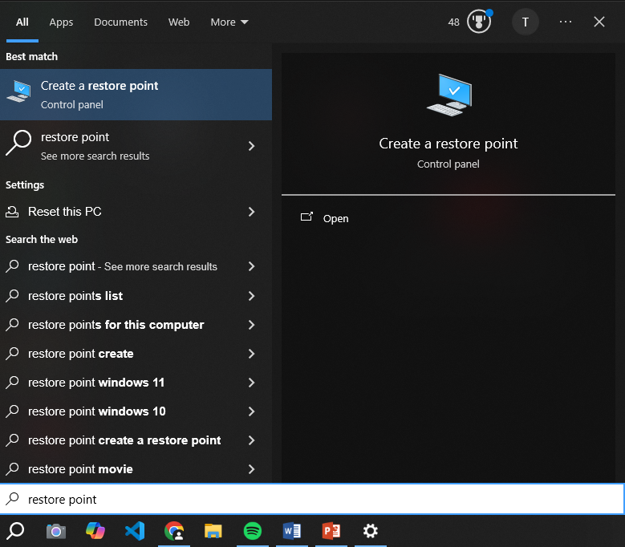
RESTORE POINT
Search for Restore Point on Start Menu

Slide 4
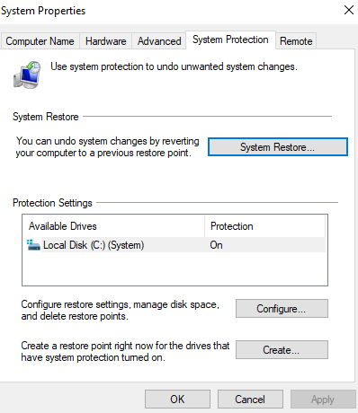
RESTORE POINT
Click Configure

Slide 5
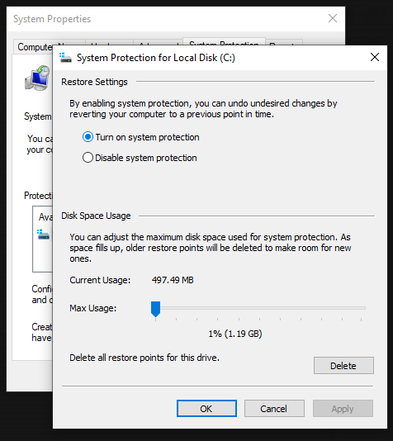
RESTORE POINT
Turn on System Protection

Slide 6
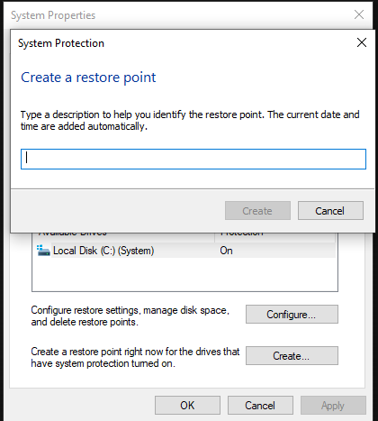
RESTORE POINT
After Turn on System Protection, Click Create to Create a Restore Point and name the Restore Point as you want

Slide 7
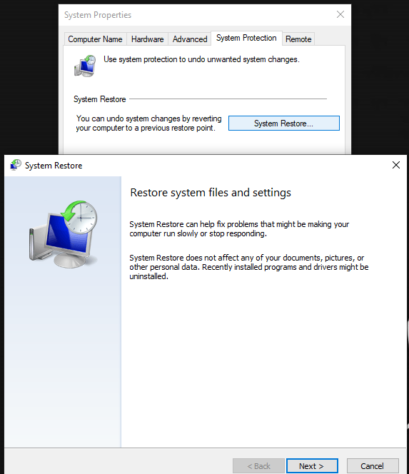
RESTORE POINT
After Creating a Restore Point, Click System Restore to Restore the System.
Click Next.

Slide 8
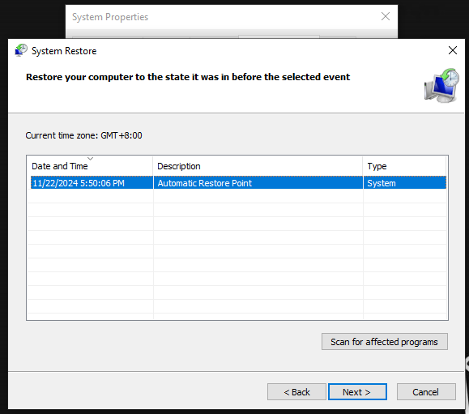
RESTORE POINT
Click the Created Restore Point.

Slide 9
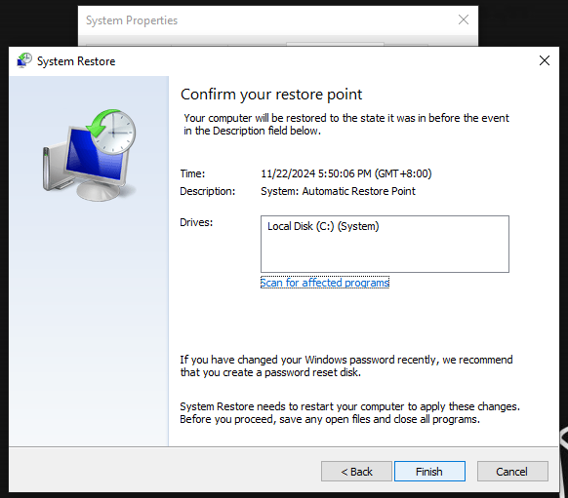
RESTORE POINT
Confirm the Restore Point and Click Finish.

Slide 10
DEVICE MANAGER
MANUAL GUIDE

Slide 11
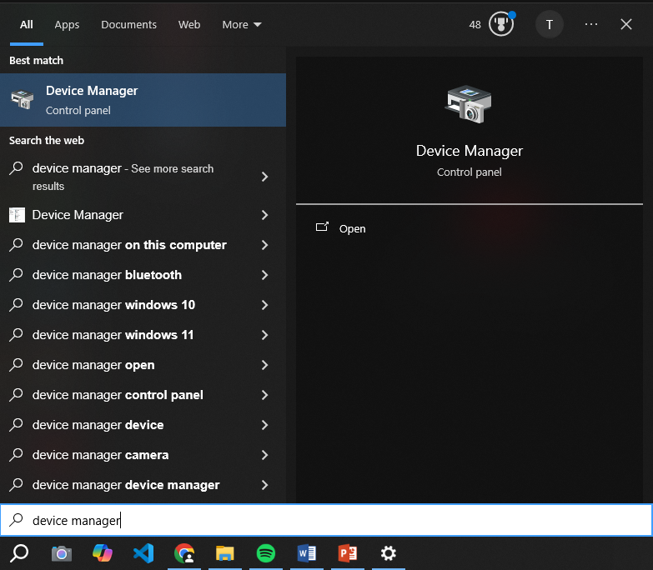
DEVICE MANAGER
Search for Device Manager on Start Menu

Slide 12
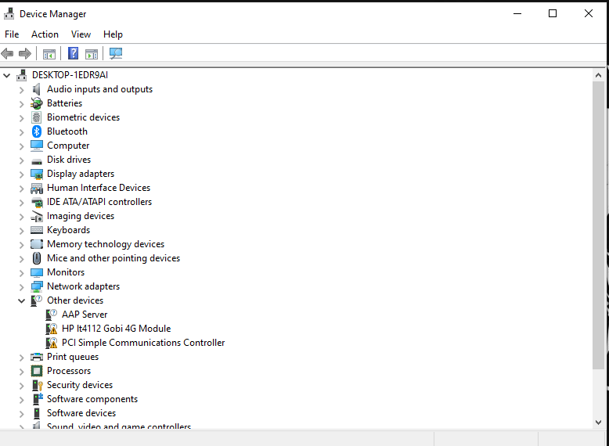
DEVICE MANAGER
Search for a driver to Configure.

Slide 13
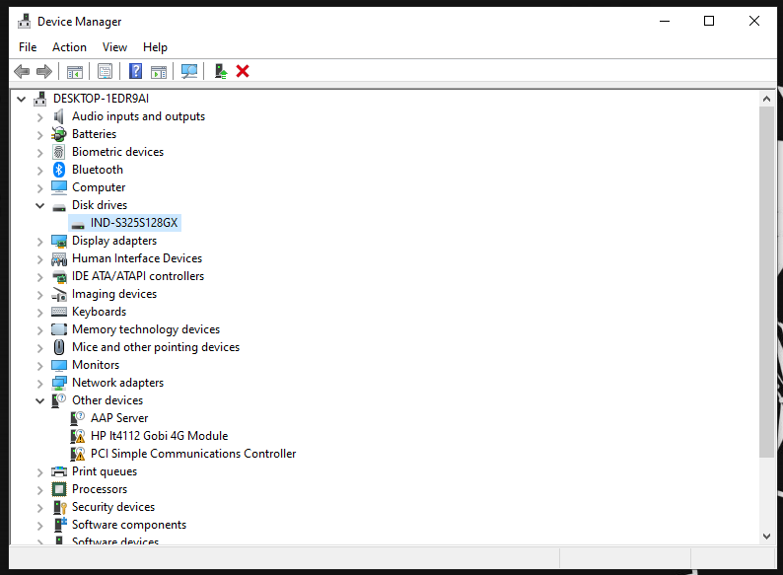
DEVICE MANAGER
Select a Driver Configure.

Slide 14
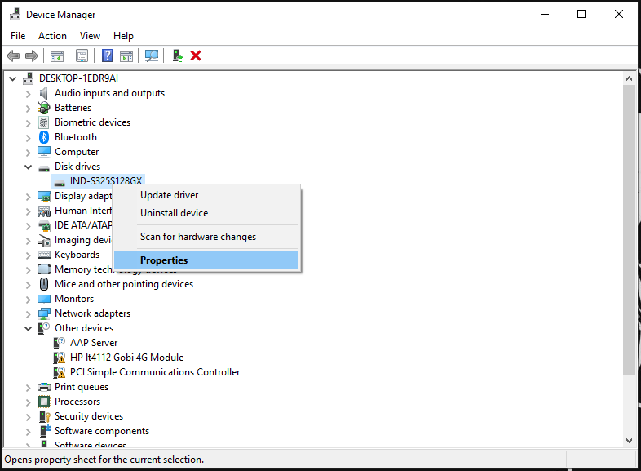
DEVICE MANAGER
Click On Properties.

Slide 15
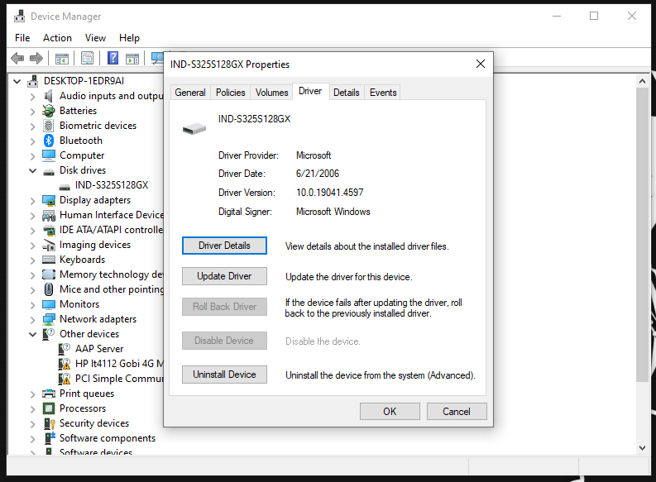
DEVICE MANAGER
Click Driver Details to View Details.
Click Update Driver to Update Outdated Drivers.
Click Uninstall Driver to Uninstall Unnecessary Drivers.

Slide 16
WINDOWS SECURITY
MANUAL GUIDE

Slide 17
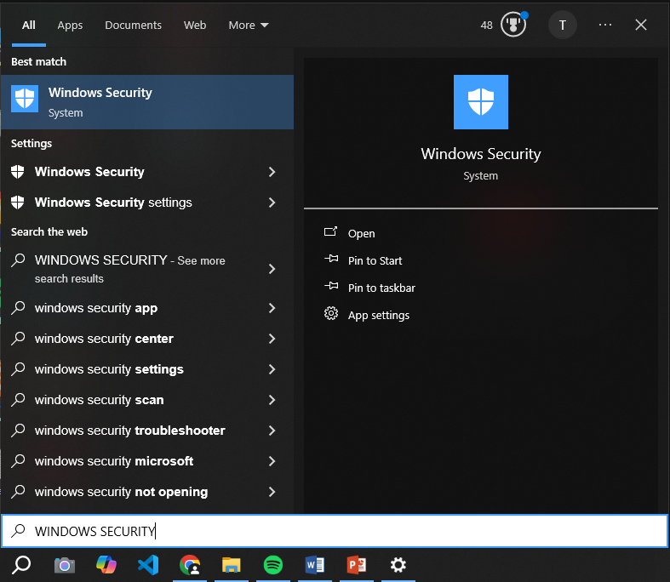
WINDOWS SECURITY
Open Windows Security: Go to the Start menu, search for "Windows Security," and select it.

Slide 18
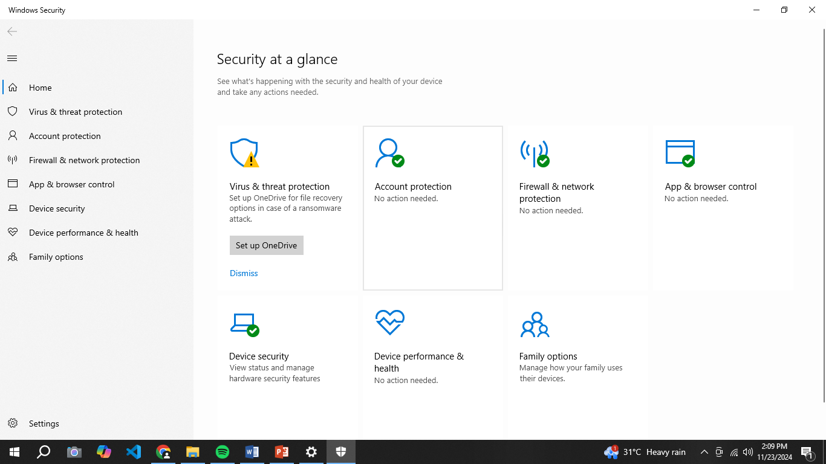
WINDOWS SECURITY
Navigate Sections:
Virus & Threat Protection: Check current threats, perform scans, and manage settings.
Firewall & Network Protection: Review and manage firewall status for different network types.

Slide 19
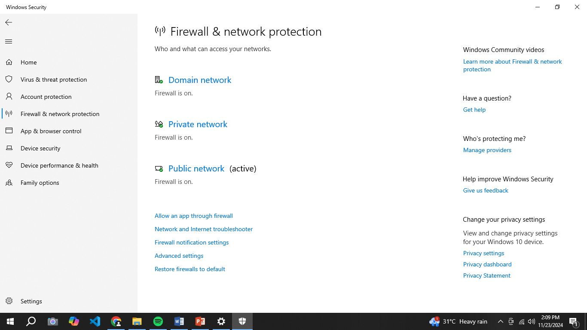
WINDOWS SECURITY
Navigate to Firewall & Network Protection: Review firewall status for different networks.
Manage Settings: Adjust settings as needed and explore additional options.

Slide 20
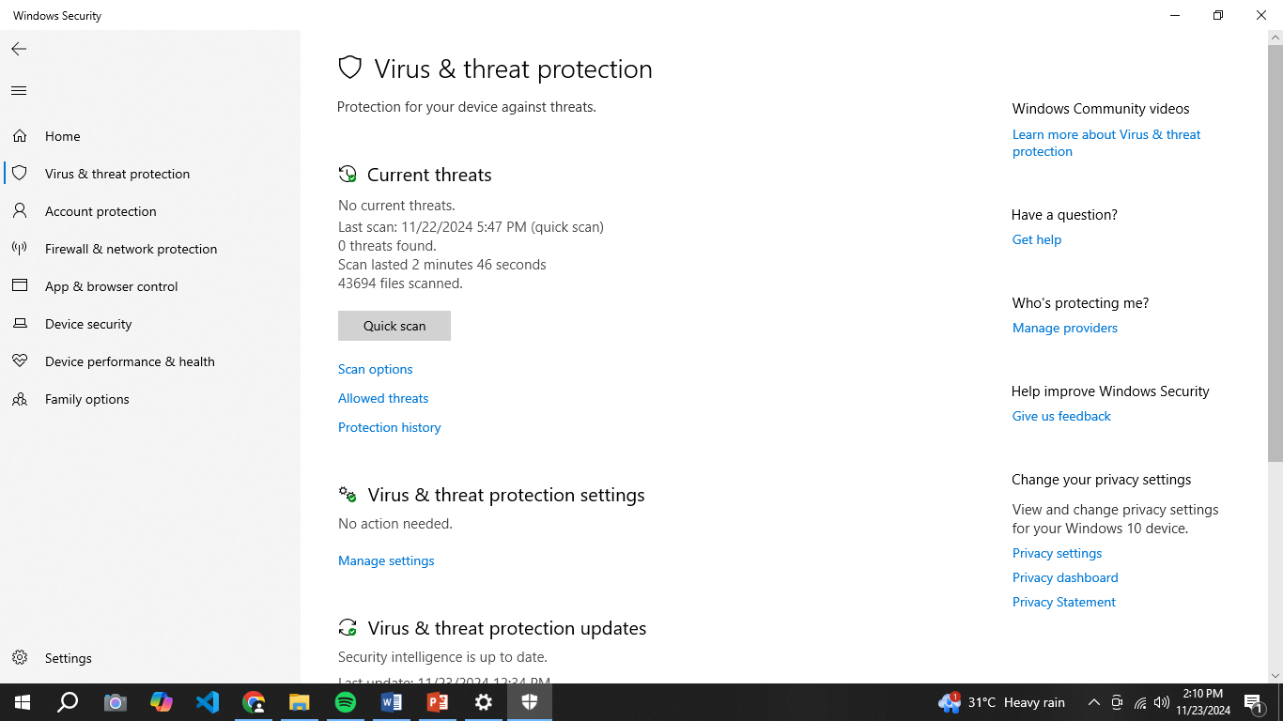
WINDOWS SECURITY
Navigate to Virus & Threat Protection: Check current threats, perform quick scans, and manage settings.
Manage Settings: Access additional options and update security intelligence.

Slide 21
WINDOWS SECURITY
Navigate to Virus & Threat Protection: Check current threats, perform quick scans, and manage settings.
Manage Settings: Access additional options and update security intelligence.

