Slide 1
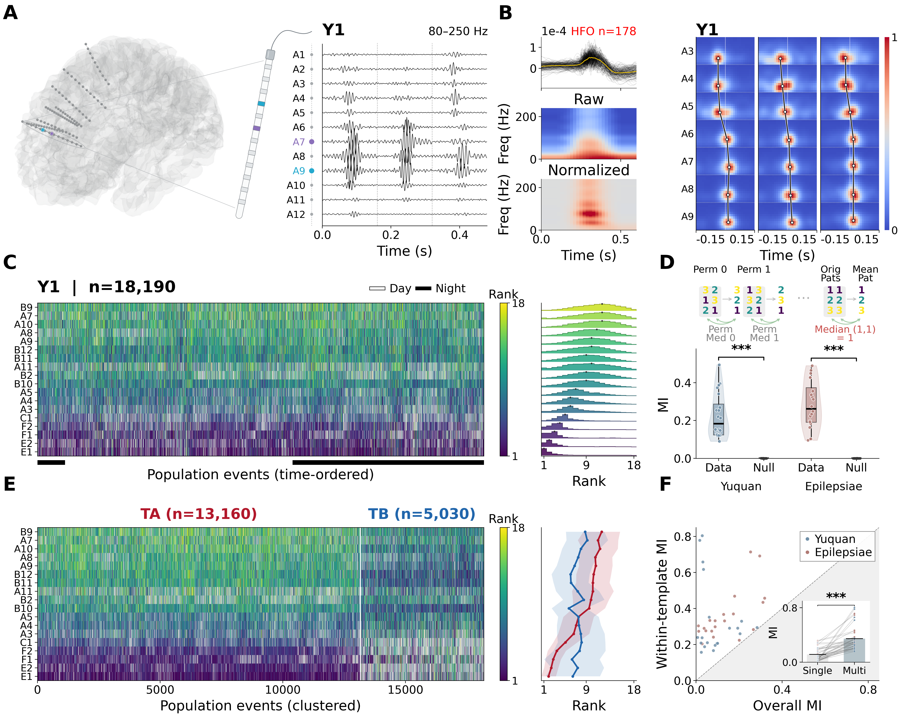
Notes:
Figure 1 complete-layout; author accepted 2026-10-10. Frozen scientific image, no resampling in source asset. Editable vector version supplied separately as PDF.

Slide 2
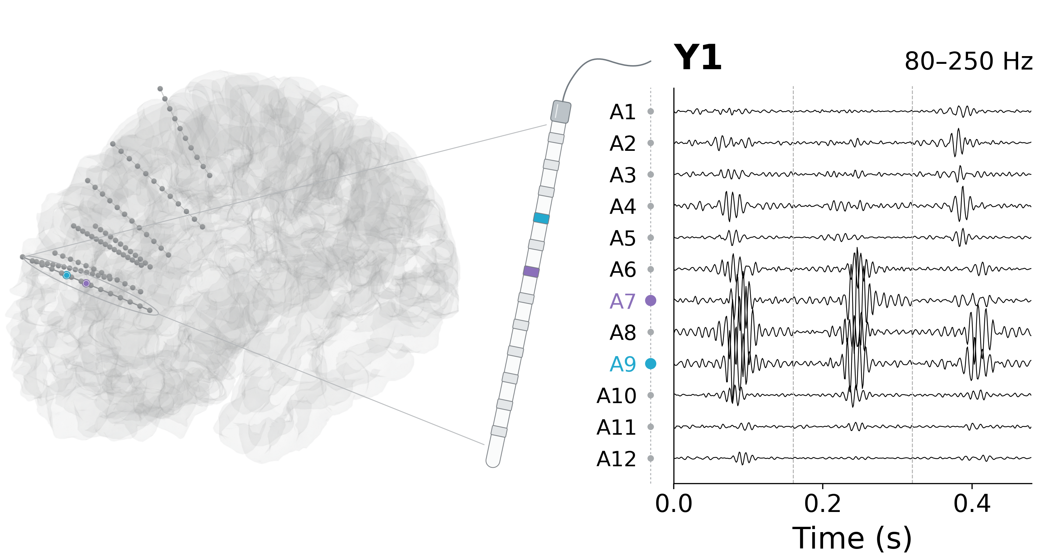
Notes:
Figure 1 panela; author accepted 2026-10-10. Frozen scientific image, no resampling in source asset. Editable vector version supplied separately as PDF.

Slide 3
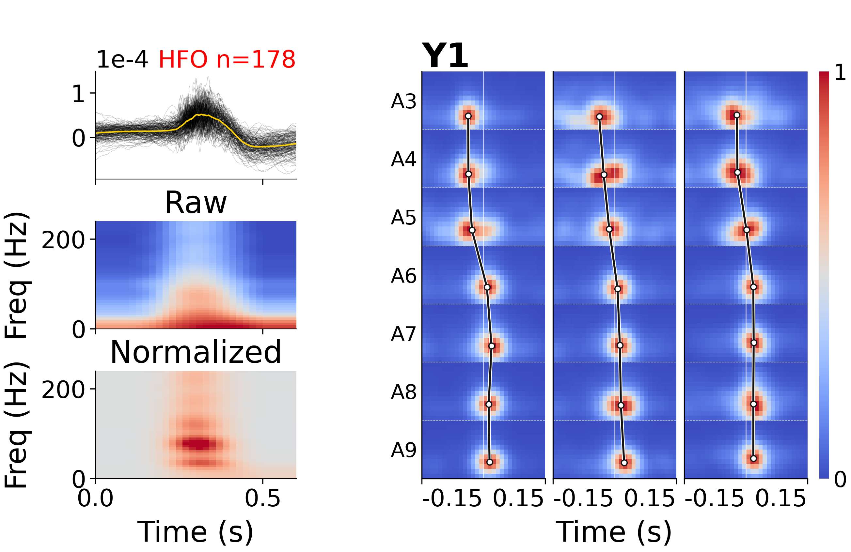
Notes:
Figure 1 panelb; author accepted 2026-10-10. Frozen scientific image, no resampling in source asset. Editable vector version supplied separately as PDF.

Slide 4
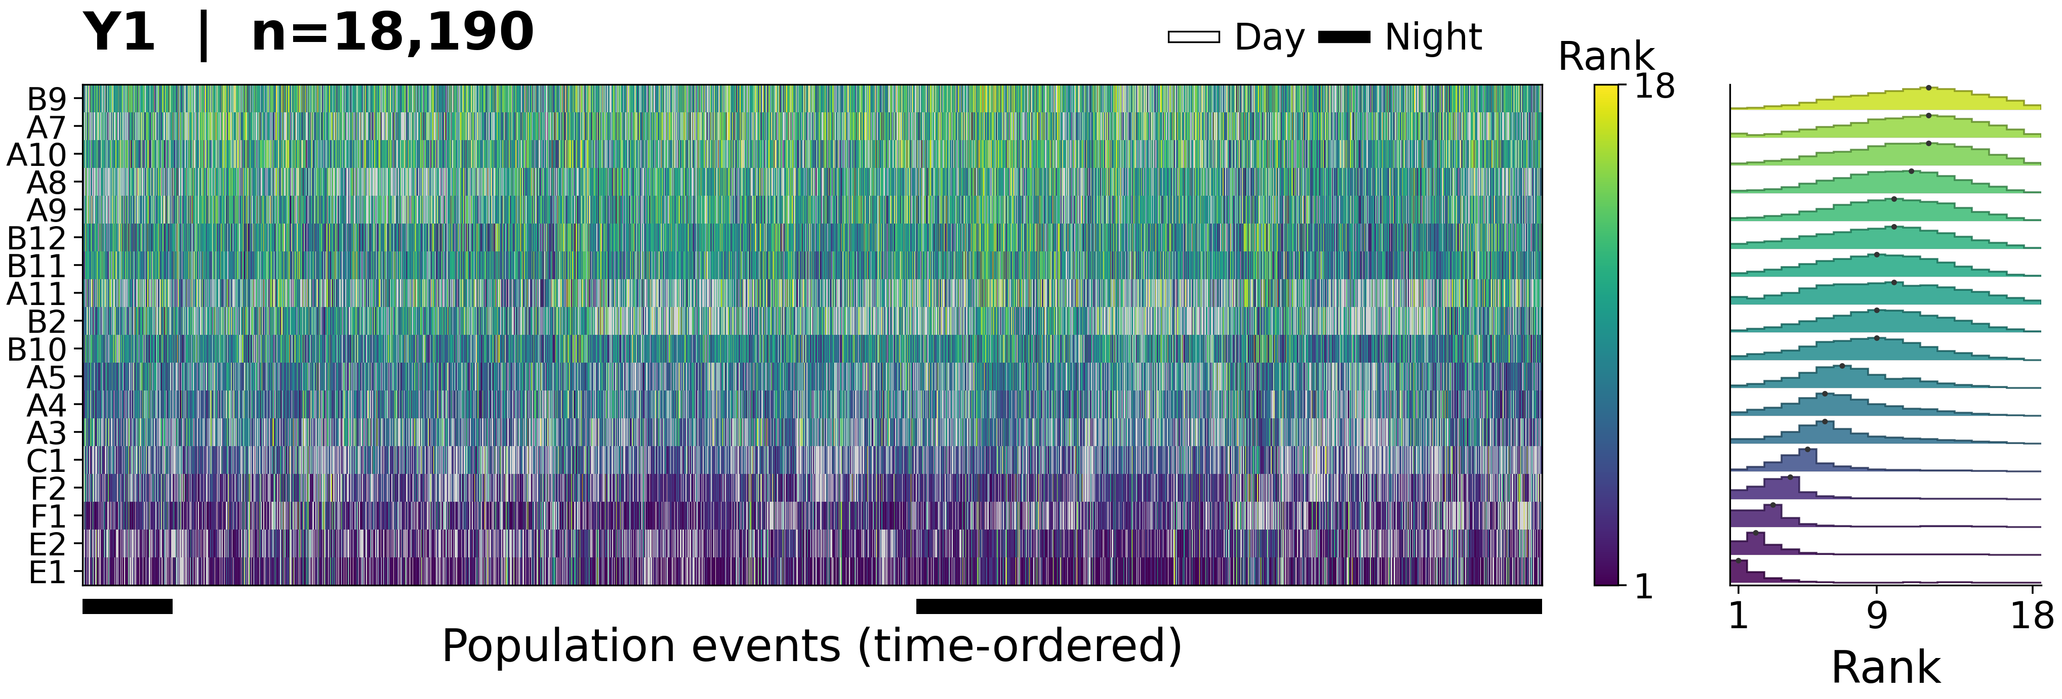
Notes:
Figure 1 panelc; author accepted 2026-10-10. Frozen scientific image, no resampling in source asset. Editable vector version supplied separately as PDF.

Slide 5
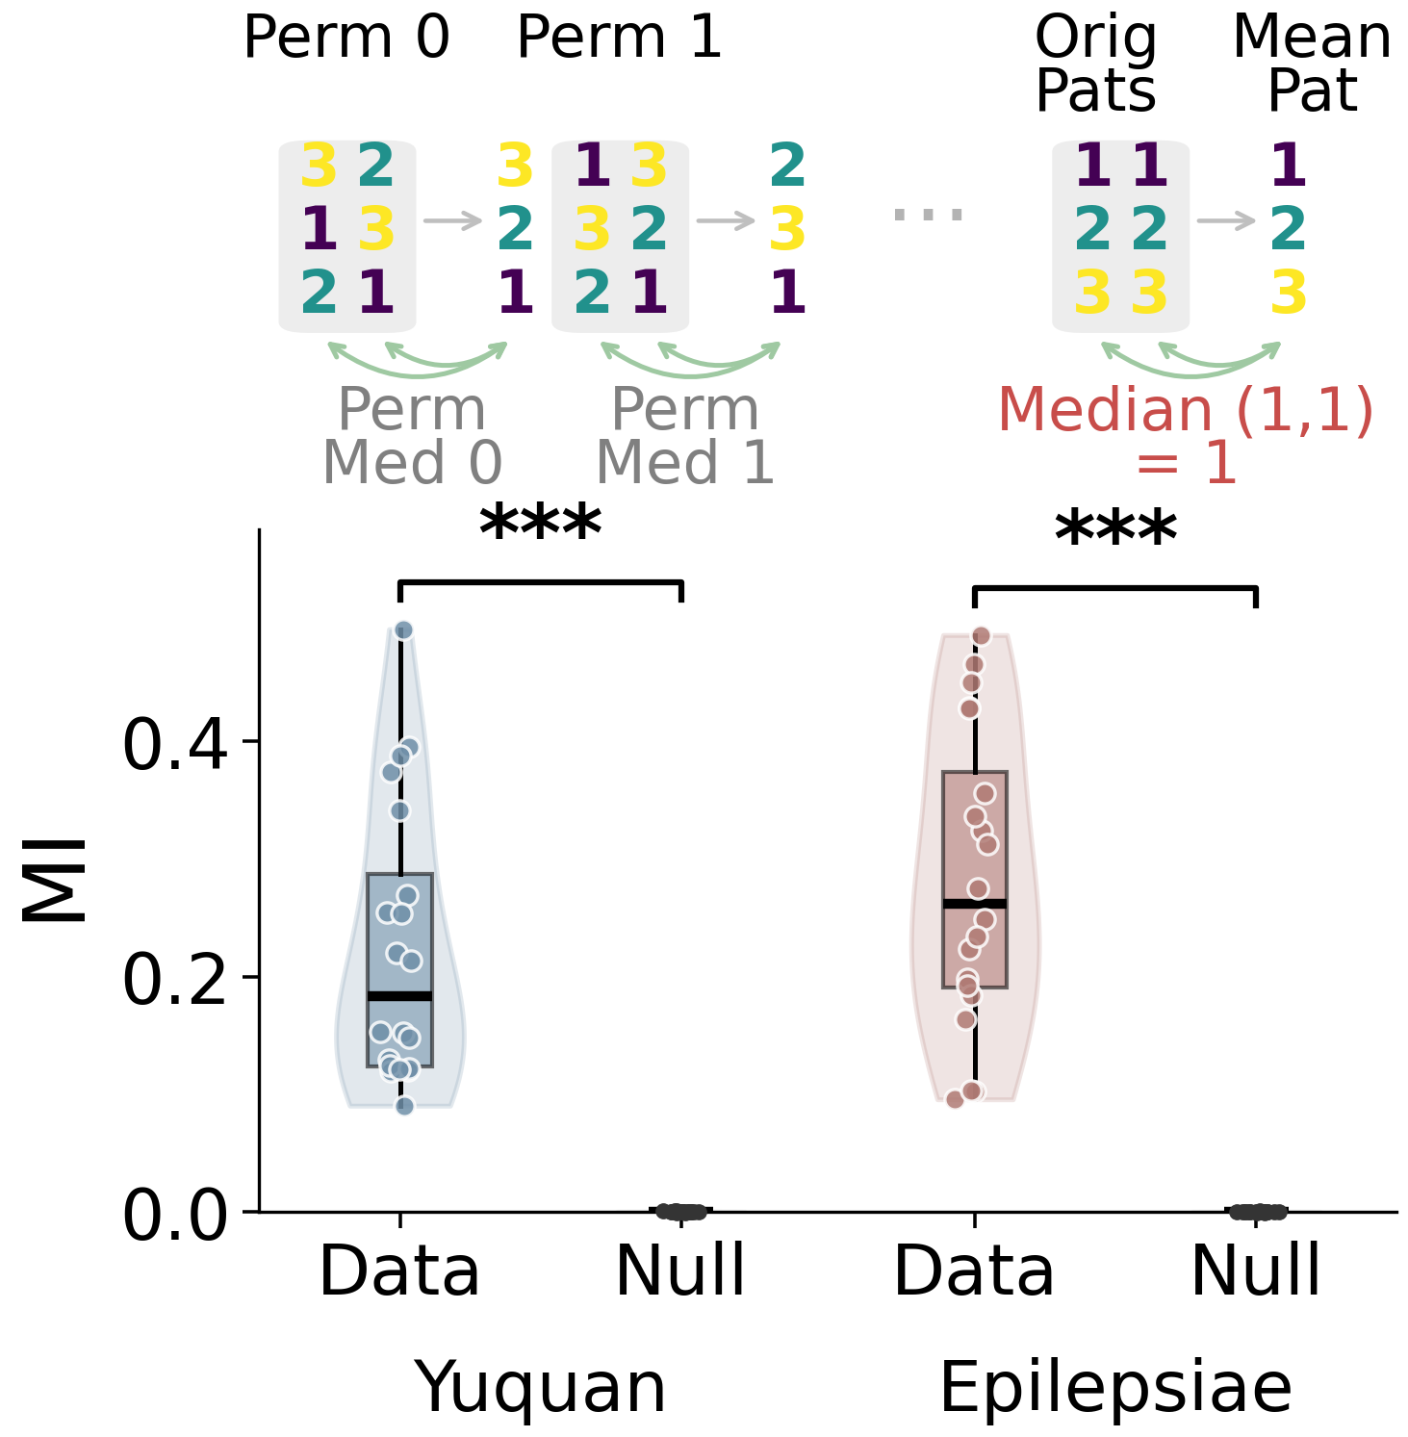
Notes:
Figure 1 paneld; author accepted 2026-10-10. Frozen scientific image, no resampling in source asset. Editable vector version supplied separately as PDF.

Slide 6
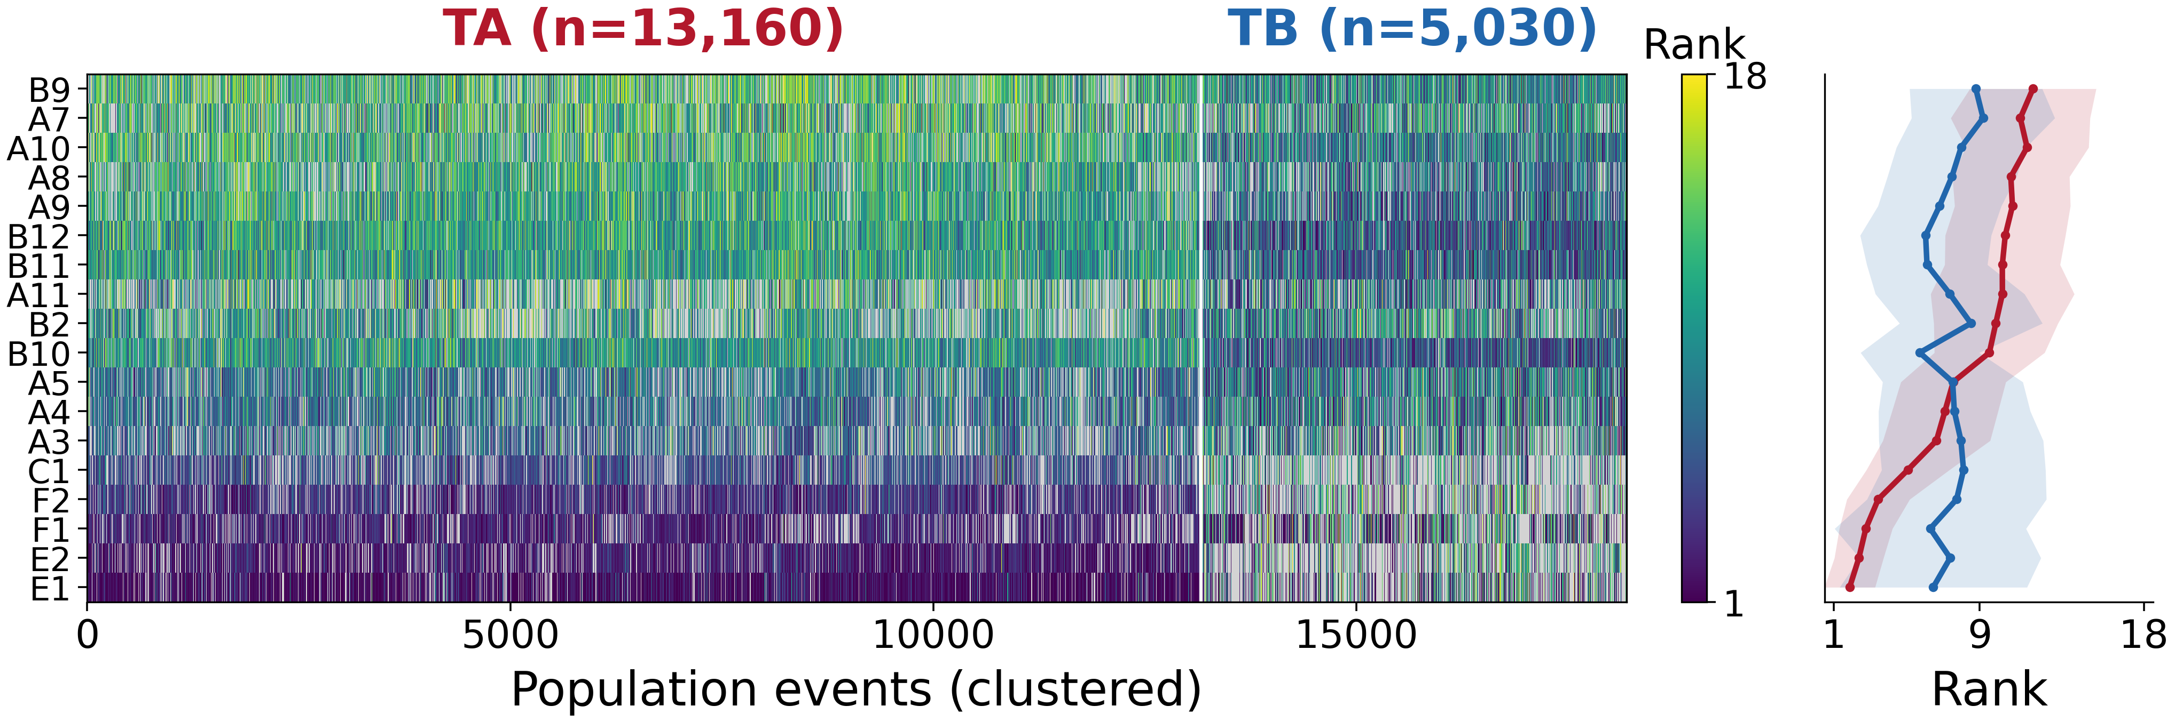
Notes:
Figure 1 panele; author accepted 2026-10-10. Frozen scientific image, no resampling in source asset. Editable vector version supplied separately as PDF.

Slide 7
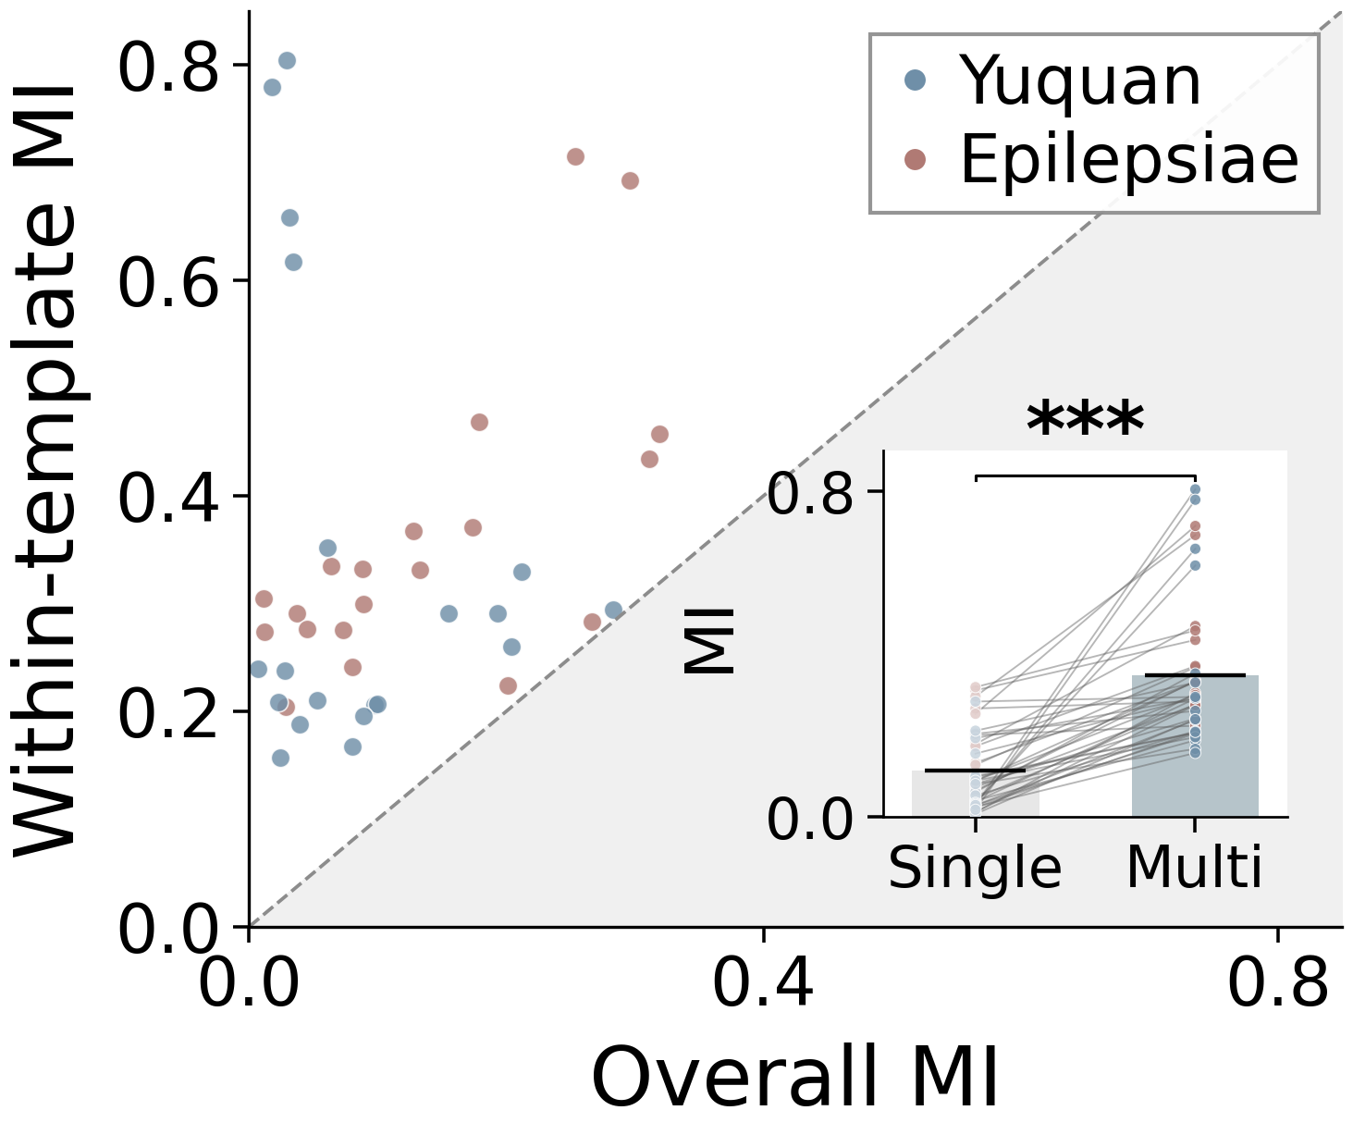
Notes:
Figure 1 panelf; author accepted 2026-10-10. Frozen scientific image, no resampling in source asset. Editable vector version supplied separately as PDF.

