Slide 1
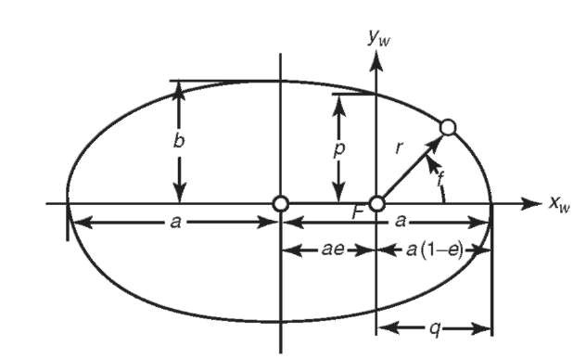



















$$Z_{peri}$$
$$Y_{peri}$$
Satellite Position
$$X_{peri}$$
$$Y_{peri}$$
$$velocity$$
$$Y_{peri}$$
$$b$$
$$p$$
$$r$$
$$a$$
$$ae$$
$$υ$$
$$r\dot{ν}$$
$$\dot{r}$$
$$X_{peri}$$
$$a(1−e)$$
$$r$$
$$υ$$
$$X_{peri}$$

