Slide 1
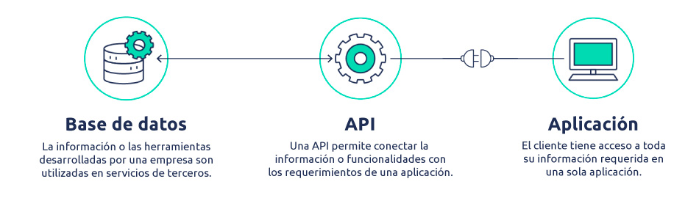
YtConsultant
de Youtube
Jose Luis Obiang Ela Nanguan

Slide 2


Slide 3
