Slide 1
Mass Storage
Josemar U. Aldana 8/21/2024

Slide 2
MASS STORAGE
Refers to systems and devices designed to store large amounts of data. Unlike primary storage like ram, which is used for temporary data storage while a computer is running, mass storage provides long-term storage for data and programs.

Slide 3

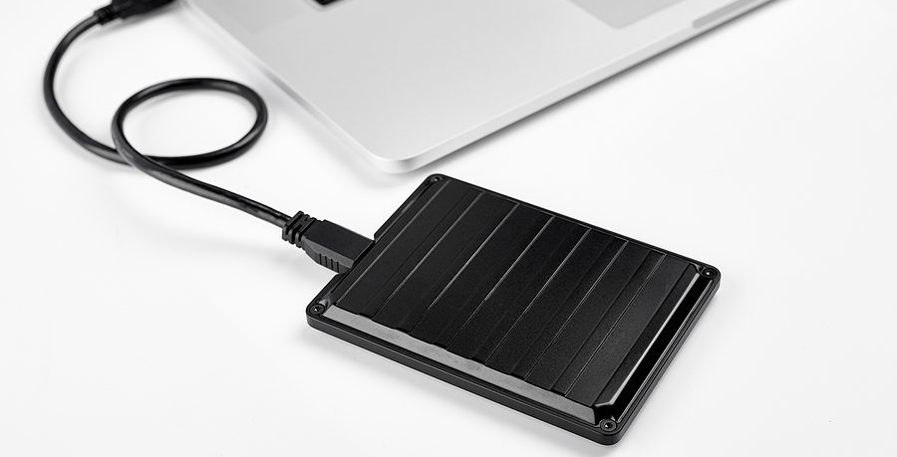
HARD DRIVE DISK

Slide 4
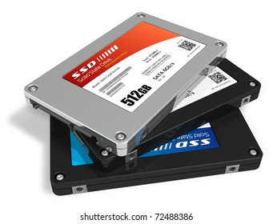
SOLID STATE DRIVES [SSD]

Slide 5

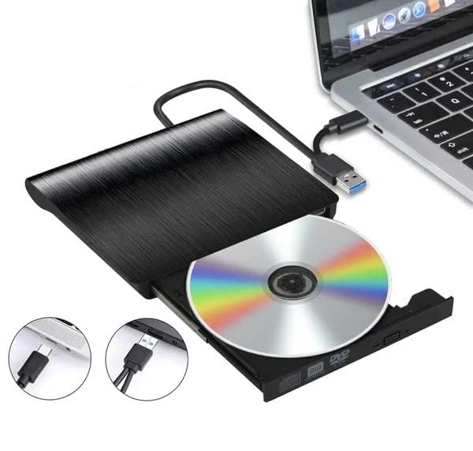
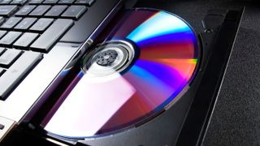
Optical Discs

Slide 6

USB Flash Drives

Slide 7
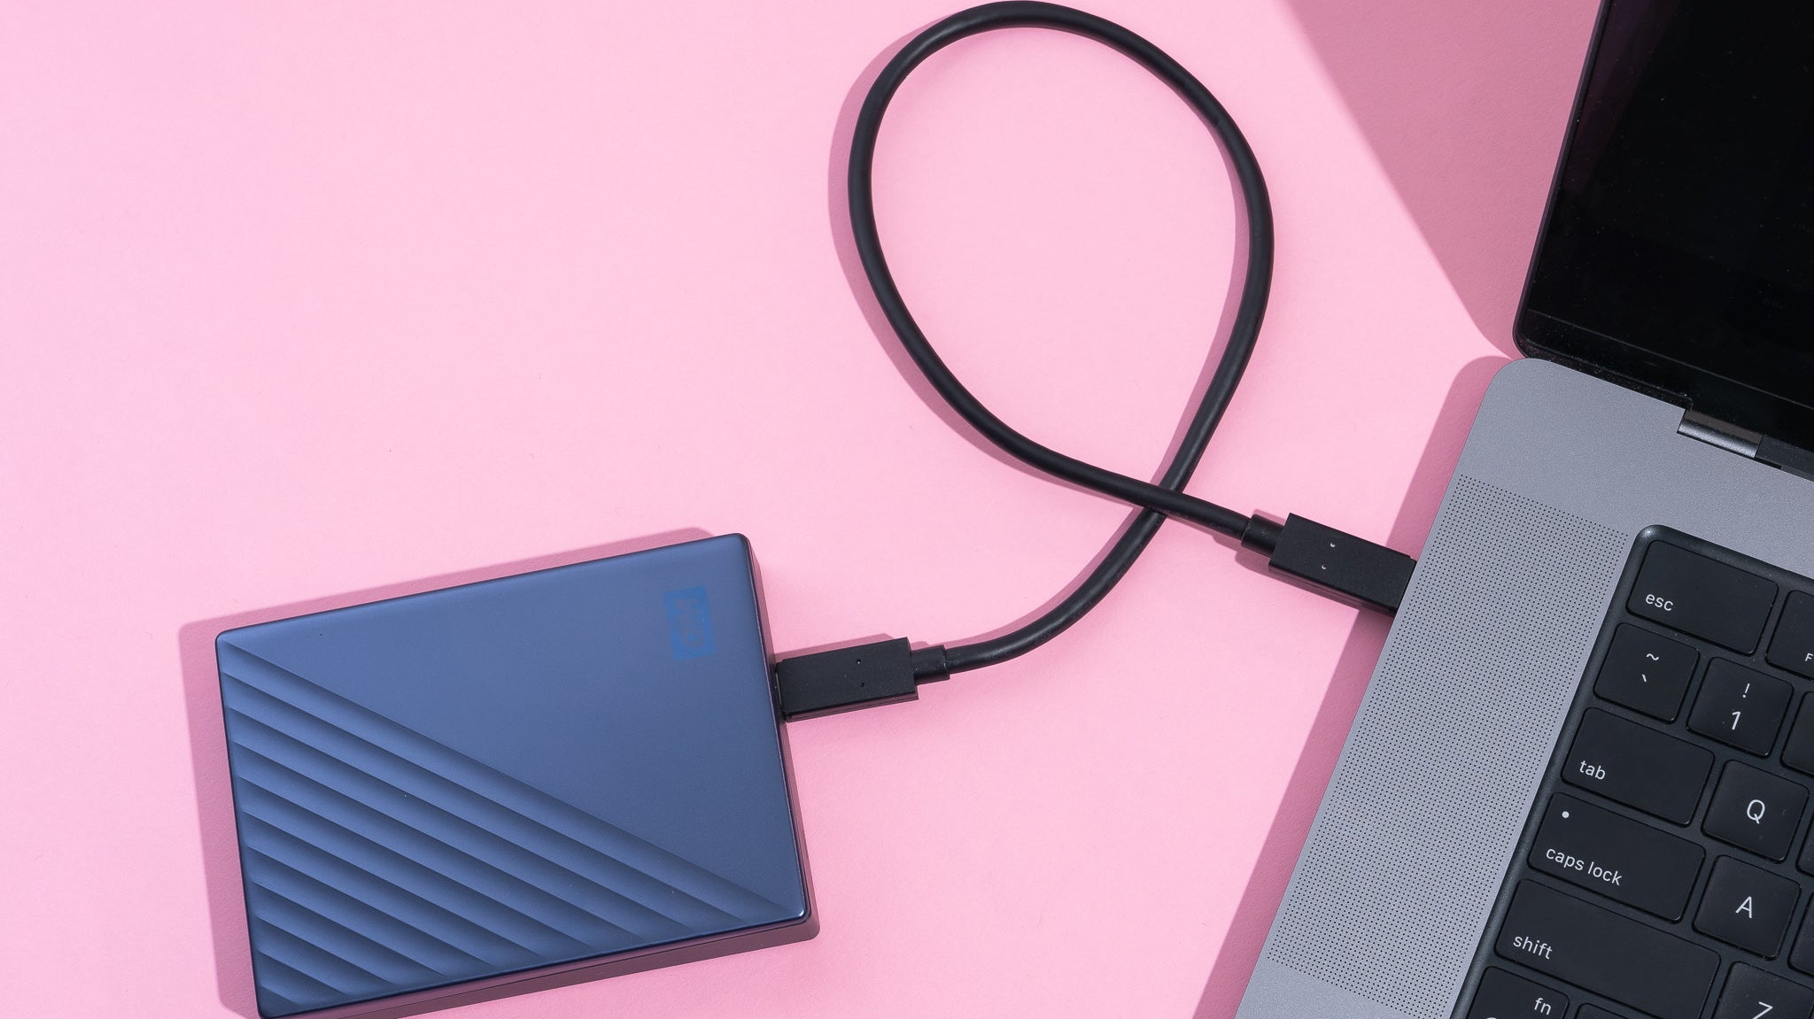
External Hard Drives

Slide 8



Slide 9

CLOUD STORAGE

Slide 10
THANK YOU!

