Slide 1
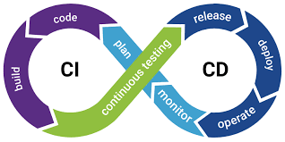
Fundamentals & Benefits of CI/CD
- Juan Lopez

Slide 2
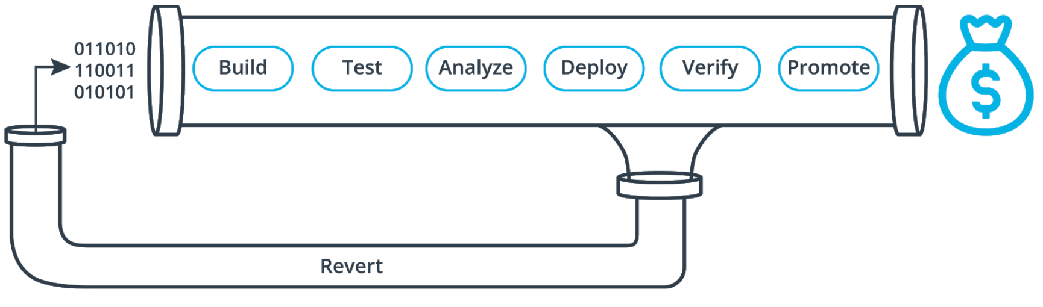
Fundamentals of CI/CD
Continuous Integration (CI)
Continuous Deployment (CD)
Practice of merging all developers code several times a day to one main repository. The process of MAKING. The ultimate goal of CI is a high quality, deployable artifact:
Compile
Unit test
Static analysis
Dependency vulnerability test
Store artifact
Approach where the value is delivered frequently through automated deployments. The process of MOVING the artifact to the spotlight:
Creating infrastructure
Provision servers
Copying files
Promote to production
Smoke test
Rollbacks

Slide 3



Benefits of CI/CD
Reduce & Avoid Cost
Increase & Protect Revenue
Catch Compile Errors After Merge:
Less developer time on issues from new developer code
Catch Unit Test Failures:
Less bugs in production and less time in testing
Detect Security Vulnerabilities:
Prevent embarrassing or costly security holes
Automate Infrastructure Creation:
Less human error, Faster deployments
Automate Infrastructure Cleanup:
Less infrastructure costs from unused resources
Faster and More Frequent Production Deployments:
New value-generating features released more quickly
Deploy to Production Without Manual Checks:
Less time to market
Automated Smoke Tests:
Reduced downtime from a deploy-related crash or major bug
Automated Rollback Triggered by Job Failure:
Quick undo to return production to working state

Slide 4
Best Practices for CI/CD
01
03
Only Road to Production
Fail Fast
Set up your CI/CD pipeline to find and reveal failures as fast as possible. The faster you can bring your code failures to light, the faster you can fix them.
Once CI/CD is deploying to production on your behalf, it must be the only way to deploy. Any other person or process that meddles with production after CI/CD is running will inevitably cause CI/CD to become inconsistent and fail.
02
04
Measure Quality
Maximum Automation & Config in code
Measure your code quality so that you can see the positive effects of your improvement work (or the negative effects of technical debt).
If it can be automated, automate it. This will only improve your process!
All configuration code must be in code and versioned alongside your production code. This includes the CI/CD configuration files!

Slide 5
The End!
We’ve gone over the fundamentals and benefits of CI/CD. Thank you for your consideration and time!
- Juan Lopez
CI/CD Pipeline

