Slide 1


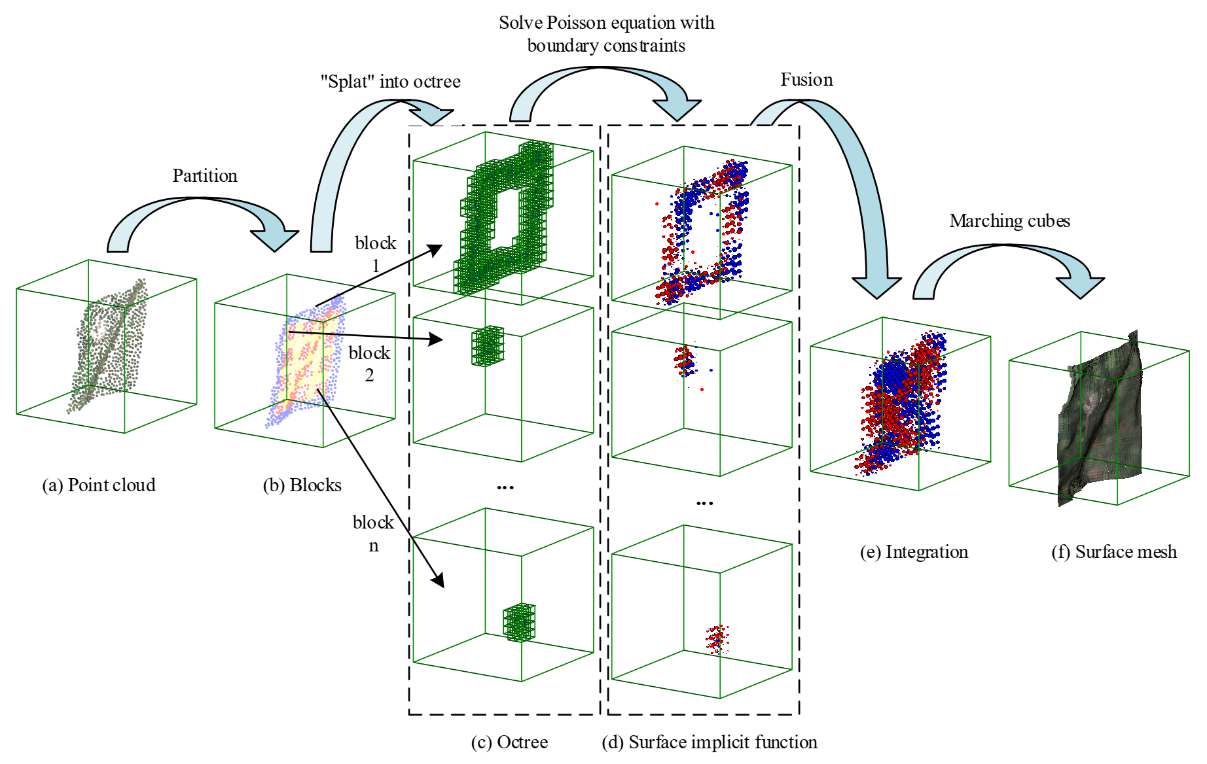
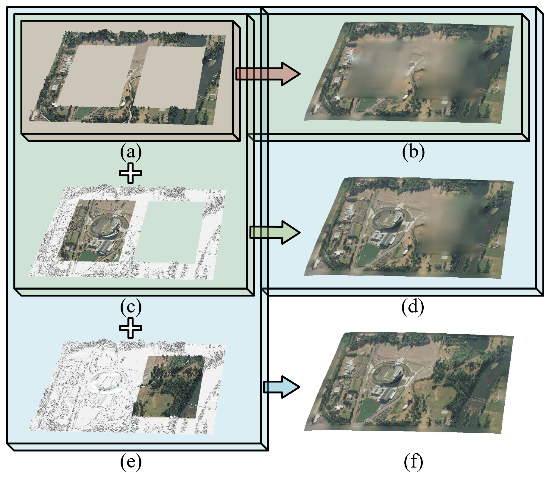
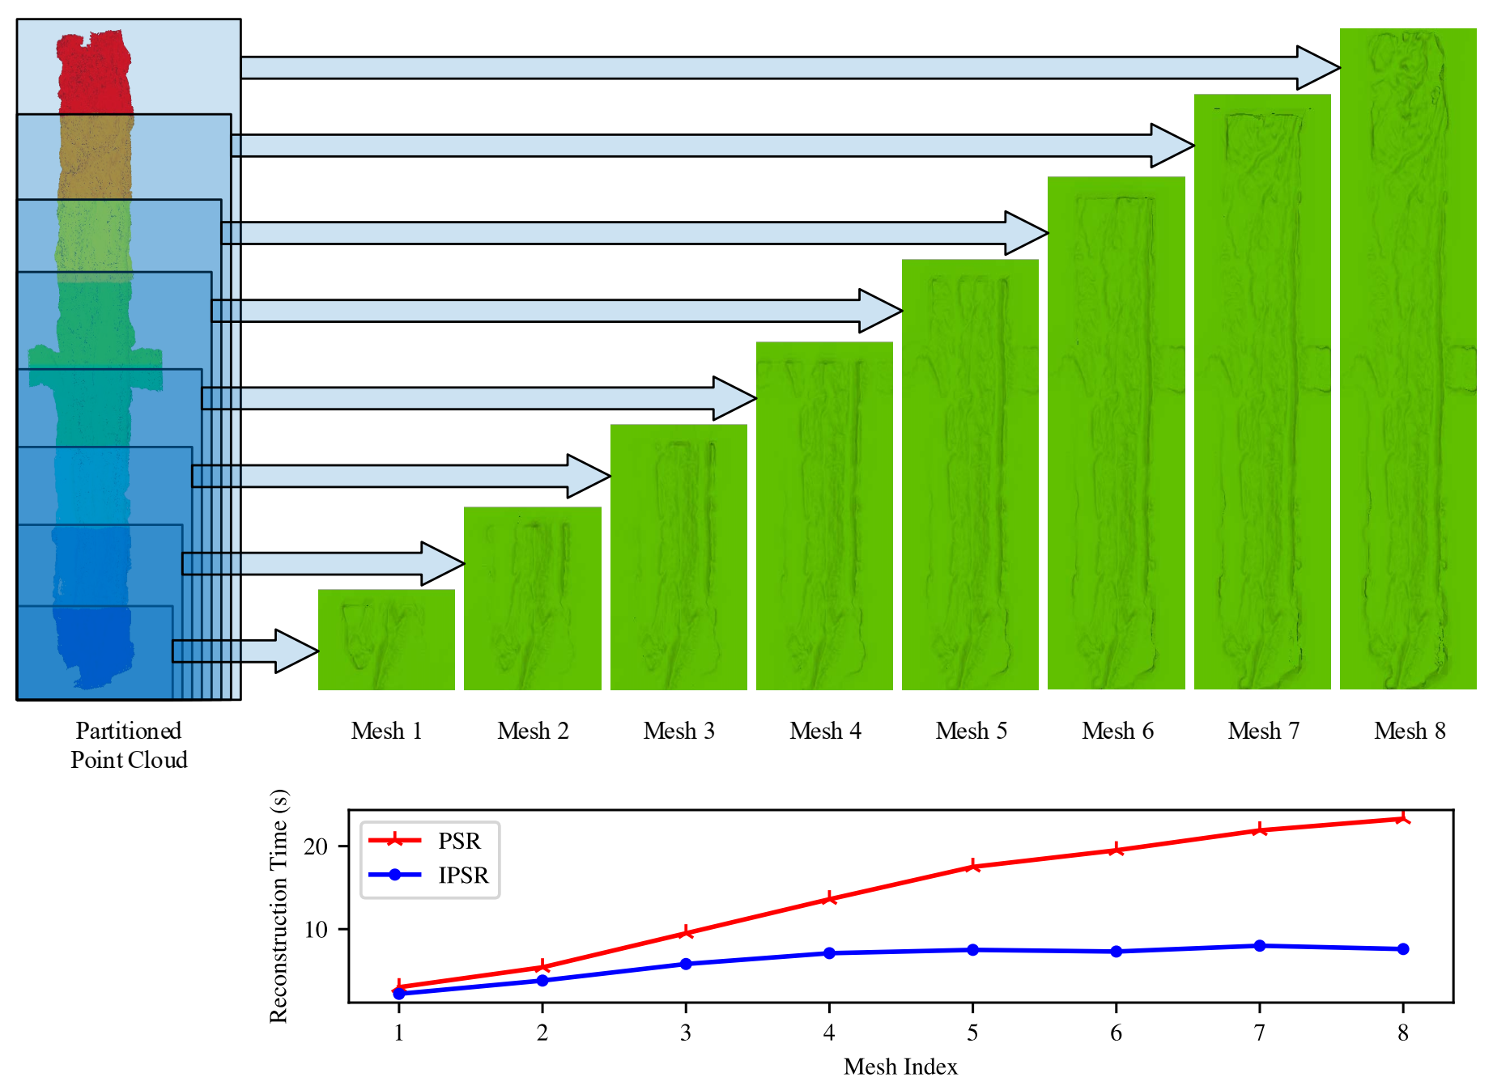
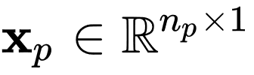




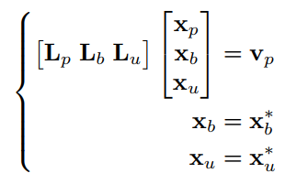
Incremental Poisson Surface Reconstruction for Large Scale Three-Dimensional Modeling
Qiang Yu^{1,2}, Wei Sui², Ying Wang², Shiming Xiang^{1,2} and Chunhong Pan²
¹ School of Artificial Intelligence, University of Chinese Academy of Sciences, Beijing 100049, China
² National Laboratory of Pattern Recognition, Institute of Automation, Chinese Academy of Sciences, Beijing 100190, China
Introduction
Experiments
Surface reconstruction from point clouds is very challenging. Most existing surface reconstruction methods suffer from low efficiency and heavy computational load.
Our main contributions:
An incremental surface reconstruction method is proposed for large scale scenes where point clouds are provided online and area by area. The proposed method is quite flexible and resource saving with the comparable reconstruction accuracy to the original PSR method, which is a popular benchmark of surface reconstruction.
A novel Poisson equation with boundary constraints is formulated based on the adaptive octree, with which neighboring point cloud blocks can be reconstructed incrementally and seamlessly.
An octree node classification method is designed to classify octree nodes into inner and boundary types. The inner nodes help reconstruct implicit functions while the boundary nodes provide boundary constraints.
We conduct comparative experiments with the PSR method to demonstrate the capacity of our method.
Two different datasets are employed to evaluate our method.
We conduct qualitative and quantitative comparison experiments between our method and the original PSR method on the benchmark dataset. The results of the proposed method are nearly the same as the ground truths. The boundary constraints guarantee the seamless transition from one block to another.
Under the circumstances that the point cloud of entire scene can not be provided at one time, our method is more profitable than almost all the IFF based surface reconstruction methods for its flexibility and resource saving ability.
The proposed IPSR method is conducted on the new arrived point cloud block only, while the PSR method needs to reconstruct the whole point cloud from scratch when a new point cloud block is provided. Our method saves a large amount of time than the PSR method.
Approach
Our method is specially designed such that it can perform the reconstruction process in an incremental manner.
It is very flexible and resource saving with comparable reconstruction accuracy to the original PSR method.
In our method, the overall implicit function is reconstructed seamlessly in a divided and progressive way.
The underlying mathematical model behind our method is a Poisson equation with well designed boundary constraints.
Point Cloud Partition
The whole point cloud is partitioned into a number of blocks of arbitrary size.
Octree Nodes Classification
The octree nodes are classified into categories: the Poisson nodes, the boundary nodes and unused nodes.
Incremental Reconstruction with Boundary Constraints
Let __________ be the coefficients vector of the Poisson nodes, __________ be the coefficients vector of the boundary nodes and __________ be the coefficients vector of the unused nodes.
Let ____ and ____ denote the true values, which are used as the boundary constraints.
Accordingly, the Poisson equation with boundary constraint of our IPSR method can be formulated as:
It can be seen that x can be easily solved by the methods such as the conjugate gradient algorithm.
Fig. 1: Our IPSR method can incrementally and seamlessly reconstruct surface meshes from a series of neighboring point cloud blocks.
Fig. 2: The pipeline of our IPSR method.
Fig. 3: Comparison between our IPSR method and the original PSR method.
References
[.] Kazhdan, M., Bolitho, M., Hoppe, H.: Poisson surface reconstruction. Eurographics Symposium on Geometry Processing.
[.] Berger, M., Levine, J.A., Nonato, L.G., Taubin, G., Silva, C.T.: A benchmark for surface reconstruction. ACM Transactions on Graphics.

