Slide 1
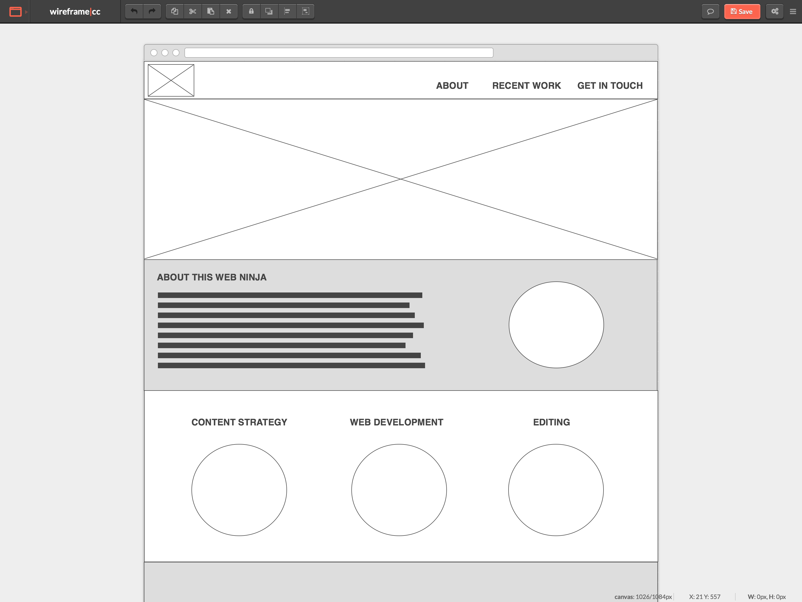
logo
nav
header
section
wrapper
div
section
section
section
section
section
footer

