Slide 1
Exploring the World of ICT
By: James Eraño Macahelos

Slide 2
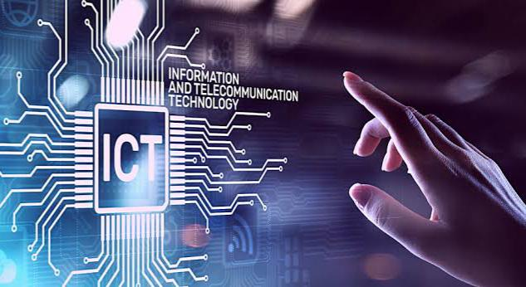
Information and Communication Technology (ICT)
Encompasses various technologies for communication, data management, and information processing.

Slide 3
Information and Communication Technology (ICT) comprises various essential components that synergize to create a vast technological ecosystem. Let's explore these key components that play a pivotal role in shaping the digital landscape.

Slide 4

1.TelecommuNication
The transmission of information over distances, involving voice, data, and multimedia.
Examples: Mobile phones, landline networks,
internet communication.

Slide 5


2. Broadcast media.
The dissemination of audio and visual content to a wide audience through traditional and digital channels.
Examples: Television broadcasting, radio broadcasting, online streaming platforms.

Slide 6
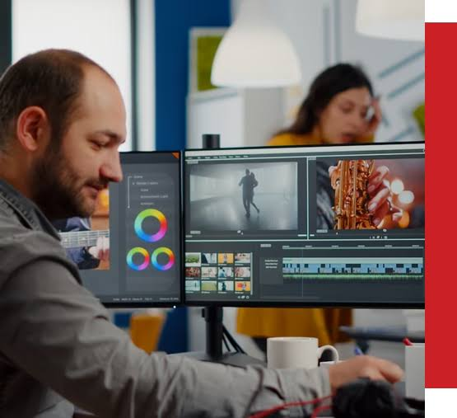
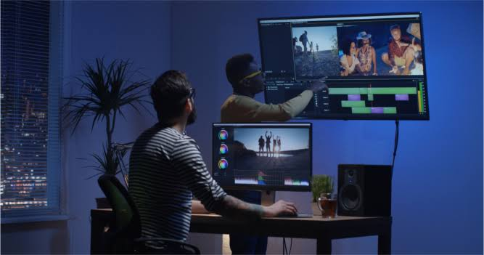
3.Audio-Visual Processing.
The manipulation and analysis of sound and visual elements for communication and entertainment purposes.
Examples: Multimedia production, video editing, graphic design.

Slide 7
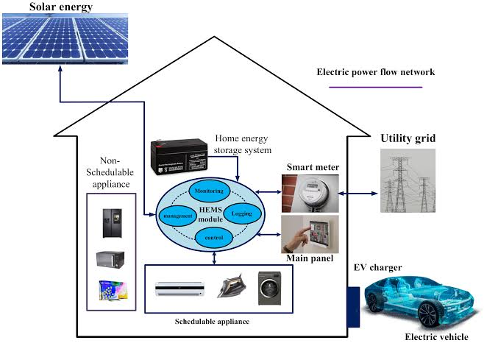
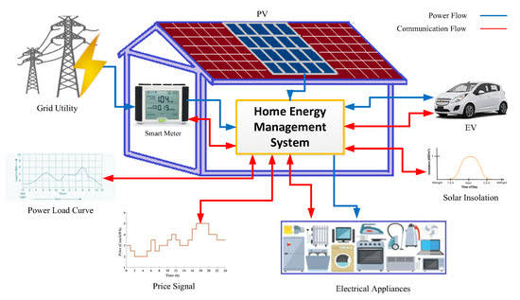
4.Intelligent Building Management Systems.
Integration of technology to optimize the efficiency and sustainability of building operations.
Examples: Smart home automation, energy management systems, security systems.

Slide 8
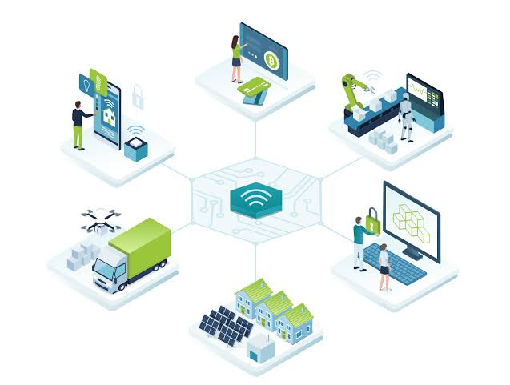
5.Network-Based Control and Monitoring.
The use of interconnected systems to control and supervise various processes and devices.
Examples: Internet of Things (IoT), remote monitoring systems, centralized control networks.

Slide 9
Understanding these components is crucial for comprehending the multifaceted nature of ICT and its impact on our interconnected world.

Slide 10
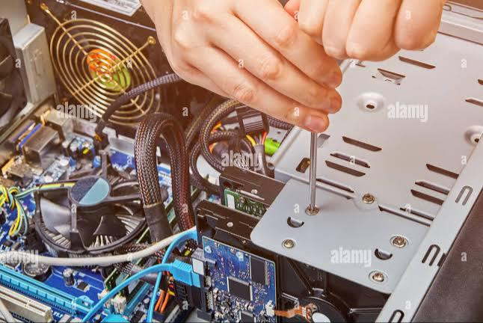
Computer System Servicing(CSS)

Slide 11
Computer System Servicing involves maintaining, repairing, and optimizing computer systems to ensure their efficient and reliable operation.

Slide 12
Importance
Ensures System Reliability: Regular servicing enhances the lifespan and performance of computer systems. Prevents Downtime: Proactive maintenance reduces the risk of unexpected failures and downtime. Optimizes Performance: Servicing helps in fine-tuning and optimizing system components for better efficiency.

Slide 13
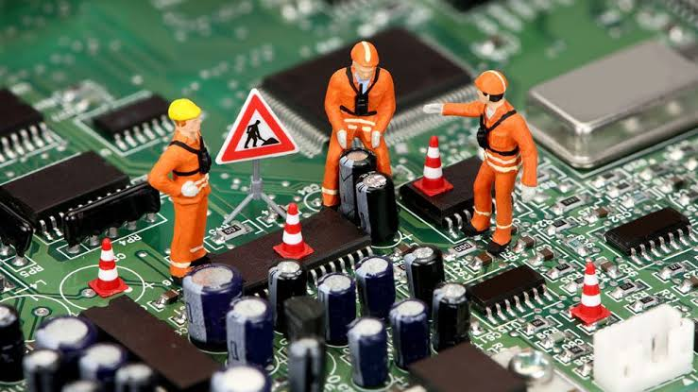
Hardware maintenance
Cleaning: Removal of dust and debris to prevent overheating. Component Inspection: Checking for wear and tear, and replacing faulty hardware.

Slide 14
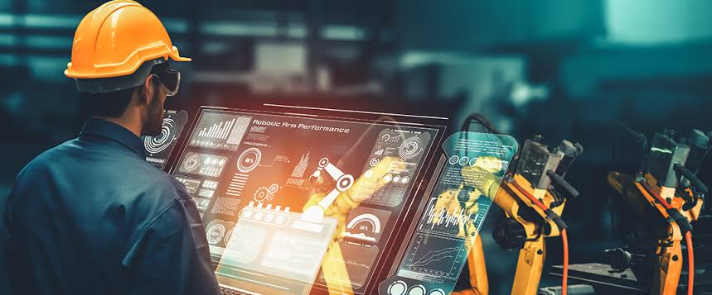
Software maintenance
Updates: Installing the latest software updates and patches for security and performance improvements. System Optimization: Adjusting settings and configurations for optimal performance.

Slide 15
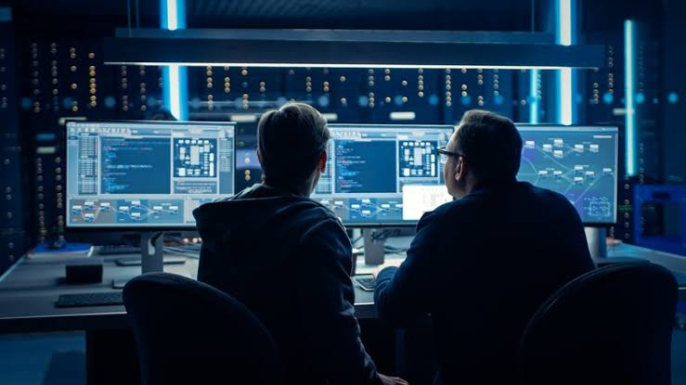
Security Measures
Anti-virus and Anti-malware: Ensuring robust security measures are in place. Data Backup: Regular backup to prevent data loss in case of system failure.

Slide 16
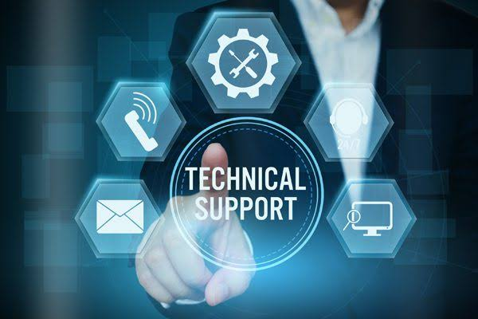
User support
Troubleshooting: Addressing user-reported issues and providing solutions. Training: Offering guidance on proper system usage and best practices.

Slide 17
Understanding and implementing comprehensive computer system servicing is vital for maintaining a reliable and efficient computing environment.

