Slide 1




Ancestría Genética: Análisis de Mestizaje Genómico
Genetic ancestry: ADMXITURE

Slide 2
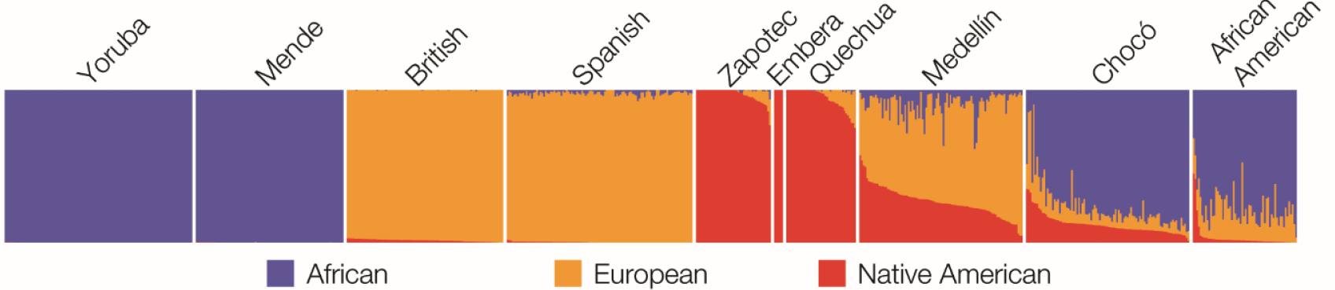
Genome-wide ancestry inference
PCA doesn’t actually quantify the ancestry of individuals – all PCA does is collapse the data into a smaller number of easy-to-manage dimensions
Nevertheless, the first question we often ask about individuals is: ‘What are their continental ancestries?’
What fraction European? Native American? African?

Slide 3
Genome-wide ancestry: ADMIXTURE
An unsupervised classification technique using observed genotypes
ADMIXTURE doesn’t need to known ancestral populations a priori
As input, ADMIXTURE wants
1 -- A matrix of observed genotypes (g) and
2 -- How many ancestries to infer (k) from those genotypes
ADMIXTURE finds two things from these inputs:
1 -- k sets of allele frequencies (a)
Represent the allele frequencies in the ancestral populations
2 -- The fractions (f) of each of the k sets of allele frequencies in each individual
Represent the admixture ratio for each individual

Slide 4
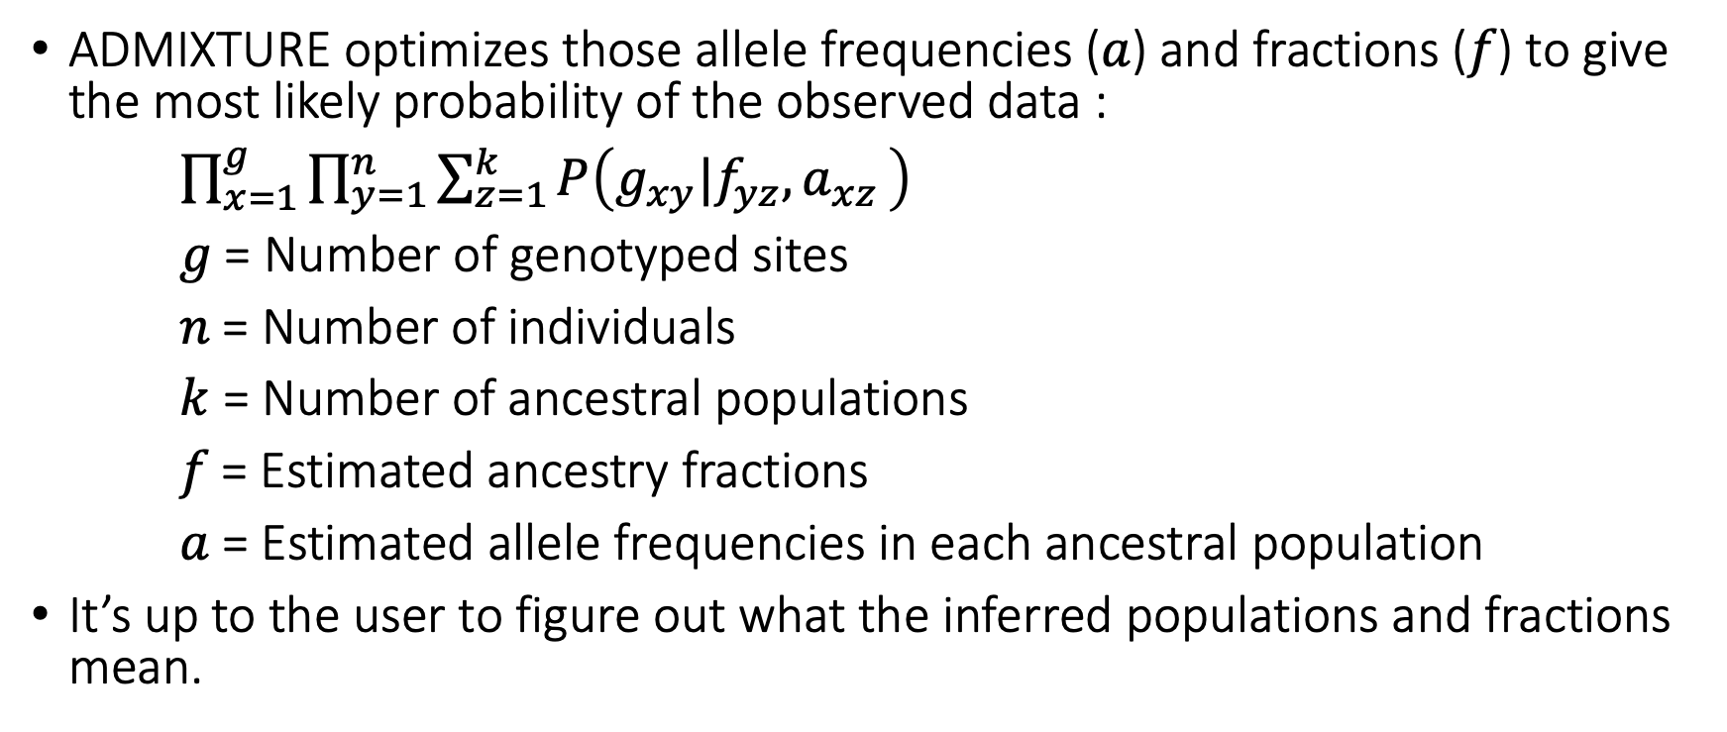
ADMIXTURE is a probabilistic approach
ADMIXTURE optimizes those allele frequencies (𝑎) and fractions (𝑓) to give the most likely probability of the observed data :
$\prod_{x=1}^{g}{\prod_{y=1}^{n}{\sum_{z=1}^{k}{P\left(g_{xy}|f_{yz}{,a}_{xz}\right)}}}$
𝑔 = Number of genotyped sites
𝑛 = Number of individuals
$k$ = Number of ancestral populations
𝑓 = Estimated ancestry fractions
𝑎 = Estimated allele frequencies in each ancestral population
It’s up to the user to figure out what the inferred populations and fractions mean.

Slide 5
The ADMIXTURE results of a few individuals
Individual | F1 | F2 | F3
Yoruba-11 | 0.99 | 0.01 | 0.00
Zapotec-2 | 0.0 | 0.0 | 0.99
British-2 | 0.0 | 0.95 | 0.05
Choco-1 | 0.77 | 0.10 | 0.13
Medellín-2 | 0.14 | 0.53 | 0.33

Slide 6
We can figure out the meaning of components from the reference individuals
Individual | African | European | Native American
Yoruba-11 | 0.99 | 0.01 | 0.00
Zapotec-2 | 0.0 | 0.0 | 0.99
British-2 | 0.0 | 0.95 | 0.05
Choco-1 | 0.77 | 0.10 | 0.13
Medellín-2 | 0.14 | 0.53 | 0.33

Slide 7
Additional resources
https://www.nature.com/articles/s41467-018-05257-7
https://bmcgenomics.biomedcentral.com/articles/10.1186/s12864-018-5195-7

