Slide 1




Cálculo de Riesgo Poligénico para Enfermedades Comunes y Complejas
Polygenic risk scores

Slide 2
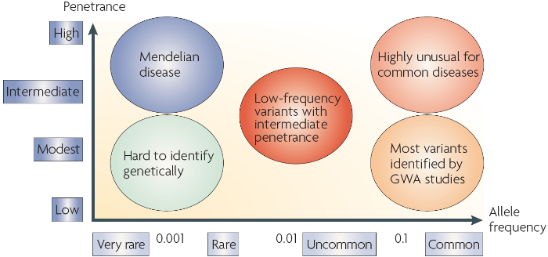
https://www.nature.com/scitable/topicpage/multifactorial-inheritance-and-genetic-disease-919/

Slide 3
Genome-wide association studies (GWAS) can be used to discover genetic variants (SNPs) that are associated with heritable traits (phenotypes) of interest: disease, anthropometric, neurological etc.
You can use these SNP discoveries to make predictions about phenotypes of interest given a personal genome sequence(s).

Slide 4
GWAS: effect alleles & risk alleles
Genetic variants (alleles) that are found at significantly different frequency in cases than controls are said to be ‘associated with’ the trait (disease) of interest.
The effect allele is operationally defined as the allele that is associated with the trait.
If you choose to build an application that predicts a complex common trait(s), you will be counting, and weighting, the number of effect alleles for that trait found in a personal genome(s).

Slide 5
GWAS: effect size
The strength (magnitude) of the effect/risk allele’s association with the trait under investigation is measured as the effect size.
For binary traits, e.g. disease (case) or no disease (control), the odds ratio can be computed to quantify the effect size of any allele.
For continuous (quantitative traits), e.g. anthropometric or clinical measures, the slope of the regression (β) between SNP allele dosage and the trait measure values can be computed to quantify the effect size of any allele.

Slide 6
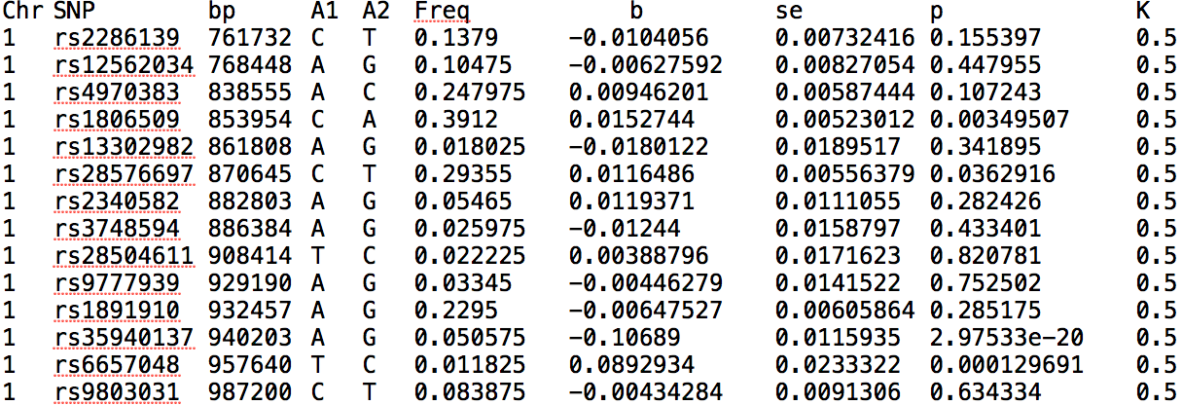
GWAS summary statistics

Slide 7
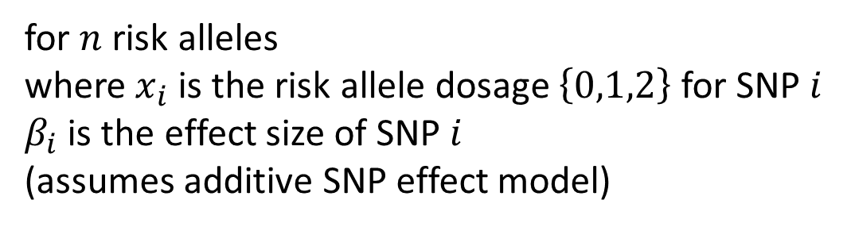
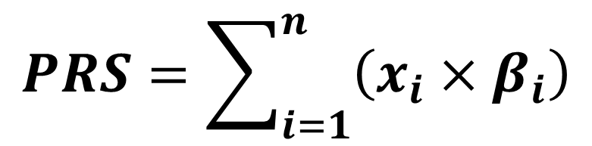
Polygenic risk scores (PRS)
PRS are calculated as the weighted sum of the number of GWAS risk alleles found in a personal genome*
$$PRS=\sum_{i=1}^{n}{\left(x_{i}×β_{i}\right)}$$
for $n$ risk alleles
where${ x}_{i}$ is the risk allele dosage $\left\{0,1,2\right\}$ for SNP $i$
$β_{i}$ is the effect size of SNP $i$
(assumes additive SNP effect model)
*there are other more complicated ways to compute PRS, but we will use this simple definition here

Slide 8

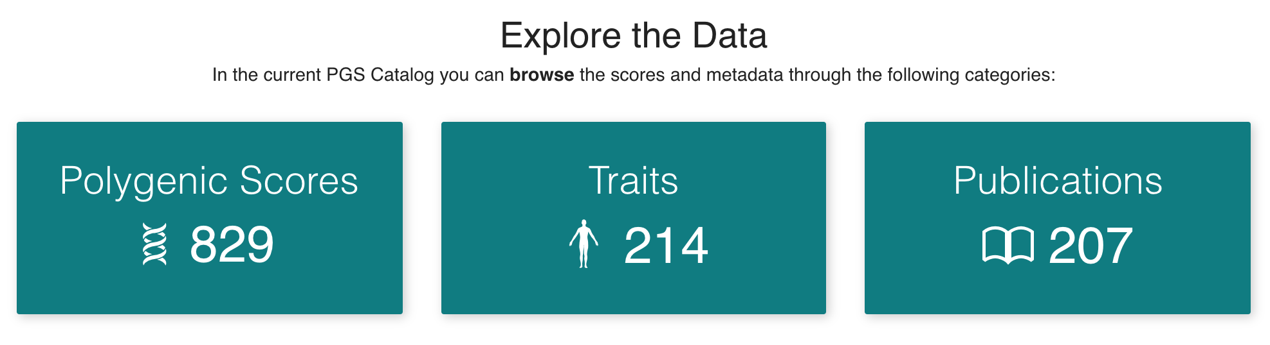
PGS Catalog
Open database of polygenic scores and the relevant metadata
Central resource for finding polygenic risk scores for a trait of interest
https://www.pgscatalog.org/

Slide 9
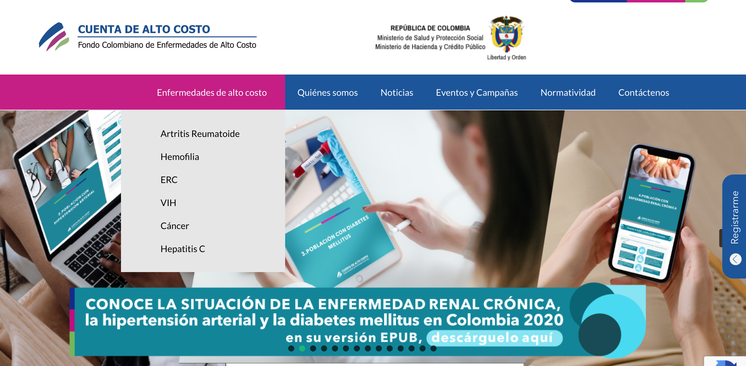

Slide 10
Additional resources
https://www.genome.gov/Health/Genomics-and-Medicine/Polygenic-risk-scores
https://www.nature.com/articles/d42473-019-00270-w
NHGRI-EBI GWAS Catalog: https://www.ebi.ac.uk/gwas/

