Slide 1




Farmacogenómica para el Tratamiento de Enfermedades
Pharmacogenomics

Slide 2
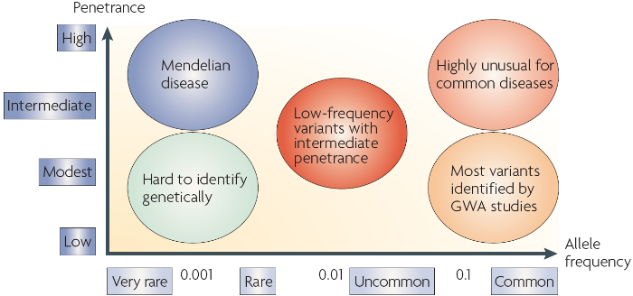

Slide 3
Pharmacogenomics
Many medicines are currently prescribed as though they work equally well in all people, or the dose is adjusted depending on the age, size, or gender of a patient.
However, even if patients are the same age, size or gender, they may still have different responses to the same medicine because of genetic variation.
As a result, the choice or dose of a medicine can be tailored to that individual, personalizing their treatment.

Slide 4
Pharmacogenomics
Pharmacogenomics is study of the relationship between genetic variations and how our body responds to medication.
Pharmacogenomic testing gives insight into how an individual patient may respond to a drug.
Text taken from PharmGKB: https://www.pharmgkb.org/whatIsPharmacogenomics

Slide 5
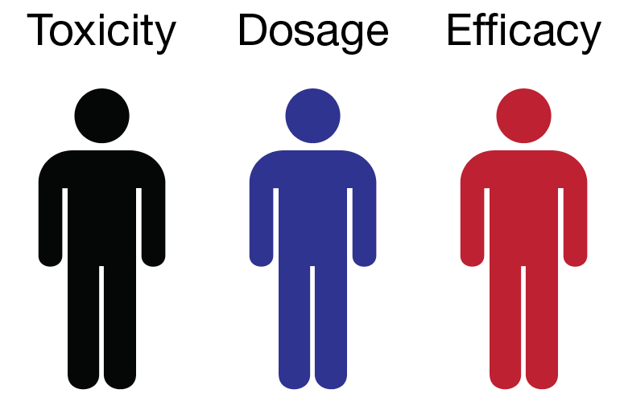
Pharmacogenomics

Slide 6

PharmGKB
Developed by Stanford University with funding from the NIH
Partner of the NIH Pharmacogenomics Research Network (PGRN)
Aim is to aid researchers in understanding how genetic variation among individuals contributes to differences in reactions to drugs
https://www.pharmgkb.org/

Slide 7
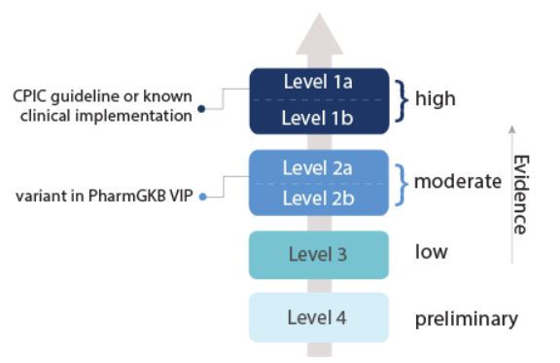
PharmGKB data
Strength of relationship provided by level of evidence for each variant

Slide 8
Additional resources
https://www.mayoclinic.org/healthy-lifestyle/consumer-health/in-depth/personalized-medicine/art-20044300
https://www.nigms.nih.gov/education/fact-sheets/Pages/pharmacogenomics.aspx
https://www.cdc.gov/genomics/disease/pharma.htm

