Slide 1
Take Home Assessment EDUARDO TELLEZ

Slide 2
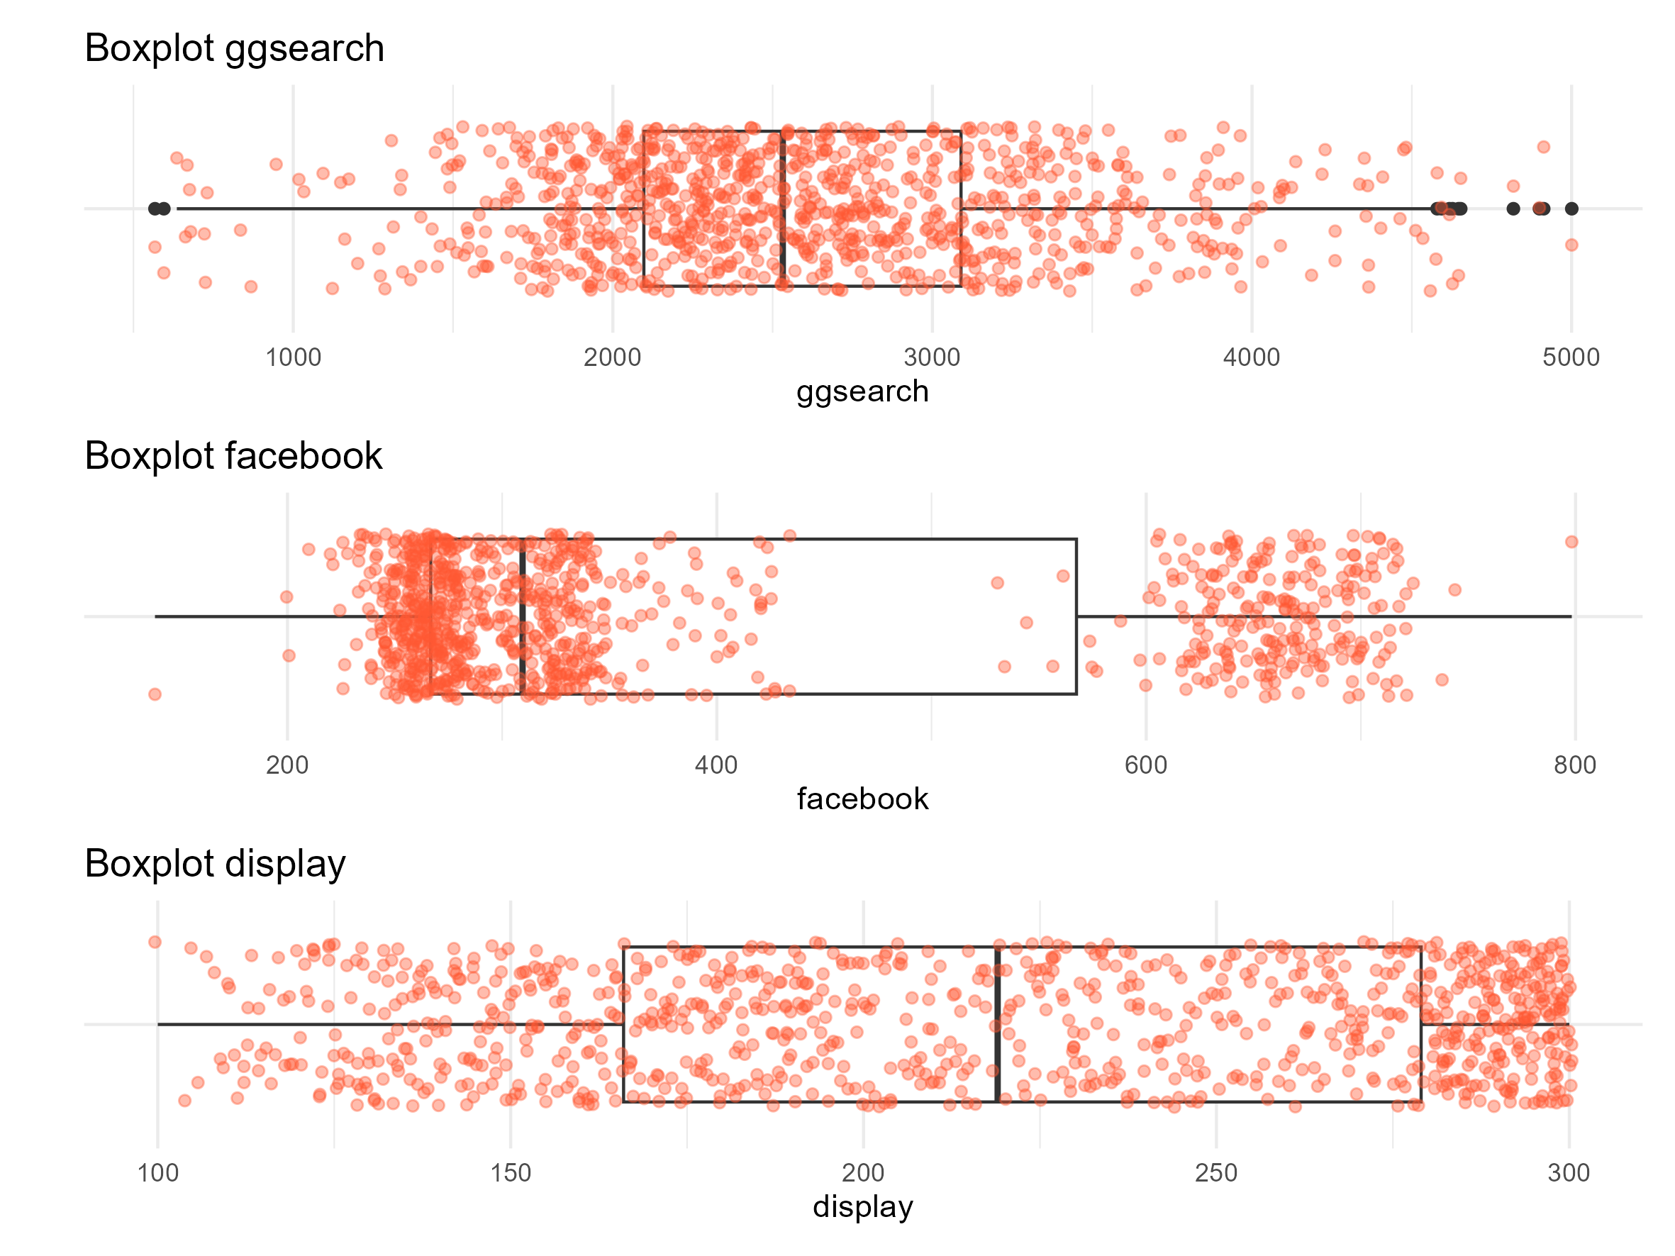
BOXPLOT Display shows the highest variability, while Facebook has seen an increase in the past year.

Slide 3
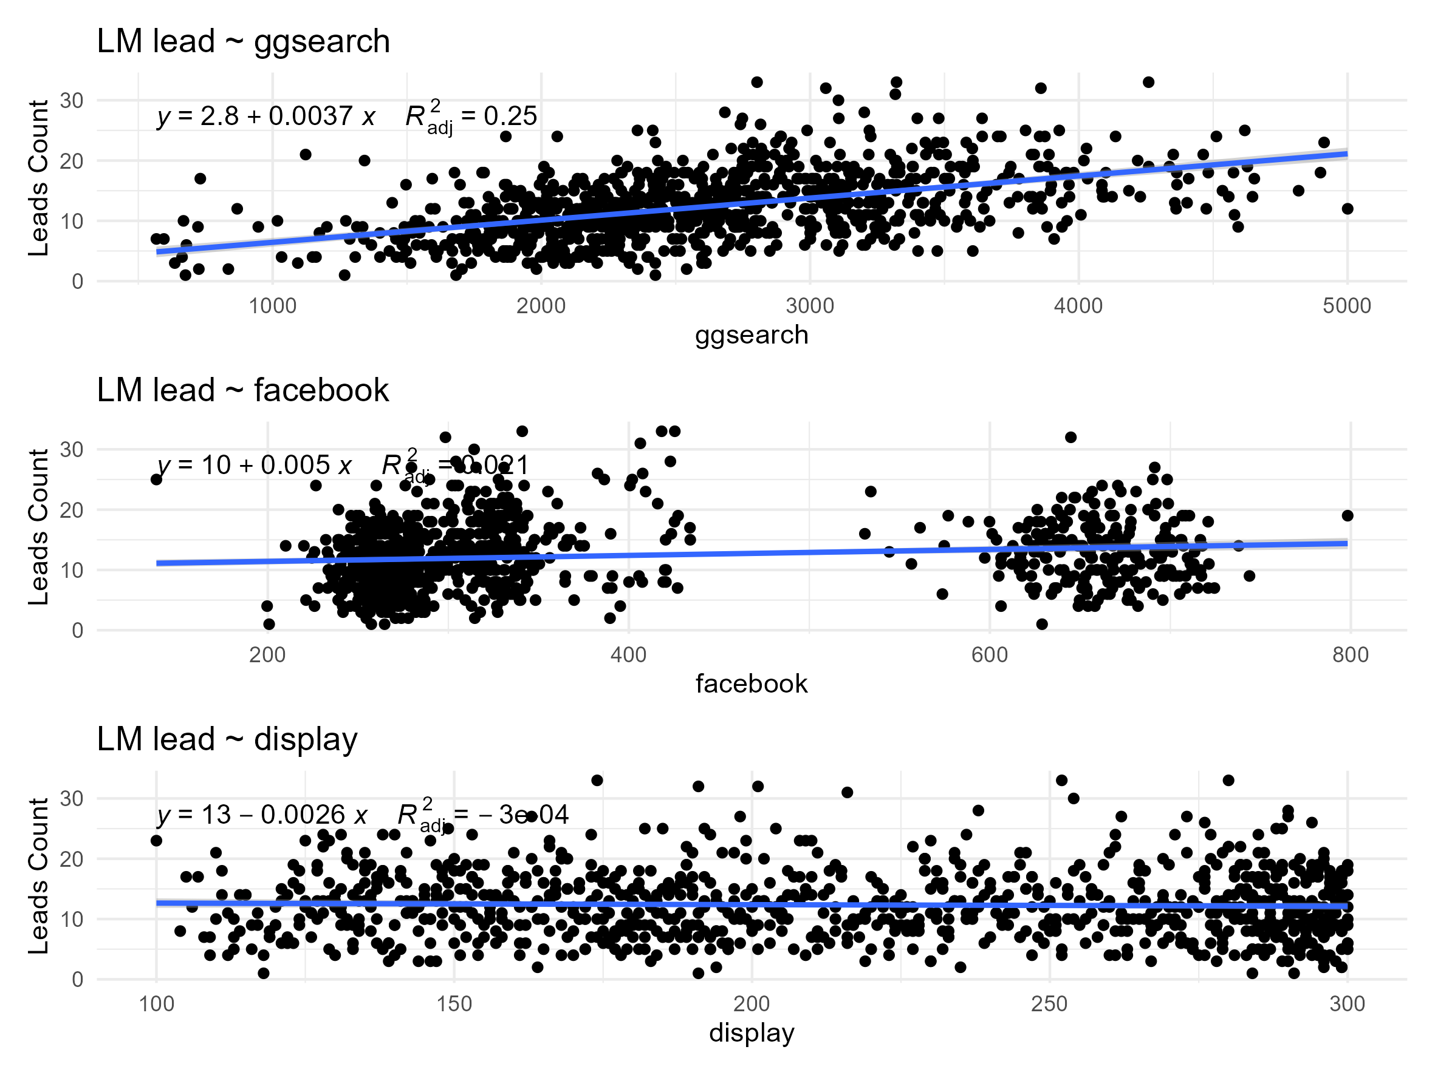
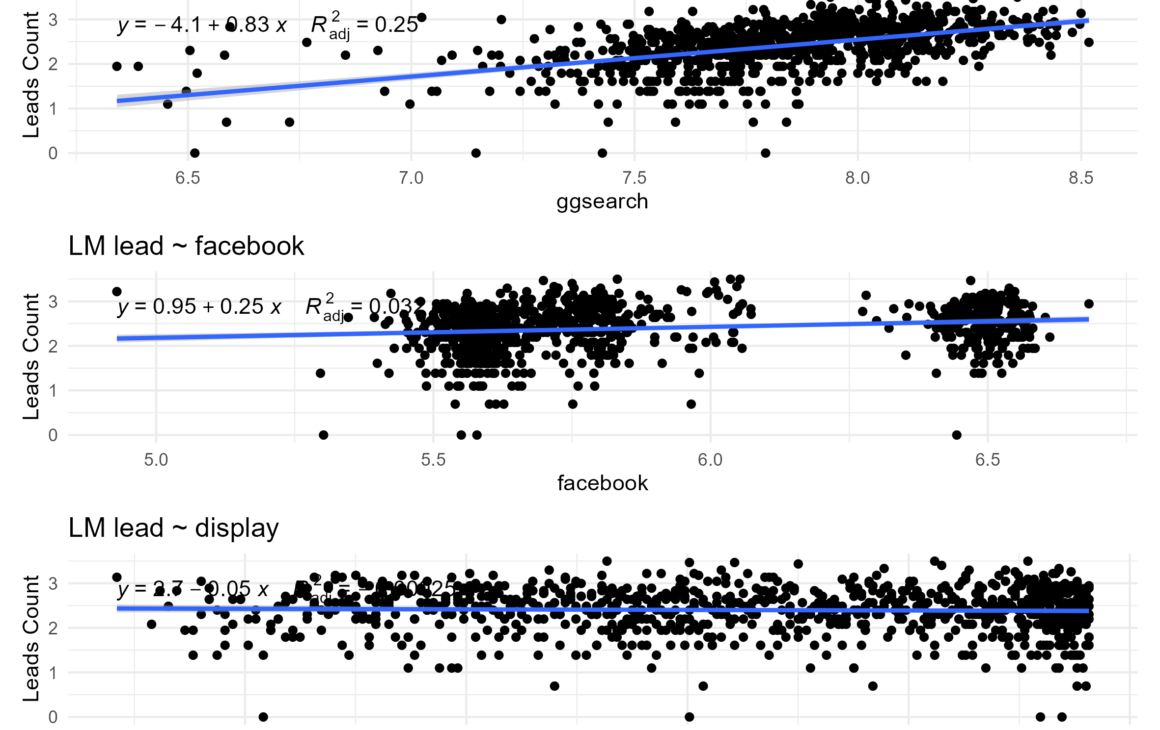
SCATTER PLOT The variable with the strongest relationship is ggsearch.

Slide 4
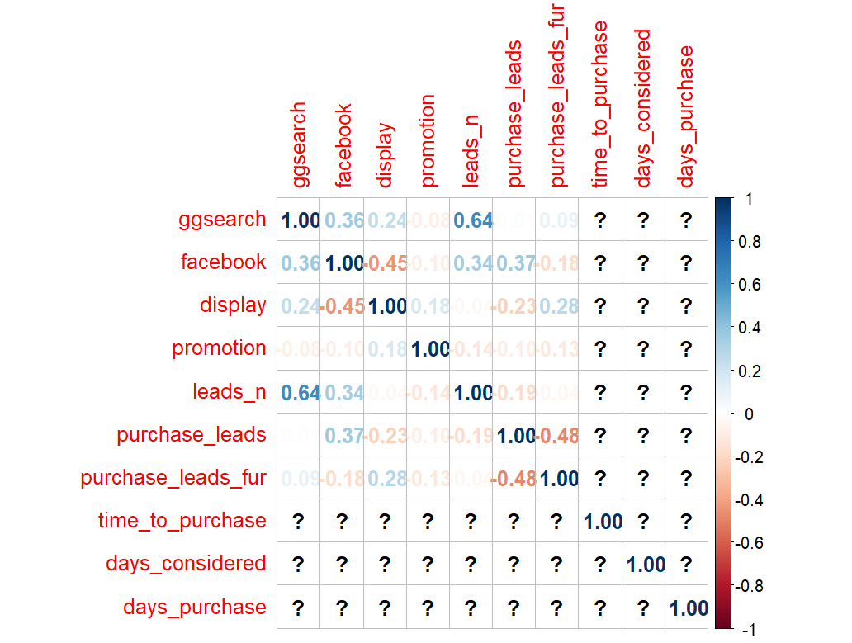
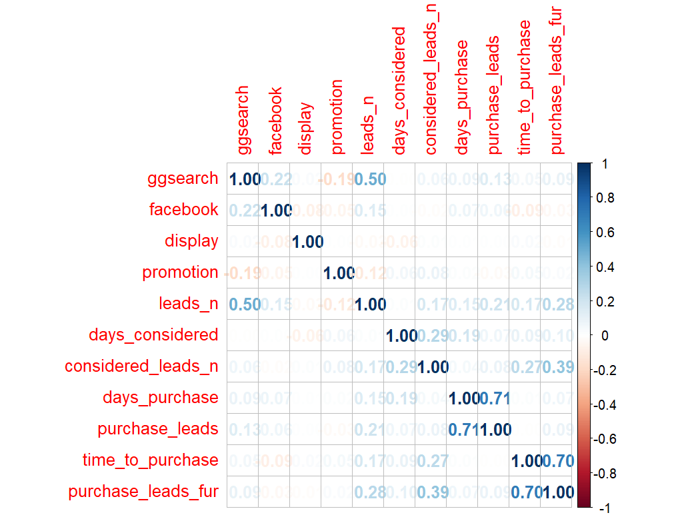
CORPLOT We can see that monthly data presents a better relationship.
CONCLUSIONS:
We observe that ggsearch shows the strongest relationship; however, it’s important to note that this is a one-to-one relationship. In a multiple regression model, this may change.
Additionally, we must consider that ggsearch is the most expensive media channel.

Slide 5
MODEL SECTION

Slide 6
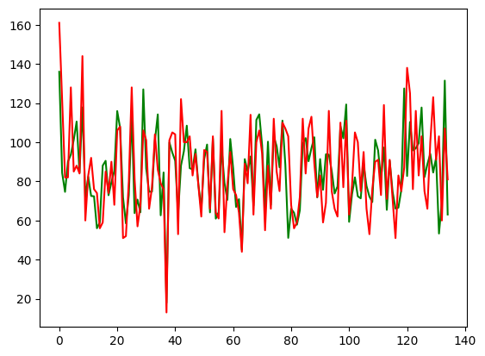
THE MODEL SHOWS AN R² OF 62%. We can see that the model's performance is strong, as it follows the trend closely.

Slide 7
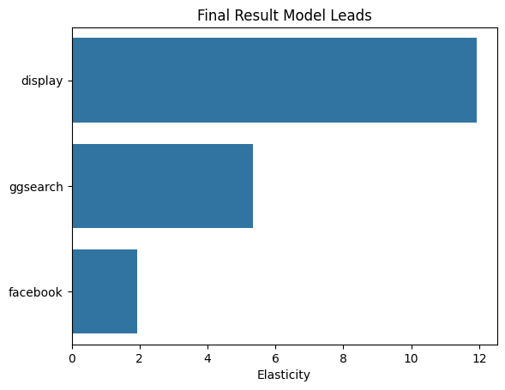
ELASTICITY
Display: A 10% increase in display spending is associated with a 12% increase in the number of leads.
GGsearch: A 10% increase in ggsearch spending results in a 5% increase in the number of leads.
Facebook: A 10% increase in Facebook spending leads to a 2% increase in the number of leads.

Slide 8
CONCLUSIONS
In the analysis, we observed that ggsearch initially showed a stronger one-to-one relationship with the number of leads. However, when working with weekly data and using a multiple regression model, display emerged as more relevant.
Additionally, when comparing market share, display proved to be the most cost-effective, while ggsearch was the most expensive.
BASED ON THIS ANALYSIS, I WOULD RECOMMEND PRIORITIZING SPENDING ON DISPLAY, FOLLOWED BY GGSEARCH, AND FINALLY FACEBOOK.

