Slide 1

LISP
By Johnny Masopust

Slide 2
What is LISP?
LISP (short for "LISt Processing") is one of the oldest programming languages still in use today. It was first developed in the late 1950s by John McCarthy, who was a computer scientist at the Massachusetts Institute of Technology (MIT). LISP is a high-level programming language, which means it is designed to be easy for humans to read and write. It is known for its ability to manipulate and process lists of data, which is where its name comes from.
LISP is a family of programming languages that are known for their use of lists as a central data structure, as well as their ability to treat code as data and vice versa. LISP is a dynamically typed, interpreted language, which means that it does not require the programmer to specify the type of each variable and that it runs directly from the source code without the need for compilation. LISP is often used for tasks such as artificial intelligence, natural language processing, and symbolic computing, and it has been influential in the development of many other programming languages.

Slide 3
Benefits of LISP
While there are several reasons why the Lisp programming language is still popular after all these years, perhaps the most important is that it's considered to be a relatively simple language to learn. This is probably why it's still popular in academia. Other benefits include the following:
access to powerful and easy-to-integrate macros
the language itself is programmable to meet nearly any need
operates on most platforms
many find programming in Lisp to be faster with smaller code footprints.

Slide 4
Unique Features of LISP
Flexible data types: LISP has a very flexible type system, which allows for the creation of complex data structures such as lists, trees, and graphs. This makes it easy to represent and manipulate data in a LISP program.
Code as data: In LISP, code and data have the same representation, which means that LISP programs can manipulate and modify themselves at runtime. This allows for powerful metaprogramming capabilities, where a LISP program can write and execute other LISP code.
Homoiconicity: LISP programs have a simple, regular structure, which means that they can be easily parsed and understood by both humans and machines. This property, known as homoiconicity, makes it easy to write and maintain LISP programs.

Slide 5
Unique Features of LISP (cont.)
Symbolic expressions: LISP uses symbolic expressions (or "s-expressions") as its primary means of representing code and data. S-expressions are a simple and intuitive notation that makes it easy to write and understand LISP programs.
Garbage collection: LISP implementations typically include automatic garbage collection, which means that LISP programs do not have to worry about memory management. This makes LISP programs more reliable and easier to write.

Slide 6
Who uses LISP?
Outside of Academia LISP is used by:
symbolic AI programmers
quantum computing professionals
embedded systems programmers
those seeking a quick scripting language
small or understaffed programming teams
Commercial applications of Common Lisp include Grammarly, which uses AI to analyze text and suggest improvements, and Boeing, which uses a server written in the Lisp variant. Lisp Clojure or ClojureScript users include Amazon, Capital One and Walmart.

Slide 7
Building Blocks of LISP
Atom: number or string of contiguous characters
Ex. Bill 123
List: Is a sequence of atoms and/or other lists enclosed within parentheses
Ex. (This is Bill) (12)
String: It is a group of characters enclosed in double quotation marks
Ex. “This is Bill”

Slide 8
Expression Evaluation in LISP
The left most element in the list is called the operator and the others are called the operands.
Use of prefix notation (operator then operands) that removes ambiguity as the operator is always the leftmost element
(+ 137 349)
486
(- 1000 334)
666
(* 5 99)
495
(/ 10 5)

Slide 9
Defining Variables in LISP
Uses “define” keyword
(define pi 3.14159) (define radius 10) (* pi (* radius radius)) 314.159

Slide 10
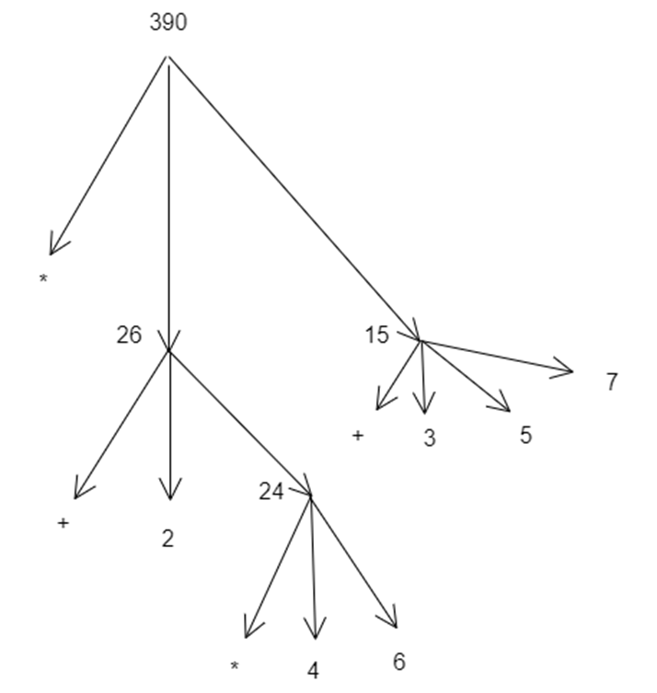
Evaluating Combinations
Each combination is represented by a node with branches corresponding to the operator and operands.
(* (+ 2 (* 4 6))
(+ 3 5 7)

Slide 11
The substitution model for procedure application 2 types of Orders to Evaluate any Procedure in LISP The interpreter first evaluates the operator and operands and then applies the resulting procedure to the resulting arguments. The default order is more efficient because the operands are not called twice.
Default Order
(sum-of-squares (+ 5 1) (* 5 2))
((+ )square 6) (* 10 10))
(+ (* 6 6) (* 10 10))
(+ 36 100)
136
Applicative Order
(sum-of-squares (+ 5 1) (* 5 2))
(+ (square (+ 5 1)) (square (* 5 2)) )
(+ (*(+ 5 1) (+ 5 1)) (*(* 5 2) (* 5 2)) )
(+ (* 6 6) (* 10 10))
(+ 36 100)
136

Slide 12

Linear Recursion
Factorial Example
(define (factorial n)
(if (= n 1)
1
(* n (factorial (- n 1)))

Slide 13
Iteration
Factorial Example
(define (factorial n)
(fact-iter 1 1 n)
(define (fact-iter product counter max- count)
(if (> counter max-count)
Product
(fact-iter (* counter product)
(+ counter 1) //implement counter
Max-count)) // max-count stays the same
(factorial 6)
(fact-iter 1 1 6)
(fact-iter 1 2 6)
(fact-iter 2 3 6)
(fact-iter 6 4 6)
(fact-iter 24 5 6)
(fact-iter 120 6 6)
(fact-iter 720 7 6)
720

Slide 14
LISP Dialects
Common LISP: Common LISP is a standardized, general-purpose dialect of LISP that is widely used for a variety of tasks, including artificial intelligence, natural language processing, and symbolic computing. It is known for its powerful features and capabilities, as well as its large and active user community.
Scheme: Scheme is a dialect of LISP that is known for its simplicity and elegance. It is often used in introductory computer science courses, and it is the basis for many popular programming languages, such as Racket and Clojure.
Emacs LISP: Emacs LISP is a dialect of LISP that is used in the Emacs text editor. It is a simple and lightweight dialect that is well-suited for writing extensions and customizations for Emacs.
Overall, the most popular dialect of LISP is likely Common LISP, due to its widespread use and large user community.

