Slide 1
Do tradable intraday patterns exist in corn futures?
A cost-aware research pipeline for CBOT corn (ZC) on Databento CME data
Group 14 · Jean Mauratille, Alex Gatti Roaf, Hanwen Xu, Dipesh Ghimire · FINM 37000
Notes:
We built an end-to-end pipeline to test whether a simple intraday rule can make money in corn, using real CME trade data from Databento - and we got a clear, honest answer. (~15s)

Slide 2
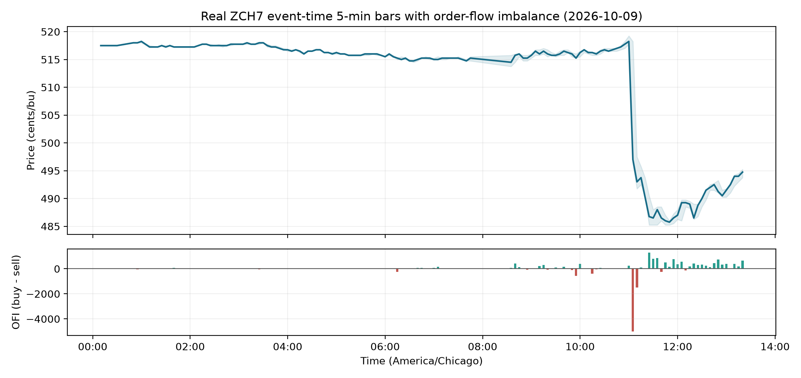
The question & the data
• Goal: test for an exploitable intraday pattern in March-2027 corn (ZCH7)
• Data: trade-level ZCH7 from Databento (CME Globex, GLBX.MDP3), ~6 months
  – Trade-level detail includes the aggressor side -> order-flow imbalance
• Approach: build the tools ourselves, tested, then let the data decide
Notes:
Frame it as a real research question, not just building a thing. Real ZCH7, Oct 9 2026: note the sharp midday price drop and how the order-flow imbalance panel spikes strongly negative at exactly that move - aggressive selling, captured by our bars. (~35s)

Slide 3
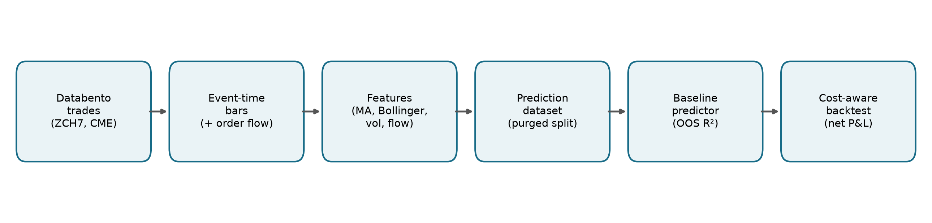
Tested pipeline
• Event-time 5-min bars, labeled at bar end; OHLCV + order flow aligned
• Features: moving averages, Bollinger bands, returns, realized vol, order flow
• Every stage is a tested module - full suite runs on synthetic data, no API key
Notes:
This is the 'what it achieved' slide. Stress reusability and that every stage validates its inputs. (~45s)

Slide 4
Doing it honestly: no look-ahead, real costs
• No look-ahead: features use only data through the bar close
  – Targets are purged from training so labels cannot leak into the test period
• Realistic execution: signals fill at the NEXT bar's open (one-bar delay)
  – Slippage (quarter-cent = $12.50/tick) and per-contract fees are charged
• Correct contract spec: 5,000 bu, cents/bushel -> P&L in real dollars
• Sanity check: on a random walk, our predictor correctly shows NO edge
Notes:
This is the rigor slide. The random-walk check proves the evaluation isn't fooling itself - it only finds an edge when one exists. (~50s)

Slide 5
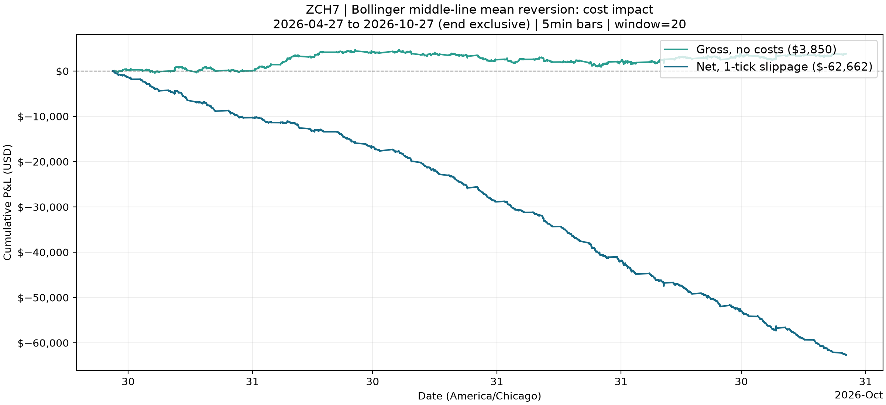
Headline result: costs sink the edge
6 months of ZCH7: gross P&L w/no costs: +$3,850, one tick of slippage per fill turns it into -$62,662 net
Notes:
The two lines are the whole story. Without costs the rule barely breaks even - no real edge. Add one realistic tick of slippage per fill and it bleeds to minus $62.7k. So the loss is a cost result, not a direction result. (~45s)

Slide 6
Robustness: the loss holds in- and out-of-sample
Period | Gross | Slippage cost | Net | Contracts
Development | +$2,075 | $46,762.50 | -$44,687.50 | 3,741
Held-out | +$1,775 | $19,750.00 | -$17,975.00 | 1,580
Full period | +$3,850 | $66,512.50 | -$62,662.50 | 5,321
• Gross P&L is roughly flat in BOTH the development and the held-out period - no edge in either.
• Slippage alone drives the loss; the result is not an artifact of one sample.
• Development + held-out = full on every column, so the split is a clean chronological partition.

Slide 7
Why it loses: the discovery
• The loss is a COST result, not a forecasting result
  – Gross P&L ≈ +$3,850 over 6 months — the raw rule has essentially no edge
  – The predictor agrees: out-of-sample R² = −0.018, hit rate 0.51 (no signal)
• The rule reverses constantly; at a 5-min horizon corn behaves like a random walk
• Each reversal pays the ¼¢ tick ($12.50) — nothing to cover it
• Takeaway: liquid intraday corn looks efficient at this horizon
Notes:
This is the insight the rubric asks for. Two independent pieces of evidence that there's no edge: the gross backtest is basically flat, and the predictor's out-of-sample R-squared is negative - it does not beat a zero forecast. So the loss is purely trading cost. (~45s)

Slide 8
Challenges, limits & next steps
• Challenges: bar-timestamp alignment (start vs end), avoiding look-ahead,
  – matching dollar units to the contract spec, and a multi-person Git workflow
• USDA overlay: actuals & release times are obtainable, but pre-report
  – expectations have no free source -> documented as feasibility, deferred
• Next: entry-at-band / exit-at-middle variants, longer horizons,
  – order-flow features; source an expectations series to finish the USDA study
Notes:
Close on maturity: we know the limits and have a concrete roadmap. Then: happy to take questions. Q&A prep - Would lower costs help? loss scales with turnover x slippage. Look-ahead free? yes, purged split + next-open fills, tested. Why trust -$62k? real ZCH7, standard ZC tick economics, predictor shows no edge on a random walk. (~40s)

