Slide 1
Sound event detection model
Sudhishna · A model that learns when each species calls
Notes:
About 10 seconds. Hi, I'm Sudhishna. My part was the sound event detection model, or SED model. I re-implemented it from the first-place write-up of this competition, trained it on Kaggle, and tested which of its design choices actually matter on the leaderboard.

Slide 2
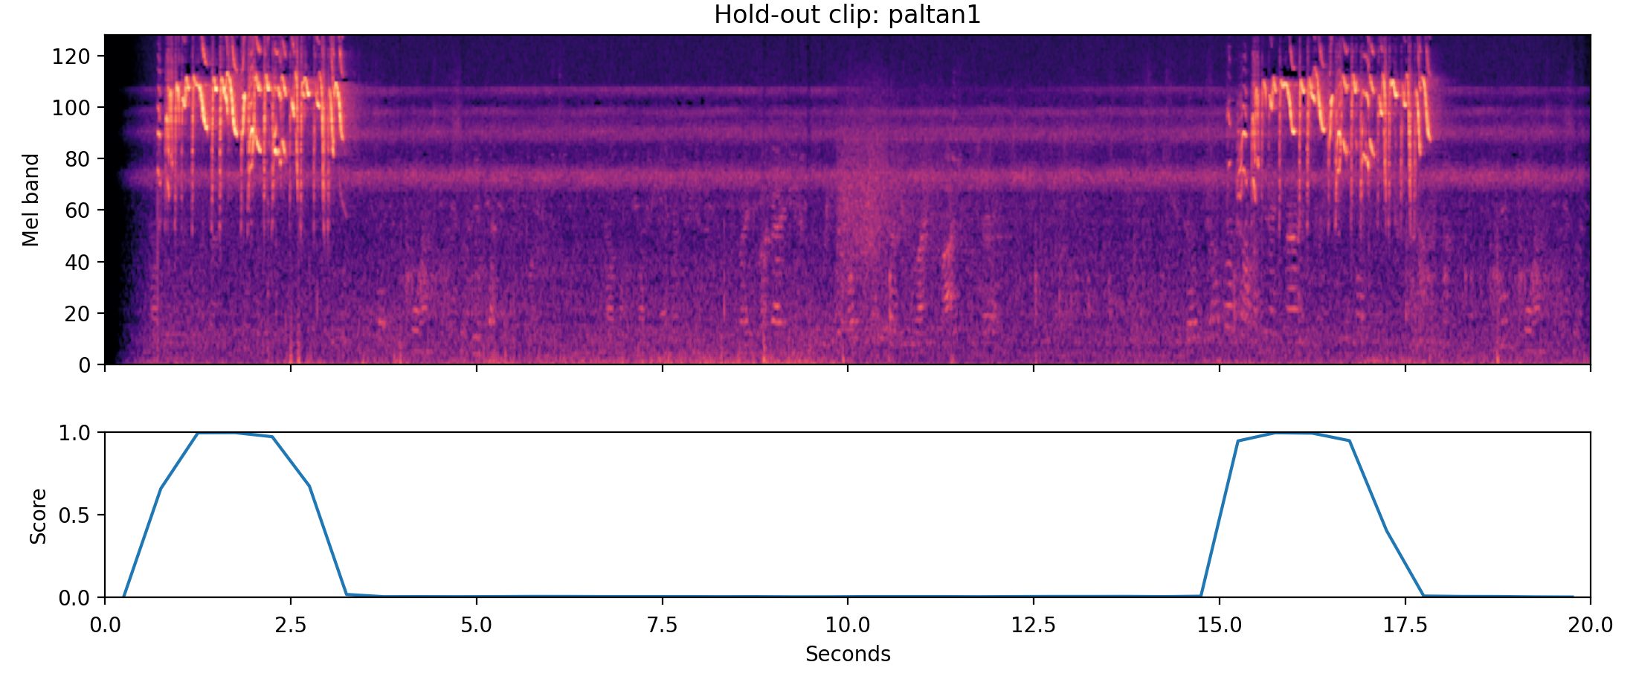
SED learns when a species calls from clip labels
The problem
One label covers a whole clip, but the call may last only a few seconds.
The SED idea
Score every 0.5 s, then pool the scores into one per clip for the loss.
A hold-out clip of paltan1. Top: its spectrogram. Bottom: the model's score for paltan1 every 0.5 s.
Notes:
About 35 seconds. Remember the weak-label problem: one label covers a whole recording, often about 20 seconds long, but the animal may call for only a few seconds of it. A sound event detection model deals with this directly. Instead of one score per input, it predicts a score for every species every half second, and then pools those scores into one score per clip, which is what the loss is trained on. So it can learn when a species calls without any timestamps. Here is a hold-out clip of one species, paltan1. The model was only ever given clip-level labels, but its score rises exactly where the calls are, and drops to zero in between.

Slide 3
How the SED model works
Log-mel chunk
20 s × 128 mel bands
EfficientNet-B0
as in v2, then GeM over frequency
Frame layer
1×1 conv: features every 0.5 s
Species scores
206 species × 40 steps
Chunk score
attention-weighted
Peak score
highest step
Training loss = 0.5 · BCE(chunk score) + 0.5 · BCE(peak score). At test time, each 5 s window takes its highest step score.
Same backbone as v2
Only the head and the chunk length change, so the comparison is fair.
No timestamps needed
The loss uses only the pooled scores, so clip labels are enough.
Built from write-ups
1st place 2025 (Babych) and 4th place 2021 (tattaka). All code is our own.
Notes:
About 40 seconds. Here is the model. It takes a 20-second spectrogram chunk and runs it through the same EfficientNet-B0 as v2, but without the final pooling, so the time axis survives. GeM pooling then collapses the frequency axis, and a small frame layer gives features for every half-second step. One head scores every species at every step. The chunk score is an attention-weighted sum of the steps, and the peak score is the highest step. We train on both with binary cross-entropy. Because the backbone is the same as v2, any difference in score comes from the head and the chunk length. I worked only from the written descriptions in the 2025 first-place write-up and the 2021 fourth-place write-up its head comes from. All of the code is our own.

Slide 4
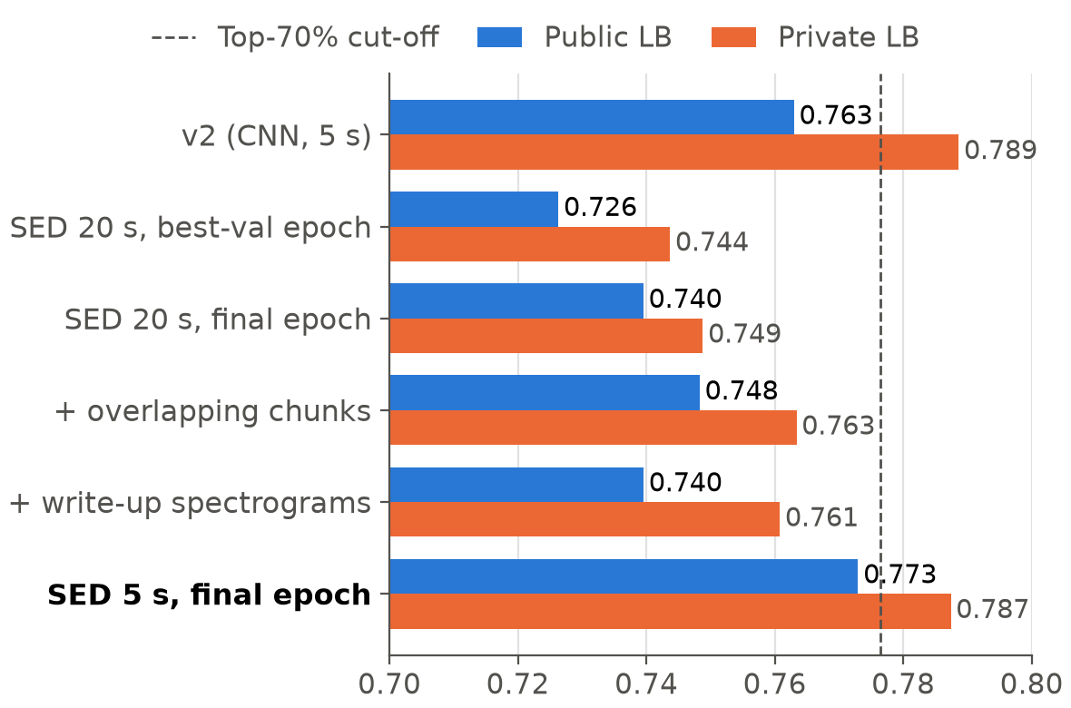
On 5 s chunks, SED draws level with v2
0.773
public (+0.010 vs v2)
0.787
private (−0.001 vs v2)
Level with v2, in about 16 CPU minutes (the 20 s model needs 34).
Notes:
About 35 seconds. This chart shows the SED leaderboard runs against v2. On 20-second chunks, the best version reached 0.748 public, still below v2. Then I trained exactly the same model on 5-second chunks. That scored 0.773 public and 0.787 private: 0.010 above v2 on public, which is our best public score so far, and 0.001 below on private. With our rule that differences under 0.01 are a tie, it is level with v2 rather than better. It is also quick: about 16 minutes on CPU for the whole test set, against 34 for the 20-second model.

Slide 5
Three lessons from seven leaderboard runs
1
Chunk length matters most +0.033 public
5 s chunks beat 20 s. The write-up found the opposite (5 s: 0.842, 20 s: 0.872).
Why 20 s chunks hurt (our guess)
47.9%
of training clips are shorter than 20 s, so their chunks are mostly silent padding.
A 5 s chunk is almost always full of sound, like a test window.
Not tested yet.
2
Keep the final epoch +0.013 public
Picking the epoch by validation score chose a worse model.
3
Overlap helps a little +0.009 public
Small but positive every time. The write-up's spectrograms did not help.
Notes:
About 45 seconds. Three lessons. First, chunk length mattered most: going from 20-second to 5-second chunks added 0.033 public and 0.039 private. The write-up found the opposite, 0.842 with 5-second chunks and 0.872 with 20. Our best guess is padding: almost half of our training clips are shorter than 20 seconds, so many 20-second chunks were mostly silence, while a 5-second chunk is almost always full of sound, like the test windows. We have not tested that yet. Second, keeping the final epoch beat keeping the epoch with the best validation score, by 0.013 public. That is the same lesson Jamie found: our clean validation clips are a poor guide. Third, overlapping chunks at test time helped a little but every time, while the write-up's spectrogram settings did not help our model.

Slide 6
Hand-off: 5 s SED is level with v2
0.773 public, 0.787 private · about 16 CPU minutes
A different kind of model from v2, so a good candidate for the ensemble.
Notes:
About 15 seconds. To sum up: the 5-second SED model is level with v2 and runs in about 16 minutes. Because it is a different kind of model from v2, it is a good candidate for the ensemble.

