Slide 1
Improving the baseline
Member 1 · Four targeted changes, ten ablation runs, one stronger baseline (v2)
Notes:
Hi, I'm Member 1. My part of the project was to take our first baseline and make it stronger in a controlled way. I tested four changes, one at a time and then together, ran ten training runs on Kaggle, and submitted every one of them to the leaderboard. The result is baseline v2, which the rest of the team builds on. I'll show what I changed, what each change was worth, and what we learned about how to evaluate models in this competition.

Slide 2
The baseline looked great locally but not on Kaggle
0.973
local validation AUC
(clean training clips)
Our data analysis found four reasons:
Weak labels
One label per clip, but the call may not be in the first 5 s
Domain shift
Clean focal recordings vs. noisy rainforest soundscapes
0.717
public leaderboard AUC
(noisy soundscapes)
Label noise
Background species are mostly unlabelled
Class imbalance
30 species have 5 clips or fewer
Notes:
Our baseline was EfficientNet-B0 on the first five seconds of each clip, with no augmentation. On our own validation split it scored 0.973, which looks excellent, but on the Kaggle leaderboard it only scored 0.717. The data analysis explained why. First, weak labels: each recording has one label, but the animal might not call in the first five seconds. Second, domain shift: training clips are clean and close, the test soundscapes are noisy. Third, label noise: background species are usually not labelled. And fourth, class imbalance: thirty species have five clips or fewer. So I picked one change for each of these problems.

Slide 3
One change for each problem, tested one at a time
Random crop → Weak labels
Any 5 s window of the whole clip, not just the first
How I tested them
Whole-clip spectrograms computed once, so any 5 s window can be cut out.
Same model, split and 15 epochs every run; only the switch changes.
Two designs: baseline + one change, and v2 − one change.
All 10 runs submitted to Kaggle.
1
Noise + mixup → Domain shift
Add real soundscape noise; blend two clips
2
Secondary labels → Label noise
Background species get a soft target of 0.5
3
Focal loss → Imbalance
Focus training on hard examples
4
Notes:
Here are the four changes. Random crop takes any five-second window of the clip instead of always the first. Noise and mixup add real background noise from unlabelled soundscapes and blend two clips together, so training looks more like the test data. Secondary labels give background species a soft target of 0.5 instead of zero. And focal loss makes training focus on the hard examples. To make random crops possible, I first built a new pipeline that stores spectrograms of the whole clip, so any window can be cut out quickly. I checked that it gives the same result as the old baseline. Then every run used exactly the same model, data split and fifteen epochs, so the only difference is the switch. I did two kinds of ablation: adding one change to the baseline, and removing one change from the best combination.

Slide 4
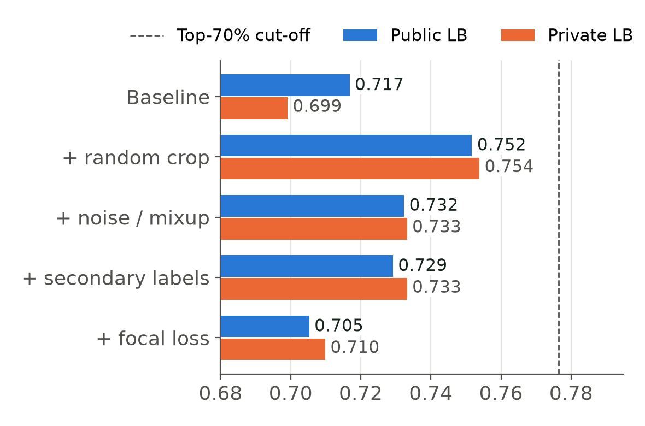
Random crop gives the biggest single gain
+0.035 public
Random crop: the label often isn't in the first 5 s
+0.016 / +0.012
Noise/mixup and secondary labels: smaller but real
−0.012 public
Focal loss: no clear effect
Notes:
This chart shows each change added to the baseline on its own. Blue is the public leaderboard, orange is the private leaderboard. Random crop gives the biggest jump, plus 0.035 on public and 0.055 on private. That confirms the weak-label problem: the first five seconds often don't contain the call. Noise with mixup, and secondary labels, give smaller but real gains, around 0.012 to 0.016. Interestingly, these two help more on the leaderboard than on our local validation, because they target the noisy test data, which our clean validation clips don't represent. Focal loss, on the other hand, didn't help: the public score went down and the private score went up slightly, so it has no clear effect.

Slide 5
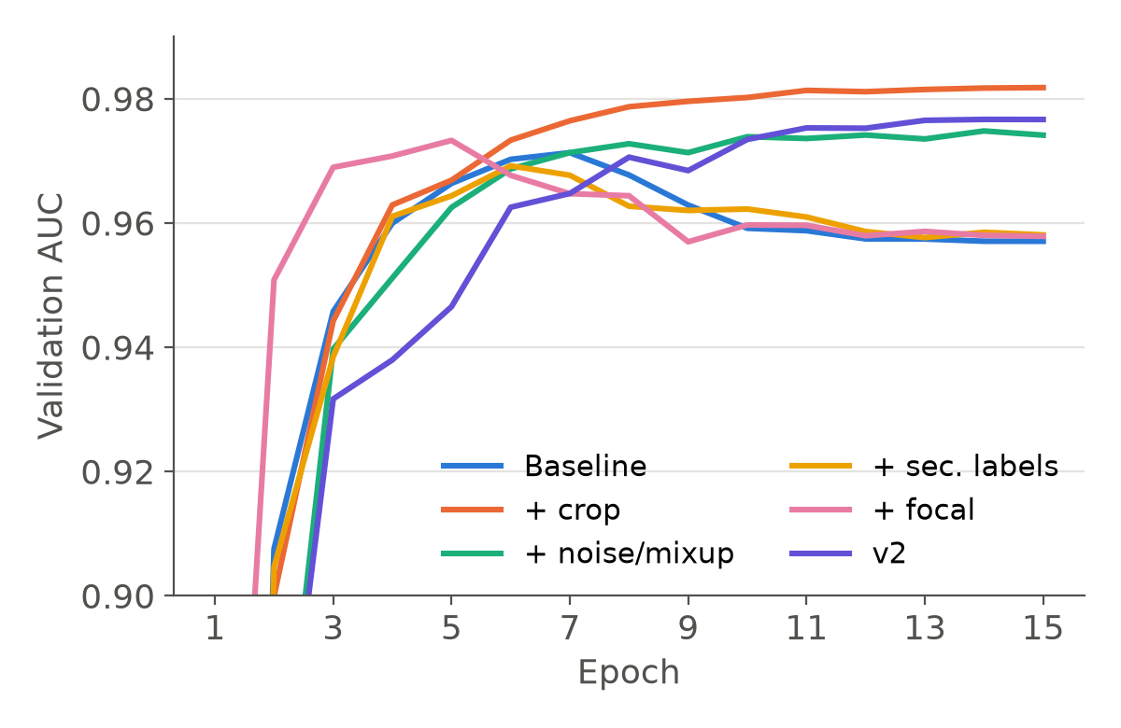
Crop and noise also stop the overfitting
Overfit after epoch ~7
Baseline, secondary labels, focal loss
Still improving at 15
Crop, noise/mixup and v2: a new window or noise every epoch
Notes:
This is validation AUC over the fifteen epochs. The baseline, secondary labels and focal loss all peak around epoch five to seven and then drop, which is overfitting: the model memorises the same five seconds every time. Random crop, noise and v2 keep rising until the end, because the model sees a different window or different noise each epoch, so they act as data augmentation. This also tells us v2 would probably gain a bit more from training longer.

Slide 6
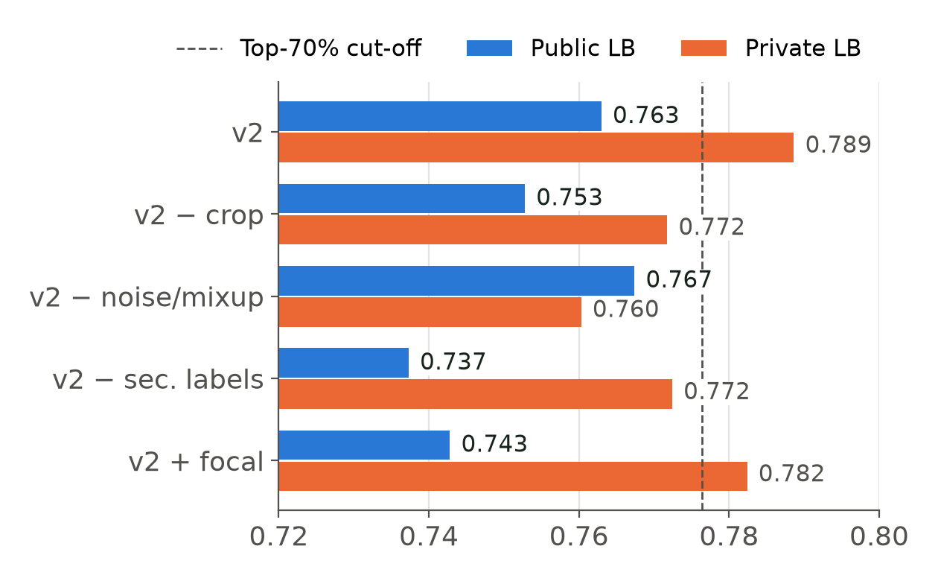
v2 combines three changes; each one matters
0.763
v2 public (+0.046)
0.789
v2 private (+0.090)
v2 = random crop
+ noise/mixup
+ secondary labels
Notes:
I then combined the three changes that helped into baseline v2. It scores 0.763 public and 0.789 private, which is plus 0.046 and plus 0.090 over the original baseline, and the best of all ten runs. To check that every part is needed, I removed one change at a time. Removing secondary labels hurts the most, minus 0.026 public, which is more than they gave on their own. My explanation is that random crops often land on background species, and secondary labels give those windows the right targets, so the two work together. Removing crop costs 0.010. Removing noise slightly raises the public score but drops private by 0.028, so I kept it. And adding focal loss to v2 again made things worse.

Slide 7
Two lessons about evaluation
1 · Local validation misleads
v2 − noise has the highest local AUC of the v2 runs (0.981) but the lowest private score (0.760).
Secondary labels lower local AUC but raise the leaderboard.
Our validation clips are clean, so they cannot measure robustness to noise.
2 · Public LB is noisy
The public score uses only part of the test set.
v2 − noise: +0.004 public but −0.028 private.
We treat public differences under ~0.01 as a tie and always report both scores.
Notes:
Two lessons came out of this that matter for the whole team. First, local validation is misleading. The run without noise had the highest local score of the v2 runs but the lowest private score, and secondary labels lowered our local score while improving the leaderboard. Our validation clips are clean, so they can't tell us how well a model handles noisy soundscapes. Second, the public leaderboard is itself noisy, because it only uses part of the test set. A difference of 0.004 on public turned into minus 0.028 on private. So we treat public differences below about 0.01 as a tie and always report both scores.

Slide 8
Hand-off: v2 is the new baseline
0.717 → 0.763 public, 0.699 → 0.789 private
Next: longer training, sound-event detection, pseudo-labels and ensembling (Members 2–4)
Notes:
To sum up: with three simple, targeted changes, we went from 0.717 to 0.763 on the public leaderboard and from 0.699 to 0.789 on private. v2 is now the baseline that the rest of the team builds on. It is still just below the top-70 percent cut-off, so the next steps are training it longer, since it was still improving, and the sound-event detection model, pseudo-labelling of the unlabelled soundscapes and ensembling, which my teammates will present.

