Slide 1
Data findings and baseline
Member 1 · What the data looks like, our first model, and where it stands
Notes:
About 5 seconds. Hi, I'm Member 1. I'll cover what we learned from the data, the baseline model we built, and how it scored.

Slide 2
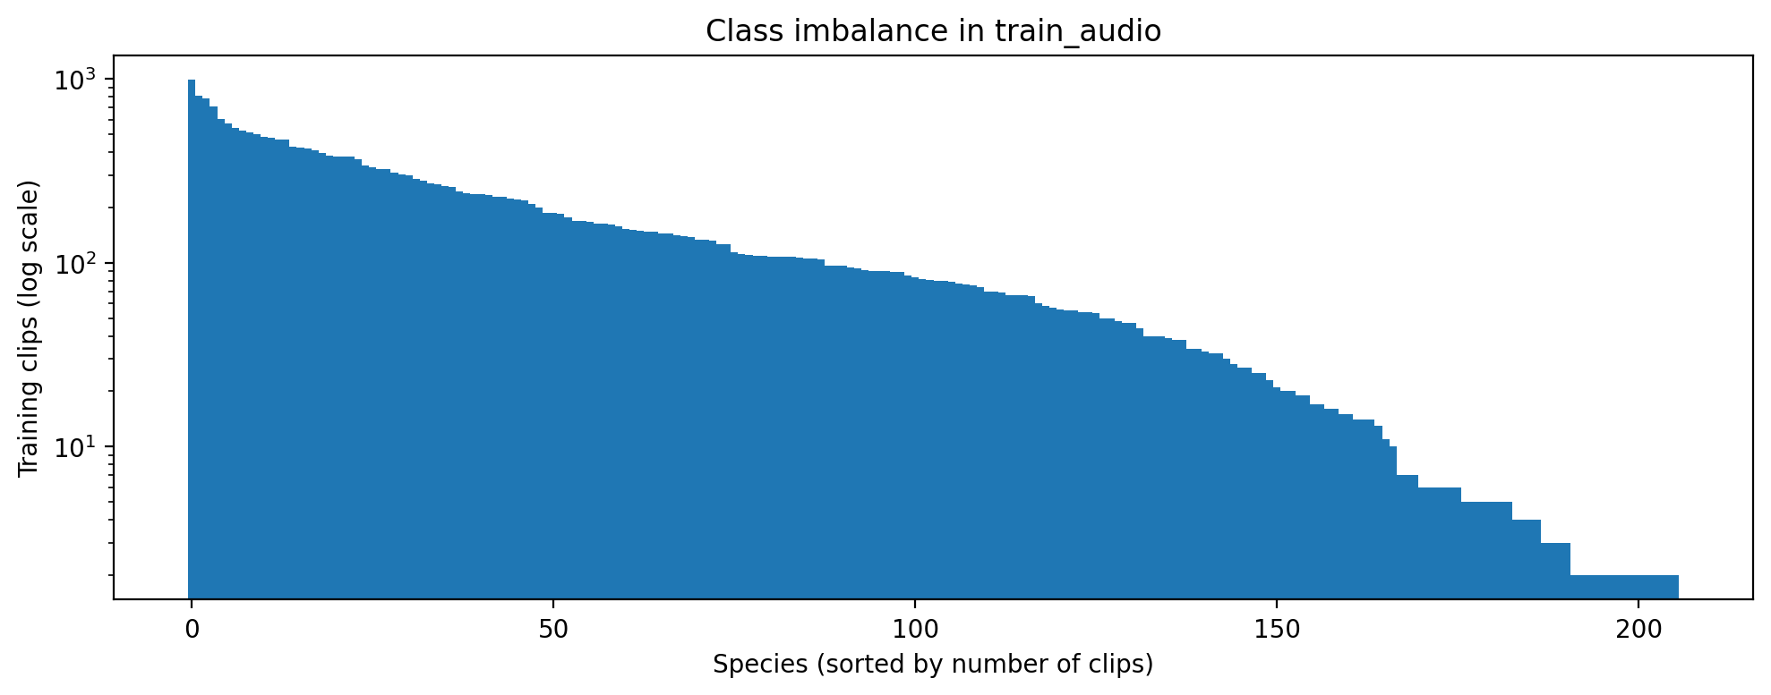
A few species have most of the data
28,564
training clips
206
species to predict
30
Clips per species, sorted. Most common: 990 clips. Median: 80.
species with 5 clips or fewer
Notes:
About 35 seconds. The training set has 28,564 short recordings of 206 species: mostly birds, plus amphibians, insects and mammals. The data is very uneven. The most common species has 990 clips, the median is 80, and 30 species have five clips or fewer. That matters because the score is macro ROC-AUC, so a rare species counts as much as a common one.

Slide 3
Four problems the data showed us
1
Class imbalance
2
Weak labels
30 species have 5 clips or fewer, but the score counts every species equally.
One label covers a whole ~20 s recording, but we must predict every 5 s.
3
Domain shift
4
Missing labels
Training clips are clean and focused. Test audio is noisy 1-minute soundscapes.
Background species are rarely labelled: only 9.3% of clips list any.
Plus a hard limit: inference must run on CPU, offline, in under 90 minutes.
Notes:
About 40 seconds. Exploring the data showed four problems. One, class imbalance, as we just saw. Two, weak labels: one label covers a whole recording of about 20 seconds, but we must predict every 5-second window, and the bird may only call for part of it. Three, domain shift: training clips are clean, focused recordings, but the test set is noisy one-minute soundscapes. Four, missing labels: other species calling in the background are rarely labelled. On top of that, the submission must run on CPU, offline, in under 90 minutes. These four problems shaped everything we tried next.

Slide 4
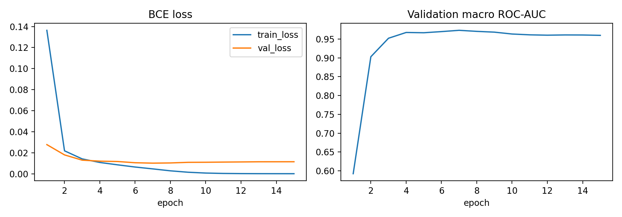
Baseline: treat sound as an image
First 5 s
of each clip
Log-mel image
128 frequency bands
EfficientNet-B0
pretrained on ImageNet
206 scores
one per species
How we trained it
Primary label only, BCE loss
AdamW + one-cycle, 15 epochs
No augmentation
80/20 stratified hold-out
Best validation AUC 0.973 at epoch 7, then it starts to overfit.
Notes:
About 35 seconds. Our baseline treats sound as an image. We take the first 5 seconds of each clip, turn it into a log-mel spectrogram, which shows frequency over time, and feed it to EfficientNet-B0 pretrained on ImageNet. It outputs one probability for each of the 206 species. We kept it simple on purpose: primary label only, BCE loss, no augmentation, 15 epochs. Validation AUC peaked at 0.973 at epoch 7, then the model started to overfit.

Slide 5
Result: rank about 1600 of 2032
0.973
local validation AUC
0.717
public leaderboard (top 79%)
Validation clips look like training clips, so the local score is too optimistic. The leaderboard is the real test.
Notes:
About 35 seconds. On the leaderboard the baseline scored 0.717 public, 0.699 private, around rank 1600 of 2032, or the top 79 percent. That is far below our local 0.973, because our validation clips come from the same clean recordings as training, while the test set is noisy soundscapes. So local validation overstates performance and we judge models on the leaderboard. To reach the next grading band we need 0.776, and the rest of our work targets the four problems I just described.

