Slide 1
From a Spectrogram CNN to Pseudo-Labelled Ensembles
GROUP 48
SC4000 · COLLEGE OF COMPUTING AND DATA SCIENCE, NTU
Closing the focal-to-soundscape gap in BirdCLEF+ 2025
Arshiya Jawahar Ali Sirajudeen
C230198@e.ntu.edu.sg
Dhanapalan Swaminathan Sudhishna Janavi
SUDHISHN001@e.ntu.edu.sg
Jamie Gonzales Esguerra
jamie002@e.ntu.edu.sg
Modi Khushi
KHUSHI008@e.ntu.edu.sg
STAGE 1
Baseline and fixes
EfficientNet-B0, one fix per data difficulty
0.717 → 0.763
STAGE 2
SED head
Per-0.5 s scores, 5 s chunks
0.763 → 0.773
STAGE 3
Pretrained backbones
Bird CNN, Perch 2.0, Bird-MAE
0.763 → 0.848
STAGE 4
Label-free adaptation
Distillation, noisy student, ensemble
0.848 → 0.887
Jamie
Notes:
Jamie, about 0:20
Good morning everyone. We are presenting our SC4000 project on BirdCLEF+ 2025. Our title is From a Spectrogram CNN to Pseudo-Labelled Ensembles. In short, it is about getting a model trained on clean recordings to work on noisy field recordings.
Transition: Let me start with the task.

Slide 2
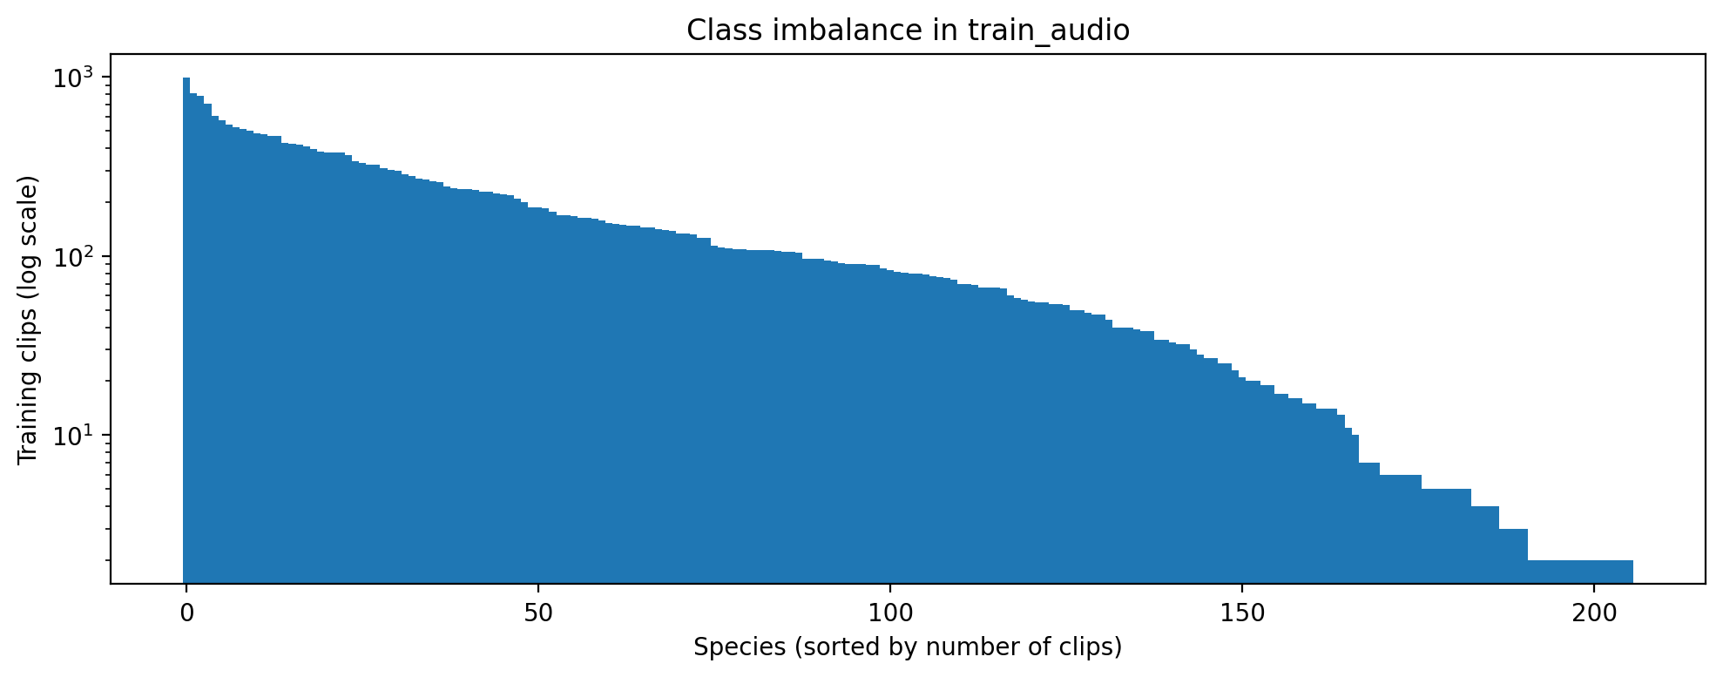
Species in noisy rainforest soundscapes
THE TASK
206
species: birds, amphibians, insects, mammals
5 s
windows scored in 1-minute soundscapes
Macro AUC
every species counts equally
90 min
CPU only, offline, about 700 files
TRAINING DATA
28,564 clean, close-up focal recordings
Each clip has one weak label for the whole recording.
FIG. 1 Training clips per species, sorted by count (log scale). The range runs from 2 to 990 clips.
WHY IT MATTERS
A rare species counts as much as a common one
Macro ROC-AUC averages over all 206 species, so the long tail of species with only a handful of clips cannot be ignored.
TEST DATA
Noisy soundscapes from field recorders
No labelled soundscapes are available, so there is nothing to validate on.
Jamie
Notes:
Jamie, about 0:45
The competition asks for the probability of each of 206 species, including birds, amphibians, insects and mammals, in every five-second window of one-minute rainforest soundscapes from Colombia. The score is macro ROC-AUC, so a rare species counts as much as a common one. The submission has to run on CPU only, offline, within 90 minutes for about 700 files. The key problem is the data. We train on about 28 thousand clean, close-up recordings, but we are tested on noisy soundscapes, and there are no labelled soundscapes to validate on.
Transition: Our data analysis showed four specific difficulties.

Slide 3
Four difficulties found in the data
THE PROBLEM
1
Class imbalance
2
Weak labels
990 vs 2
20.5 s
Clips for the most common versus the rarest species. 30 species have five clips or fewer.
Median clip length, with one label per clip but predictions per 5 s window. A fixed crop may hold no call.
Tried: focal loss
Fix: random crop
3
Domain shift
4
Incomplete labels
Clean → field
9.3%
Focal calls in training, but rain, insects and overlapping calls in the test soundscapes.
Only this share of clips list secondary species, so audible background species are often unlabelled.
Fix: soundscape noise and mixup
Fix: secondary labels as soft targets
Jamie
Notes:
Jamie, about 0:40
First, class imbalance: some species have 990 clips, thirty have five or fewer. Second, weak labels: one label covers a whole clip, so a fixed five-second crop may contain no call at all. Third, domain shift from clean calls to rain, insects and overlapping calls. And fourth, incomplete labels: background species are often not labelled. Each of these motivated one change in our baseline.
Transition: So here is how we built that baseline.

Slide 4
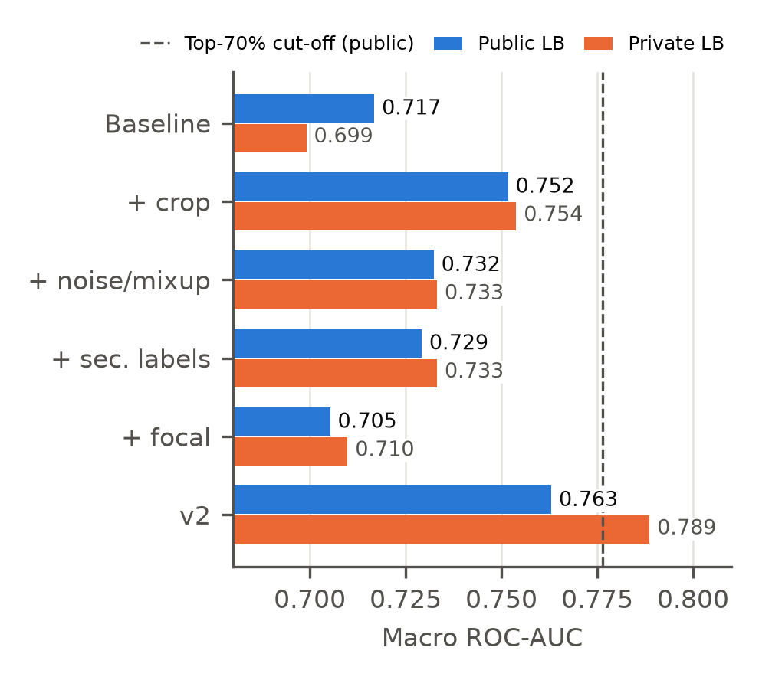
Baseline v2: one targeted fix per difficulty
STAGE 1 · BASELINE
Random crop
Pick a random 5 s window so the model sees the call, not padding. Fixes weak labels.
+0.035
Soundscape noise + mixup
Mix in unlabelled soundscape audio and clips with Beta(0.4, 0.4). Fixes domain shift.
+0.016
Secondary labels
Background species get a soft target of 0.5 instead of 0. Fixes incomplete labels.
+0.012
Focal loss (dropped)
Did not help the imbalance, so it was removed from v2.
−0.012
FIG. 2 Public and private leaderboard AUC as each change is added to EfficientNet-B0. v2 reaches 0.763 public and 0.789 private (+0.046 and +0.090 over the baseline).
Jamie
Notes:
Jamie, about 0:50
We started with an ImageNet EfficientNet-B0 on log-mel spectrograms and changed one thing at a time. Random crops, which address weak labels, gave the largest single gain. Soundscape noise with mixup and secondary labels also helped on the leaderboard. Focal loss, for the imbalance, did not help, so we dropped it. Combining the helpful changes gave baseline v2, with 0.763 public and 0.789 private. Every later model starts from this recipe. I'll hand over to Sudhishna for the sound event detection model.
Transition: Over to Sudhishna.

Slide 5
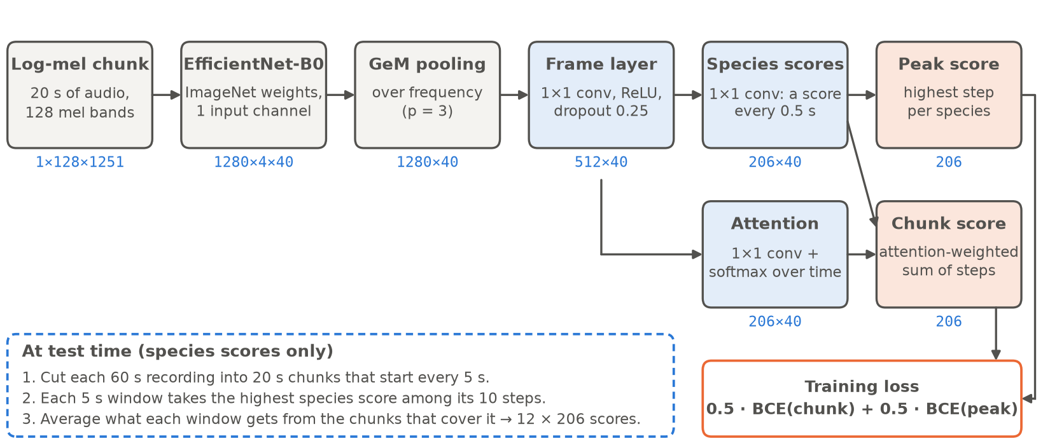
Learning when a species calls
STAGE 2 · SOUND EVENT DETECTION
PROBLEM
The baseline scores a whole window
It cannot say when inside a clip a species calls, and global pooling throws away timing.
IDEA
Score every 0.5 s, pool for training
GeM pooling over frequency only keeps 40 time steps, so clip labels alone teach call timing.
FIG. 3 SED model. A 20 s log-mel chunk passes through EfficientNet-B0 and GeM pooling. A frame layer gives 206 species scores every 0.5 s. Peak and attention-weighted chunk scores feed the loss, 0.5·BCE(chunk) + 0.5·BCE(peak).
SOURCE
1st-place approach
Re-implemented from the written description only [12], with no code.
0.773
public AUC, SED on 5 s chunks
+0.010
public over v2, level on private
+0.033
5 s beat 20 s chunks
Sudhishna
Notes:
Sudhishna, about 0:50
The baseline scores a window as a whole, so it cannot tell when inside a clip a species calls. A sound event detection, or SED, model predicts a score every half second and pools these into one clip score for training. We re-implemented the approach from the first-place write-up, using only its written description. In the diagram, EfficientNet-B0 keeps the time axis, GeM pooling removes the frequency axis, and two small heads give a score and an attention weight for every species every half second. The loss combines the attention-weighted chunk score and the peak score. Our best version scores 0.773 public, level with baseline v2.
Transition: But the setting that mattered most surprised us.

Slide 6
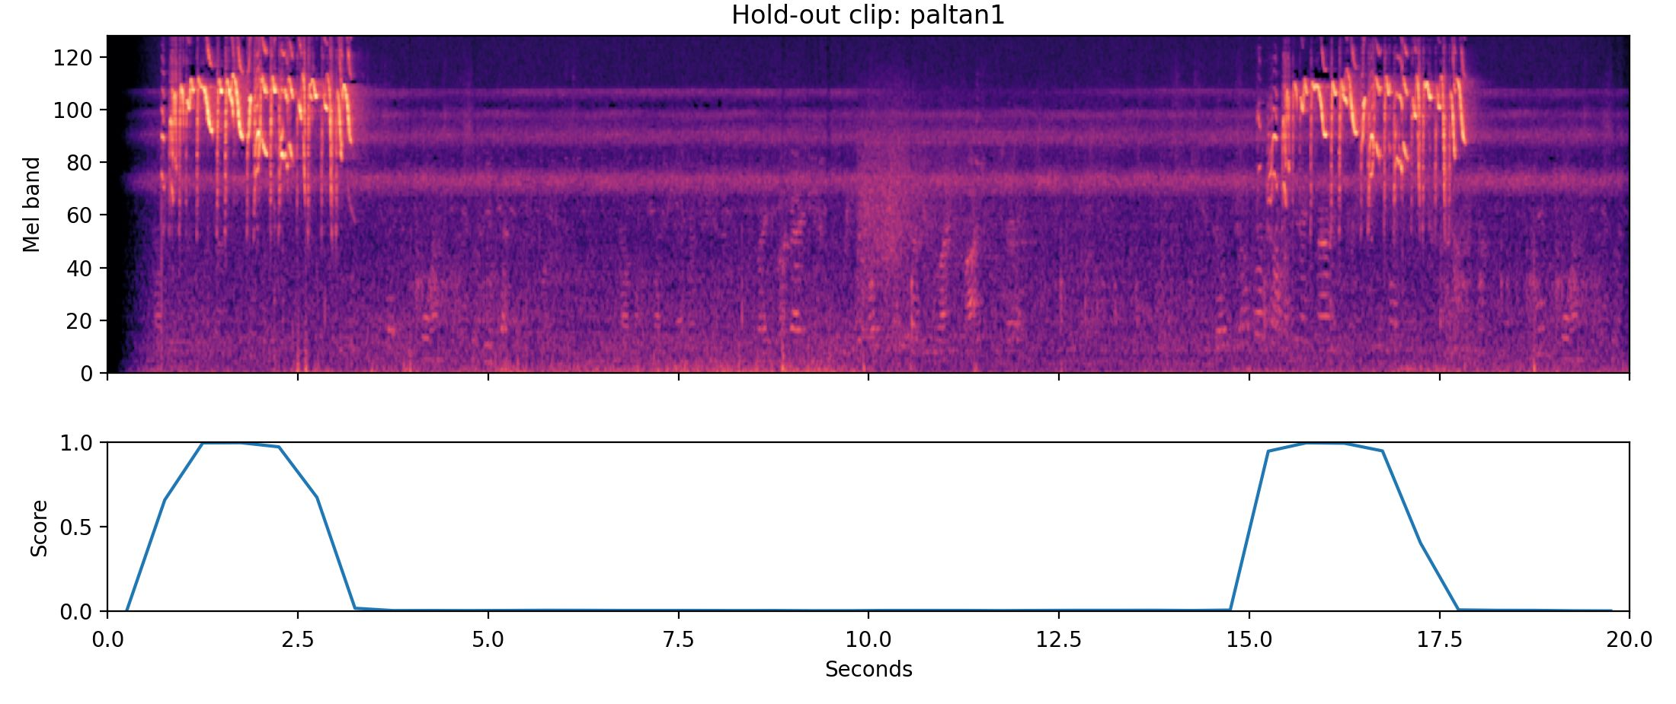
SED results: chunk length was the key setting
STAGE 2 · RESULTS
KEY FINDING
5 s chunks beat 20 s by +0.033
Public AUC draws level with v2. Overlapping chunks helped every time.
LIKELY REASON (UNTESTED)
47.9% of clips are shorter than 20 s
Long training chunks are then mostly padding.
FIG. 4 Hold-out clip "paltan1". Top: log-mel spectrogram. Bottom: per-step score. It rises exactly where the call is audible (0 to 3 s, 15 to 18 s), learned from clip-level labels alone.
VALIDATION WARNING
Best-validation epoch was not best
The final epoch beat it on the leaderboard, so clean validation was a poor guide.
RUN | VAL | PUBLIC | PRIVATE
v2 (CNN, 5 s windows) | 0.977 | 0.763 | 0.789
SED 20 s, best epoch | 0.970 | 0.726 | 0.744
SED 20 s, final epoch | 0.974 | 0.740 | 0.749
SED 20 s, final epoch + overlap | 0.974 | 0.748 | 0.763
SED 5 s, final epoch | 0.980 | 0.773 | 0.787
Sudhishna
Notes:
Sudhishna, about 0:50
The plot shows a hold-out clip: the score rises exactly when the species calls, even though the model was only trained with clip-level labels. Trained on 20-second chunks, as in the first-place solution, our SED model stayed below v2. Overlapping chunks and using the final epoch helped. The biggest effect was the chunk length: the same model on five-second chunks gained 0.033 public and drew level with v2. Our likely, but untested, explanation is that almost half of our clips are shorter than 20 seconds, so long chunks are mostly padding. Arshiya will now cover pretrained models and adaptation.
Transition: Over to Arshiya.

Slide 7
Three pretraining paradigms, one fixed protocol
STAGE 3 · PRETRAINED BACKBONES
MODEL | VAL | PUBLIC | PRIVATE | GAP | CPU MIN
v2: EfficientNet-B0, ImageNet | 0.977 | 0.763 | 0.789 | .214 | 11.1
A1: EfficientNetV2-S, bird-pretrained | 0.983 | 0.828 | 0.816 | .155 | 8.0
A2: Perch 2.0, frozen | 0.992 | 0.848 | 0.852 | .144 | 25.0*
A3: Bird-MAE, frozen | 0.975 | 0.776 | 0.780 | .199 | 61.6*
Gap = validation minus private leaderboard AUC. * projected from a 20-file dry run.
A1 · SUPERVISED
Bird-pretrained CNN
EfficientNetV2-S pretrained on bird audio, then fine-tuned. Same recipe as v2.
A2 · FROZEN ENCODER
Perch 2.0 + small head
Transfers best: +0.085 public over v2, with only a lightweight head trained.
A3 · SELF-SUPERVISED
Bird-MAE, frozen
Barely improves on v2 and is the slowest on CPU, so it stays out of the final system.
Every model still has a 0.14 to 0.21 transfer gap between clean validation and the leaderboard. That gap drives the rest of our work.
Arshiya
Notes:
Arshiya, about 0:40
Next, we kept v2's recipe and split fixed and changed only the pretrained model: A1, a bird-pretrained EfficientNetV2-S; A2, Google's Perch 2.0, frozen, with a small head; and A3, the self-supervised Bird-MAE, also frozen. Perch transferred best, 0.085 public above v2. But every model kept a transfer gap of 0.14 to 0.21 between clean validation and the leaderboard, and closing that gap without labels is the rest of my part.
Transition: So, can we close it without labels?

Slide 8
Closing the gap without labels: what we tried, and why
STAGE 4 · LABEL-FREE ADAPTATION
WHY
Every model loses 0.14 to 0.21 AUC from clean clips to soundscapes, and no soundscape labels exist.
WITH WHAT
9,726 unlabelled train soundscapes from the test set's recorders (1,000 files for AdaBN, CORAL, distillation; all for noisy student).
HOW JUDGED
One submission per variant against its unadapted parent; variants fixed before scores; selection by public score.
STATISTICS-LEVEL: CHANGE HOW FEATURES ARE SCALED
CONTENT-LEVEL: CHANGE WHAT THE MODEL IS TRAINED ON
ADABN · LI 2018
Re-estimate BN statistics
Idea: domain style lives in BN means and variances.
We reset all BN stats and recomputed them on 12,000 soundscape windows.
Applied to: v2, A1 (CNNs).
CORAL · SUN 2016
Align embedding statistics
Idea: match mean and covariance of source to target.
We mapped focal embeddings to soundscape statistics (full CORAL, or mean/std only), then retrained the head.
Applied to: A2, A3 (frozen).
DISTILL · HINTON 2015
Learn from soft labels
Idea: a teacher's probabilities carry more than hard labels.
A teacher labels 12,000 soundscape windows; a student head trains on them plus real labels.
Applied to: A2 → A3, A1 → A2.
NOISY STUDENT · XIE 2020
Self-training with noise
Idea: a noised student trained on pseudo-labels can beat its teacher.
Teacher labels all 116,712 windows; a fresh CNN trains with mixup and drop-path.
Applied to: a new V2-S CNN.
Motivation: Boudiaf et al. (ICML 2023) found that standard source-free adaptation can fail under natural shifts in bioacoustics, so we tested both families under one protocol.
Arshiya
Notes:
Arshiya, about 0:45
So how do we close the gap without labels? We had 9,726 unlabelled soundscapes from the same recorders as the test set. We tested two families. Statistics-level methods change how features are scaled: AdaBN, from Li et al., re-estimates batch-norm statistics on the soundscapes, and CORAL, from Sun et al., matches the mean and covariance of our embeddings to the soundscapes. Content-level methods change what the model is trained on: distillation, from Hinton et al., trains a student on a teacher's soft labels, and noisy student, from Xie et al., trains a fresh, noised model on pseudo-labels. Boudiaf et al. had found that standard adaptation can fail in bioacoustics, so we tested both under one protocol.
Transition: Here is every run, grouped by method.

Slide 9
Every adaptation run, grouped by method
STAGE 4 · RESULTS BY METHOD
MODEL | VARIANT | PUBLIC | Δ PUB | PRIVATE | Δ PRIV | GAP (PUB)
AdaBN: re-estimate BatchNorm statistics (CNNs) |  |  |  |  | HURT 2 / 2
v2 | AdaBN | 0.739 | −0.024 | 0.764 | −0.025 | .214 → .202
A1 | AdaBN | 0.772 | −0.056 | 0.766 | −0.051 | .155 → .199
CORAL / mean-std: align embedding statistics (frozen heads) |  |  |  |  | HURT 4 / 4
A2 | CORAL (standardised) | 0.688 | −0.160 | 0.709 | −0.144 | .144 → .302
A2 | mean/std matching | 0.687 | −0.161 | 0.706 | −0.146 | .144 → .304
A3 | CORAL (standardised) | 0.643 | −0.134 | 0.647 | −0.133 | .199 → .330
A3 | mean/std matching | 0.670 | −0.107 | 0.680 | −0.100 | .199 → .305
Hybrid: distillation on CORAL-mapped features |  |  |  |  | HURT 1 / 1
A3 | Perch-distilled + CORAL | 0.693 | −0.083 | 0.689 | −0.092 | .199 → .279
Head distillation: teacher pseudo-labels 12,000 windows |  |  |  |  | HELPED 2 / 2
A3 | Perch-distilled (A3d) | 0.812 | +0.036 | 0.802 | +0.022 | .199 → .163
A2 | A1-distilled (A2d) | 0.867 | +0.019 | 0.857 | +0.005 | .144 → .125
Noisy student: fresh CNN on 116,712 pseudo-labelled windows |  |  |  |  | HELPED 2 / 2
A1 | MAIN teacher (A1 + A2) | 0.860 | +0.032 | 0.852 | +0.035 | .155 → .127
A1 | ABLATION teacher (A2d) | 0.840 | +0.012 | 0.838 | +0.022 | .155 → .145
Δ = change vs. the unadapted parent (A1 for the noisy students). Gap = first-5 s validation AUC minus public AUC. Highlighted rows are discussed. Public differences below 0.01 treated as noise.
Statistics-level: 7 of 7 hurt (−0.024 to −0.161 public). Content-level: 4 of 4 helped (+0.012 to +0.036), and the gap narrowed every time.
Arshiya
Notes:
Arshiya, about 0:40
Each group shows whether it helped or hurt, and I'll only mention the highlighted rows. AdaBN hurt both CNNs; on A1 it lost 0.056. CORAL and mean-std matching hurt all four frozen heads; CORAL on Perch lost 0.16. Even distillation on top of CORAL could not recover. In contrast, head distillation helped both times, A2d gaining 0.019, and the noisy student gained 0.032. So: seven of seven statistics runs hurt, four of four content runs helped, and the transfer gap narrowed every time.
Transition: Drops this large made us check why.

Slide 10
Why statistics alignment hurt: not what we expected
STAGE 4 · DIAGNOSING THE FAILURE
1 · SUSPECT A BUG
Ruled out
CORAL inference path vs. the original notebook, same head: max difference 3.0 × 10⁻⁸ on 240 rows. The unadapted A1 control reproduced 0.82822 / 0.81642 exactly.
→
2 · TEST OUR GUESS (H1*)
Not supported
Mean probability on 12,000 soundscape windows rose for only one variant (0.0035 → 0.0044); the share of windows with max > 0.5 fell in every case.
→
3 · FIND THE REAL CAUSE
Class rankings were scrambled
Per-class Spearman* with the original head: 0.29 to 0.37 for Perch, 0.57 to 0.72 for Bird-MAE. ROC-AUC* scores only that ranking.
HEAD (3 SEEDS) | VAL AUC, MEAN ± STD
A2 original | 0.99163 ± 0.00029
A3 original | 0.97451 ± 0.00076
A2d | 0.99133 ± 0.00047
A3d | 0.97506 ± 0.00012
The story: matching statistics leaves validation almost unchanged (seed noise ≤ 0.0008) but reorders which windows the model ranks highest for each species. On soundscapes that ordering is what the metric scores, so the leaderboard fell by 0.08 to 0.16. Plausible but untested: soundscape statistics are dominated by empty windows, so aligning to them pulls call-bearing clips towards background.
* H1: our pre-registered hypothesis that adapted heads give much higher probabilities on background windows. AdaBN: Adaptive Batch Normalisation. CORAL: CORrelation ALignment. Spearman: rank correlation, 1 = same order. ROC-AUC: probability that a positive window is ranked above a negative one, averaged over species.
Arshiya
Notes:
Arshiya, about 0:40
This slide tells the story of the failure in three steps. First we suspected a bug, and ruled it out: the inference paths match to three times ten to the minus eight, and the unadapted control reproduced its score exactly. Second, we tested our own pre-registered guess, H1, that the models would flag background as calls. That was not supported. Third, we found the real cause: the ranking of windows within each species was scrambled, and ROC-AUC only measures that ranking. Validation barely moved, far inside seed noise, while the leaderboard fell by up to 0.16.
Transition: So what did work?

Slide 11
Distillation and noisy student: who taught whom
STAGE 4 · CONTENT-LEVEL ADAPTATION
STUDENT | TEACHER | WINDOWS | NON-ZERO | PUBLIC | PRIVATE | Δ PUB
A3d: Bird-MAE head | A2 Perch (stronger) | 12,000 | 1.9% | 0.812 | 0.802 | +0.036
A2d: Perch head | A1 CNN (weaker) | 12,000 | 3.7% | 0.867 | 0.857 | +0.019
NS MAIN: fresh V2-S | mean(A1, A2) | 116,712 | 2.50% | 0.860 | 0.852 | +0.032
NS ABLATION: fresh V2-S | A2d | 116,712 | 0.74% | 0.840 | 0.838 | +0.012
HEAD DISTILLATION
Teacher (A1 CNN)
→
Soft labels, 12k windows
→
Student head
NOISY STUDENT
Teacher mean(A1, A2)
→
Labels, 116,712 windows
→
Fresh CNN + noise
Pseudo-labels: p^1.3, values < 0.01 set to 0, soundscape loss weight 0.5. NS student: focal clips + 30,000 windows per epoch, mixup Beta(0.4, 0.4), drop-path 0.15, 15 epochs.
Dashed = frozen, shaded = trained. Only a head is trained in distillation; the whole CNN in noisy student.
SURPRISE
A weaker teacher still helped
A2d learned from A1 (0.828 public), weaker than its own 0.848, and became our best single model (0.867). A1 and A2 disagree a lot (Spearman 0.31).
NOISY STUDENT
CNN: 0.816 → 0.852 private
Largest single gain (+0.035 private) at almost the same CPU cost (9.9 vs 8.0 min). MAIN beat ABLATION by +0.020 public.
CAVEAT
MAIN vs ABLATION is confounded
The arms differ in teacher and in label density (2.50% vs 0.74%). Validation ended within 0.002, so it could not choose.
Showing the model soundscape content during training worked in every configuration; re-scaling its features did not.
Arshiya
Notes:
Arshiya, about 0:45
The diagram on the right shows the two content-level methods. In head distillation, a teacher labels soundscape windows and only a small head is trained. In noisy student, the teacher labels all 116 thousand windows and a whole fresh CNN is trained with noise. The highlighted rows are the key results. A2d learned from the CNN, which is weaker than Perch, and still became our best single model, probably because the two models make different errors. The noisy student took the CNN from 0.816 to 0.852 private. One caveat: MAIN and ABLATION differ in both teacher and label density.
Transition: Finally, we combined the two best models.

Slide 12
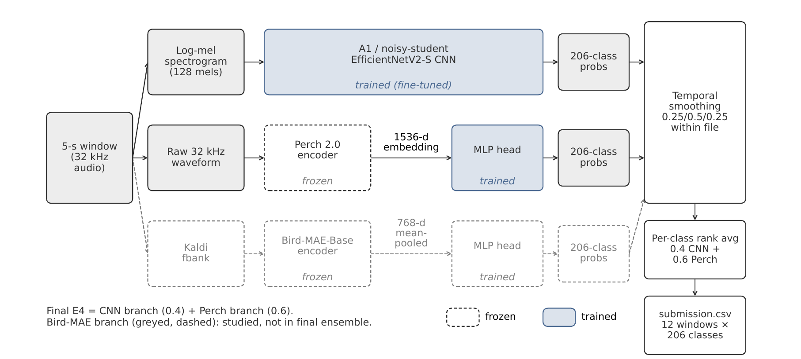
Building the ensemble one question at a time
STAGE 4 · FINAL SYSTEM
 | WHAT CHANGED | QUESTION | ANSWER | PUBLIC | PRIVATE
E1 | MAIN CNN + A2d, 50/50 | Does combining help? | Yes, +0.017 | 0.8835 | 0.8720
E2 | E1 + smoothing | Does smoothing help? | A little | 0.8866 | 0.8801
E3 | E2 + ABLATION, 1/3 each | Does a 3rd model help? | No, worse | 0.8806 | 0.8752
E4 | E2, 0.4 CNN / 0.6 Perch | Do the weights matter? | Barely (tie) | 0.8875 | 0.8803
All four variants were fixed before any ensemble score. Each changes one thing. E4 was picked by the pre-registered rule (highest public score); E2 vs E4 differs by +0.0009, within noise. “ABLATION” = the noisy student taught by A2d.
FIG. 5 Final E4 system: noisy-student CNN (0.4) + distilled Perch head (0.6), smoothed and rank-averaged. Bird-MAE (grey) not used.
WHY RANK-AVERAGE
CNN and Perch make different errors
Spearman correlation only 0.31; ROC-AUC depends only on ranking, so ranks put both models on one scale.
WHY SMOOTH
Calls spill across window borders
Each window is averaged with its neighbours (0.25 / 0.5 / 0.25) within the same file.
COST
E4 runs in 32.3 CPU minutes
Well inside the 90-minute limit; the Perch branch is about 73% of the compute.
Combining helped, smoothing helped a little, a third model hurt, weights barely mattered. Final: 0.887 public / 0.880 private.
Arshiya
Notes:
Arshiya, about 0:50
Since the CNN and Perch make different mistakes, the obvious move was to combine them. We planned four versions before seeing any scores, each changing one thing. E1 just combines the two, and that alone beat our best single model. E2 adds smoothing across neighbouring five-second windows, because calls often spill over, and that helped a little more. E3 asks: what if we add a third model? It didn't help, because it was another, weaker CNN, so Perch got less say. And E4 asks whether trusting Perch a bit more matters. It basically tied with E2, which tells us the result isn't fragile. E4 was our final pick: 0.880 private, in about 32 minutes. So the one thing I'd want you to remember: to work in the field, the model has to actually hear the field during training. Over to Khushi!
Transition: Over to Khushi.

Slide 13
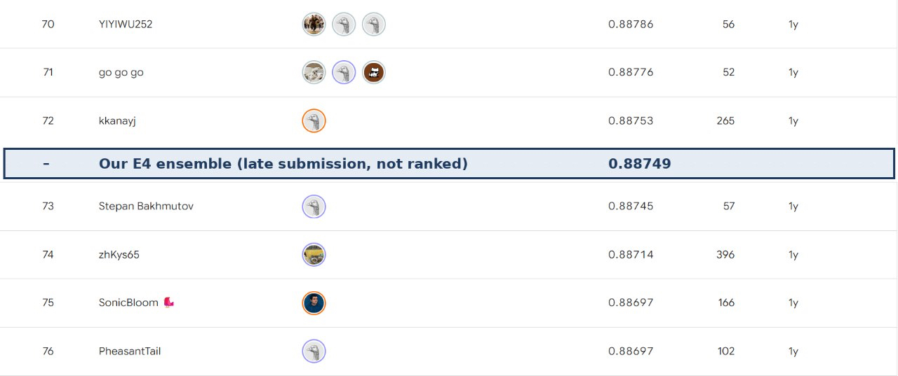
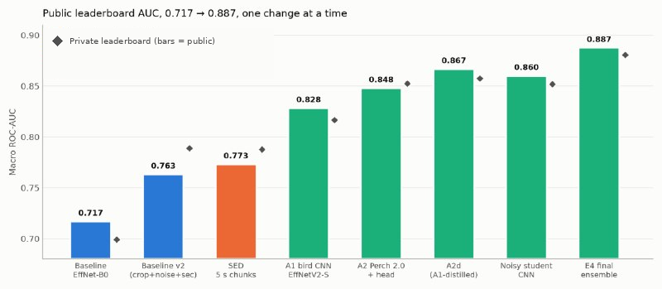
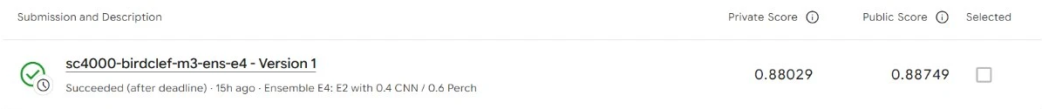
From 0.717 to 0.887 public, one change at a time
RESULTS
FIG. 7 Public leaderboard around our E4 score (0.88749): it would sit between ranks 72 and 73 of 2,032.
0.887
public AUC
0.880
private AUC
~73rd
of 2,032, top 3.6%
FIG. 6 Public AUC (bars) and private AUC (diamonds) at every step, one change at a time from the first baseline to E4.
FIG. 8 Kaggle submission page for E4 (private 0.88029, public 0.88749). Late and unranked, and Perch 2.0 was released after the competition closed. The winning private score was 0.931.
Khushi
Notes:
Khushi, about 0:40
This chart shows every main step from the first baseline to the final ensemble. Bars are public AUC, diamonds are private AUC, Overall we moved from 0.717 to 0.887 public, and 0.880 private, which would have placed about 73rd of 2,032 on the public board. The Kaggle screenshot below is the E4 submission itself, so every number here can be checked. It was a late submission, so it is unranked, and the winning private score was 0.931.

Slide 14
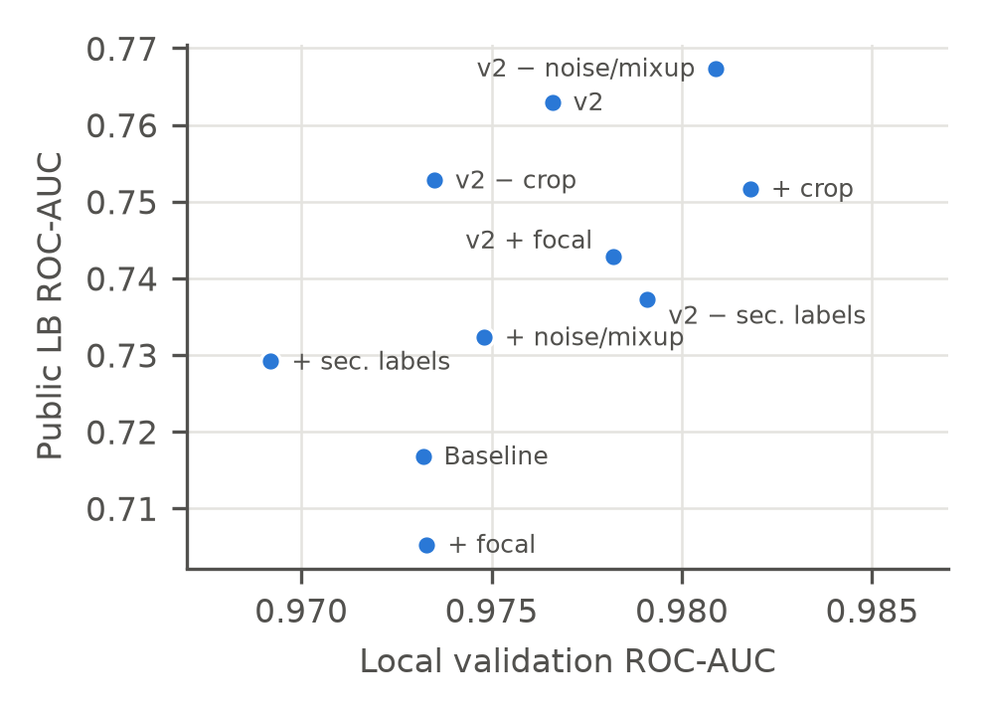
Clean validation did not predict the leaderboard
MAIN LESSON
ABLATIONS
Best validation, worst private
Among the v2 runs, v2 without noise had the highest validation AUC and the lowest private score.
SED
Best-validation epoch cost up to 0.016
Public AUC dropped whenever we picked the epoch by validation.
ADABN AND CORAL
Barely moved validation, lost up to 0.16
On the leaderboard they were the worst runs.
SO WE
Selected by public score
and treated differences below 0.01 as noise.
FIG. 9 Local validation AUC (x) against public leaderboard AUC (y) for the Stage 1 ablations. There is no usable relationship.
Khushi
Notes:
Khushi, about 0:40
Clean validation did not predict the leaderboard. In the ablations, among the v2 runs, the one with the highest validation score had the lowest private score. For SED, choosing the best-validation epoch cost up to 0.016. And AdaBN and CORAL barely changed validation while losing up to 0.16 on the leaderboard. Because of this, we selected models by public score and treated differences below 0.01 as noise.
Transition: Of course, our study has limits.

Slide 15
What we cannot claim, and what comes next
LIMITATIONS AND FUTURE WORK
Limitations
Future work (if we had more time)
1 Only one round of noisy student
The 2025 winner repeated it over several rounds [12][13]. We stopped after one, even though it gave our biggest single jump (+0.035 private).
2 No filtering of pseudo-labels
We used every window, only sharpened. The 2nd-place solution added pseudo-labels only under strict selection logic, such as a confidence gate [14].
3 No extra training data
The organisers report that teams frequently pretrained on external datasets such as Xeno-Canto [1]. We used only the competition data plus weights others had released.
4 SED was not in the final ensemble
The winner reportedly used 20 s SED chunks with noisy student, overlap averaging, smoothing and delta-shift inference [14]. Our SED scored 0.787 private and stayed out, and our 20 s chunks did worse than 5 s.
5 Our own experimental limits
One data split, CNNs trained once, the 0.01 noise level never measured, and no labelled soundscapes to check our explanations against.
1 More noisy-student rounds
Use E4 (0.880 private) as the next teacher. Watch for diminishing returns: a 2026 write-up saw public AUC keep rising over repeated rounds while private peaked early and then slipped [13].
2 Smarter pseudo-labels
Keep only windows where the teachers are confident or agree, and run a matched-density control to separate teacher quality from label density (the MAIN vs ABLATION confound).
3 SED on longer context
Fix the padding problem (47.9% of clips are under 20 s), for example by cropping from call-bearing regions, then add SED as a third, genuinely different ensemble member.
4 Better inference tricks
Overlapping windows and time-shift averaging, as the winner did [14], instead of only neighbour smoothing.
5 A small labelled soundscape set
Even a few dozen hand-labelled minutes would give a validation set that predicts the leaderboard, which was our biggest problem throughout.
Khushi
Notes:
Khushi, about 0:50
We compared our work with what the winners did. For limitations: we ran only one round of noisy student, while the winner repeated it; we used no pseudo-label filtering, while second place used strict selection; we added no external training data, which the organisers say teams often did; and our SED model stayed out of the final ensemble, while the winning system was built around SED. We also had one data split and no labelled soundscapes. For future work, the next step is more noisy-student rounds with E4 as teacher, but a 2026 paper saw private scores peak early and then slip, so we would monitor that. Then smarter pseudo-label selection with a matched-density control, SED on longer context, overlap and time-shift inference, and a small labelled soundscape set.

Slide 16
What we learned
CONCLUSION
STAGE 1 · BASELINE
Targeting each data difficulty built a strong baseline
+0.046 public over the first baseline; random crop alone gave +0.035
PUBLIC AUC
0.717 → 0.887
+0.170 in total
STAGE 2 · SED
SED localises calls from clip labels, but chunk length mattered most
5 s chunks beat 20 s by +0.033 public
STAGE 3 · PRETRAINED BACKBONES
Bird-domain pretraining gave the largest jump
Frozen Perch 2.0 head: 0.848 public, +0.085 over v2
Thank you.
Questions?
STAGE 4 · ADAPTATION
Pseudo-labels helped every time; matching statistics hurt
4 of 4 content-level runs improved, 7 of 7 statistics runs dropped
RESULTS
Clean validation did not predict the leaderboard
Final E4 ensemble: 0.887 public, 0.880 private, in 32.3 of 90 CPU minutes
Khushi
Notes:
Khushi, about 0:30
One takeaway from each stage. Stage 1: targeting each data difficulty built a strong baseline. Stage 2: SED localises calls from clip labels, and chunk length mattered most. Stage 3: bird-domain pretraining gave the largest jump. Stage 4: showing the model soundscape content helped every time, while matching statistics hurt. And overall, clean validation did not predict the leaderboard. Together this took us from 0.717 to 0.887 public. Thank you, we are happy to take questions.

Slide 17
Sources
REFERENCES
[1] Cañas, J. S. et al. Overview of BirdCLEF+ 2025: Multi-Taxonomic Sound Identification in the Middle Magdalena, Colombia. CLEF 2025 Working Notes. ceur-ws.org/Vol-4038/paper_232.pdf
[8] Sun, B., Feng, J. and Saenko, K. Return of Frustratingly Easy Domain Adaptation. AAAI 2016.
[2] Sydorskyi, V. and Gonçalves, F. Tackling Domain Shift in Bird Audio Classification via Transfer Learning and Semi-Supervised Distillation: A Case Study on BirdCLEF+ 2025. CLEF 2025 Working Notes.
[9] Hinton, G., Vinyals, O. and Dean, J. Distilling the Knowledge in a Neural Network. 2015.
[3] van Merriënboer, B. et al. Perch 2.0: The Bittern Lesson for Bioacoustics. 2025.
[10] Zhang, H., Cissé, M., Dauphin, Y. N. and Lopez-Paz, D. mixup: Beyond Empirical Risk Minimization. ICLR 2018.
[4] Rauch, L. et al. Can Masked Autoencoders Also Listen to Birds? 2025.
[11] Boudiaf, M. et al. In Search for a Generalizable Method for Source Free Domain Adaptation. ICML 2023. arxiv.org/abs/2302.06658
[5] Tan, M. and Le, Q. EfficientNetV2: Smaller Models and Faster Training. ICML 2021.
[12] Babych, N. 1st place solution: Multi-iterative noisy student is all you need. Kaggle BirdCLEF+ 2025 competition write-up, 2025.
[6] Xie, Q., Luong, M.-T., Hovy, E. and Le, Q. V. Self-Training With Noisy Student Improves ImageNet Classification. CVPR 2020.
[13] Chen, Y. Class Interaction as Domain Recalibration: A Variance-Aware Sound-Event-Detection Pipeline for BirdCLEF+ 2026. CLEF 2026 Working Notes. ceur-ws.org/Vol-4283/paper330.pdf
[7] Li, Y., Wang, N., Shi, J., Hou, X. and Liu, J. Adaptive Batch Normalization for practical domain adaptation. 2018.
[14] Becoming a Kaggle Master course (LAMSADE, Dauphine). BirdCLEF 2025 top-3 solution review, course slides. lamsade.dauphine.fr/~ebenhamou/Becoming_a_Kaggle_Master

