Slide 1
Comparison Results CIBERSORT data

Slide 2
CIBERSORT Example Data
LM22: Signature genes file, 547 genes, 22 cell-type
Example mixtures: 5 samples, 11866 genes
Example Ground Truth: Grand Truth of the cell subset fractions in the example mixtures. 5 samples, 22 cell type
Link: https://cibersort.stanford.edu/download.php

Slide 3
Precise Prediction values by SVR

Slide 4
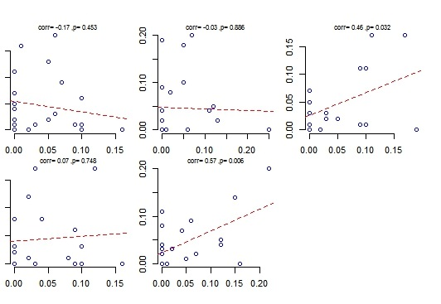
Observed versus predicted frequencies for each sample – SVR
Observed frequency
Predicted frequency

Slide 5
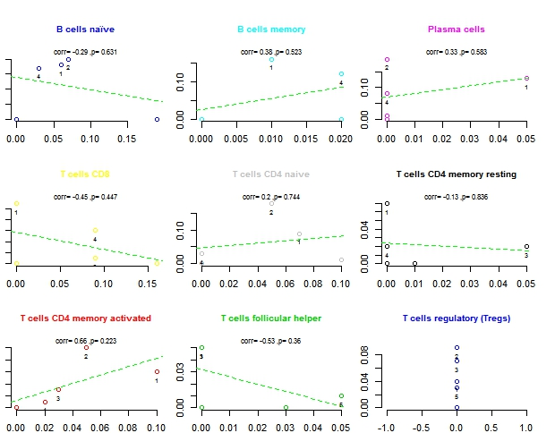
Observed versus predicted frequencies for each cell type (1-9) – SVR
Observed frequency
Predicted frequency

Slide 6
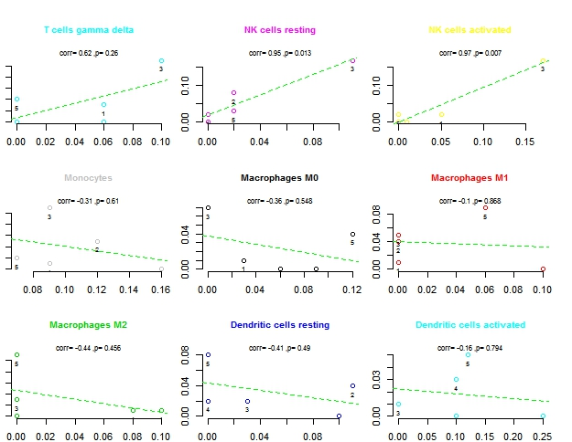
Observed versus predicted frequencies for each cell type (10-18) – SVR
Observed frequency
Predicted frequency

Slide 7
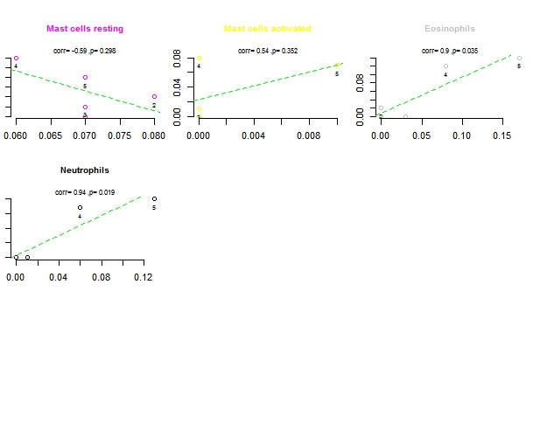
Observed versus predicted frequencies for each cell type (19-22) – SVR
Observed frequency
Predicted frequency

Slide 8
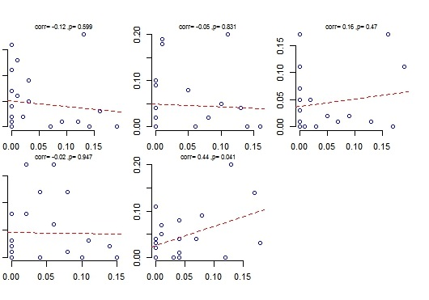
Observed versus predicted frequencies for each sample – nnlm
Observed frequency
Predicted frequency

Slide 9
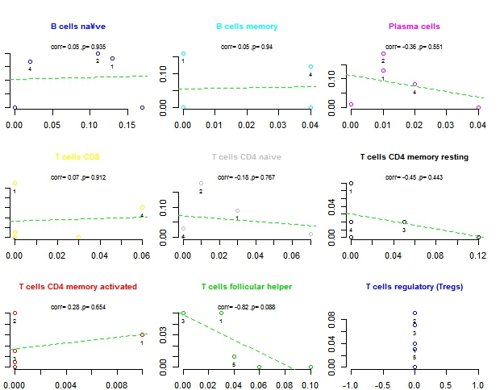
Observed versus predicted frequencies for each cell type (1-9) – nnlm
Observed frequency
Predicted frequency

Slide 10
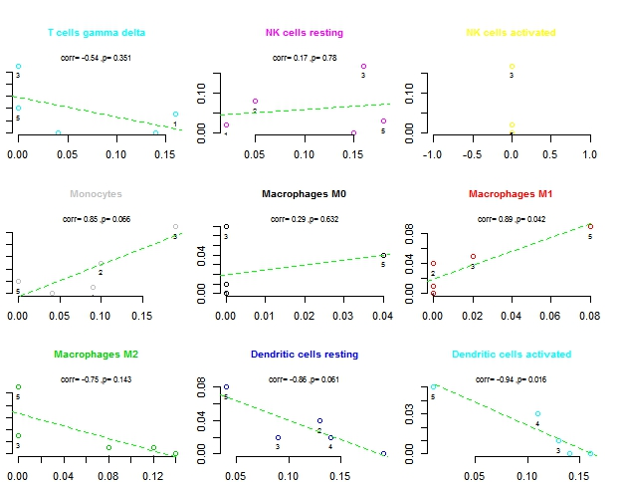
Observed versus predicted frequencies for each cell type (10-18) – nnlm
Observed frequency
Predicted frequency

Slide 11
Observed versus predicted frequencies for each cell type (19-22) – nnlm
Observed frequency
Predicted frequency

Slide 12
Prediction By SVR vs. Prediction by nnlm for each cell type

Slide 13
Prediction By SVR vs. Prediction by nnlm for each sample

