Slide 1


Data Governance @ SneakerPark
Prepared by: John Mekubo
Submitted on: 23/11/2021

Slide 2
Background
SneakerPark is an online shoe reseller that allows people to buy and sell used and new shoes. Buyers can bid for shoes or buy them outright, and sellers can set a price or sell to the highest bidder.
Each buyer and seller must have an active account in order to sell, bid, or purchase sneakers using SneakerPark’s website.
SneakerPark authenticates the shoes before shipping them to the buyer, so before listing an item, the seller must ship it to SneakerPark’s warehouse. Upon receipt, SneakerPark assigns an item number to each pair of sneakers and notifies the seller that they are now free to list their item. If the item is not listed within 45 days, SneakerPark returns it to the seller and sends an invoice to the seller for the shipping cost.
If the item is found to be inauthentic or in an unacceptable condition, it is also returned back to the seller in a similar fashion.
When the item sells, the buyer’s account is credited with the purchase price minus the SneakerPark service fee and shipping fees to deliver the item to the buyer.
Currently, SneakerPark only supports sales within the United States.

Slide 3
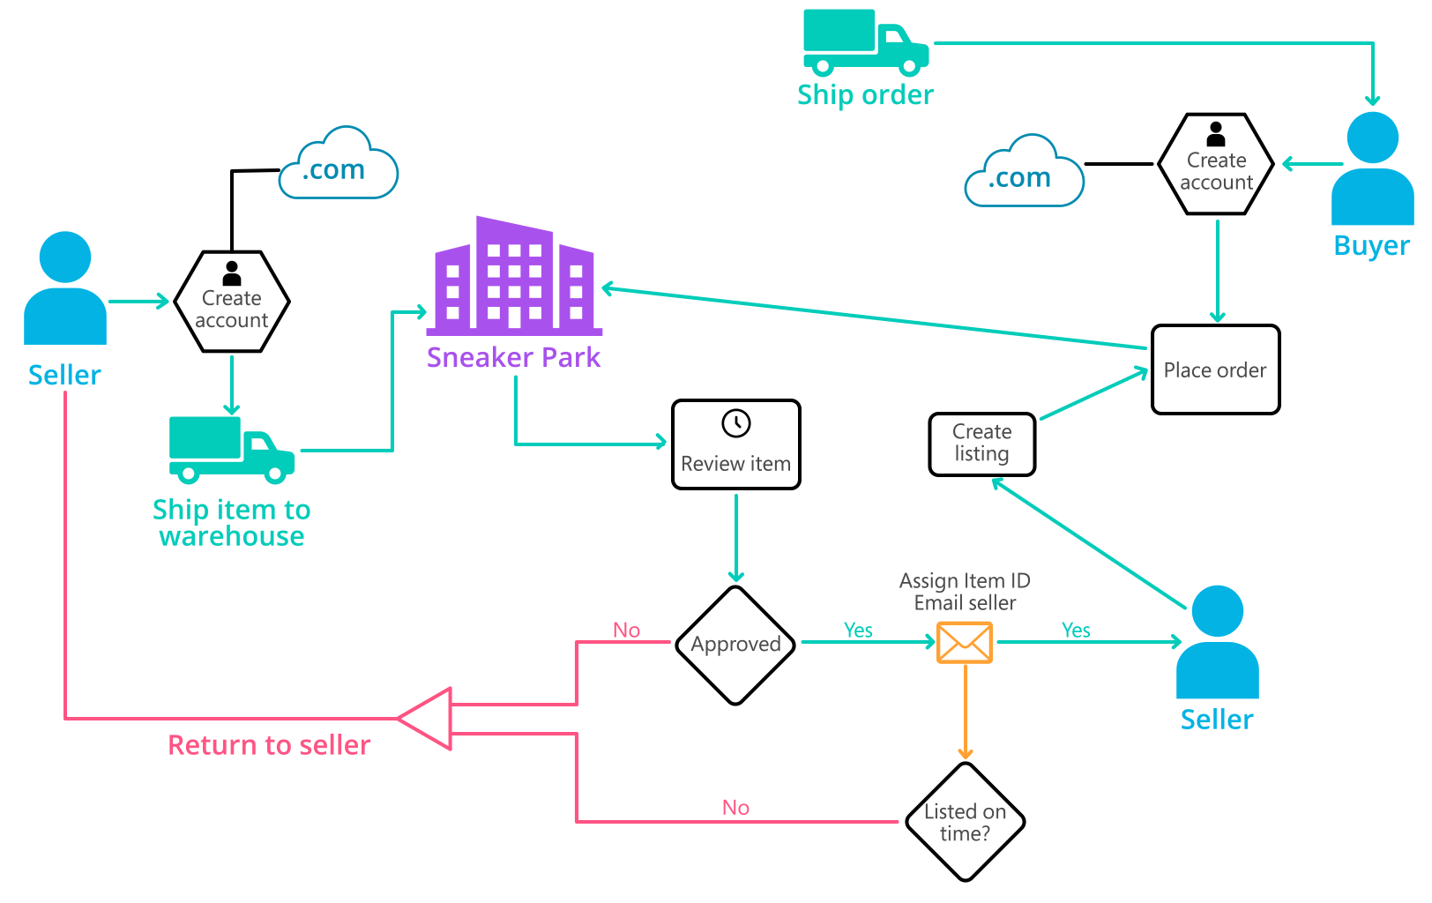
Background (cont’d)
Below you can see a diagram that will hopefully help you visualize some of SneakerPark's business processes. Keep in mind that it does not capture ALL processes and every nuance, but simply serves as another artifact to use in your project.

Slide 4
Step 1
Enterprise Data Catalog Part 1: Enterprise Data Model

Slide 5
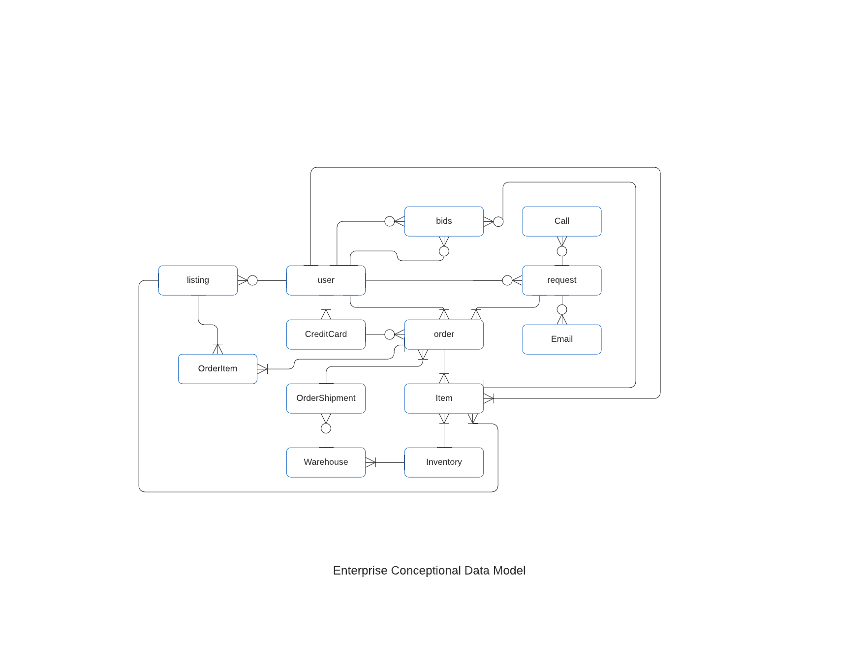

Slide 6
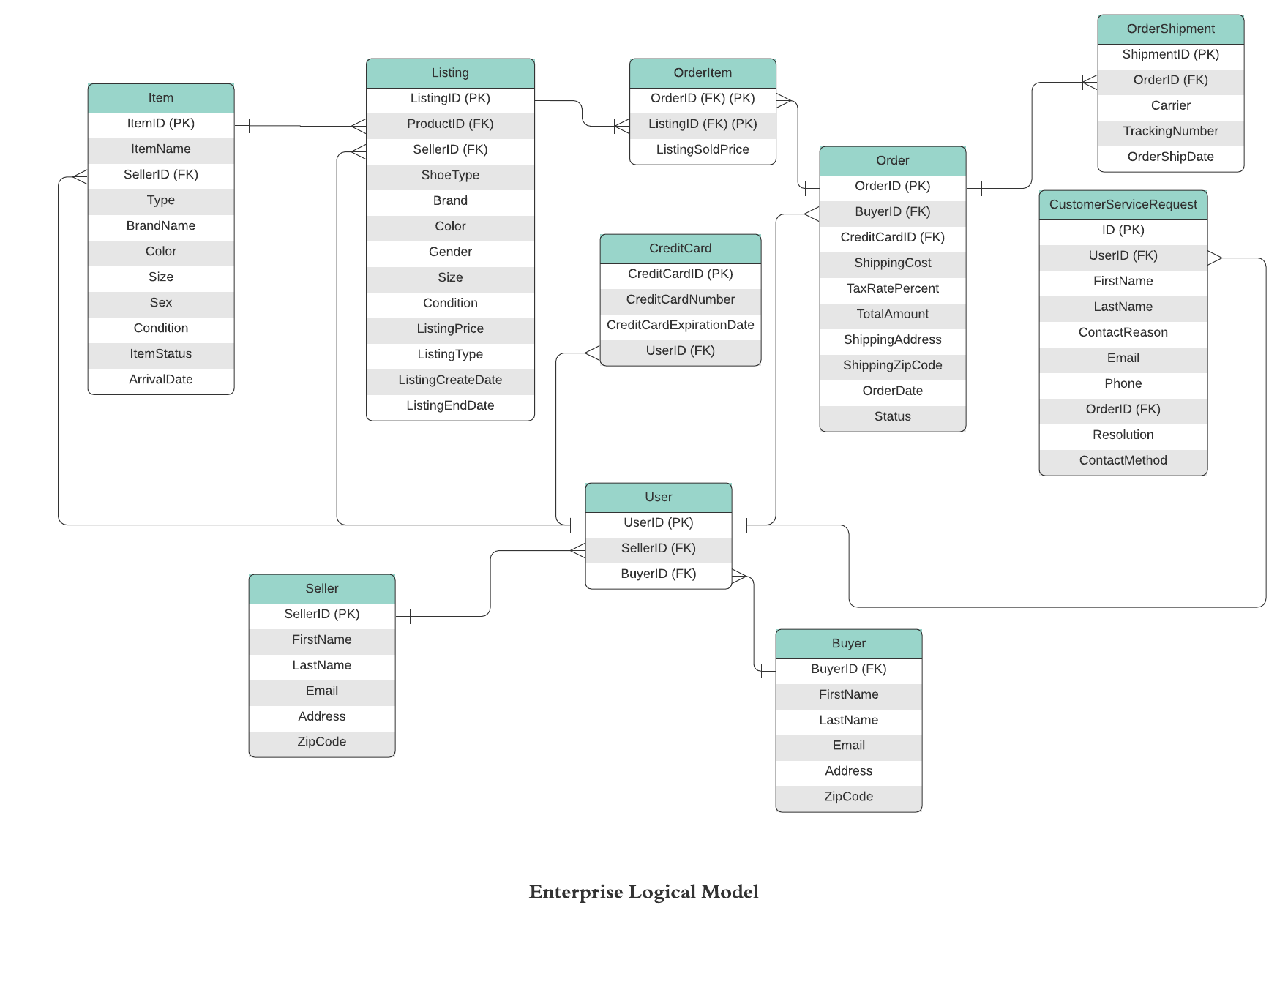

Slide 7
Step 2
Enterprise Data Catalog Part 2: Metadata

Slide 8
Please note Included in Zip file –sneakerpark-enterprise_data_catalogue

Slide 9
Step 3
Data Quality
Part 1: Profiling and Cleansing

Slide 10
Please note: Included in Zip file –sneakerpark-enterprise_data_catalogue

Slide 11
Step 4
Data Quality
Part 2: Monitoring

Slide 12
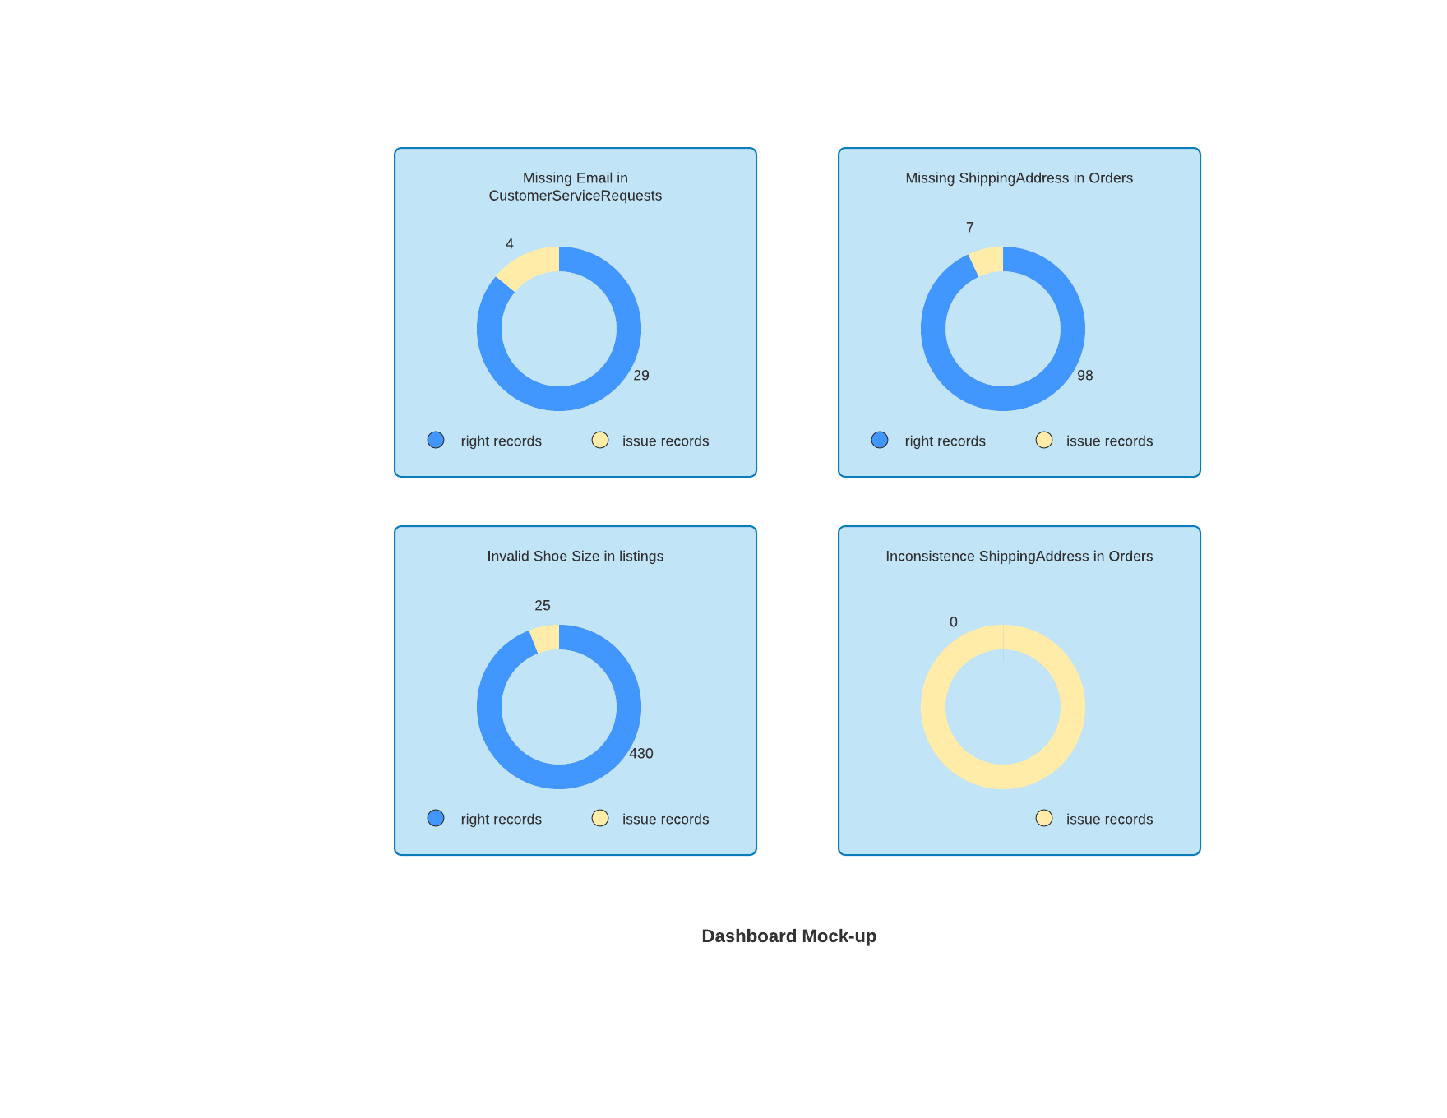

Slide 13
Step 5
Master Data Management
Part 1: MDM Architecture

Slide 14
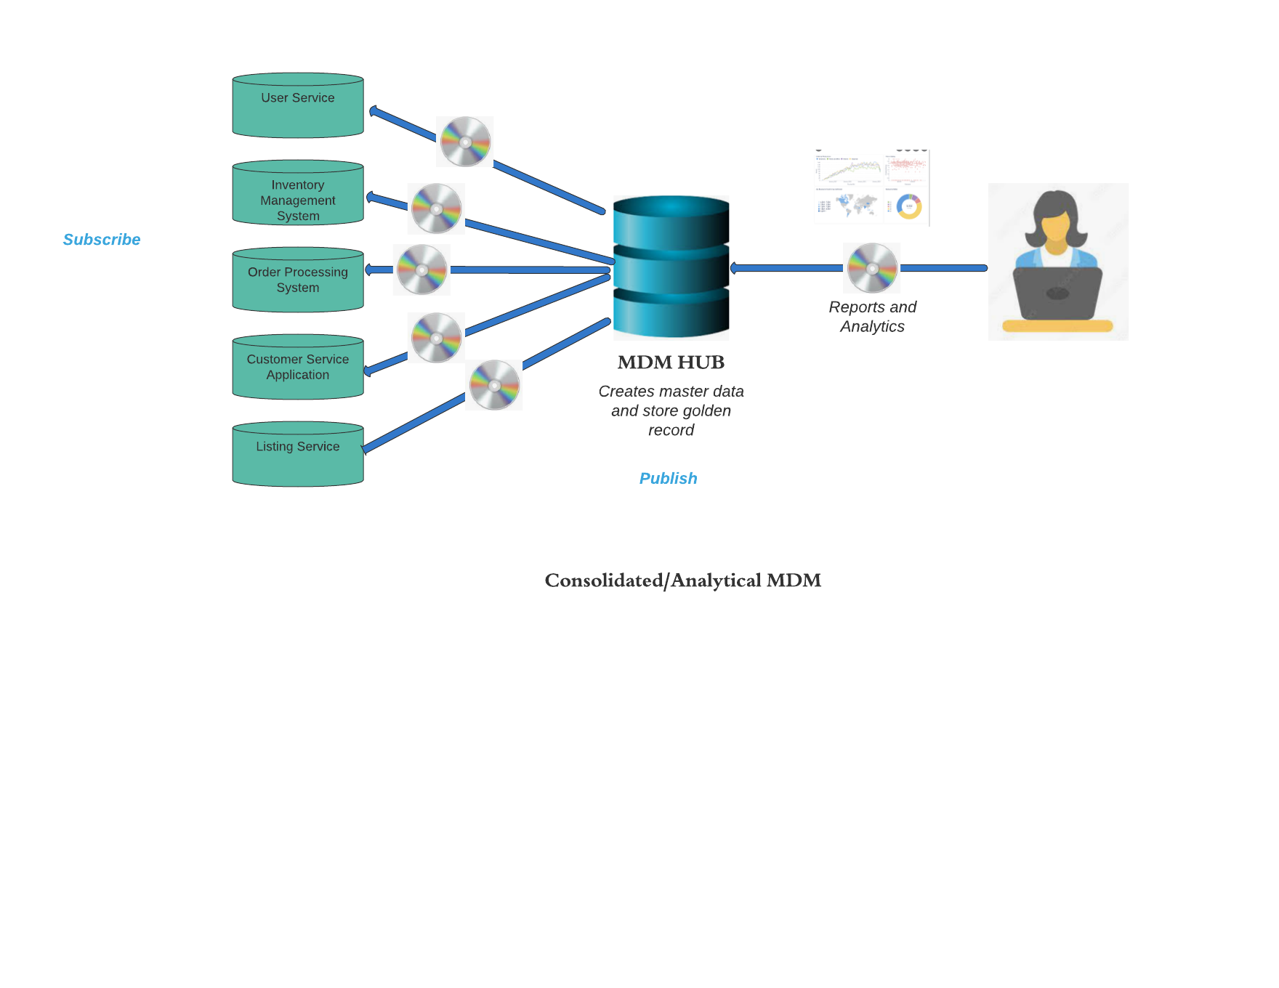

Slide 15
Explanation:
The centralized/ transactional model is ideal for SneakerPark as it will allow for consolidation and creation of golden record in the Master Data Management(MDM) hub. This will eliminate duplicate records existing in silos in different systems across the company that led to discrepancies in data contained in those systems. The MDM hub will server as single source of truth for storing and querying organization data. The centralized /transaction model eliminates the chances of duplicate entries for same record by different users. It is also easy to manage business rules and administer data governance from the MDM hub rather than different systems.

Slide 16
Step 6
Master Data Management
Part 2: Master Record

Slide 17
Please come up with 4 rules - 2 for Items and 2 for Customers and list them below.
Item Match Rules
Primary Match: Match item data on ItemID
Secondary Match: Match item data on SellerID and sex
Note: gender field in listings is standardized to sex
Customer Match Rules
Primary Match: Match customer data on UserID
Secondary Match: Match customer data on creditcardID

Slide 18
Step 7
Data Governance:
Roles and Responsibilities

Slide 19
Sneaker Park requires various roles that are critical to the success of implementing data governance in the company. Currently, the two staff are not enough. Jessica the Senior Bussiness Analyst can comfortably fit in the role of Data Steward as she has firm knowledge and expertise on the company’s data. She can handle Data Quality Management and Metadata management with minimal support. Jake can handle the IT support and help with setting up the MDM Hub and integration with source systems. However, SneakerPark needs a Data Administrator to manage the MDM Hub data warehouse /database. The company also needs a Data Engineer to help with data pipelines from source systems to MDM Hub and manage the reporting dashboards. Lastly, the initiation of the project requires a sponsor from the senior management of the company to ensure successful implementation.

Slide 20
Standout Suggestions

