Slide 1

Data Lake Value Proposition
Medical Data Processing Company
John Mekubo
Udacity IPS Version 1.0

Slide 2
Agenda
What is a Data Lake
Components of a Data Lake
Data Lake vs Data Warehouse
Business Value of Data Lake Solution
Proposed Data Lake Architecture for Medical Data Processing system
Udacity IPS Ver. 1 2/2020

Slide 3
What is a Data Lake
Executive summary
A data lake is a central repository in which to store an organization’s data, regardless of its source or format at any scale. The data can be structured, semi structured (non-relational e.g. JSON) or unstructured.
Data lakes use Schema on read model. With schema on read model, the data is loaded and verified during querying hence increasing the speed at which data is loaded into the data store.
Data in data lakes is persisted as long as possible and is often built using Hadoop.
Data lakes have a huge capacity as the storage is separate from the computing platform.

Slide 4
Components of Data Lake
Ingestion
Storage
Processing
Serving
Data from external and internal sources is ingested using various ETL tools such as Kafka, NiFi and Scoop
This forms the storage layer for all data. Usually in the Hadoop distributed file system (HDFS)
Here data is cleaned, aggregated and transformed using appropriate tools such as Hive, Spark
Processed data is stored here in readiness for consumption by analytical and reporting tools as well as web apps

Slide 5
Data Lake vs Data Warehouse
A data warehouse can solve only a limited number of questions as it is designed to collect only data that is controlled for quality and conforming to an enterprise data model. Data lakes on the other hand are fed information in its native form. Little or no processing is performed for adapting the structure to an enterprise schema and are more flexible by allowing the data to remain in its native format, hence a far greater stream of data is available for analysis.
Data modelling for an enterprise data warehouse can be more complex than data lakes since decisions have to be made upfront during requirement gathering before database design.
Enterprise data warehouse are not flexible or easy to scale as compared to data lakes.
It is difficult for business analysts, data scientists to ask ad hoc questions of the data stored within a data warehouse. They need to have thought about it in advance as you need to create the data structures and analytics for it. Unfortunately, the only analytics results are ones that the data has been designed to return. Data lake eliminates these issues. Both structured and unstructured data can be ingested easily, without any data modelling or standardization upfront.
In Data Lake, Analysts choose which tag and tag groups to assign. The same piece of data can be given multiple tags, and tags can be changed or added at any time.

Slide 6
Data Warehouse
Data Lake
Schema on write
Structured Data
Limited scale
Tightly coupled Storage & Compute
Schema on read
Structured, semi-structured unstructured data
Unlimited scale
Separate Storage & Compute
Udacity IPS Ver. 1 2/2020

Slide 7
Business Value of Data Lake
Data Lake has huge capacity as the storage layer is separate from processing layer making scaling easy. This will cater for the growing storage requirements of the Medical Data Processing Company.
Data Lake stores data centrally in one location eliminating silos. The Data Lake will form a single source of truth for all analytical requirements of the Medical Data Processing Company.
Data Lake is built on distributed fault tolerant system that ensures reliability and accessibility. Cases of system downtime will be a thing of the past.
Data Lake provides option for integrating machine learning frameworks like SparkMlib that will help Data Scientist develop predictive models that will provide insightful information.

Slide 8
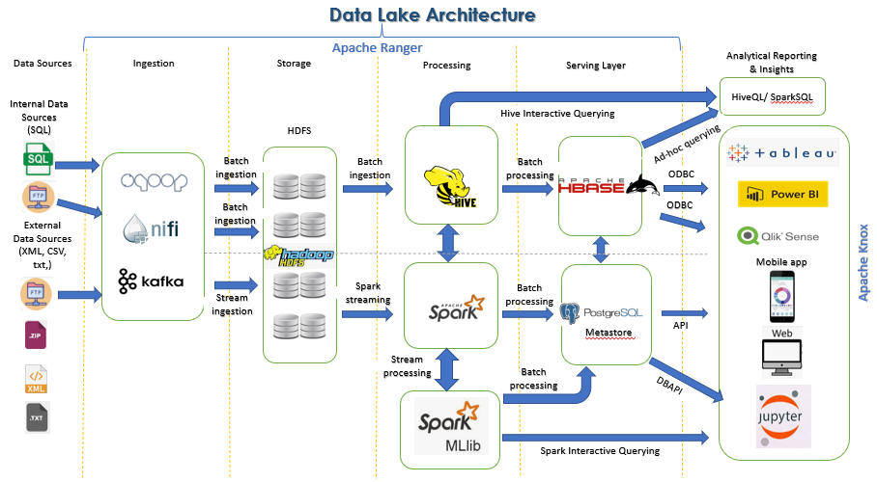

Slide 9
THANK YOU
Udacity IPS Version 1.0

