Slide 1
Global Capacity Orchestrator
One API. Every Accelerator. Any Region
Last updated 05/30/2026

Slide 2
Who am I?
Background in bioinformatics and machine learning; managed large-scale DevOps for bioinformatics analysis at a synthetic biology company prior to coming to AWS. Also was involved in the production of the Moderna mRNA vaccine for Covid-19 during the pandemic (was categorized an essential worker).
I’m the creator of the following projects:
Global Capacity Orchestrator on AWS (the topic of this presentation)
The bioinformatics workflow framework Shepard (blog / code)
The infrastructure library Morphogen2 (blog)
Microservices framework Fluoride (blog / code)
OpenEMR on EKS (code), OpenMRS on ECS (code) , OpenEMR static Binary Forge (code; allows compilation of mostlystatic PHP interpreters for use with OpenEMR for FreeBSD, Linux, and macOS), and multiple contributions to the source code of OpenEMR and almost all of the code for the current production v8.1.0 version of OpenEMR found in dockerhub
OpenMRS on ECS (code) and multiple contributions to the source code of OpenMRS (successfully advocated for changes to the backend to enable horizontal scaling which became a roadmap item)
While at AWS:
Though Leadership Champion award winner from the Healthcare and Life Sciences Technical Field Community for 2025 for work with open-source electronic health records on 6 continents.
4 x finalist for HPCWire’s 2025 Editor’s/People’s choice awards (including 2 different nominations for “Best Use of HPC in Life Sciences”.
Led AWS’s collaboration with Columbia University and Novo Nordisk in making Openfold3; the most advanced open-source protein folding model (blog)
Led AWS’s collaboration with Harvard Medical School in democratizing access to structural biology tools critical for drug discovery (blog)
Led AWS’s collaboration with NASA and Navteca in creating and open-sourcing “Open Science Studio” (blog; first author; try for free at https://smce.nasa.gov/oss/ )
Part of AWS’s collaboration with Stanford University’s Artificial Intelligence in Medical Imaging Institute where we developed new techniques for privacy-preserving federated learning and then applied those techniques to create an AI model that diagnoses and segments pediatric brain tumors. (publication/code)
This work was published in Nature Communications and then featured Nature’s “Applications of Artificial Intelligence in Cancer” collection for “significantly [moving] forward the rapidly evolving field of cancer research” and has been cited over 30 times and was the topic of the my presentation for the 20th SBRC International Cryo-EM Seminar entitled “Using Federated Learning and AI to Treat Rare Disease and Cancer” hosted by “The High Energy Accelerator Research Organization” in Japan.
LinkedIn
GitHub
https://www.jacobmevorach.com/

Slide 3
Agenda
01
Solution Overview
10 min
Architecture: GA → API Gateway → EKS Auto Mode
02
Auto Routing
10 min
Getting workloads where they need to be automatically
03
GCO MCP
10 min
Running jobs and deploying inference using nothing but natural language
04
Live Demo & FAQ
10 min
CLI deployment, job submission, autoscaling
3

Slide 4
01
Solution Overview
Addressing GPU capacity constraints & multi-region complexity

Slide 5
The Problem: Finding and best utilizing GPU Capacity
What customers are telling us:
"We can't get GPU capacity in our primary region"
"Managing multi-region infra is a nightmare"
"Our teams spend more time on infrastructure than ML"
"How can I serve multi-region inference with automatic failover?"
“How can I scale my workload?”
GPU demand is outpacing supply and there’s capacity out there that customers don’t know about or can’t use easily that can help us meet this challenge.
What could be accomplished if we always knew how to find capacity and, when we did find it, how to immediately put it to use?

Slide 6
The Solution: Uber but for compute
How much better would life be if we knew exactly where capacity was available and could use it immediately?
Challenge | Traditional Approach | With Global Capacity Orchestrator
GPU Availability | Manually check each region | Auto-routes to available capacity
Node Provisioning | Pre-provision or wait for scaling | EKS Auto Mode provisions on-demand
Multi-Region Ops | Manage clusters separately | Single API, automatic routing
Authentication | Configure per-cluster kubeconfig | IAM-based, existing AWS credentials
Job Outputs | Lost when pods terminate | Persisted to EFS / FSx storage
Failover | Manual intervention required | Automatic via Global Accelerator

Slide 7
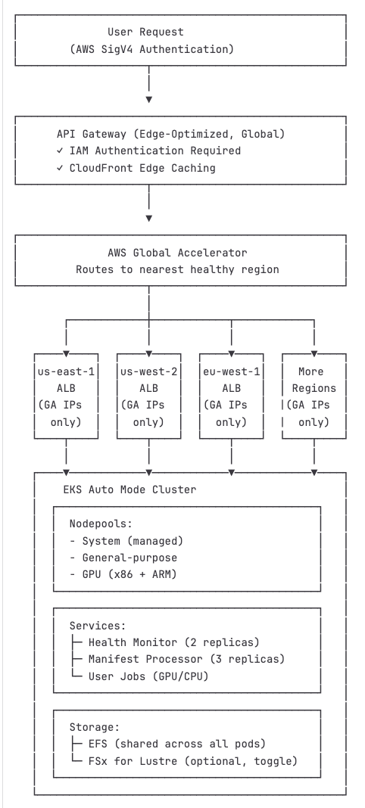
What is Global Capacity Orchestrator?
Global Capacity Orchestrator is a multi-region compute orchestration platform
You get the complete source code that consists of …
Infrastructure written in pure CDK
A well documented API that uses IAM authentication
An accompanying CLI that makes using the API easy
Capable of scaling compute across 38+ regions to over 27 million GPUs (theoretical maximum; in practice you’ll be limited by the actual compute available at any one time)
Capable of running complex worfklows, distributed training and above all inference in the form of multi-region, distributed inference endpoints with automatic failover and centralized management.
All metrics from every region flow into a single CloudWatch dashboard so monitoring can be done from a single pane of glass.
All infrastructure is bundled into a single CDK deployment orchestrated by the GCO CLI

Slide 8
Deploying with a single command!
Set up the GCO CLI
Set up AWS CDK
Set up your preferred container runtime (will auto-detect and support Docker, Finch, and Podman).
Install Python CLI with pip
(optional) Install fastmcp with pip to use the MCP
Run a single command: “gco stacks deploy-all -y”
Wait <60 minutes (even true for multi-region deployments when done with the ”--parallel” flag)
Deploys are idempotent; change your infrastructure and redeploy to have your changes take effect

Slide 9
Programmatically Generated Diagrams
B
C
D
A
Note: This diagram was autogenerated using AWS-PDK (use generate.py in the “diagrams” folder at any time to generate these diagrams programmatically from the CDK code)
Global Stack – Global Accelerator, cross-region routing
Monitoring stack – CloudWatch dashboards, alarms, SNS
API Gateway Stack – REST API with IAM auth, WAF, Lambda proxy
Regional Stack – EKS auto mode cluster with ML frameworks pre-installed, ALB, SQS, EFS per region
Regional stack is replicated in each specified region!

Slide 10
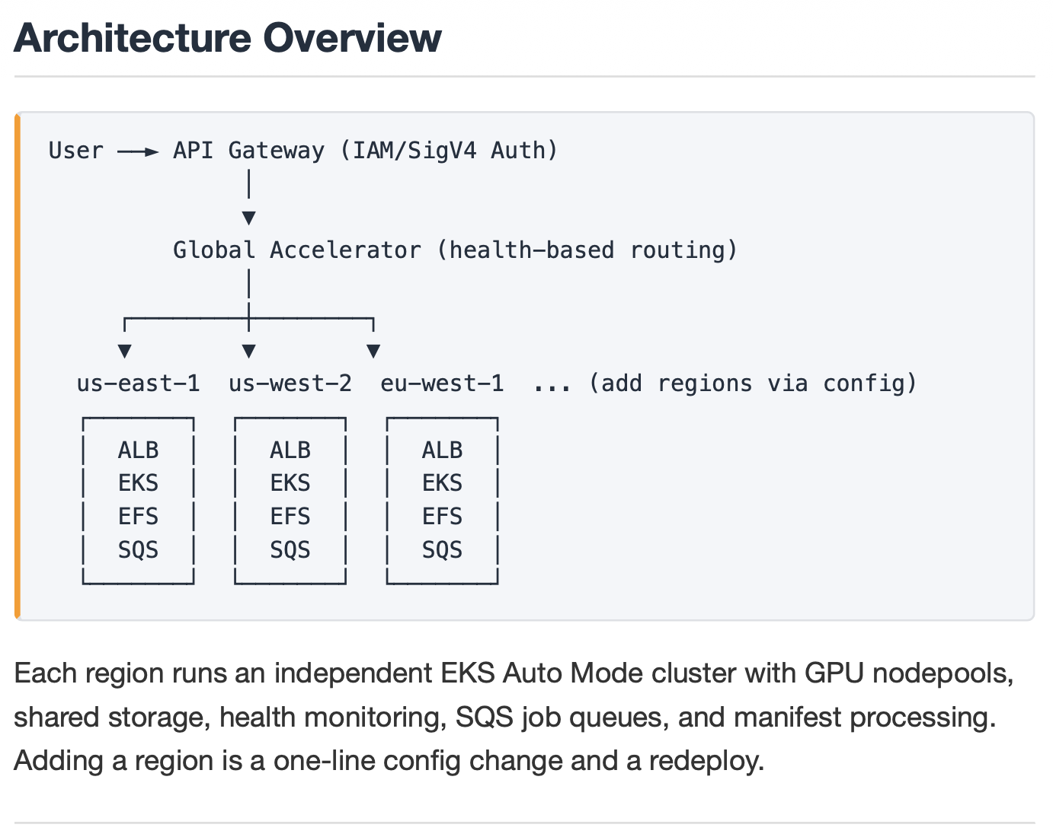
Maintaining end-to-end edge acceleration for inference and batch jobs
All latency optimized
and over the AWS Edge Network

Slide 11
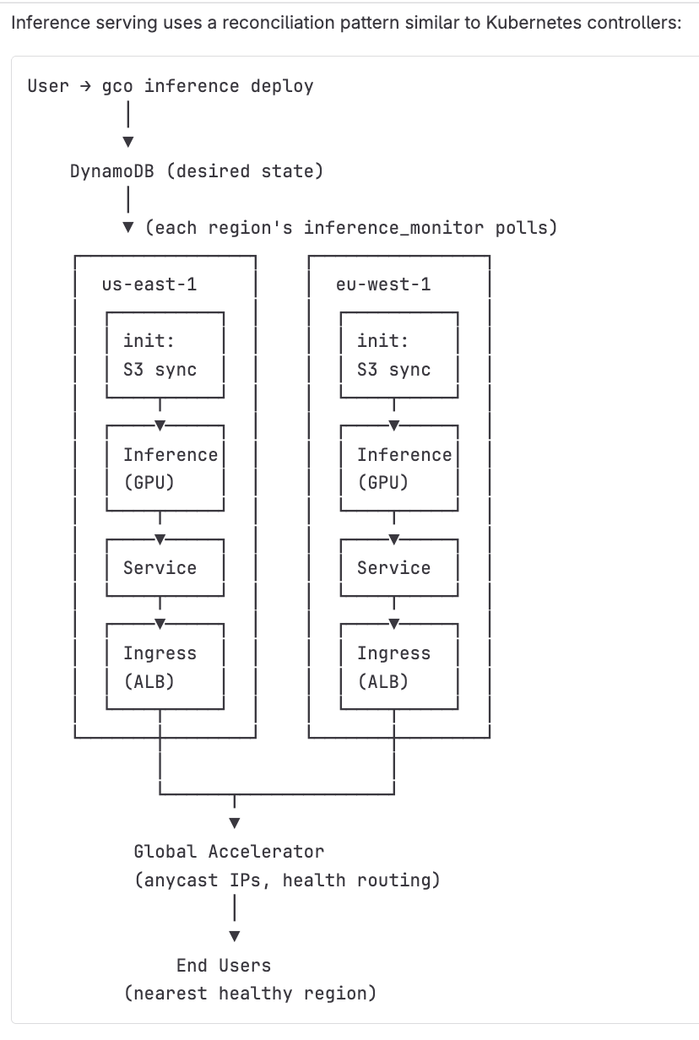
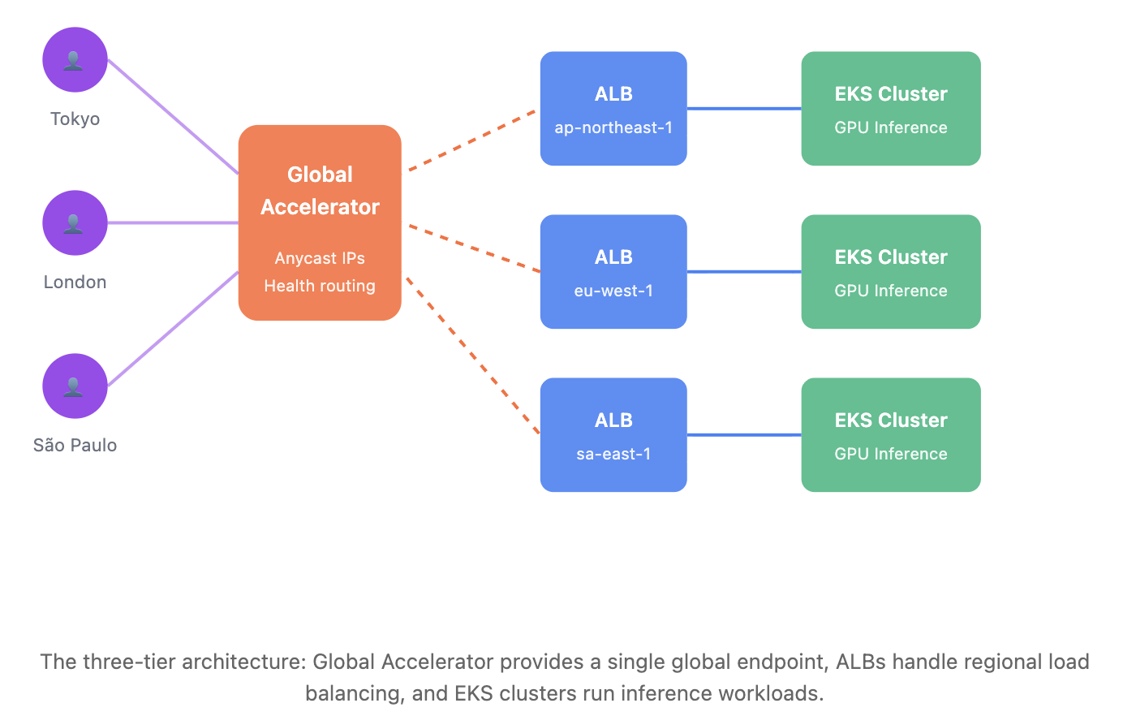
Inference Architecture
https://day1inference.com/global-inference-serving/

Slide 12
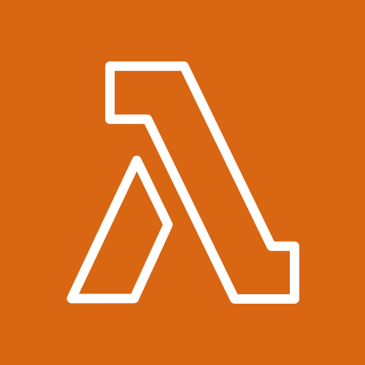

The Problem: Operational Complexity
The Solution: Idempotent Deploys and Managed Cluster Setup
Configuration (cdk.json)
Kubectl lambda
Installs manifests
Helm lambda
Installs charts
gco stacks deploy-all
EKS Auto Mode Cluster
Done; infra now matches config
EKS auto mode cluster comes pre-installed with ML frameworks ,EKS add-ons and configured with best practices
Easily extensible and customizable. Designed to be totally modular and all aspects of the system can be reconfigured by the user.
Idempotent Infra Management
One file and one command

Slide 13
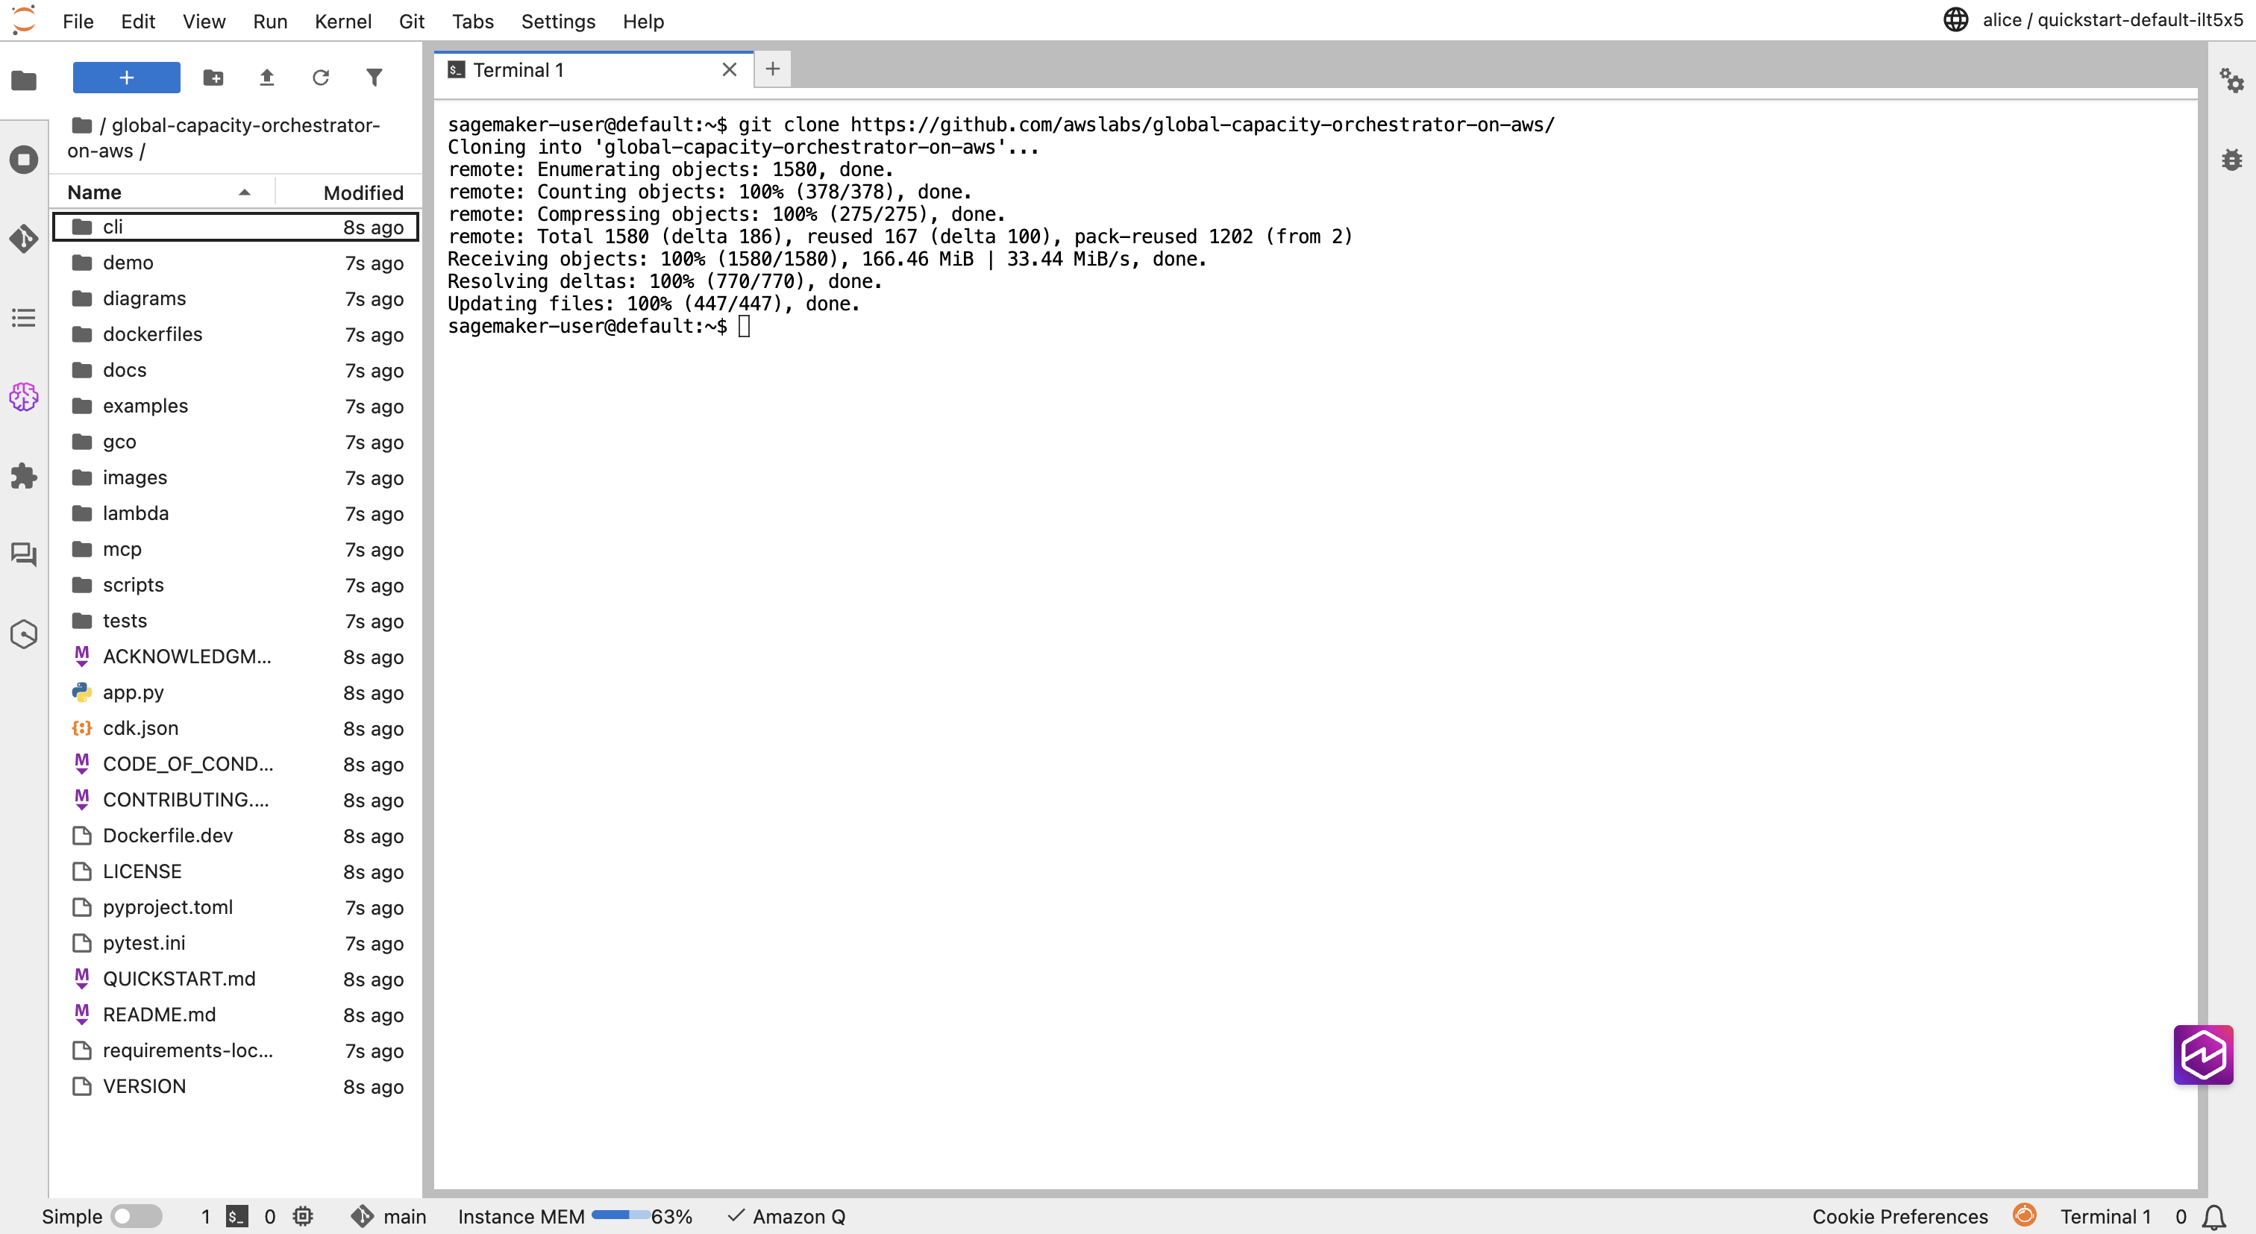
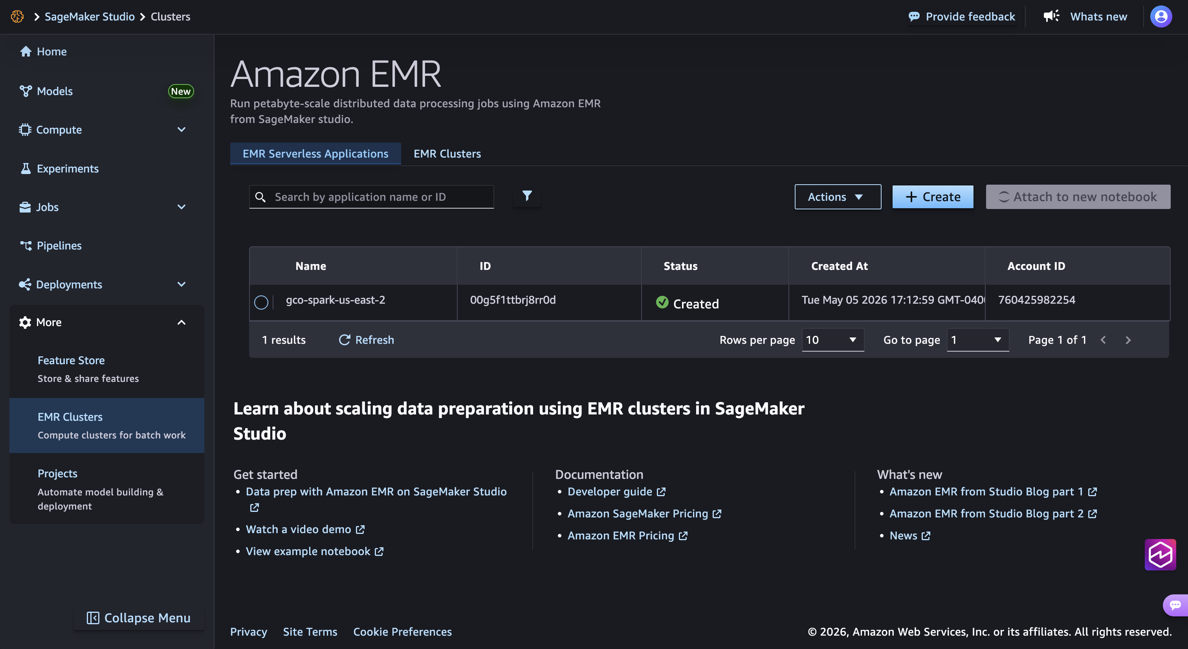
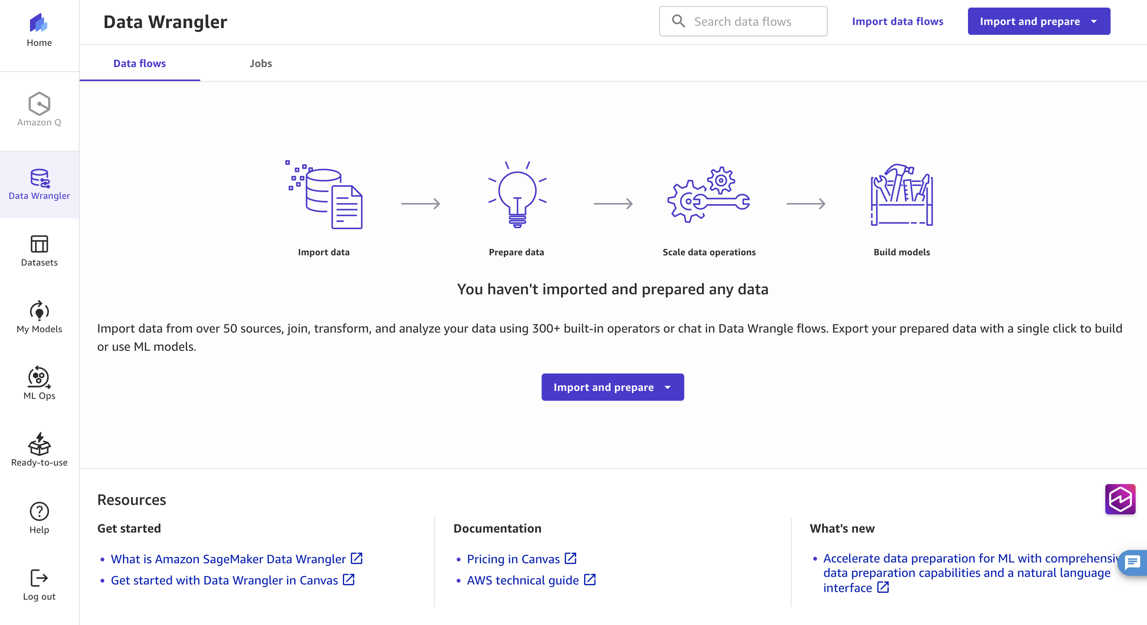
Integrated Analytics Environment
Automated user management with Cognito and GCO CLI
Encrypted SageMaker environment with KMS key
EFS for persistent storage
EMR Serverless cluster for data analysis and Spark jobs
Shared JupyterLab environment with persistent storage
Access a shared S3 bucket that all clusters can also read/write to
Submit to GCO clusters in multiple regions from the environment
Canvas for no-code ML and data processing
MLFlow for experiment tracking!
Deploy with a single command!
For a complete guide see ANALYTICS.md in the “docs” folder!

Slide 14
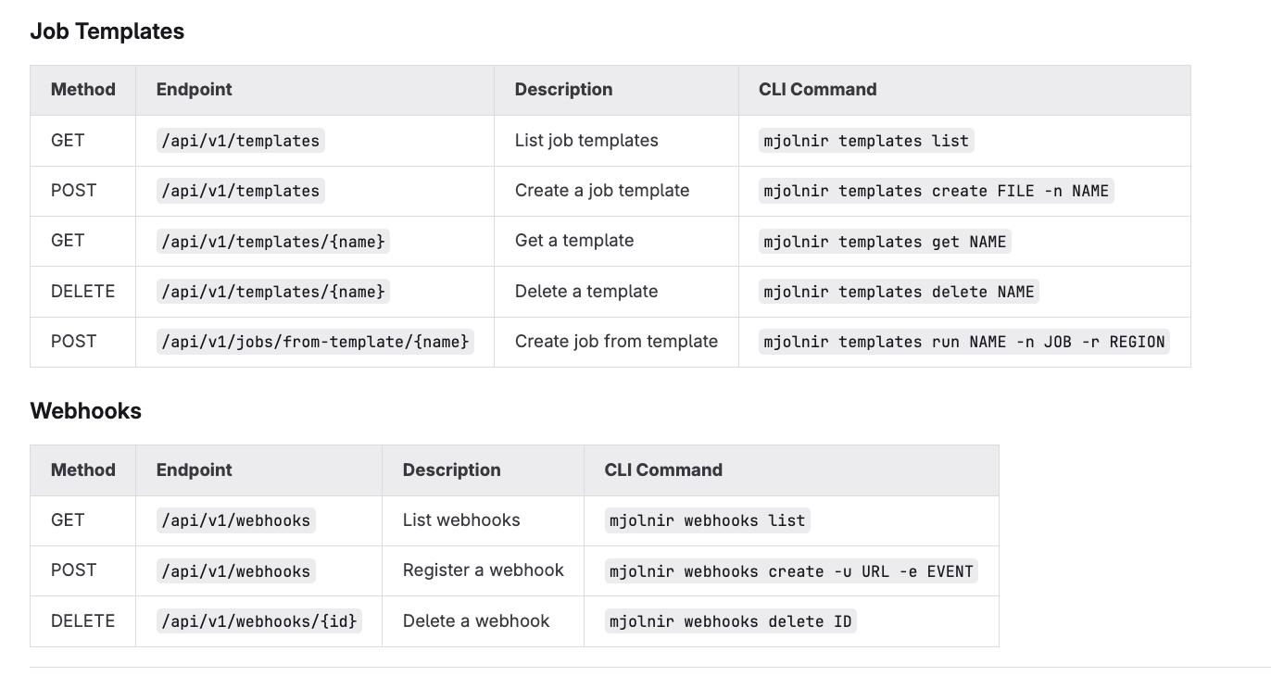
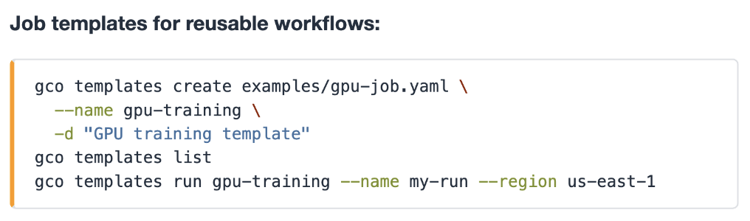
Webhooks and Templates
Globally accessible templating library allows quick sharing of job templates within your deployment only!
Options to integrate with external systems at every stage of a job’s lifecycle!

Slide 15
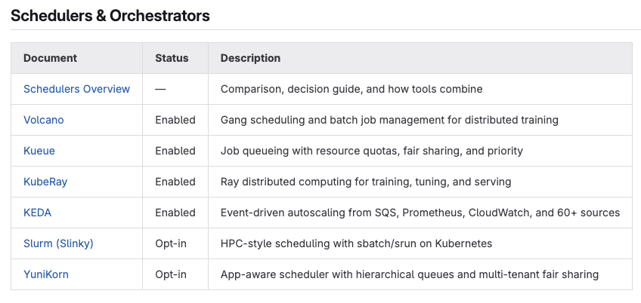
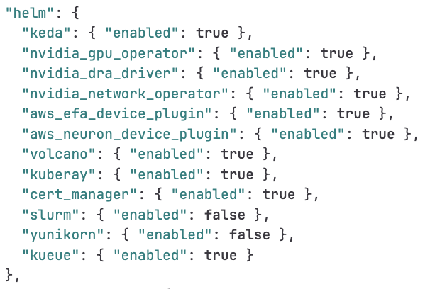
Customizable Schedulers (run multiple in combination or turn them all on)

Slide 16
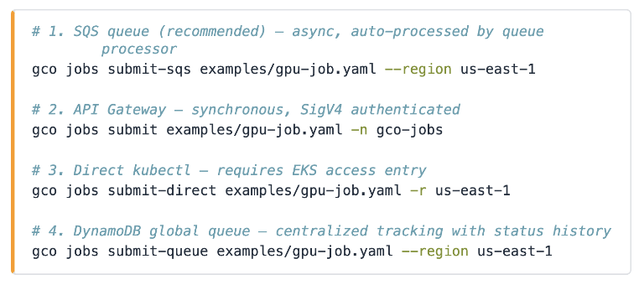
Multiple Job Submission Types

Slide 17
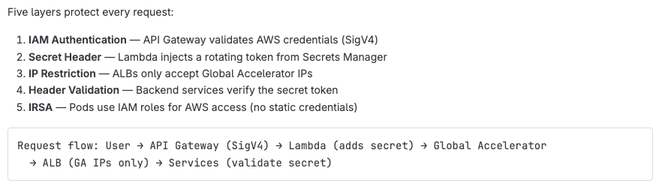
Security in Depth

Slide 18
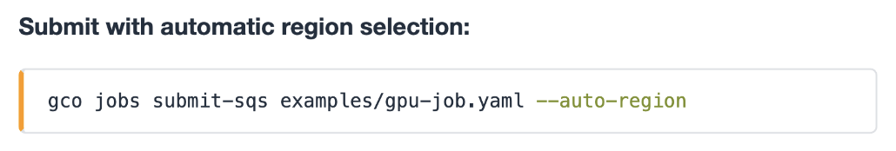
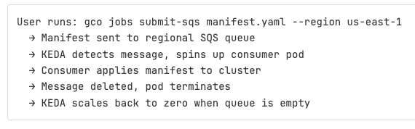
Built-in KEDA Queue Processor

Slide 19
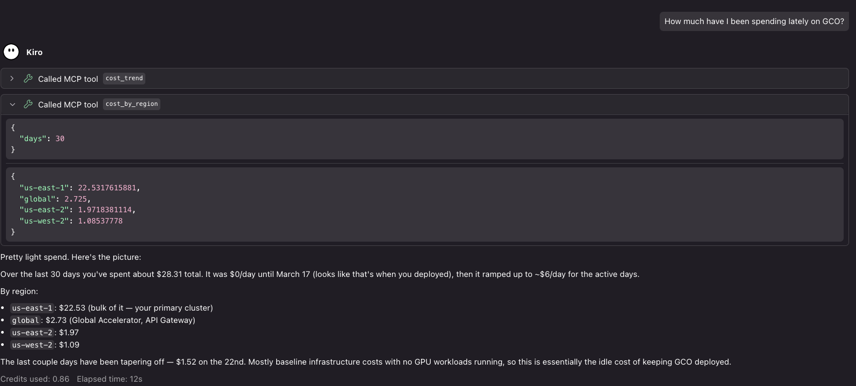
In-built Cost Management Tools

Slide 20
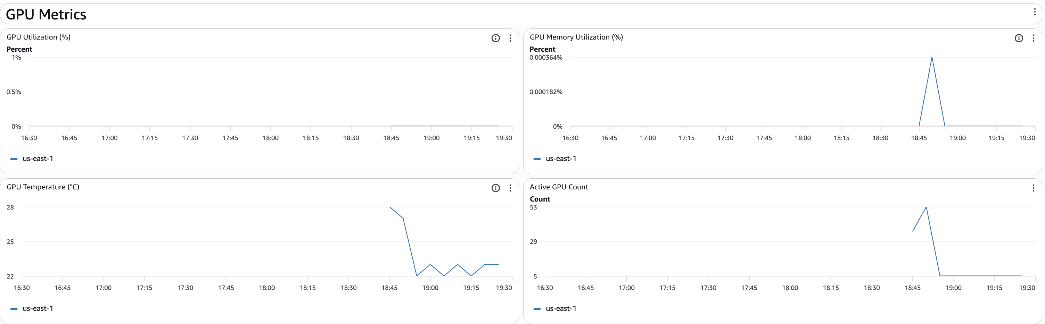
Monitoring From a Single Pane of Glass
Metrics from all regions all flow into a single CloudWatch dashboard provisioned by CloudFormation automatically as part of the larger deployment. Also includes several built in alarm and alerting features.
The dashboard is far too large to screenshot here but above are pictures from the GPU metric section (hosted in us-east-2) showing GPU metrics scraped automatically from the cluster using the Nvidia DCGM node exporter in us-east-1

Slide 21
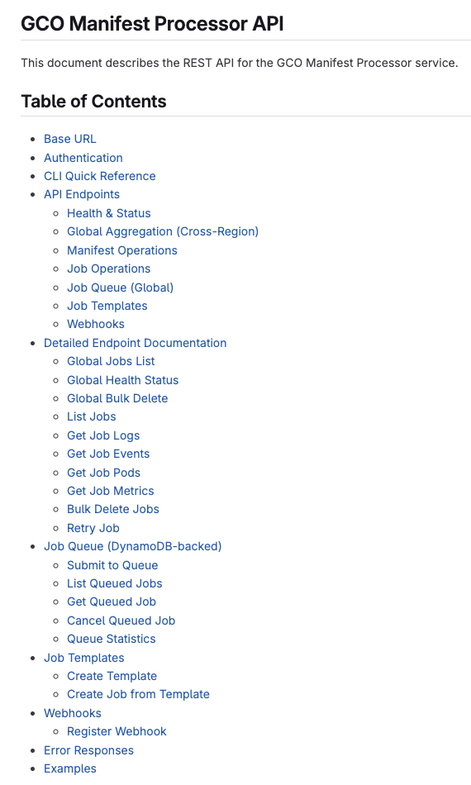
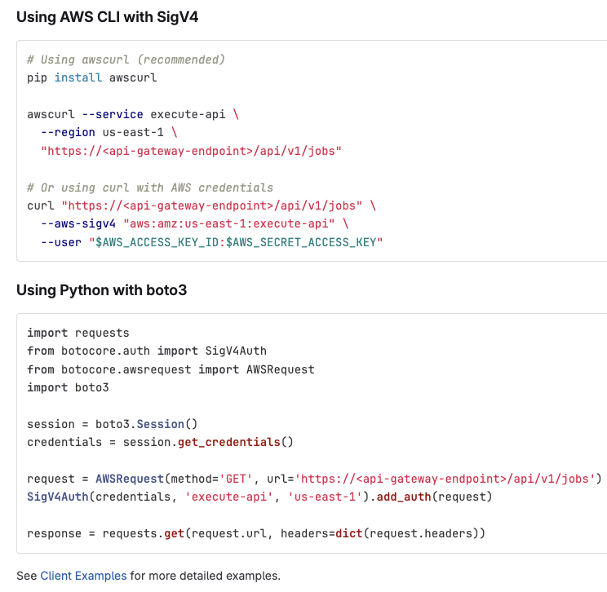
Powerful and Extensive API

Slide 22
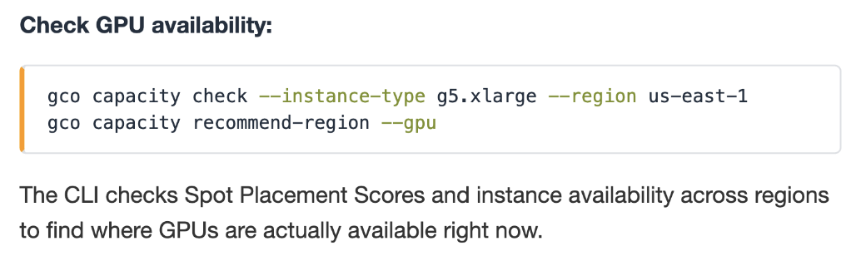
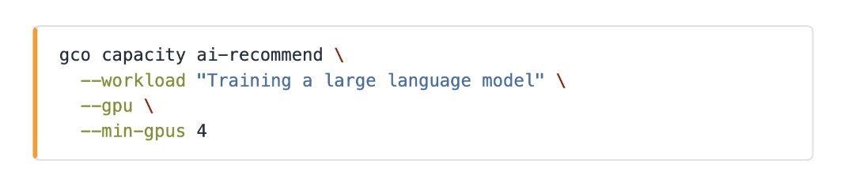
Capacity Finding Tools
Analyze live signals to infer available capacity across one or more regions
Converse with an AI about capacity recommendations powered by live data and your choice of Bedrock model (defaults to Claude Sonnet 4.0)

Slide 23
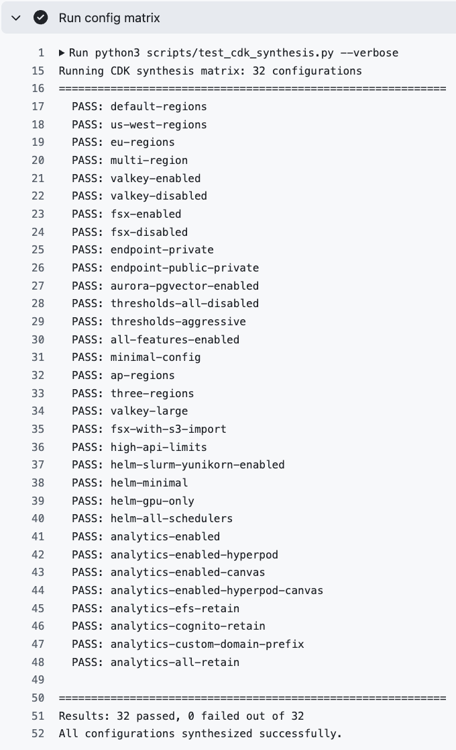
Comprehensive CI
90%> code coverage
9 different security scanners (Bandit, CodeQL, Trivy, Checkov, KCIS, Semgrep, Gitleaks, Trufflehog, pip-audit)
9 different linters (CodeQL, Ruff, Flake8, Black, Isort MyPy, Yamllint, Hadolint, ShellCheck)
Over 5,500 total unit tests (PyTest and BATS)
CDK Synthesis Matrix test makes sure the project reliably synthesizes CloudFormation under 32 diverse configuration sets.

Slide 24
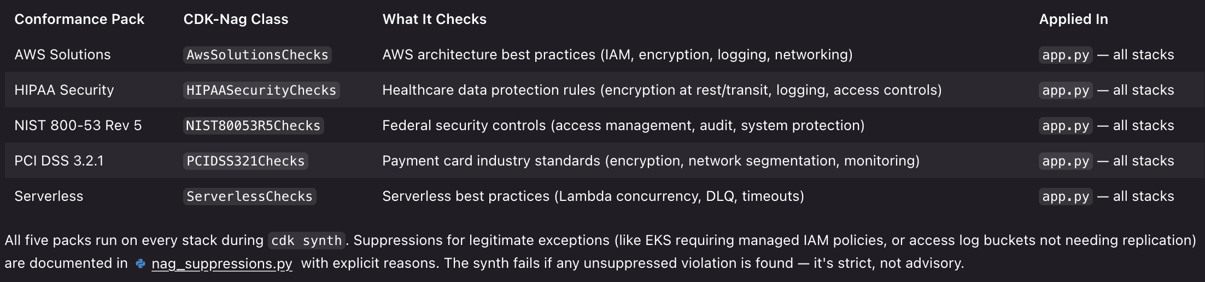
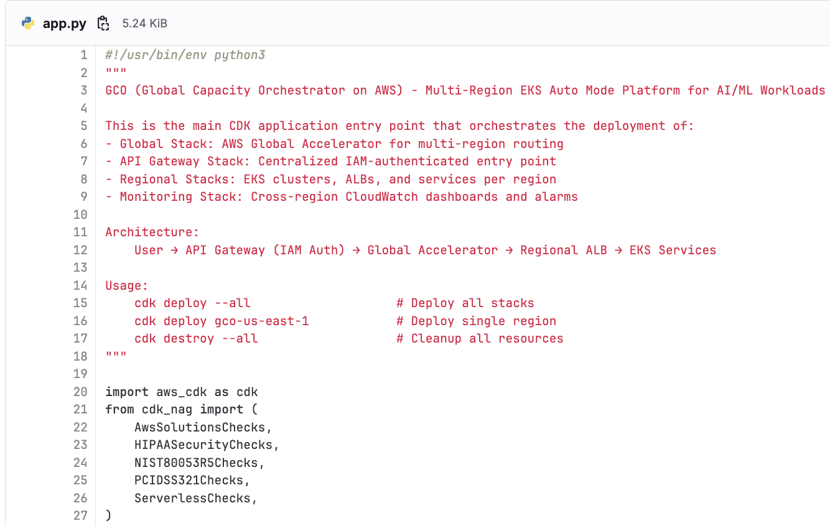
5 CDK Nag Conformance Packs
https://github.com/cdklabs/cdk-nag/blob/main/RULES.md

Slide 25
02
Auto Routing
Automatically selecting the best region for workloads

Slide 26
GCO Auto Routing Capability #1: Take my workload to the nearest region and don’t go to a region if it is already running too much stuff.

Slide 27
GCO AWS Global Accelerator Concepts
Users in South America
Users in New Zealand
Single AWS Global Accelerator Endpoint
Uses AWS Global Network from Edge to Region
Client traffic ingresses via closest available Edge location
Route client to closest healthy endpoint (THIS IS VERY IMPORTANT)
AWS Cloud
Edge location
Edge location
Edge location
Edge location
Redundant paths
US East (N. Virginia) (Primary)
Asia Pacific (Singapore) (Secondary)
Application Load Balancer
Application Load Balancer
GCO Services
GCO Services

Slide 28
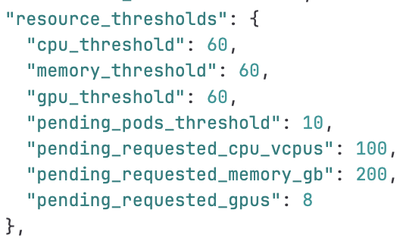
The Problem: Run my job ASAP wherever there’s capacity
The Solution: Automated resource-based job routing
Generally, when an application fails health checks its because its not working.
However, there’s no reason we can’t programmatically fail healthchecks and use this to control Global Acclerator’s routing behavior.
All of these thresholds can be changed at any time in cdk.json and redeployed out to the infra
If an EKS cluster exceeds any of these thresholds incoming jobs will route away from the cluster to other clusters

Slide 29
GCO Auto Routing Capability #2: Automatically determine the optimal region for my workload.

Slide 30
The Problem: Knowing what region to run in can be difficult
The Solution: Give customers better information and tools

Slide 31
GCO Auto Routing Capability #3: Set up autoscaling, multi-region, latency minimized custom inference endpoints with automatic failover and IAM authentication using a single CLI command.

Slide 32
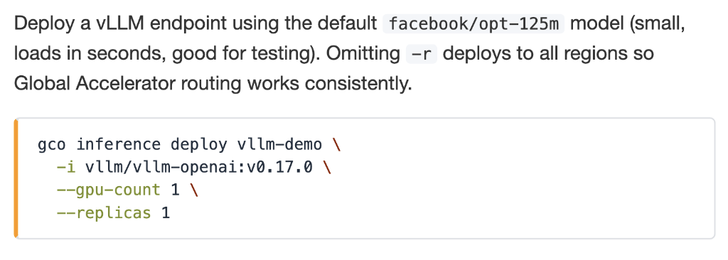
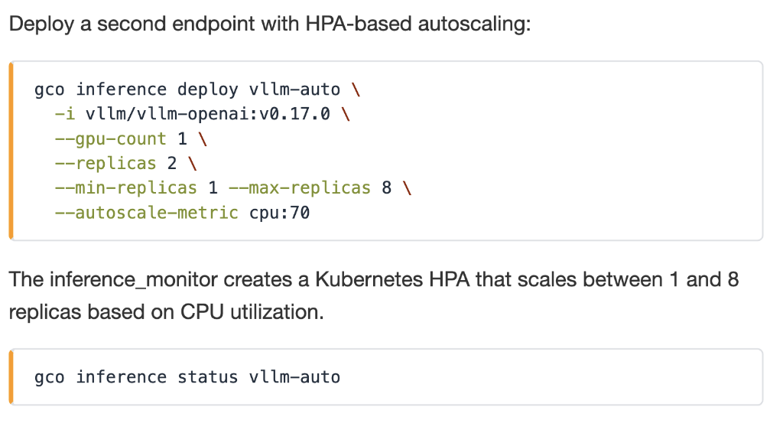
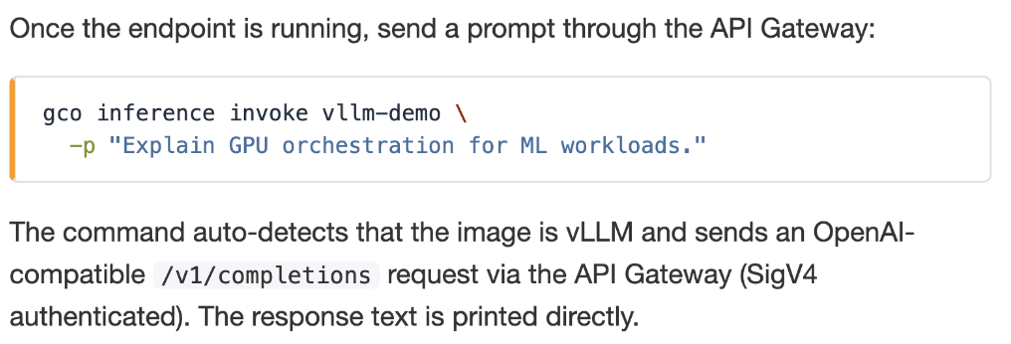
The Problem: Setting up multi-region inference is hard
The Solution: Automate the process in one command

Slide 33
03
GCO MCP
Access to over 120 different tools that can be used by agents and organized context for all files and documentation in the codebase.

Slide 34
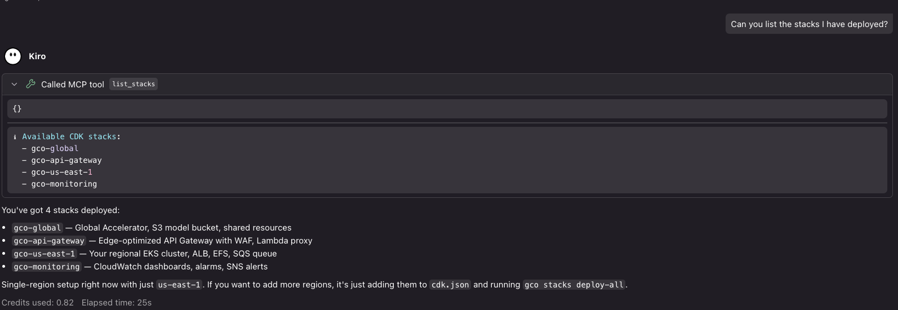

Use the MCP wherever the MCP protocol is supported
Using the MCP in Kiro

Slide 35
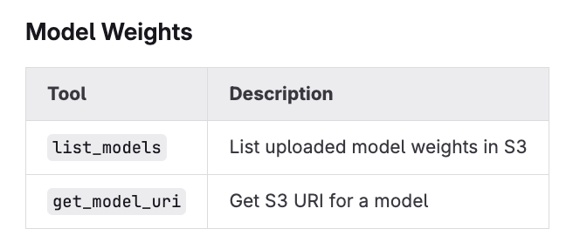
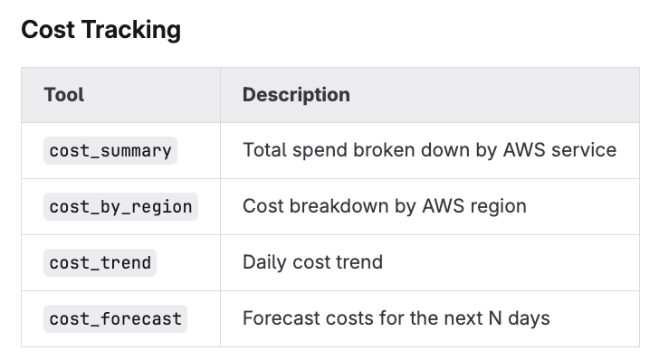
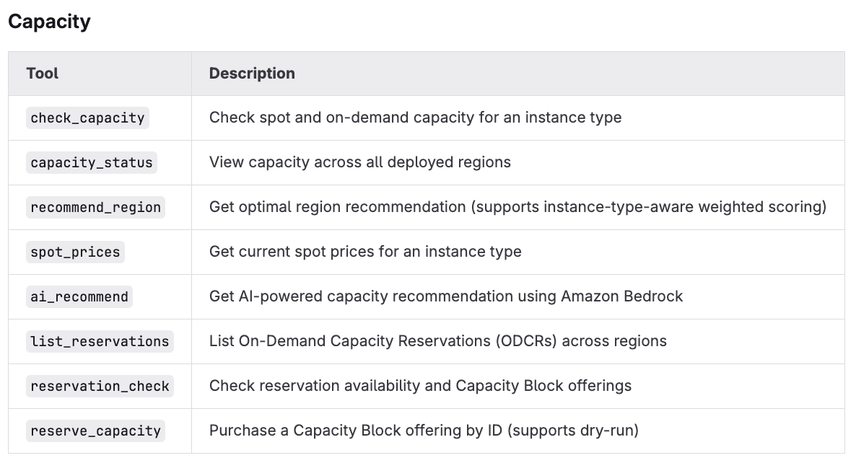
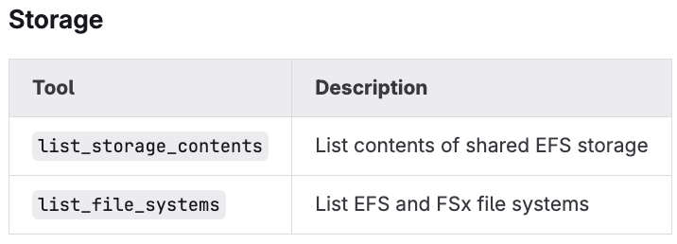
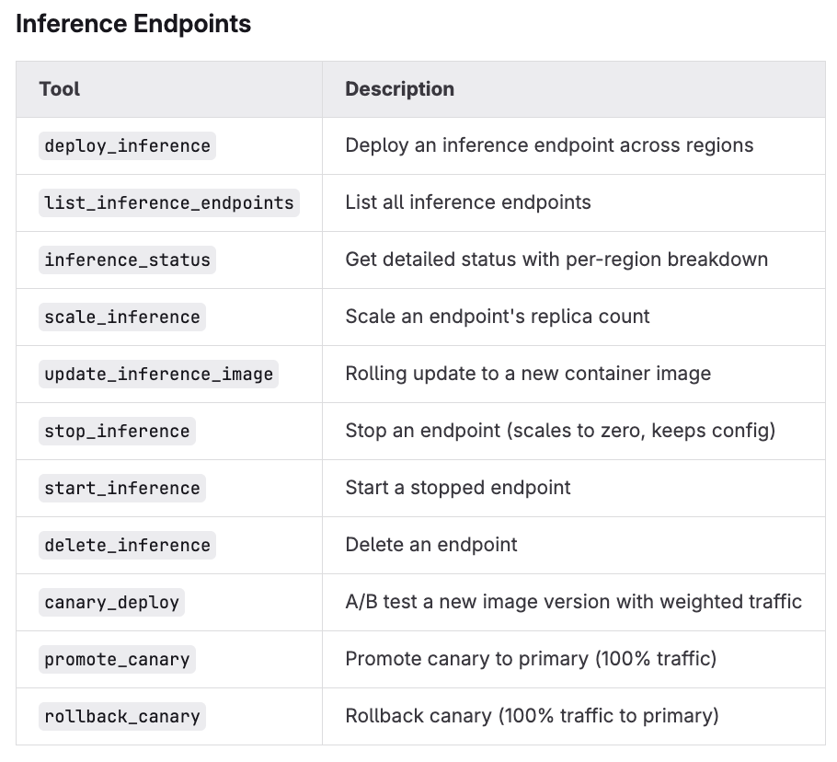
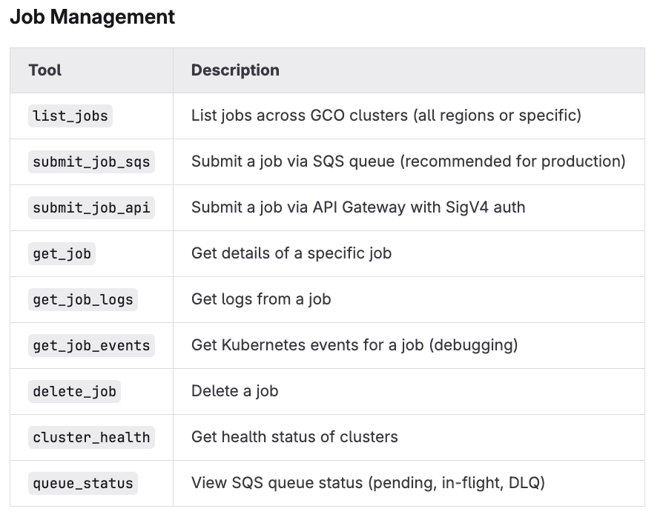
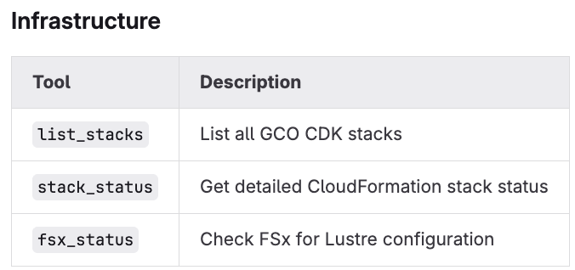
Many supported tools

Slide 36
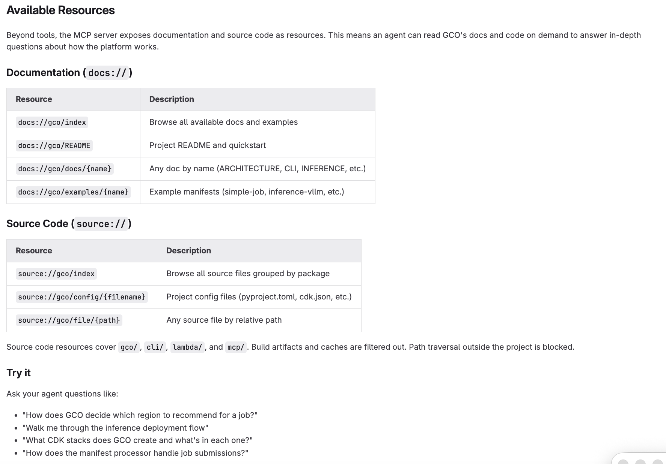
Make Agents an Expert in the Codebase

Slide 37
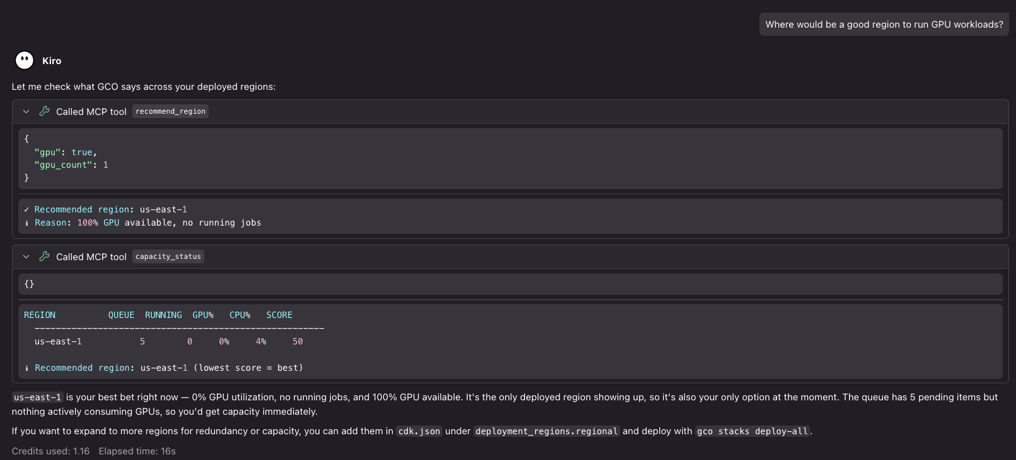
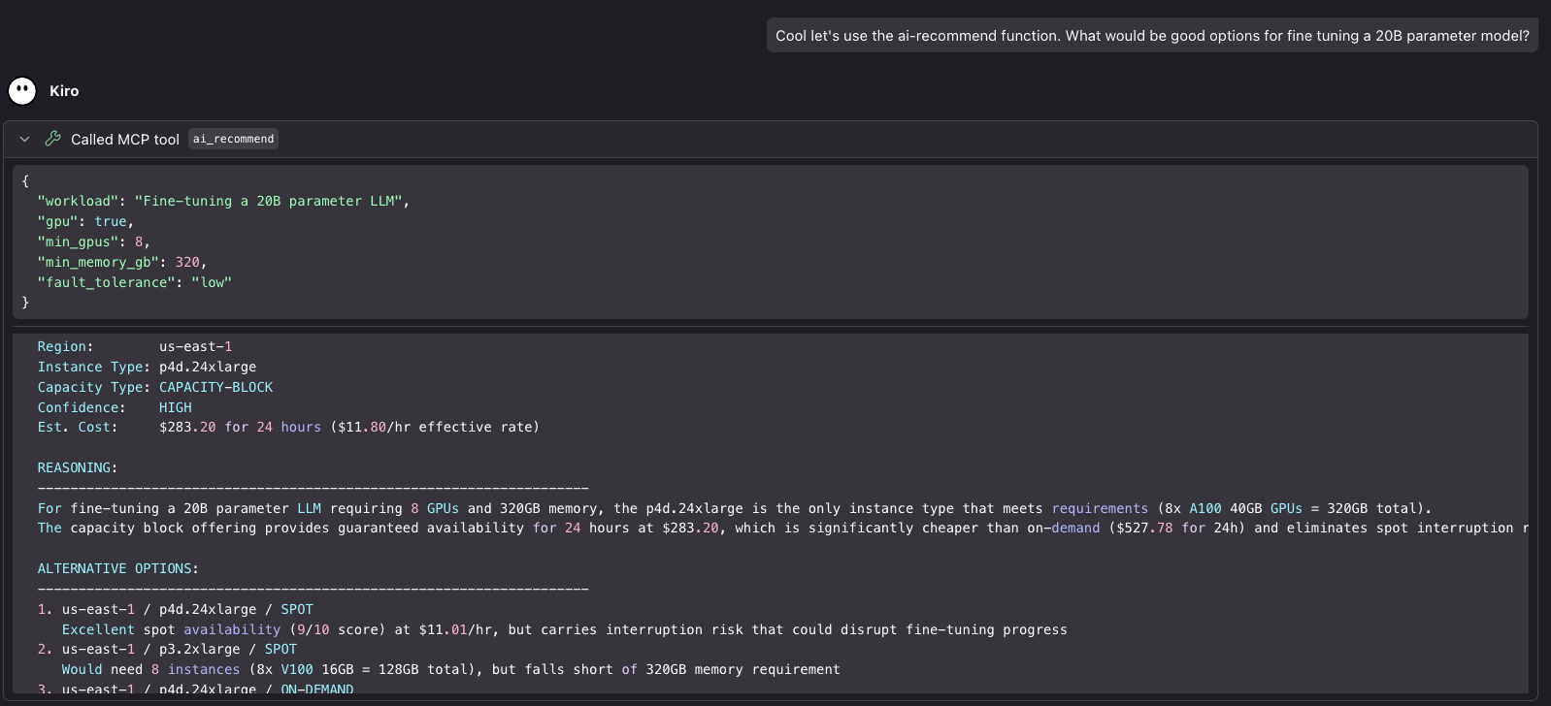
Capacity Scanning
Solve complex capacity planning problems using nothing but natural language!
Combining knowledge of the codebase and capacity is where things get really interesting!

Slide 38
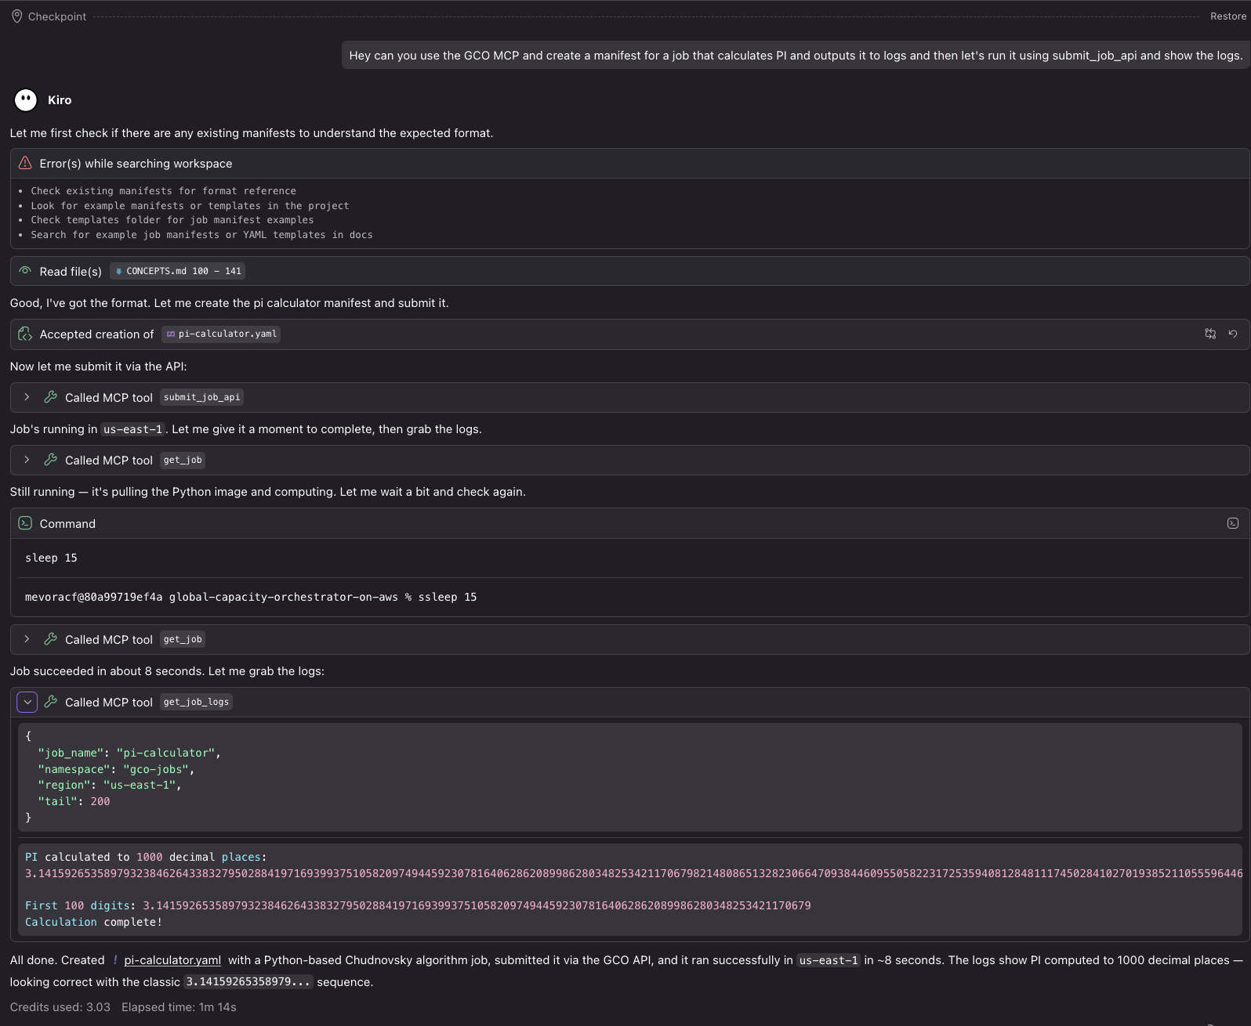
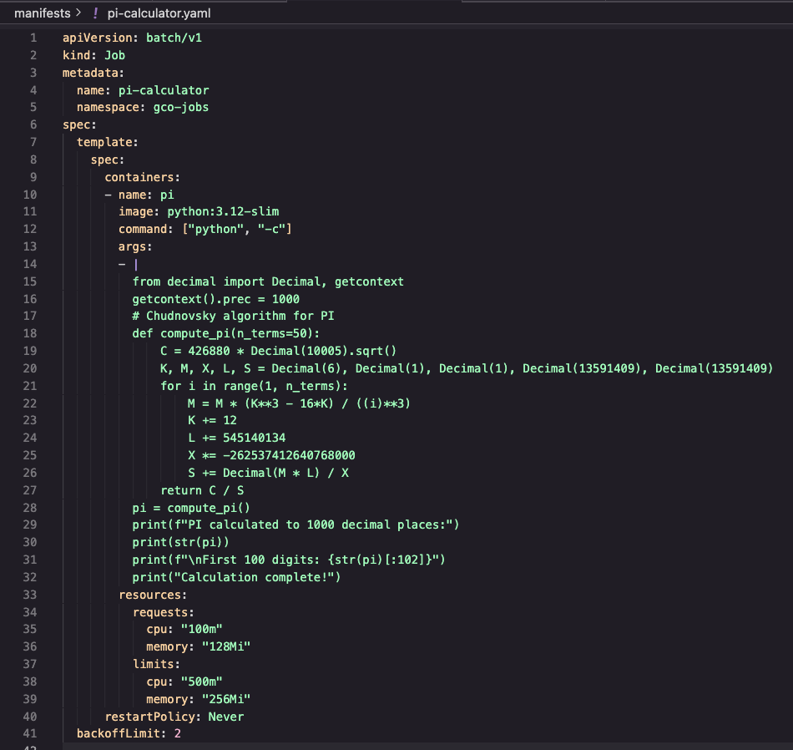
Combining MCP Capabilities to Automate Entire Workflows

Slide 39
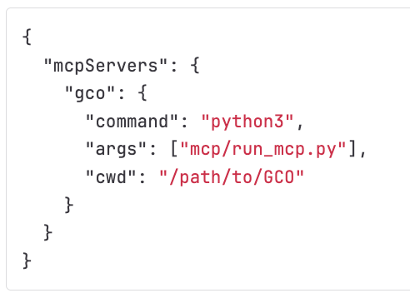
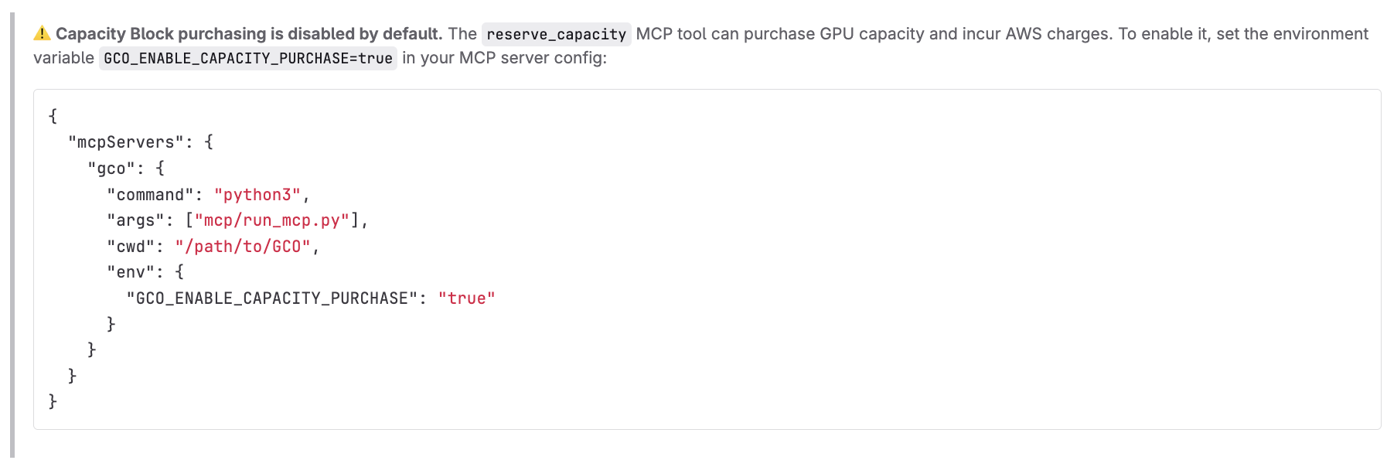
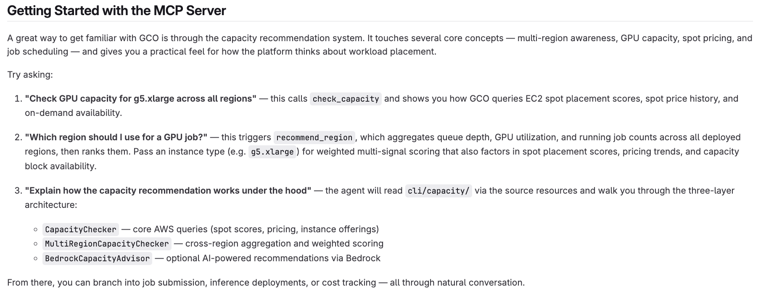
Simple Setup and Optional Capacity Purchasing

Slide 40
04
Live Demo & FAQ

Slide 41
Thank You
Jacob Mevorach Senior Generative Artificial Intelligence Solutions Architect Frontier AI Team
https://www.jacobmevorach.com

