Slide 1

Project Name : Online Home Rental System
Presentation on Project Proposal
Supervicsed By:
Md. Abdul Wahab
(Lecturer)
Department Of Computer Science & Engineering
Submitted By:
Arnab Das
Semester: 7th
Roll: 1524007 Reg:150224007

Slide 2
Outline
Introduction
Goal
Swot Analysis
Important Tools & Language
System Architecture
Conclusion

Slide 3
Introduction
Online Home Rental System will provide the information about Homes/Flats/Houses/Mess which is available for Rent.
Home Rental System will make easy to find the location of Homes/ Flats/Houses/Mess which select for the renter.
It will make easy to upload the location, contact No., Expected rent, Facilities and Other information by Landlord/Houses-master.
This site will be able to show the homes/houses with in a particular area selected by user.

Slide 4
Goal
This site will be save both time and resources.
Provide Homes Locations by Google Map service with help of GPS.
This will increase the efficiency of current renal system.
It will provide all nearby locations to renter and multiple renters to the landlord.
Quick deal.
Direct communication between renter and landlord.
It will be a web application so no extra resources required.

Slide 5
Swot Analysis
This Project have a most important problem is verification. Because It is very hard for finding who is the real Homemaster/ landlord and a great challenge for filter different in real or fake post.

Slide 6
Important Tools & Language
PhpStrom(Editor),
XAMPP(server),
Composer,
Git - Version Control
MySql PDO,
Html, CSS, BootStrap, JavaScript, JQuery
Raw Php, Laravel/WordPress(Framework) &
Third party packages

Slide 7
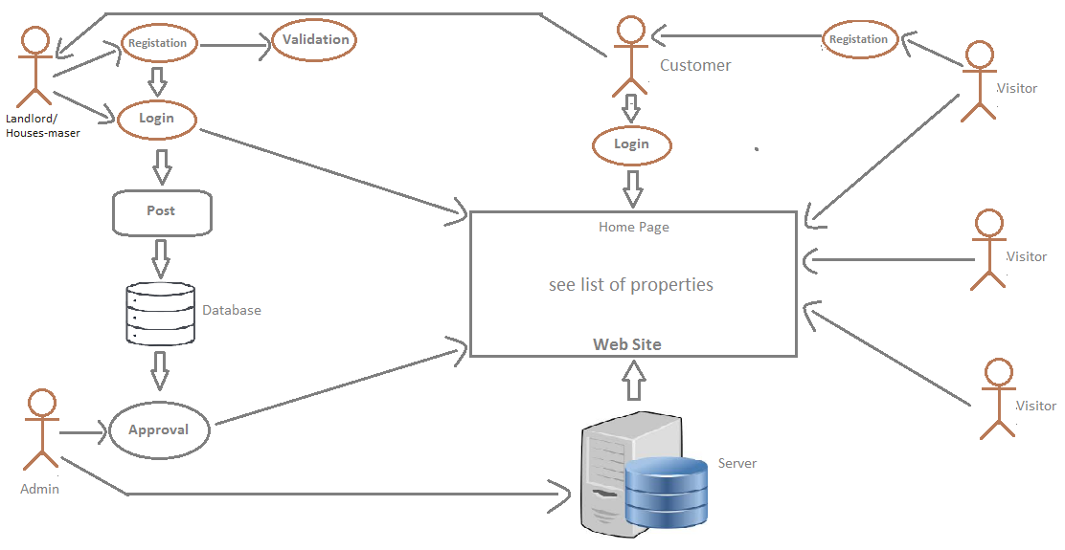
System Architecture

Slide 8
Conclusion
It will be save the physical hard work and invaluable time to find home/flat. So, It is very important in our busy Life. And it is open Source Site so that everyone freely used it and easily find his/her rent Homes/flats/houses/mess and Homemaster/ Landlord easily sell his/her homes. So it is very helpful and very efficient at this time.

Slide 9


