Slide 1
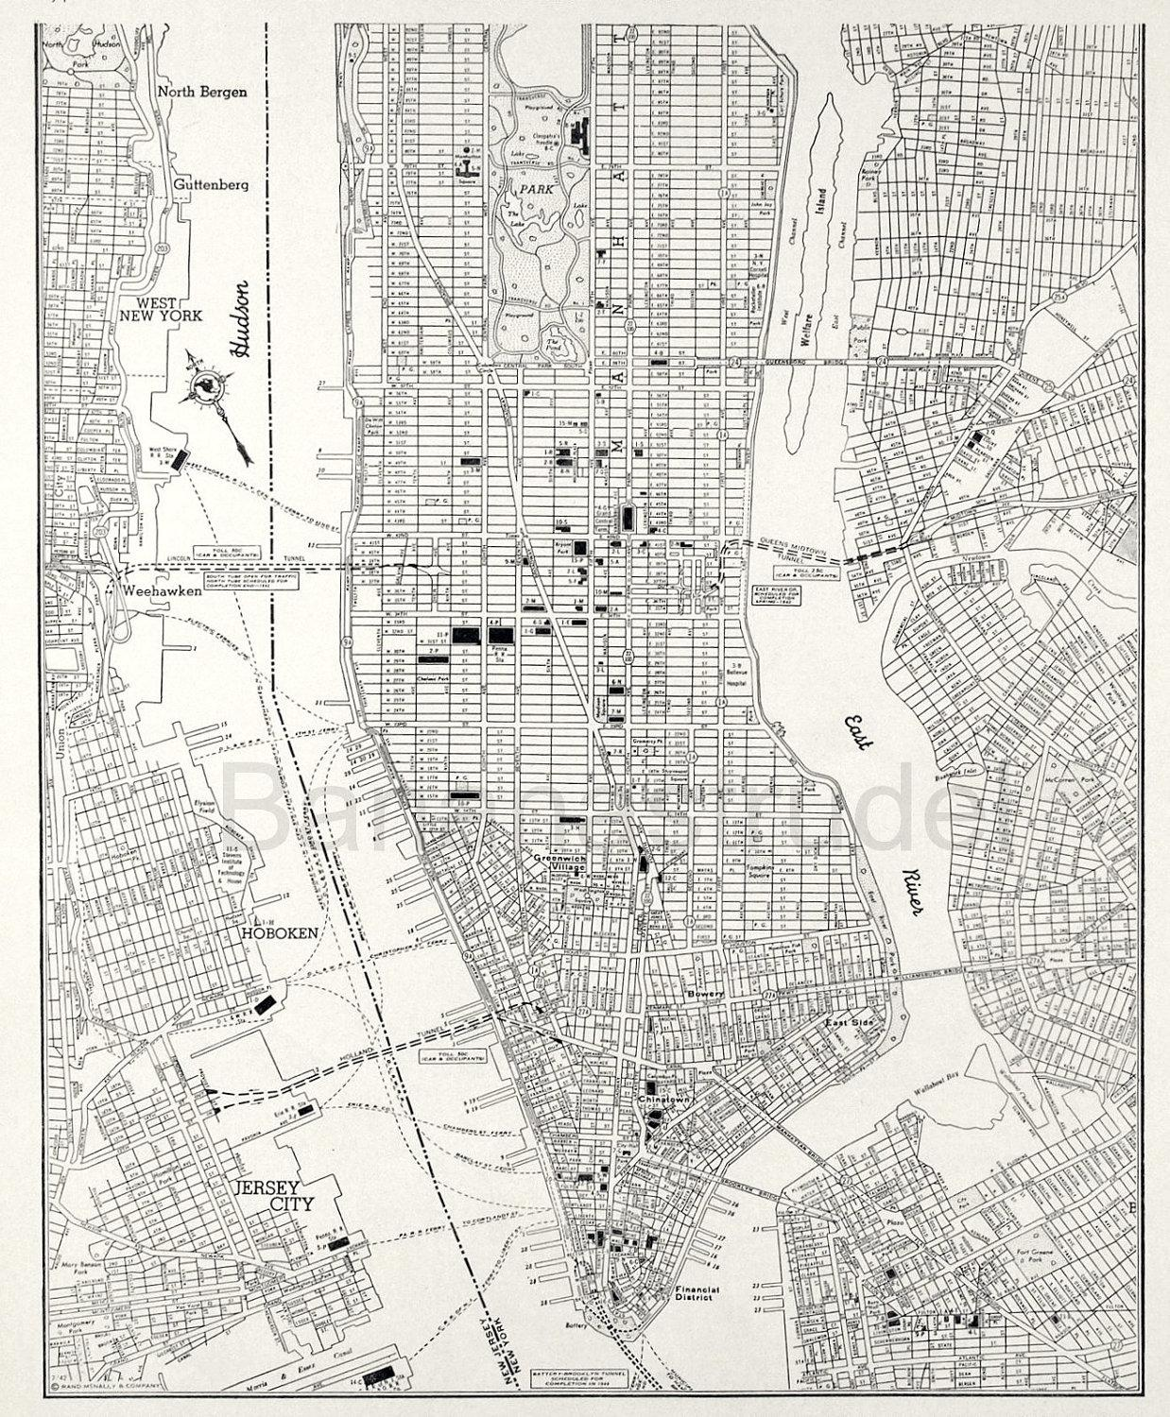




COOP PRESENTS: NYC ARRESTS

Slide 2

AGENDA
INTRODUCTION
EXECUTIVE SUMMARY
CONTEXT
METHODOLOGY
FINDINGS
CONCLUSION

Slide 3




MEET THE TEAM
Ryohei Shima
Justin Miller
Akif Rahman
Ranphy Cabral

Slide 4
INTRODUCTION

Slide 5
INTRODUCTION
Project Objective
Analyze over 155,000 records from the NYPD 2021 arrest data (NYC Open Data) to identify key trends and insights.
Provide data-driven recommendations to the Mayor of New York City to support informed public safety and community well being.
Questions We Asked
Which borough has the highest crime rate?
What seasons see the highest spike in crimes?
What age group commits the most crimes?
How do the arrests differ by gender?

Slide 6
EXECUTIVE SUMMARY

Slide 7
ISSUES

Slide 8
ISSUES
Borough concentration – Most arrests occurred in Brooklyn and Manhattan.
Seasonal spikes – Arrests were highest in Fall and Summer.
Age group disparity – Adults aged 25–44 made up the majority of arrests.
Gender gap – Males were arrested nearly five times more than females.

Slide 9
RECOMMENDATIONS

Slide 10
RECOMMENDATIONS
Balance Enforcement –Have more NYPD officers deployed in Manhattan and Brooklyn since it’s a larger city area.
Seasonal Crime Prevention – Strengthen community policing, youth engagement, and outreach efforts during the summer and fall.
Support the 25–44 Age Group – Provide mental health services, job training, and rehabilitation centers.
Gender-Responsive Programs – Expand mentorship, rehabilitation, and violence-prevention initiatives tailored for young men.

Slide 11
CONTEXT

Slide 12
What is the problem?
We do not know how effectively safety is maintained across New York City communities. Data analysis is needed to determine whether certain boroughs or populations are disproportionately impacted.

Slide 13
Why is this project important?
It helps the Mayor’s office understand who is being arrested and where these arrests are occurring. With these insights, we can identify strategies to enhance public safety and better serve New York City communities.

Slide 14
Why is this a meaningful space to explore?
This analysis sheds light on what crimes are committed most often, who is being arrested, and where. It’s essential for shaping fairer, more effective public safety policies and figuring out ways to prevent crimes.

Slide 15
METHODOLOGY

Slide 16


Team Process
DATA COLLECTION
DATA CLEANING
DATA TRANSFORMATION
ANALYSIS
VISUALIZATION
USED THE NYPD 2021 ARRESTS DATASET PROVIDED
CHECKED FOR DUPLICATES
REMOVED COLUMNS
REPLACED NULL VALUES
STANDARDIZED COLUMNS
ADDED NEW COLUMNS
USED EXCEL AND PYTHON FOR EXPLATORY DATA ANALYSIS
CREATED VISUALIZATIONS USING TABLEAU

Slide 17
FINDINGS

Slide 18
WHAT BOROUGHS HAVE THE HIGHEST CONCENTRATIONS OF ARRESTS?

Slide 19
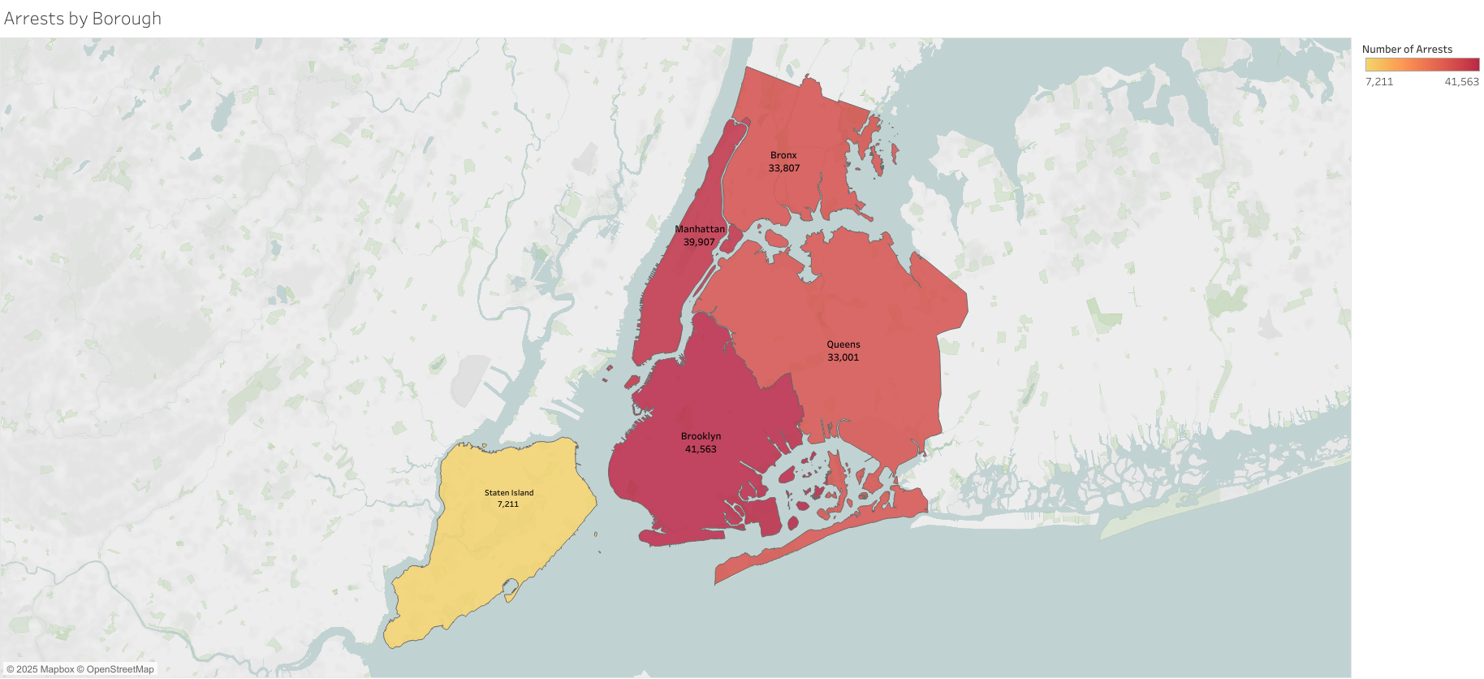
ARRESTS BY BOROUGH
Brooklyn had over (41,000) arrests, making it the borough with the largest share of total arrests.
Staten Island had the lowest number of arrests, with Just over (7,000) arrests.
Both the Bronx and Queens were nearly tied in arrests, despite Queens having almost a million more residents.

Slide 20
WHAT MONTHS SAW AN INCREASE OR DECREASE IN CRIME?

Slide 21
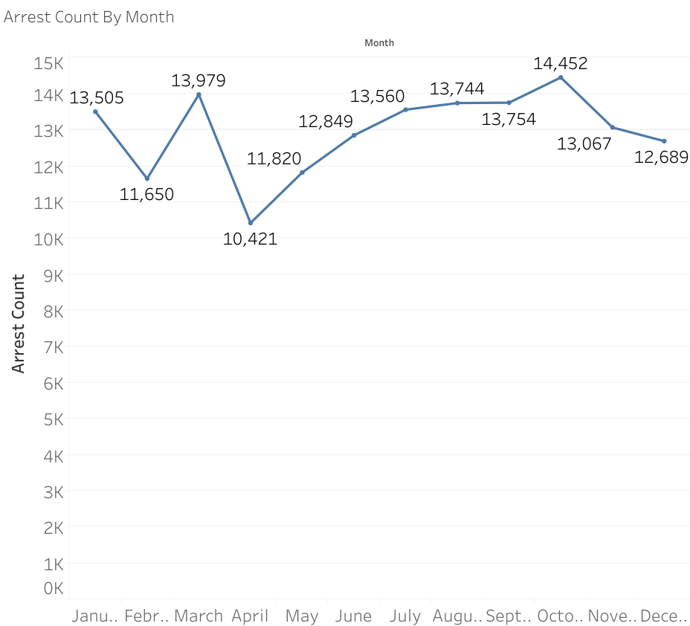
ARRESTS BY MONTH
October had the highest number of arrests in 2021 with (14,452) arrests made.
April had the lowest number of arrests for 2021 with (10,421) arrests made.
The highest spike in crime occurred between February and March.
The biggest dip in crime happened between March and April.
Arrests steadily increase after April.

Slide 22
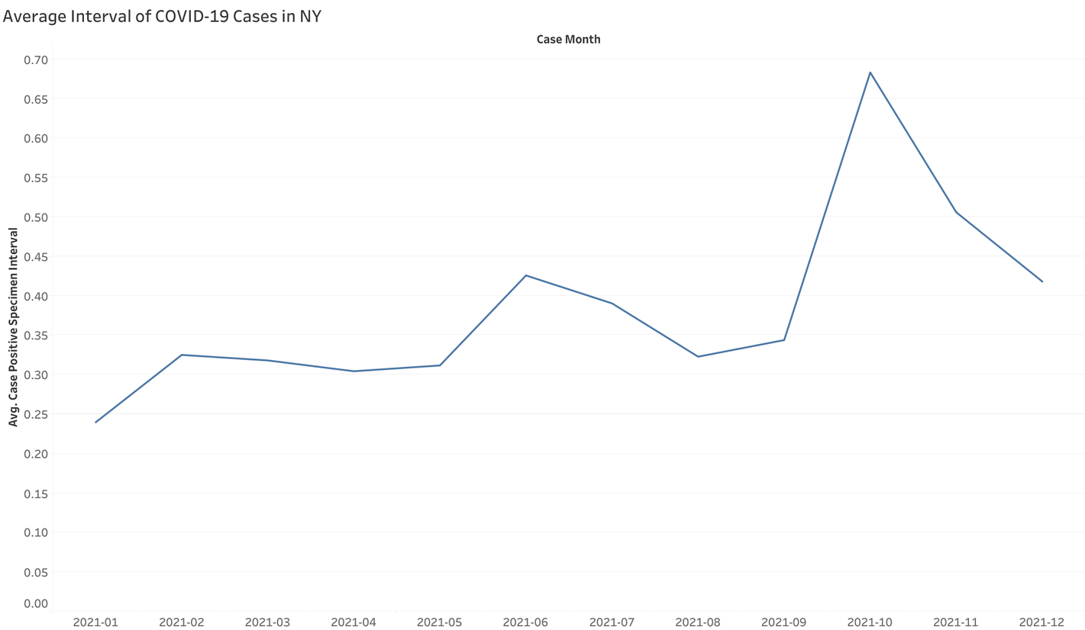
ARRESTS VS COVID CASES
*COVID RESTRICTIONS IN NYC WERE LIFTED AFTER APRIL OF 2021. THERE IS A STEADY INCREASE IN ARRESTS AND COVID CASES UNTIL OCTOBER, WHERE BOTH ARRESTS AND COVID CASES PEAK.

Slide 23
WHAT AGE GROUP HAD THE HIGHEST NUMBER OF ARRESTS?

Slide 24
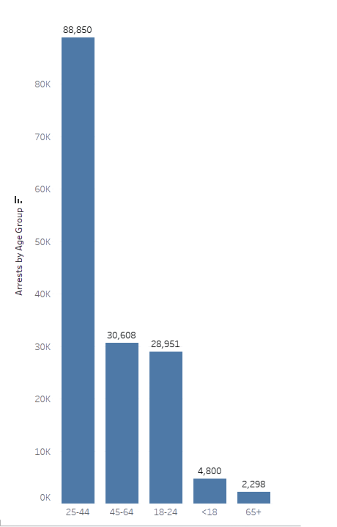
ARRESTS BY AGE GROUP
The 25–44 age group accounts for the highest number of arrests, with 88,850 arrests, making it the dominant category by a large margin.
The 45–64 age group comes second with 30,608 arrests, followed closely by the 18–24 age group at 28,951 arrests.
Arrests drop significantly for minors (<18) at 4,800 arrests, and are the lowest for seniors (65+) with just 2,298 arrests.
The data shows a clear concentration of arrests among young to middle-aged adults, particularly ages 25–44, which far surpasses all other groups combined.
Both the youngest (<18) and oldest (65+) age groups represent only a small fraction of overall arrests, highlighting that crime is heavily concentrated in the working-age population.

Slide 25
WHAT WAS THE GENDER GAP IN ARRESTS?

Slide 26
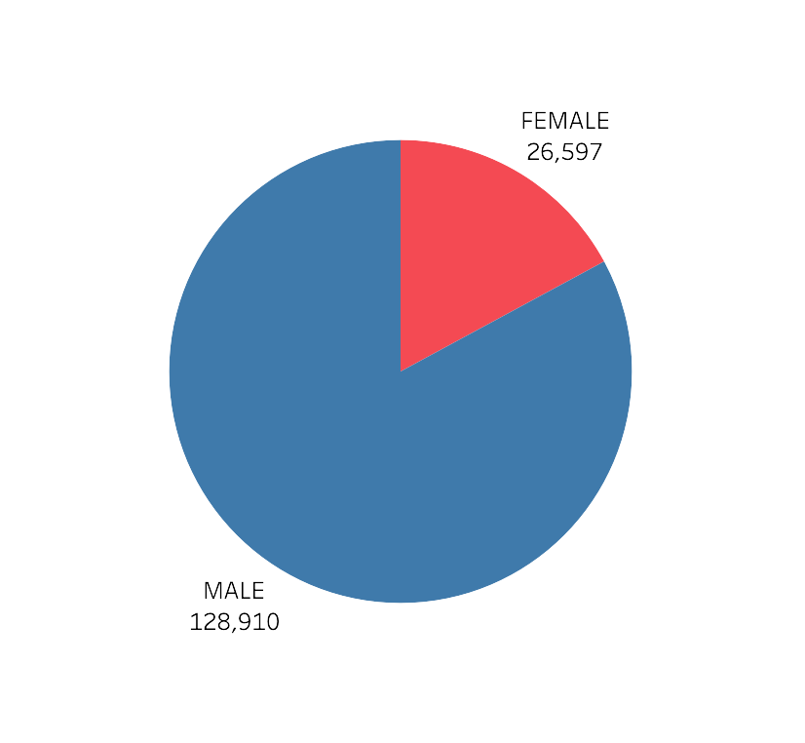
ARRESTS BY GENDER
Males dominate arrest statistics, accounting for 128,910 arrests (~83%).
Females make up a much smaller share, with 26,597 arrests (~17%).

Slide 27
ADDITIONAL FINDINGS

Slide 28
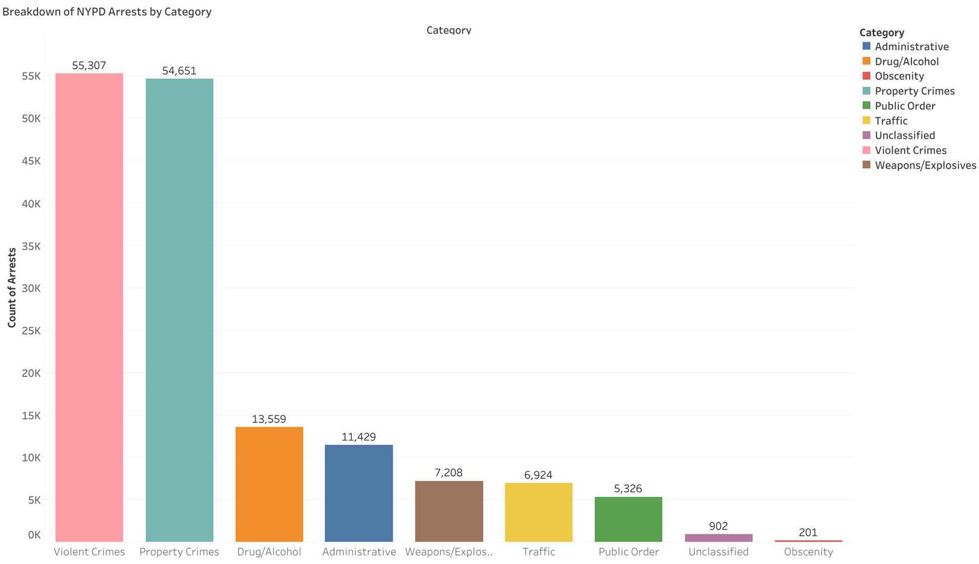
NYPD ARRESTS BY CATEGORY
Violent Crimes (55,307) and Property Crimes (54,651) make up the majority of arrests.
Drug/Alcohol offenses (13,559) and Administrative arrests (11,429) are in the middle
Weapons/Explosives (7,208), Traffic violations (6,924), and Public Order (5,326) represent the lower portion
Unclassified (902) and Obscenity (201) arrests are minimal, and rare

Slide 29
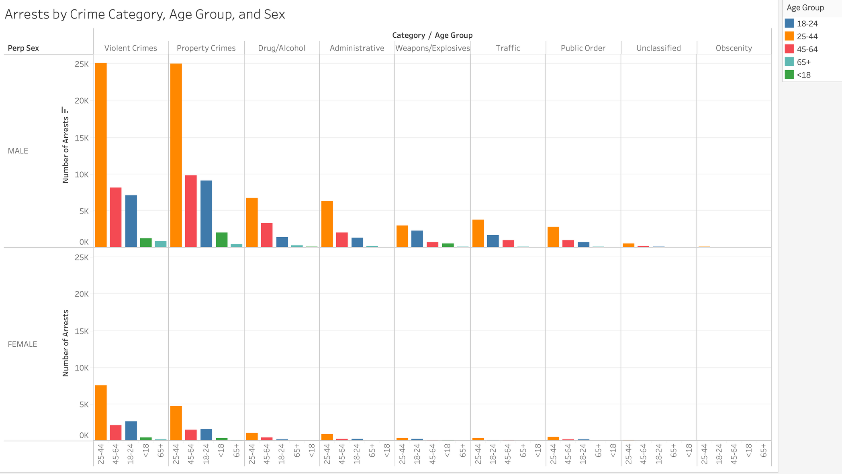
ARRESTS BY CRIME, AGE, AND SEX
Notes:
By combining the previous charts on arrest category, age group, and gender we are able to reinforce previous observations while also focusing on a specific demographic.
This being that Men within the ages of 25-44 are most likely to commit crimes, especially if it's considered violent or property crimes within NYC.
Through this we are able to solidify our recommendations that could help decrease such occurrences.

Slide 30
CONCLUSION
Based on the analysis on NYC Arrest Data, we can conclude:
Most Arrests: Brooklyn & Manhattan
Likely Demographic: Men within age group of 25-44
Monthly Arrests Trends: Arrests were the lowest in April, but peaked at October
COVID Influence: The steady rise in arrests after April was similar to the rise in COVID-19 cases after restrictions were lifted.
Notes:
Most arrests occurred in Brooklyn and Manhattan.
The majority of crimes were committed by men.
Individuals between the ages of 25 and 44 were arrested the most.
Arrests peaked in October and were the lowest in april.
the steady rise in arrests after april wAS similar to the risE IN COVID-19 CASES after restrictions were lifted.
Environmental Influeces: COVID 19 and Restrictions

Slide 31
CONCLUSION: CALL TO ACTION
Balance Enforcement: Have more NYPD officers deployed in Manhattan and Brooklyn due to higher crime occurrences within the large city area.
Support the 25–44 Age Group: Provide mental health services, job training, and rehabilitation centers.
Seasonal Crime Prevention: Arrests are high during Summer and Fall, therefore we should strengthen community policing, youth engagement, and outreach efforts during these times.
Gender-Responsive Programs: Since men ages 25-44 are arrested most for violent crimes and property crimes, we should expand mentorship opportunities, support groups, rehabilitation, and violence-prevention initiatives tailored for young men.

Slide 32
RESOURCE PAGE
NYC Open Data
COVID 19 DATA
ONE PAGER

Slide 33

THANK YOU!

