Slide 1
A 1.25GHz 161fJ
6-bit Absolute-Value Detector
Alexander Graening
Joseph Miller

Slide 2
Design Summary
Circuit topology: Mixed static CMOS with PTL
Circuit Style: Custom logic (Inversion stage + CLA Adder)
Design Philosophy: Utilize binary arithmetic to compute |X| and –T-1 then sum the results to determine which is larger.
Delay | Layout size | Energy | Verfication
Sch. t_{p} = 789.40 ps | X= 24.9, Y= 17.0 | Sch. E = 122 fJ | Func: Y
Lay. t_{p} = 799.07 ps | A = 424 µm² | Lay. E = 161 fJ | DRC: Y
Critical Input = X₁ | AR = 1.46 | Lay. V_{DD} = .6525V | LVS: Y
ECE115C – Spring 2019

Slide 3
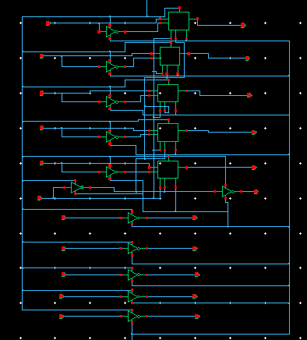
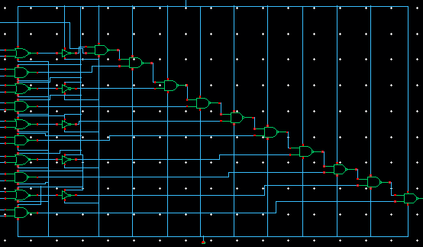
Critical Path Analysis
5-bit Carry Lookahead Adder
Inversion Stage
t_{critical} = 2t_{INV} + 10t_{NAND} + t_{NOR} + t_{MUX}
ECE115C – Spring 2019

Slide 4
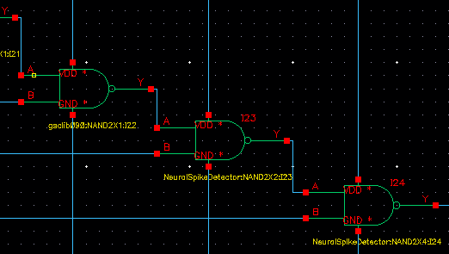
Design Optimization
Focus on minimizing area (sized all gates to half size)
Sized gates towards output larger to improve delay
Pass transistor logic for the mux
Removed inverter from PTL (improved delay and reduced energy)
ECE115C – Spring 2019

Slide 5
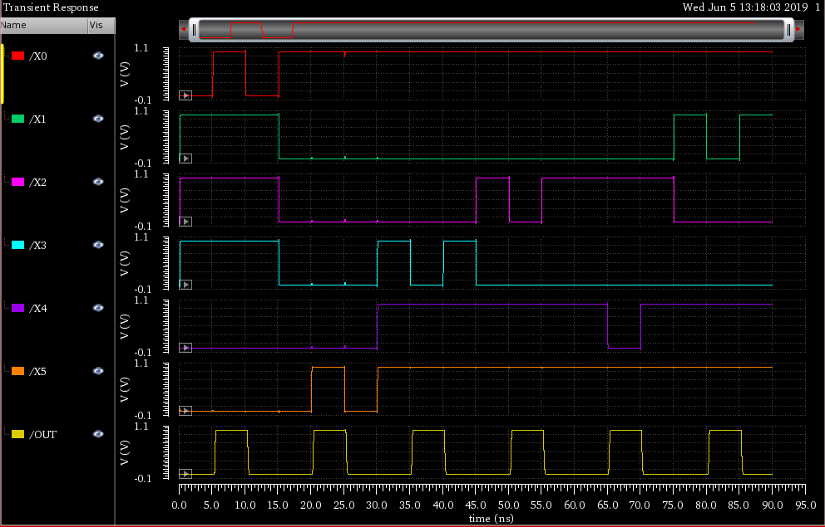
Functionality Check
Tested circuit Externally in online digital circuit simulator (https://logic.ly) to further guarantee functionality for all inputs
ECE115C – Spring 2019

Slide 6
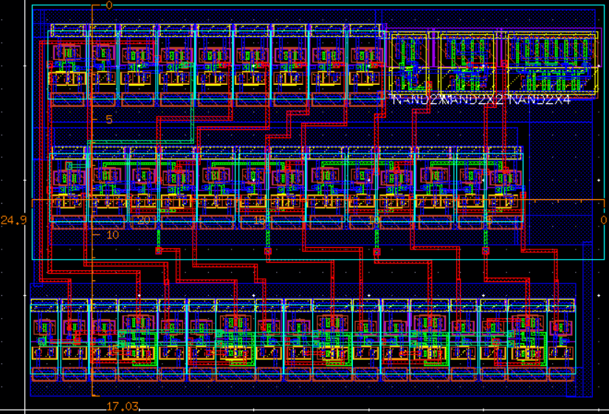
Absolute-Value Detector Layout
X = 24.9μm
Y = 17.0μm
NAND Chain for CLA
OUT
Aspect ratio:
1.46
Area:
424μm²
NANDs and NORs for CLA
Inverters and Muxes
ECE115C – Spring 2019

Slide 7
Discussion
Most important design features
  Computation of |X| through carry in of CLA removing need of Full Adders
  Logic optimization resulted in low transistor count, low energy, and small area usage.
  NAND chain placed close together for short critical path in layout.
If we had more time
  Test additional adder topologies (we only tested carry-lookahead and carry-bypass)
  Optimize layout for better aspect ratio, improve parasitics, and lower area.
  Perform additional sizing and decrease size of custom gate layouts
ECE115C – Spring 2019

