Slide 1
Data 520
Introduction To Programing
Project: Most popular dog breeds
Judy Minichelli
December 4, 2017
Technical objectives:
1. Import a .csv file into a Sqlite3 database table
2. Query a database table, perform calculations
3. Build a GUI using Tkinter to display top 10 breeds in PA

Slide 2
QUIZ

Slide 3
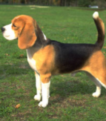
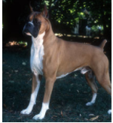
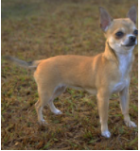
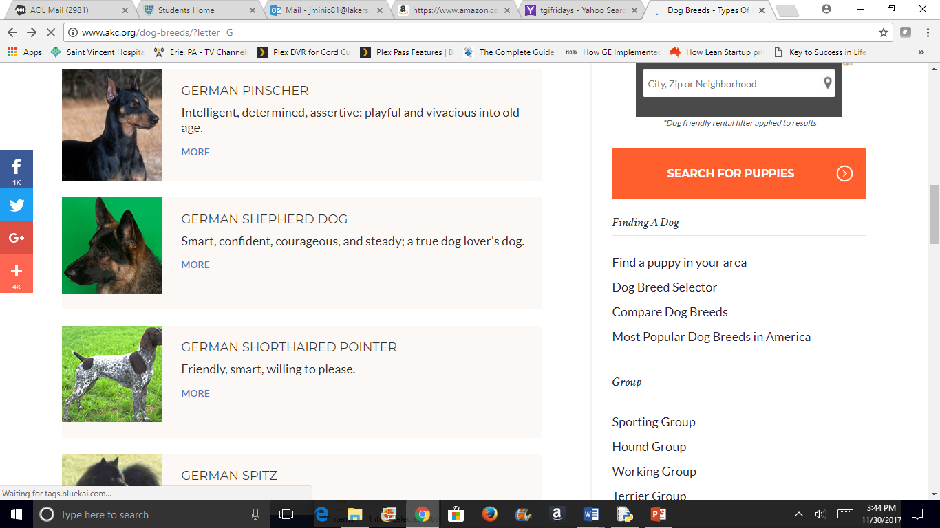
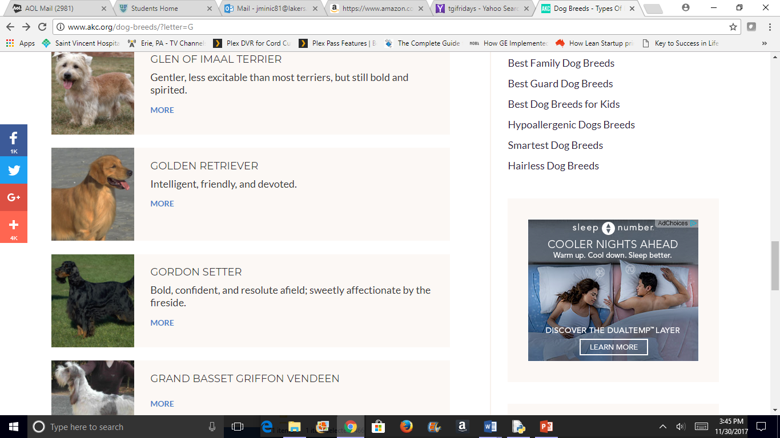
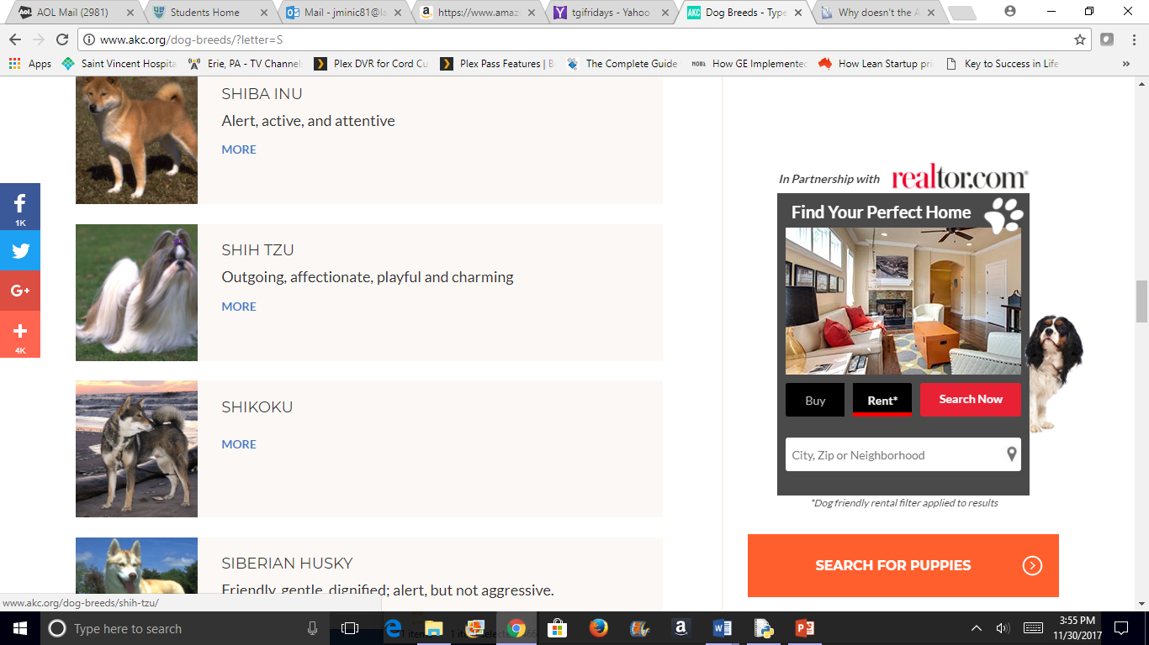
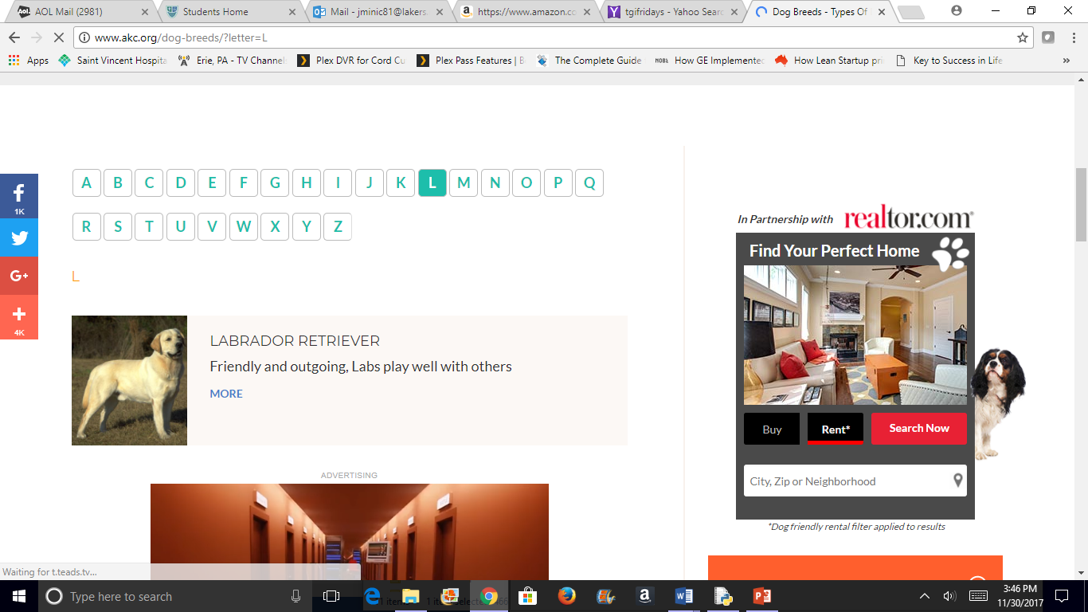
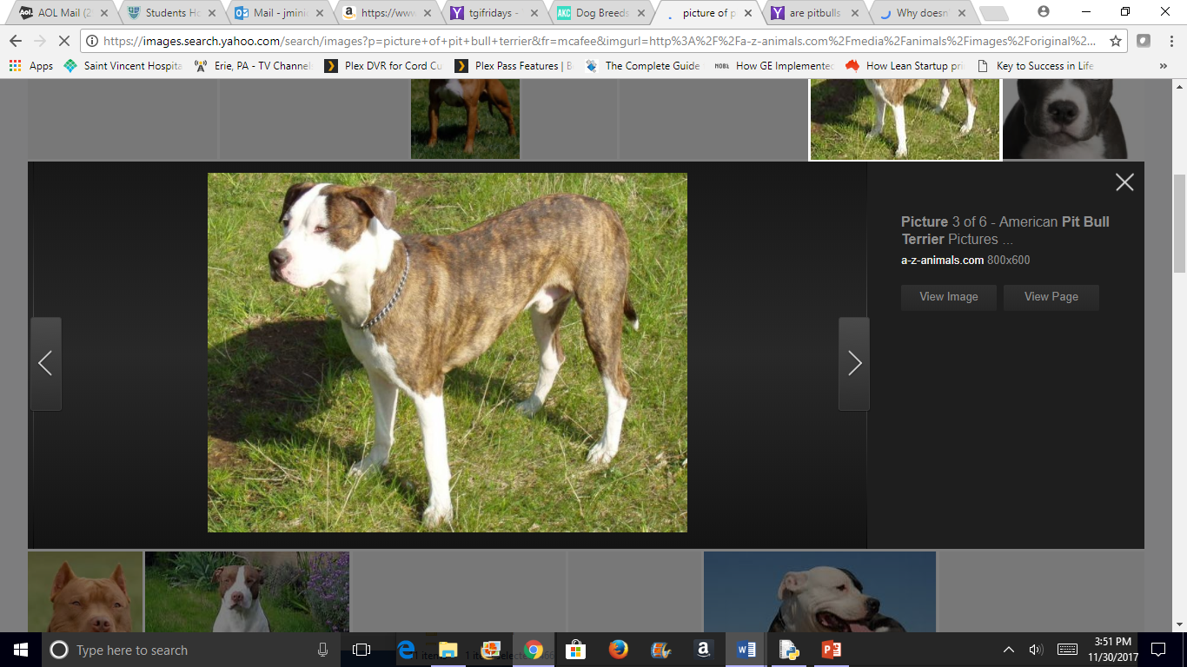
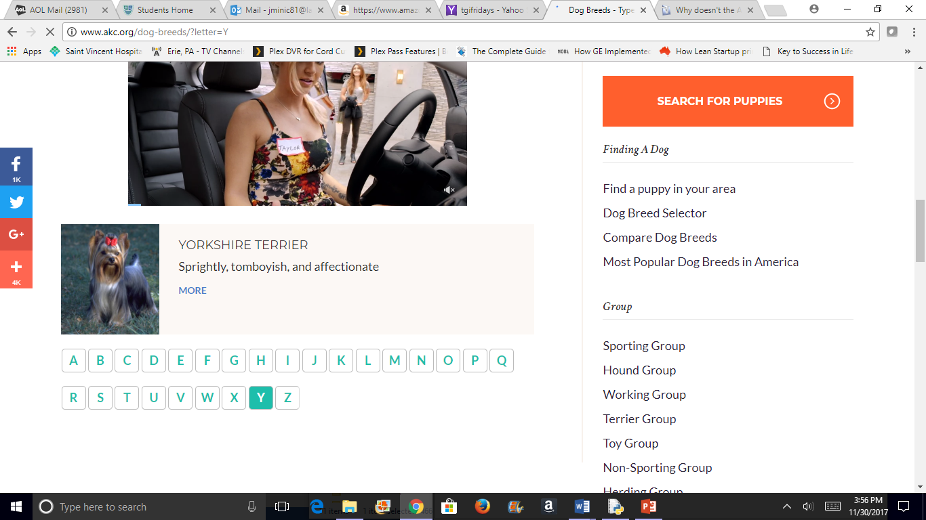
Beagle
Boxer
Chihuahua
German
Shepherd
Golden
Retriever
Labrador
Retriever
Mixed
Pit Bull Terrier
Shih Tzu
Yorkshire
Terrier
?

Slide 4
DEMO 1
GUI

Slide 5
DEMO 2
Sqlite3

Slide 6
CODES

Slide 7
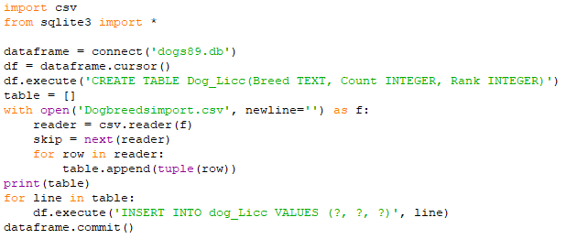
Code 1: import .csv file into Sqlite3 database table
Create database, database table and empty table (placeholder)
Open and read .csv file
Skip column headings
Add each row in .csv file to empty table as a tuple
Add each row in table to database table
Save database table

Slide 8
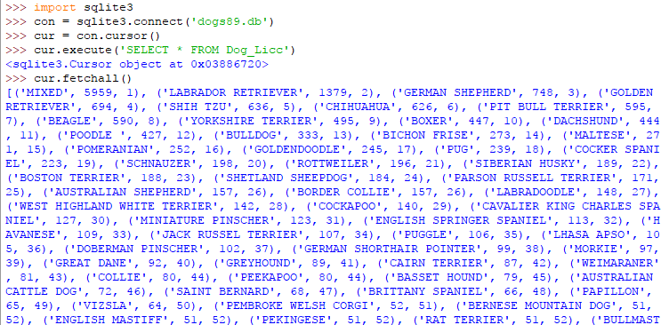
Code 2: Sqlite3 database table/queries, Part 1
Connect to database
Connect the cursor
View contents of table

Slide 9
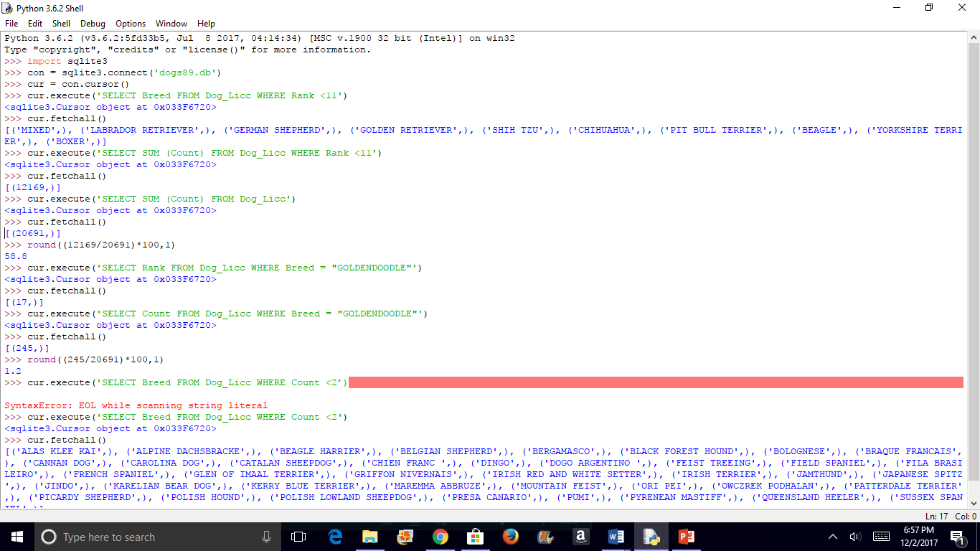
Code 2: Sqlite3 database table/queries, Part 2

Slide 10
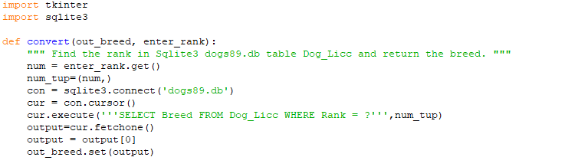
Code 3: Tkinter GUI, Part 1
Function
Read user input
Connect to database
Find input in tuple in table
Return breed that corresponds to input (rank)

Slide 11
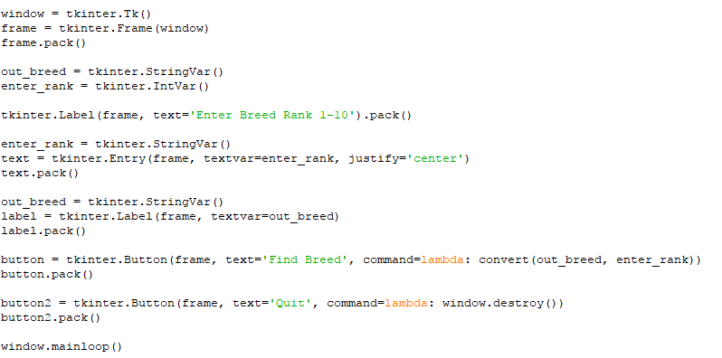
Code 3: Tkinter GUI, Part 2
Create root window (visible container)
Create frame (invisible container for widgets)
Call method “pack” for all widgets, to place them in the parent widget
Variables change with each input
Entry box for rank input (centered)
Output label for breed type
Create two buttons
Allows the code to run multiple times

Slide 12
References
1. Kaggle dataset: https://www.kaggle.com/kingburrito666/largest-dog-breed-data-set
2. Pictures of dogs on Slide 6: http://www.akc.org/dog-breeds/
Acknowledgements
BIG thank you to Justin Minsk for .csv file import code on Slide 10 plus tweaks to other codes!
Conclusions
Singularity is already here (my computer is smarter than I am)
This project was a good learning exercise: it could have gone in many different directions and used several other tools

Slide 13
BACKUP

Slide 14
Background DATABASE TABLE = BREED, COUNT, RANK
The Kaggle Largest Dog Breed dataset contains the 2017 Pennsylvania dog license renewals in the greater Pittsburgh area.
A excerpt from the dataset above was imported into a Sqlite3 database table as a .csv file. A GUI will be used to extract the top 10 breeds by count from the database table.
189 different breeds of dogs are recognized by the American Kennel Club (AKC) but the file contains 212 unique breeds.
AKC list is not static: breeds are added/removed as they rise and fall in popularity

Slide 15
Background Print these two pages for myself
As of December 2016, there are 189 different breeds of dogs are recognized by the American Kennel Club. Each falls into 7 different categories based on the type of dog and/or function for which they were bred: Terrier, Toy, Working, Sporting, Hound, Non-sporting, Herding,
Breeds are added to and removed from the list of AKC recognized dogs as they rise and fall in popularity. Mixes or cross-breeds like Labradoodles (Labrador retriever + poodle) and not on the list, and the American Pit Bull Terrier was removed the list in the early 70s due to breeding practices; they were and still are being bred to fight other dogs so there is an ethical consideration and they no longer fit the breed category = “ratters” (= hunt vermin and dig them from their holes). The version of the breed that is recognized is the Staffordshire Bull Terrier.
The Kaggle Largest Dog Breed Data (REFERENCE) consists of .csv files for the years 2007 through 2017. I used the 2017 dataset which contains about 20,000 rows, each row represents a dog PA dog license renewal There are millions of dogs in PA. There are 212 unique breeds in the dataset.
A .csv file containing 2017 data for breed, count and rank was imported into an Sqlite3 database. A GUI will be used to show top 10 breeds by count in the greater Pittsburgh area.

Slide 16
Quiz ANSWERS: Top breed (29% by count in these data) is not “a” breed” (mixed) – typically healthier than AKC pure bred “show dogs” because pure bred dogs have a greater chance of inheriting recessive genes for genetic disorders. For example, hip dysplasia appears in dogs over 60 pounds, like Retrievers and German Shepherds.
2nd (or first if you don’t count mixed) is lab/golden retriever = 1 in 10 of all dogs! Same as in the US for the past 12 years. It used to be the poodle(now ranked 12th). The trend is believed to be due to doubling of home size since the 70s and the delightful nature of the retriever.
male:female 1:1
small:medium:large by breed type = 1:1:1, by count =2:1:2
Top 25 make up 77% of total 20691 dogs
87 breeds have a count of 5 or less

Slide 17
Rank order the dog breeds below where 1 = most popular (AKC Group is in parenthesis):
8 Beagle (Hound) 10 Boxer (Working) 6 Chihuahua (Toy) 3 German Shepherd (Herding) 4 Golden Retriever (Sporting) 2 Labrador Retriever (Sporting) 1 Mixed (N/A) 7 Pit Bull Terrier (formerly Terrier) 5 Shih Tzu (Toy) 9 Yorkshire Terrier (Toy)

Slide 18
THE SEVEN GROUPS http://www.nds.nationaldogshow.com/event-info-groups.php
Each of the more than 190 AKC registered breeds and varieties are assigned to one of seven groups representing characteristics and functions the breeds were originally bred for. The First In Group from among each of these seven groups compete against each other for Best In Show.
TERRIER GROUP All but two of the terriers evolved in the British Isles. The geography of the specific area (water, rocky terrain) helped to determine the exact duties of each breed, but it usually involved hunting vermin and varmints ranging from rats to badgers to otters and more. These are dogs of great determination, courage and self-confidence, with a great willingness to go to ground in search of its quarry.
TOY GROUP Toy dogs have been around for centuries, and are bred for one purpose: to be companions for their humans. Many have been bred down from and still resemble their larger cousins. Their small size and portability make them ideal for city dwellers and those with limited space.
WORKING GROUP While the uses and appearances of the dogs in the Working Group vary, most are powerfully built and intelligent, performing various tasks for their people. These dogs are working farm and draft animals. They guard homes and livestock, serve heroically as police and military dogs, security dogs, guide and service dogs and hunters.
SPORTING GROUP The invention of the gun led to the development of the sporting, or gun dogs, to aid in hunting upland game birds or waterfowl, performing at the direction of the hunter. While a number of these breeds perform more than one task, it is generally the duty of pointers and setters to point and mark game; for spaniels to flush game; and for retrievers to recover dead and wounded game.
HOUND GROUP Originally classified as sporting dogs because of their function as hunters, breeds in the Hound Group are of a great variety of size, shape and coat. Most of these breeds were developed to hunt somewhat independently for their humans, who usually followed on foot or on horseback as the hounds chased down the prey. This group informally consists of scent hounds, dogs that hunt by tracking a scent, and sight hounds, who spot their game and run it down.
NON-SPORTING GROUP The AKC originally registered dogs as either Sporting or Non-Sporting. Eventually, hounds and terriers were split from the Sporting Group, and the Toys and Working dogs were split off from Non-Sporting, with the Herding Group eventually splitting from Working. Today, the Non-Sporting Group is literally every breed that is left, resulting in a wide variety of sizes, shapes, hair, function and history.
HERDING GROUP Herding is a natural instinct in dogs that is seen in the wild. Humans have used that instinct to their advantage on farms and ranches with herding dogs who have the sole purpose of gathering and moving livestock from one place to another.

Slide 19
How much do you know about dog breeds?
I wouldn’t know a poodle from a Ramen noodle
I own or have owned a dog
I can recognize several different breed types
I could be a judge at the Westminster Kennel Club annual dog show

