Slide 1
Data 520
Introduction To Programming
Project: Most popular dog breeds
Judy Minichelli
December 4, 2017
Technical objectives:
1. Import .csv file into SQLite3 database table
2. Query database table, perform calculations
3. Build GUI using Tkinter to display top 10 breeds in PA

Slide 2
About the dataset…
The Kaggle Largest Dog Breed dataset contains the 2017 Pennsylvania dog license renewals (20,000+) in the greater Pittsburgh area.
An excerpt from the dataset above was imported into SQLite3 dogs89.db table Dog_Licc as a .csv file:
Three columns: Breed, Count, Rank.
212 rows, one for each aggregated breed type but only 189 different breeds recognized by the American Kennel Club (AKC)?
Top 3 same as in US

Slide 3
QUIZ

Slide 4
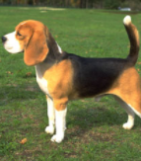
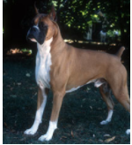
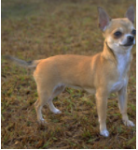
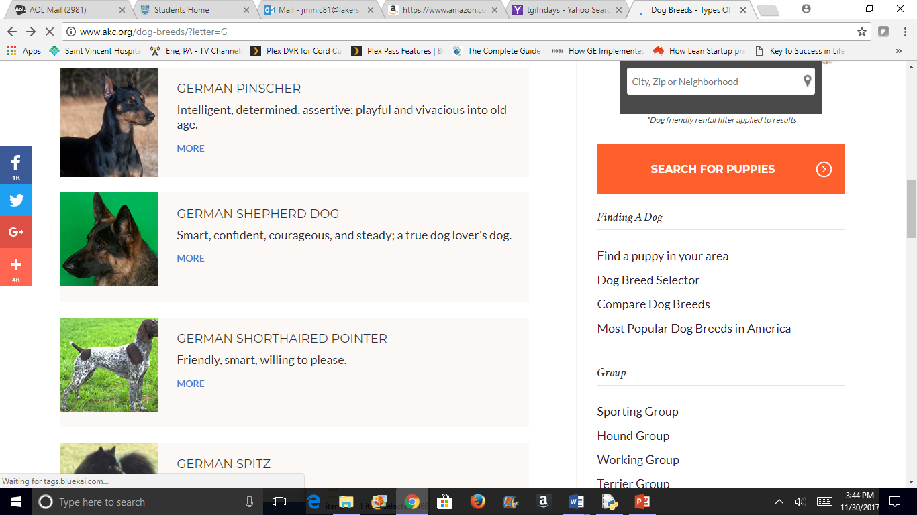
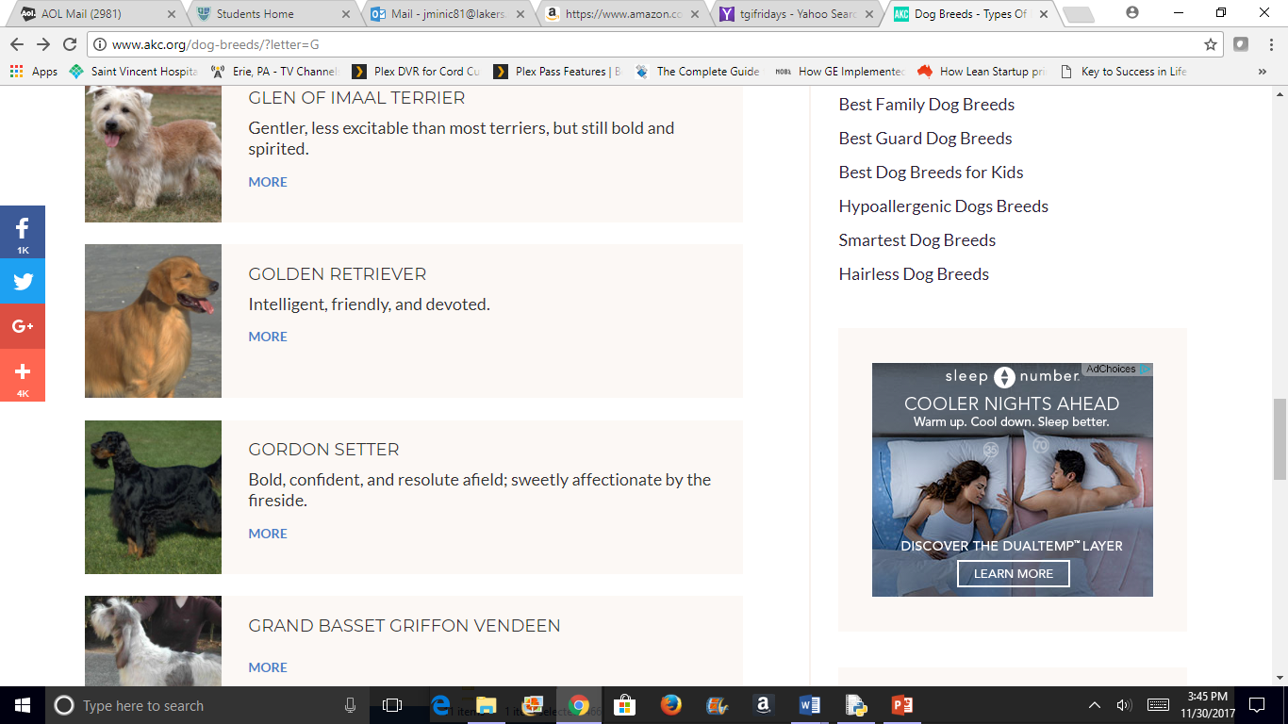
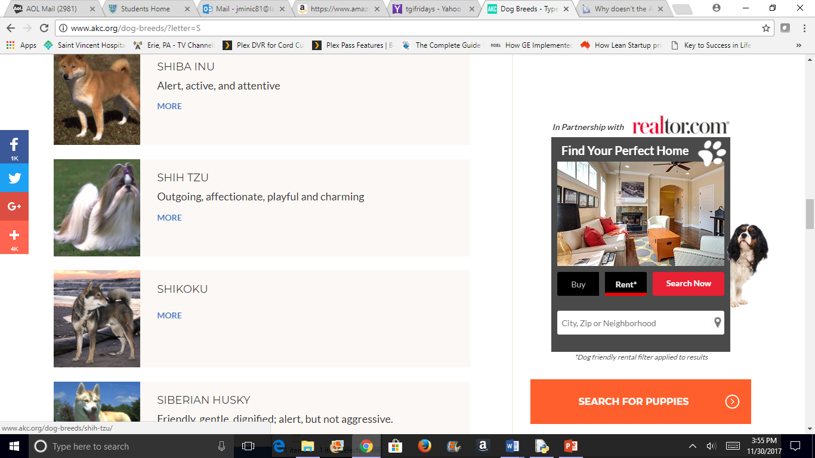
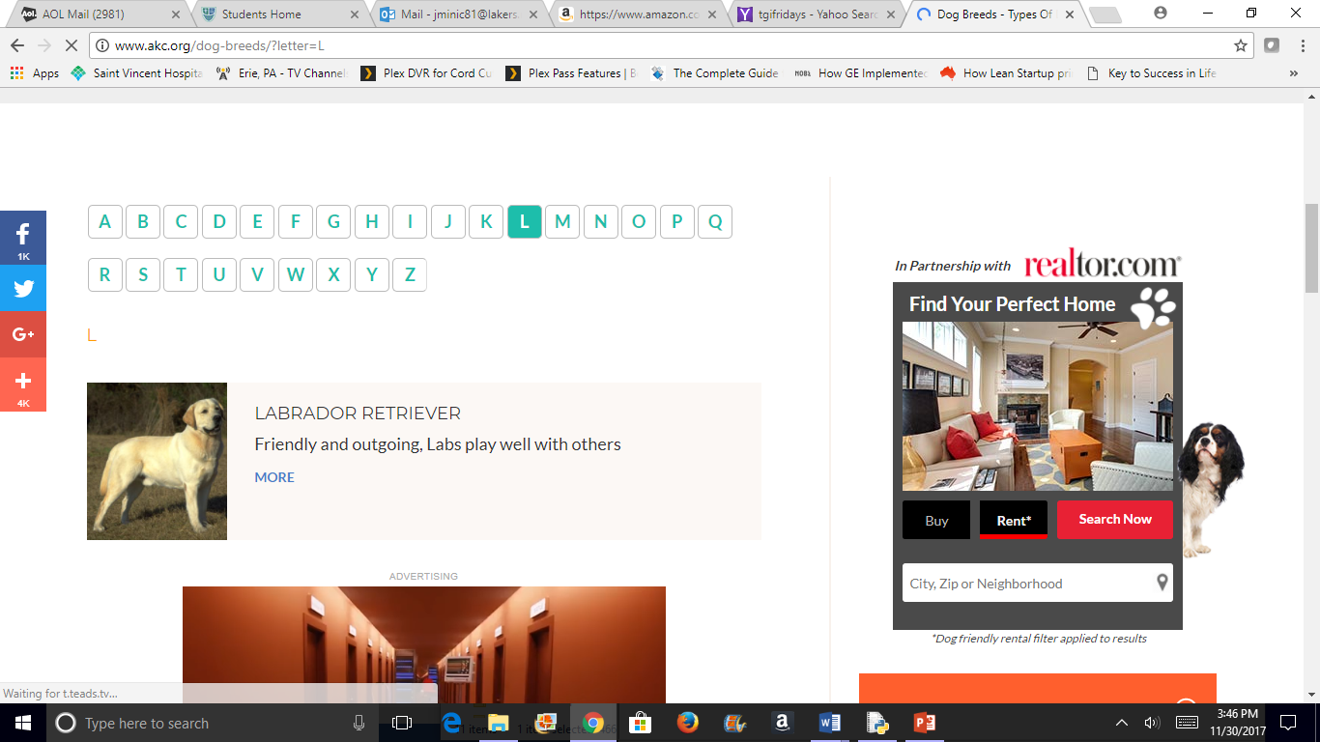
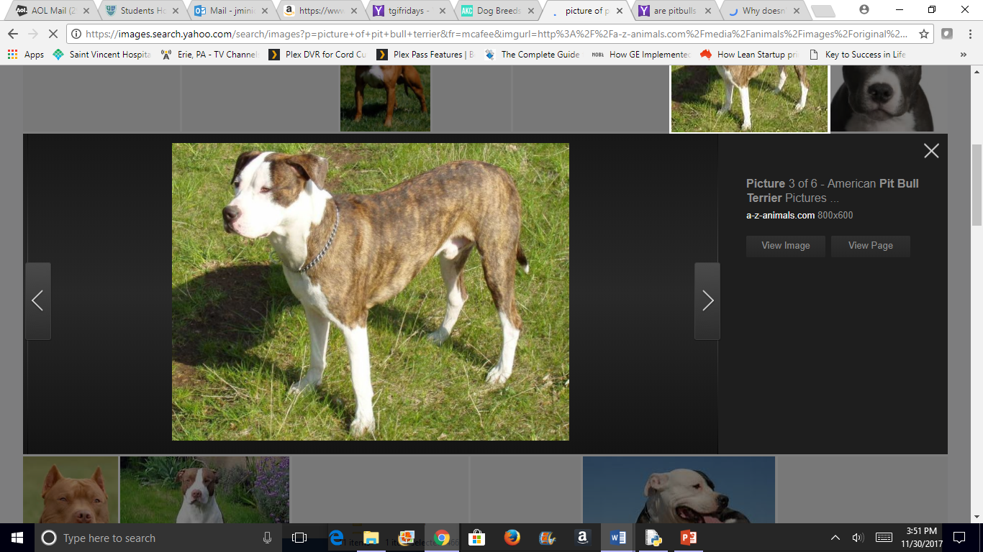
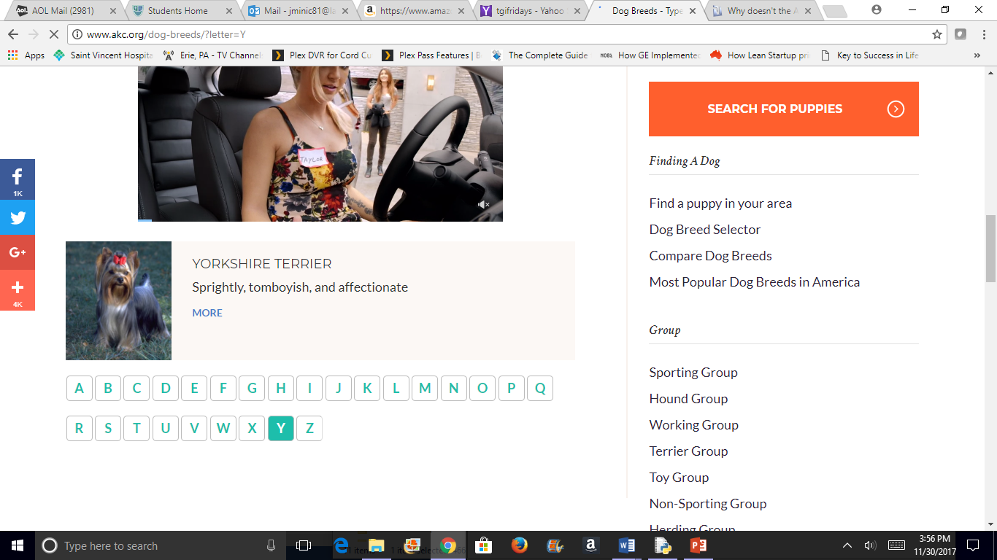
Beagle
Boxer
Chihuahua
German
Shepherd
Golden
Retriever
Labrador
Retriever
Mixed
Pit Bull Terrier
Shih Tzu
Yorkshire
Terrier
?

Slide 5
DEMO 1
GUI

Slide 6
QUIZ ANSWER KEY

Slide 7
Rank order the dog breeds below where 1 = most popular:
8 Beagle 10 Boxer 6 Chihuahua 3 German Shepherd 4 Golden Retriever 2 Labrador Retriever – 10% of total count, (was Poodle, now #12) 1 Mixed – 29% of total count, includes “designer dogs”, ex. Labradoodle 7 Pit Bull Terrier – no longer recognized by AKC 5 Shih Tzu 9 Yorkshire Terrier

Slide 8
DEMO 2
SQLite3

Slide 9
CODES

Slide 10
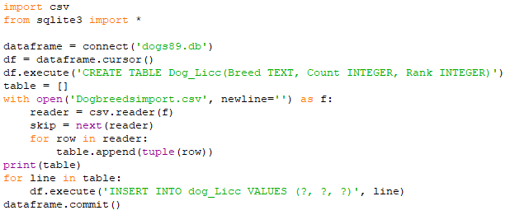
Code 1: import .csv file into SQLite3 database table
Create database, database table and empty table (placeholder)
Open and read .csv file
Skip column headings
Add each row in .csv file to empty table as a tuple
Add each row in table to database table
Save database table

Slide 11
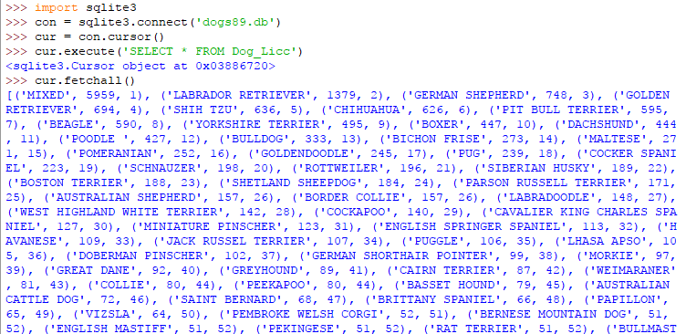
Code 2: SQLite3 database table/queries, Part 1
Connect to database
Connect the cursor
View contents of table

Slide 12
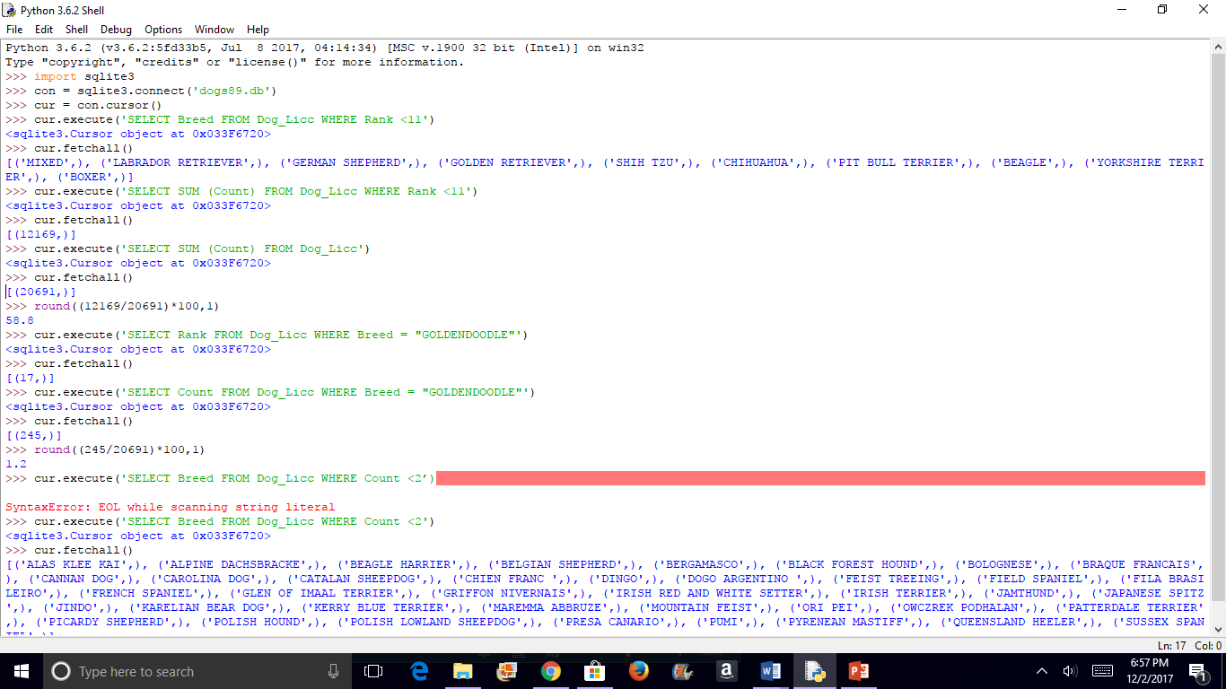
Code 2: SQLite3 database table/queries, Part 2
Count for top ten breeds
Count for all breeds
Calculate % of total for top ten breeds to 1 decimal place
Same exercise as above but for single breed

Slide 13
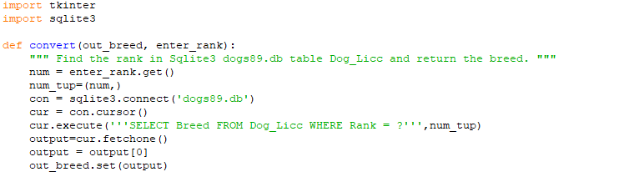
Code 3: Tkinter GUI, Part 1
Function
Read user input
Connect to database
Find input in tuple in table
Return breed that corresponds to input (rank)

Slide 14
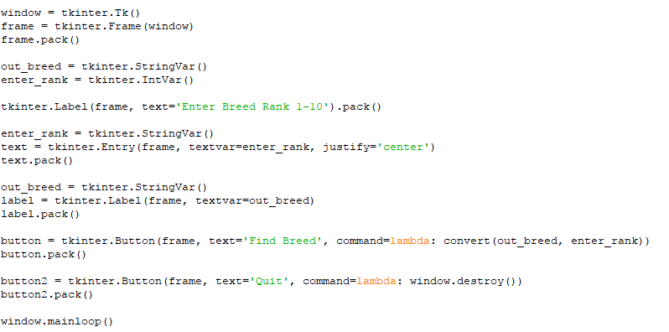
Code 3: Tkinter GUI, Part 2
Create root window (visible container)
Create frame (invisible container for widgets)
Call method “pack” for all widgets, to place them in the parent widget
Variables change with each input
Entry box for rank input (centered)
Output label for breed type
Create two buttons
Allows the code to run multiple times

Slide 15
Conclusions
Singularity is already here (my computer is smarter than I am)
Great learning exercise:
Project could have gone in many different directions and used other applications
Know dataset/objectives before committing to app, method, visualization type
Acknowledgements
BIG thank you to Justin Minsk for .csv file import code on Slide 10 plus tweaks to other codes!
References
1. Kaggle dataset: https://www.kaggle.com/kingburrito666/largest-dog-breed-data-set
2. Pictures of dogs on Slide 6: http://www.akc.org/dog-breeds/

Slide 16
QUESTIONS?
Thank you!

Slide 17
BACKUP

Slide 18
Rank order the dog breeds below where 1 = most popular (AKC Group is in parenthesis):
8 Beagle (Hound) 10 Boxer (Working) 6 Chihuahua (Toy) 3 German Shepherd (Herding) 4 Golden Retriever (Sporting) 2 Labrador Retriever (Sporting) – 10% of total count, used to be Poodle (now #12) 1 Mixed (N/A) – 29% of total count, includes “designer dogs”, ex. Labradoodle 7 Pit Bull Terrier (formerly Terrier) – no longer recognized by AKC 5 Shih Tzu (Toy) 9 Yorkshire Terrier (Toy)
Other facts:
male:female = 1:1
small:large = 1:1
Top 25 breeds = 77% of total count
Bottom 87 breeds = count of 5 or less

Slide 19
THE SEVEN GROUPS http://www.nds.nationaldogshow.com/event-info-groups.php
Each of the more than 190 AKC registered breeds and varieties are assigned to one of seven groups representing characteristics and functions the breeds were originally bred for. The First In Group from among each of these seven groups compete against each other for Best In Show.
TERRIER GROUP All but two of the terriers evolved in the British Isles. The geography of the specific area (water, rocky terrain) helped to determine the exact duties of each breed, but it usually involved hunting vermin and varmints ranging from rats to badgers to otters and more. These are dogs of great determination, courage and self-confidence, with a great willingness to go to ground in search of its quarry.
TOY GROUP Toy dogs have been around for centuries, and are bred for one purpose: to be companions for their humans. Many have been bred down from and still resemble their larger cousins. Their small size and portability make them ideal for city dwellers and those with limited space.
WORKING GROUP While the uses and appearances of the dogs in the Working Group vary, most are powerfully built and intelligent, performing various tasks for their people. These dogs are working farm and draft animals. They guard homes and livestock, serve heroically as police and military dogs, security dogs, guide and service dogs and hunters.
SPORTING GROUP The invention of the gun led to the development of the sporting, or gun dogs, to aid in hunting upland game birds or waterfowl, performing at the direction of the hunter. While a number of these breeds perform more than one task, it is generally the duty of pointers and setters to point and mark game; for spaniels to flush game; and for retrievers to recover dead and wounded game.
HOUND GROUP Originally classified as sporting dogs because of their function as hunters, breeds in the Hound Group are of a great variety of size, shape and coat. Most of these breeds were developed to hunt somewhat independently for their humans, who usually followed on foot or on horseback as the hounds chased down the prey. This group informally consists of scent hounds, dogs that hunt by tracking a scent, and sight hounds, who spot their game and run it down.
NON-SPORTING GROUP The AKC originally registered dogs as either Sporting or Non-Sporting. Eventually, hounds and terriers were split from the Sporting Group, and the Toys and Working dogs were split off from Non-Sporting, with the Herding Group eventually splitting from Working. Today, the Non-Sporting Group is literally every breed that is left, resulting in a wide variety of sizes, shapes, hair, function and history.
HERDING GROUP Herding is a natural instinct in dogs that is seen in the wild. Humans have used that instinct to their advantage on farms and ranches with herding dogs who have the sole purpose of gathering and moving livestock from one place to another.

Slide 20
How much do you know about dog breeds?
I wouldn’t know a poodle from a Ramen noodle
I own or have owned a dog
I can recognize several different breed types
I could be a judge at the Westminster Kennel Club annual dog show

