Slide 1
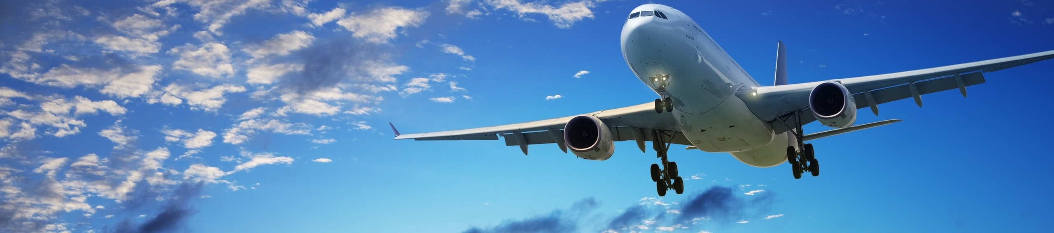










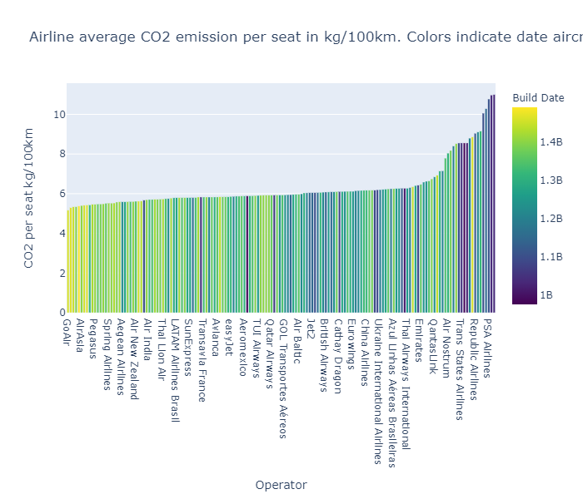
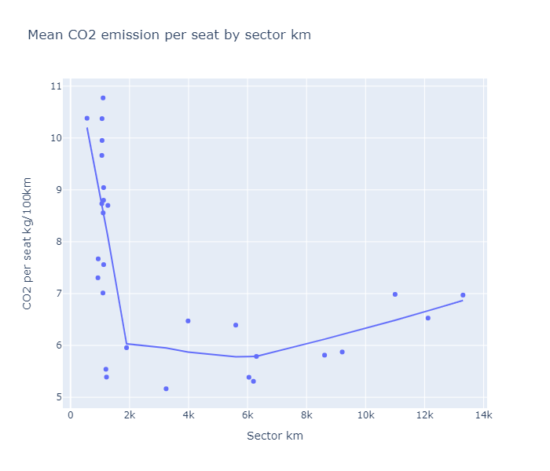
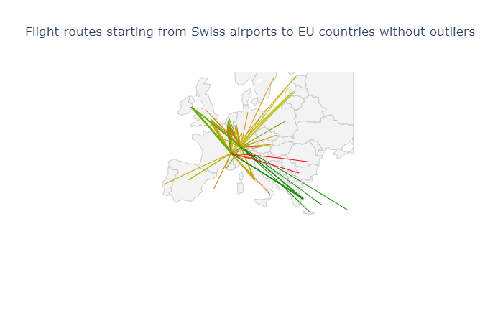
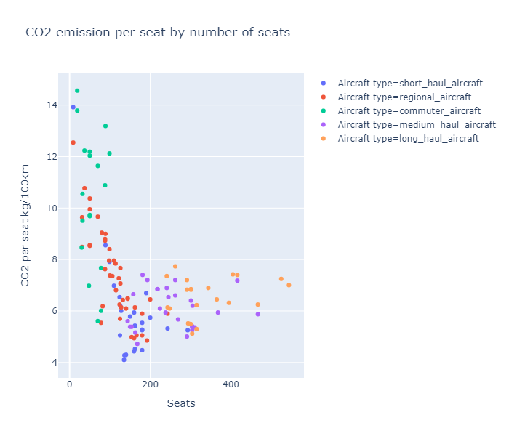
AVIATION GLOBAL CARBON EMISSIONS
Andrea Scalisi
andrea.scalisi@epfl.ch
Bastien Beuchat
bastien.beuchat@epfl.ch
Jeremy Mion
jeremy.mion@epfl.ch
Johan Barthas
johan.barthas@epfl.ch
Full story here!
Talking about being "eco responsible" is the trend. But since in our team, we are true students, we were already talking about the next summer holidays. In the middle of the discussion, we suddenly became worried about a specific aspect of the holidays: What role does aviation play in the global carbon emissions?
Datasets
Even though the aviation industry is quite protective of its data, we were able to find several open source datasets.
Data Cleaning
TODO
Analysis
TODO
Results
Build data matters
Distance matters
Where to fly
Size matters
10.99 kg/100km
Average CO2 emissions by seat of Air Wisconsin
Boeing A220-300
Least pollutant widely-used aircraft
5.16 kg/100km
Average CO2 emissions by seat of GoAir
Bombardier CRJ-100
Most pollutant widely-used aircraft

