Slide 1
Python for Science!
PyLadies Boston Meetup #3, December 18, 2013
Adrienne Bolger
(adrienne.bolger@gmail.com)

Slide 2
Why SciPy?
Free (as in software and as in beer)
Cross platform coding
Real time integration
  Live data measurement and plotting
  Robotics
Easy as Python!

Slide 3
SciPy Available Tool Stack http://scipy.org/docs.html
Numpy- numerical data structures and symbols for use in Python
Scipy- Signal and image processing, linear algebra, Fourier transforms, statistics
MatPlotLib- Graphs of all kinds, GUIs, and animations
SymPy- Symbolic math (calculus, matrices, and geometric algebra)
Pandas- Easy data file processing from many filetypes

Slide 4
Why all this stuff?
In today's scientific environment,
everybody codes
  MATLAB
  Excel
  MySQL
  Traditional computer languages
  Code from the Web

Slide 5
Boring things in the way of Science:
  Parsing files from a scientific instrument or sensor
  String parsing data exported from a database
  Resampling data to process it
  Filling in all the blank spots with zeroes
  ...and the list goes on.

Slide 6
Getting started: your tools
Python 2.7 + Scipy + MatPlotLib all downloaded separately and installed on your machine
OR...
Canopy package manager and IDE installed on your machine
Sample Data- housing price data from Ames, Iowa http://www.amstat.org/publications/jse/v19n3/decock/AmesHousing.txt
Sample Python code (we'll create this as we go)

Slide 7
So you want to...
...plot data and arrays like MATLAB?
Enter Matplotlib

Slide 8
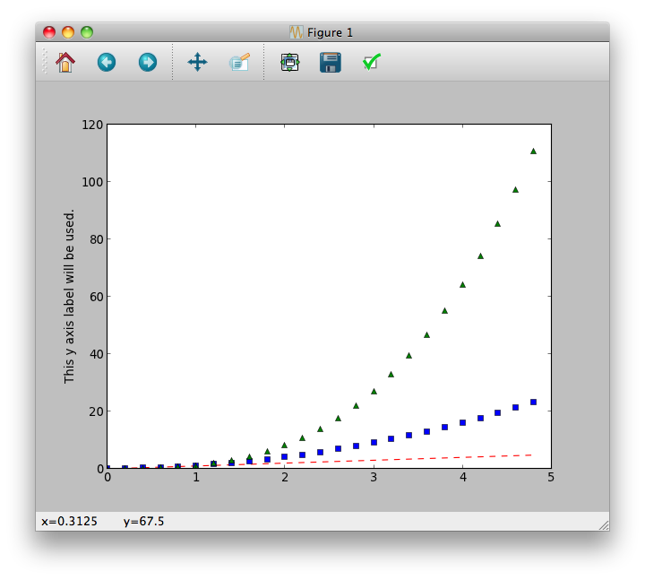
Hello Matplotlib! http://matplotlib.org/users/pyplot_tutorial.html
import numpy
import matplotlib.pyplot as plt
#uses MatPlotLib the way you use Matlab- as an interactive console
t = numpy.arange(0., 5., 0.2) # evenly sampled time at 200ms intervals
plt.plot(t, t, 'r--', t, t**2, 'bs', t, t**3, 'g^') # red dashes, blue squares and green triangles
plt.ylabel('This y axis label will be used.')
plt.show()
plt.ylabel('This label will NOT appear') #isn't called until AFTER we "show" the plot, so it's ignored

Slide 9
So you want to...
...have fast numerical computation?
You've noticed that...
... Python lists don't replace matrices very well?
Enter Numpy.

Slide 10
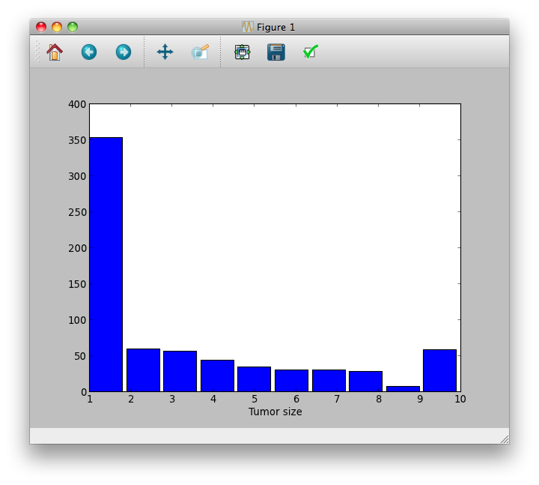
Hello Numpy! http://docs.scipy.org/doc/numpy/reference/generated/numpy.histogram.html
import numpy as np
import matplotlib.pyplot as plt
import os, sys
#Numpy has a BUILT IN function for data loading... if all your data is numeric
present_directory = os.path.dirname(sys.argv[0])
data = np.loadtxt(present_directory + os.sep + 'breast-cancer-wisconsin.data', delimiter=",", skiprows=0)
tumor_cell_size = data[:,3]
#Numpy has built in statistics functions as well:
histogram_data, bin_edges = np.histogram(tumor_cell_size);
plt.bar(bin_edges[:-1], histogram_data) #Bar graph the generated histogram data
plt.xlabel("Tumor size")
plt.xlim(min(bin_edges), max(bin_edges))
plt.show()

Slide 11
So you want to …
… avoid spending all your time parsing data files?
You want...
… one line of code to import your files into labeled rows and columns like Excel?
Enter Pandas.

Slide 12
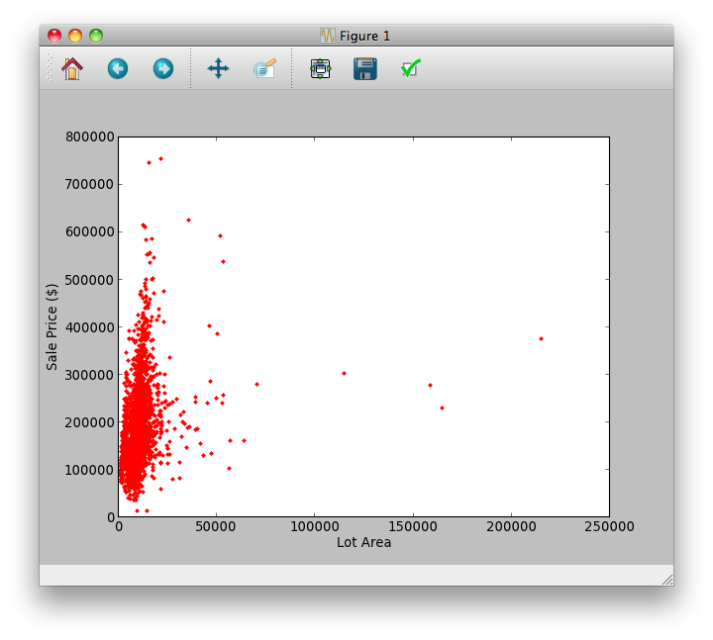
Hello Pandas! http://pandas.pydata.org/pandas-docs/dev/cookbook.html
import matplotlib.pyplot as plt
import pandas
import os, sys
present_directory = os.path.dirname(sys.argv[0])
Filename = present_directory + os.sep + 'ames_iowa_housing_dataset.txt'
data = pandas.read_csv( filename, header=0, delimiter="\t")
print "Listing available columns:", data.columns
plt.plot(data["Lot Area"], data["SalePrice"], 'r.') #Uses MATLAB style data formatting: red dot for plotted points
plt.xlabel("Lot Area")
plt.ylabel("Sale Price ($)")
plt.show()

Slide 13
But I was promised a statistics library!
… Ok fine.

Slide 14
Hello statistics!
#Calculate some statistics about these houses:
mean_sale_price = np.mean(data["SalePrice"])
mean_lot_area = np.mean(data["Lot Area"])
#Calculate and plot a correlation line using the numpy linear regression linalg library:
A = np.array([data["Lot Area"], np.ones(len(data["Lot Area"]))])
w = np.linalg.lstsq(A.T,data["SalePrice"])[0]
line = w[0]*data["Lot Area"] +w[1] # regression line
#CDF for the Lot Area:
n_counts, bin_edges = np.histogram(data["Lot Area"],bins=40,normed=True)
cdf = np.cumsum(n_counts) # cdf not normalized, despite above
scale = 1.0/cdf[-1]
ncdf = scale * cdf

Slide 15
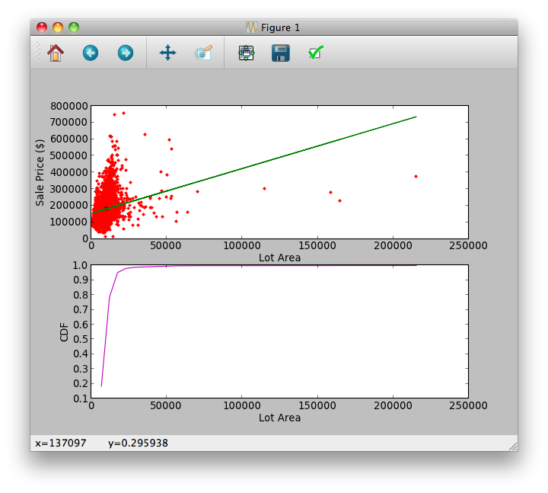
Hello statistics!

Slide 16
And I can't afford MATLAB's Signal Processing Toolbox!

Slide 17
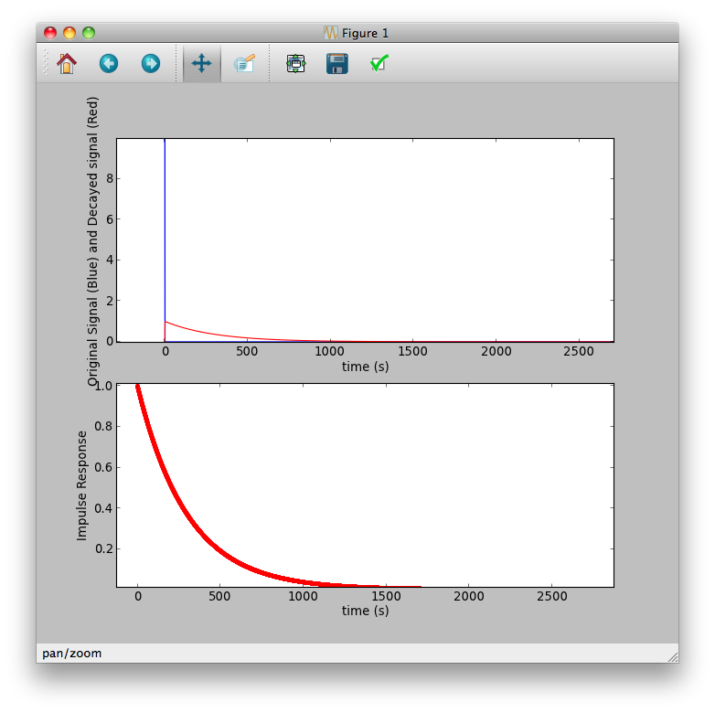
Hello signal processing! http://docs.scipy.org/doc/scipy/reference/signal.html
#...Code continued from previous slide
plt.subplot(2, 1, 1)
plt.plot(h_times, impulse_function, 'b-')
plt.plot(system_output_t, system_output, 'r-')
plt.xlabel('time (s)')
plt.ylabel('Original Signal (Blue) and Decayed signal (Red)')
plt.subplot(2, 1, 2)
plt.plot(h_times, impulse_response/impulse_response.max(), 'r.-')
plt.xlabel('time (s)')
plt.ylabel('Impulse Response')
#
plt.show()

Slide 18
Hello signal processing! http://docs.scipy.org/doc/scipy/reference/signal.html
import numpy as np
from matplotlib import pyplot as plt
from scipy import signal
tau = 5.0*60 # 5 minutes
h_times = np.arange(0.0, 10*tau, 0.1)
impulse_function = len(h_times)*[0]
impulse_function[1] = 10
#Simple first order system model. Example = X = Xo * e^(-t/T)
#Physical examples: Voltage in a capacitor in an RC circuit, temperature of a cooling off pot of water
sys = signal.lti(1,[1, 1/tau]) #Signal with a 1/t decay, like a swinging door
#2 ways to simulate the same basic dynamic
#1. we can simulate an input and plot the output (more general cases)
system_output_t, system_output, system_output_state_vector = signal.lsim(sys, impulse_function, h_times)
#2. Or, we can use the LTI class to just ask for an impulse response
impulse_response = sys.impulse(T=h_times)[1]

