Slide 1



APIs:
What are they, why you should care, and how you can use them.

Slide 2


What is an API?
Application Programming Interface
definition: “a set of programming instructions and standards for accessing a web-based application”

Slide 3
The Echo Nest
Local, located in Davis Square
“The Echo Nest powers all of today's best music experiences by automatically knowing everything about music.”
Created a Python client for their API, pyechonest
$ pip install pyechonest

Slide 4
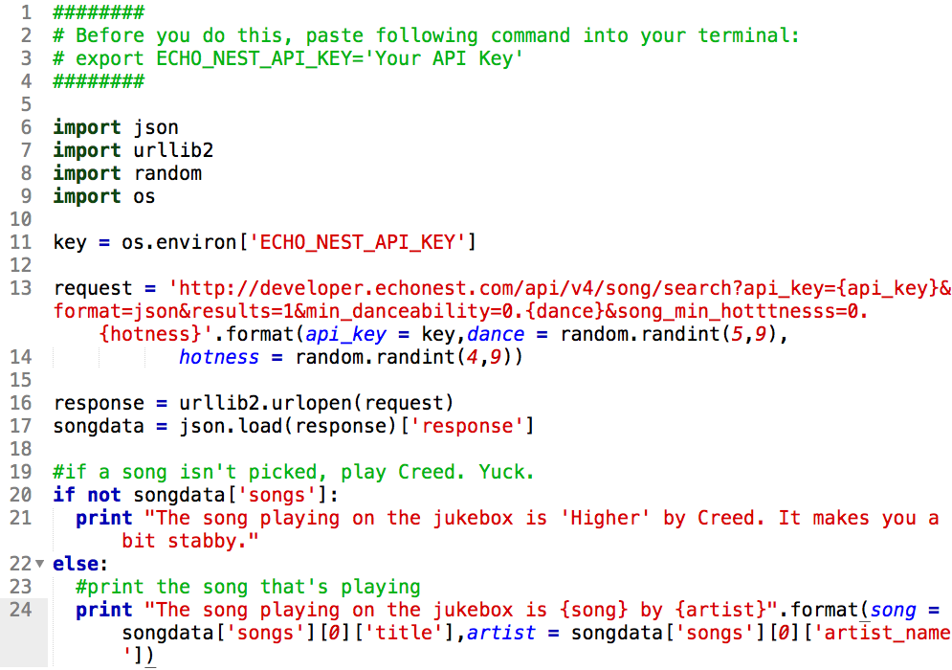

Slide 5
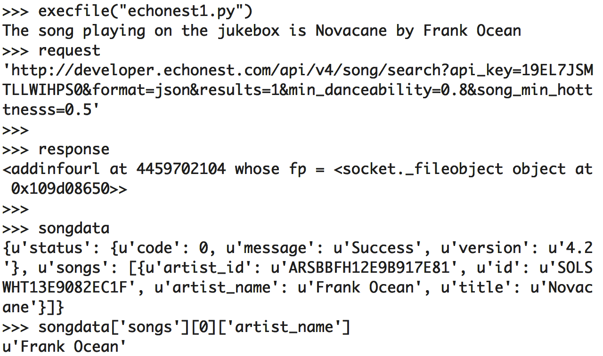
Results

Slide 6
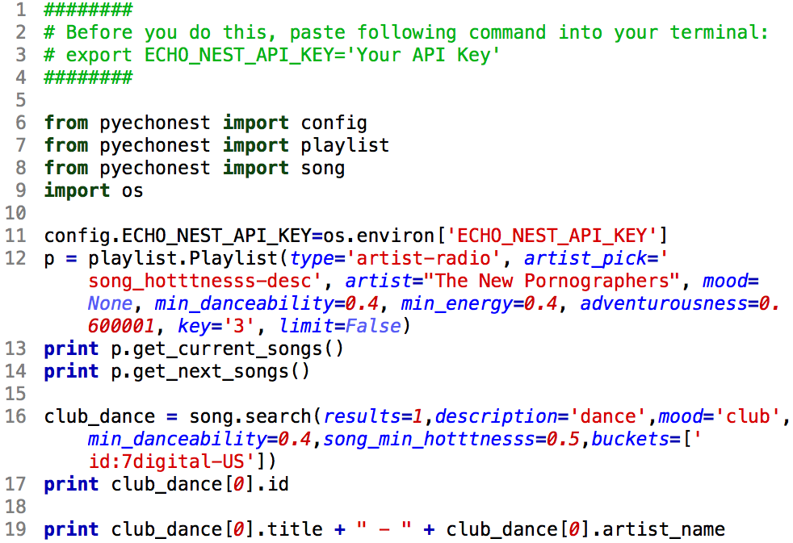
Pyechonest

Slide 7
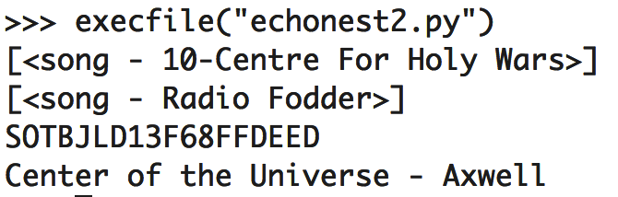
Results

Slide 8
Twitter
Microblogging service. It is pretty big.
https://github.com/bear/python-twitter
$ pip install python-twitter

Slide 9
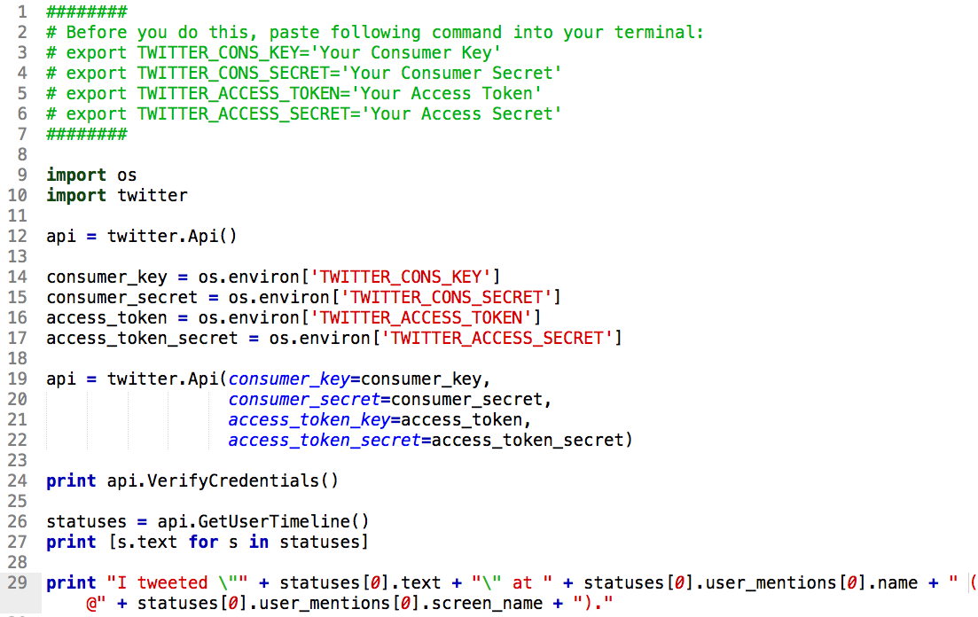
Twitter using python-twitter

Slide 10
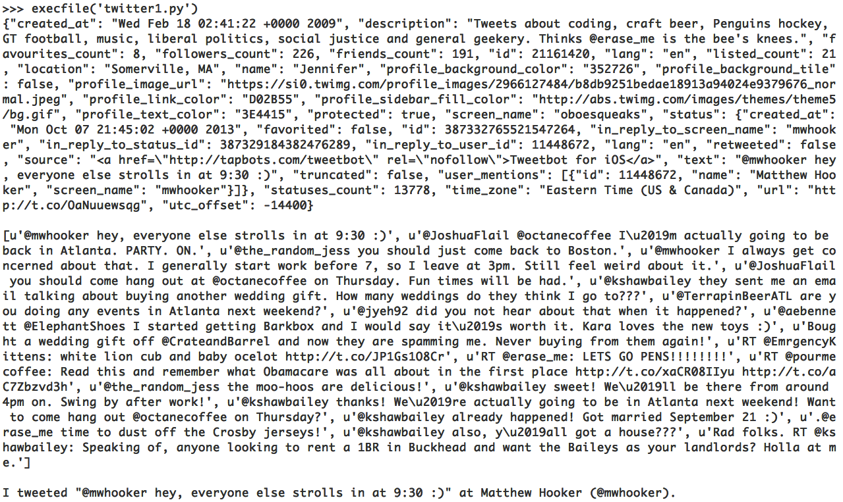
Results

Slide 11
Other methods
PostUpdates(self, status, continuation=None, **kwargs)
GetFriends(self, user_id=None, screen_name=None, cursor=-1, skip_status=False, include_user_entities=False)
CreateFriendship(self, user_id=None, screen_name=None, follow=True)
GetRetweetsOfMe(self, count=None, since_id=None, max_id=None, trim_user=False, include_entities=True, include_user_entities=True)
DestroyStatus(self, count=None, since_id=None, max_id=None, trim_user=False, include_entities=True, include_user_entities=True))

