Slide 1
Creating a containerized Django + React + PostgreSQL development environment
Dan Taylor
@qubitron
Program Manager
Python Developer Tools
DjangoCon 2019

Slide 2
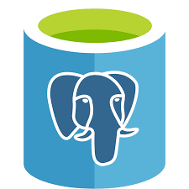
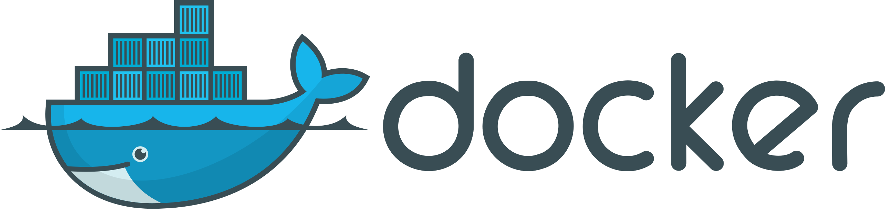

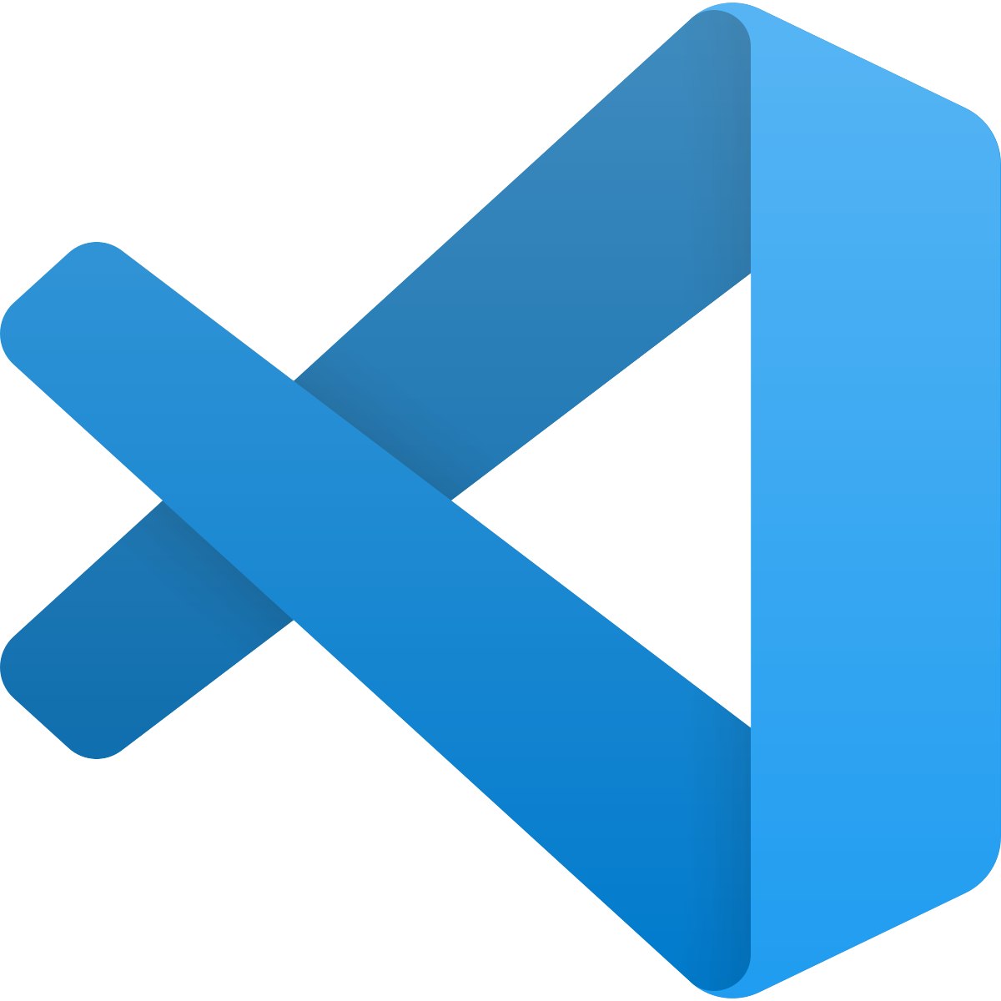

Building an app using Docker and Visual Studio Code
PostgreSQL
Database
docs.docker.com/install
Django Rest Framework API
code.visualstudio.com
React Front End

Slide 3
Developing with containers
Key benefit: if it works locally, it works in production
Code
Dockerfile
Build/Run
Container
Locally
Container
Developer Tools
App
Does Things
Deploy to Production
Container
Does the same things

Slide 4
Additional benefit: easily acquire dev dependencies
Orchestrate multiple containers using docker compose
docker-compose.yml
Code
Build/Run
Containers
Locally
Database
Container
Developer Tools
App
Microservice

Slide 5
Tradeoff: container boundary causes issues for tools
Re-build the container every time you make a code change
Auto-complete may not work if Python or packages not installed locally
Debugger not set up to run the app in the container
Testing framework not installed in container can’t run the app
Build/Run
Containers
Locally
Container
Developer Tools
App
Edit
Debug
Test

Slide 6
Developing inside of containers
Some portion of the IDE is running inside of the container
Dockerfile
Container
Code
Editor UI
Editor Backend
App
Does Things
Dev Dependencies

Slide 7
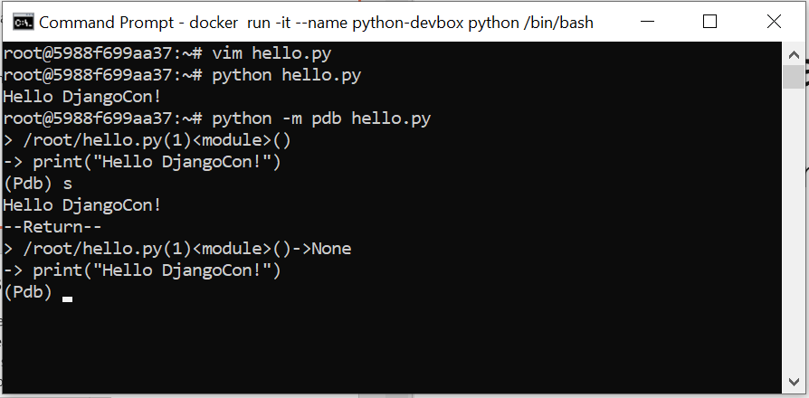
A low-tech example…
docker run -it --name python-devbox python bash
apt-get update
apt-get install vim
Edit
Run
Debug
Containerized Debian development environment!

Slide 8
That’s neat! But there’s problems…
Have to remember all these docker commands
Limited to only command line developer tools (git, pdb, vim)
Code will disappear as soon as the container stops
Can’t access web sites hosted in the container

Slide 9
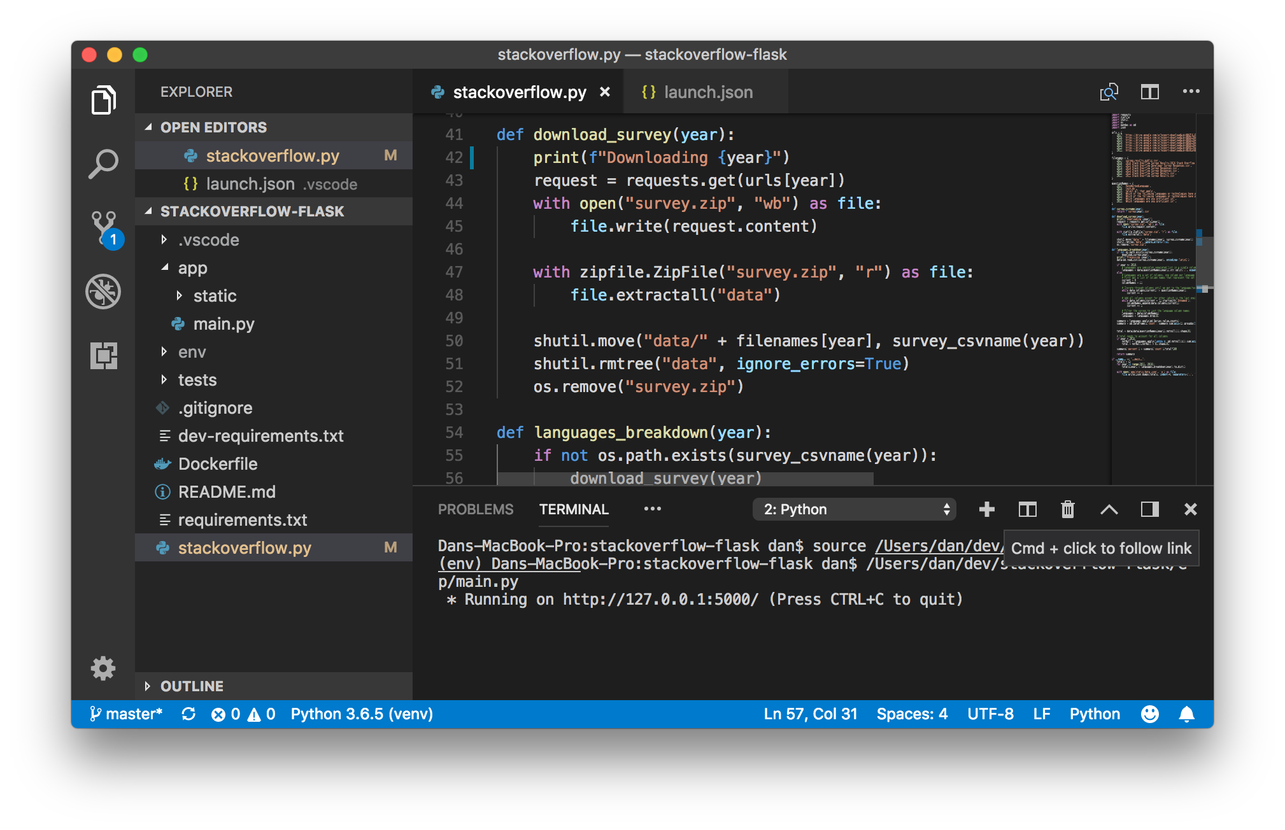
Visual Studio Code
Built-in JavaScript/TypeScript support
IntelliSense
Debugging
Free, cross-platform, open source
Fast and lightweight
Rich extension ecosystem
Source Control

Slide 10
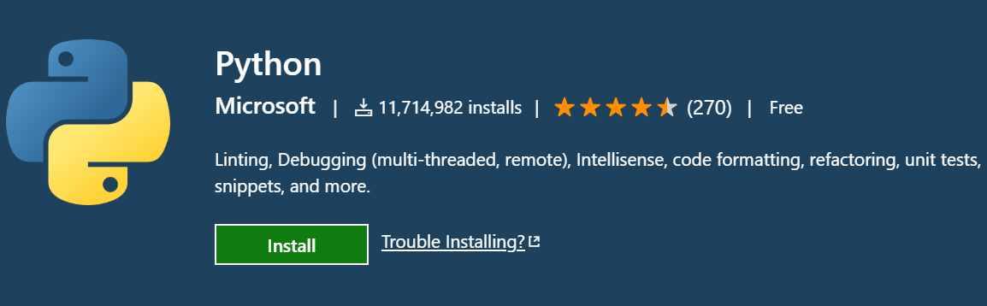
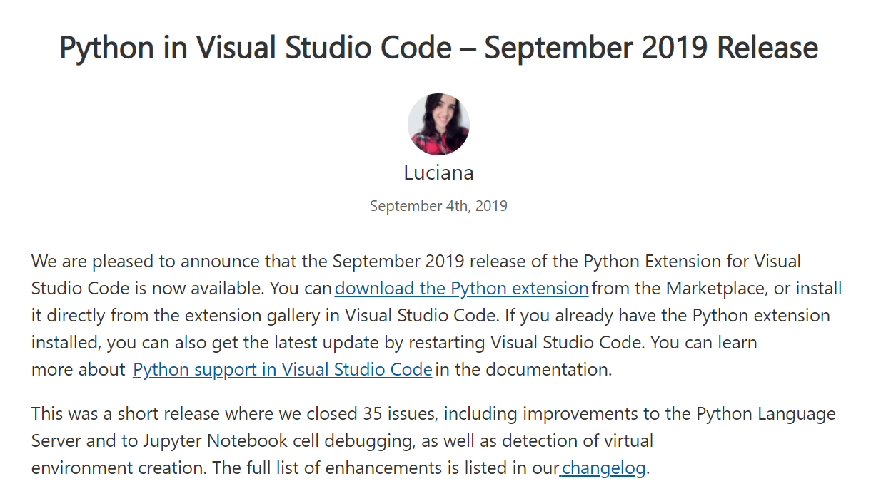
Python Extension
+
Adds Python support: IntelliSense, Debugging, Linting, Testing, Refactoring
Most popular extension on the VS Code Marketplace
Developed in the open on GitHub
New release every month
aka.ms/pythonblog

Slide 11
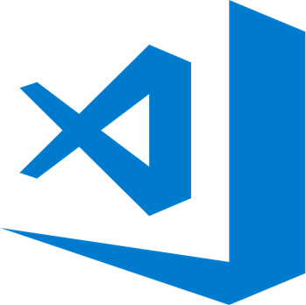
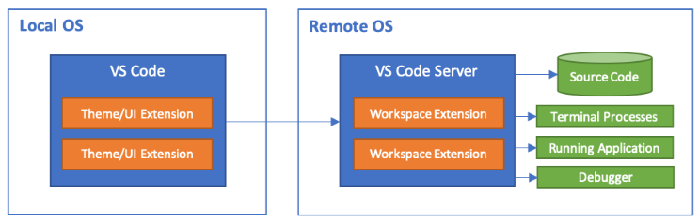
Visual Studio Code Remote
Unique architecture enables a fully featured “just like local” experience
Develop in Containers, WSL, and SSH workspaces
Released at PyCon in May 2019
code.visualstudio.com
https://aka.ms/vscode-remote

Slide 12
Benefits of this approach
Quickly create or switch between development environments
Others can replicate your development environment on another machine
Remote development capabilities in tools like VS Code, PyCharm, Vim

Slide 13
Steps
Background
Attaching to an existing container
Creating a new development container
Adding a React front-end
Building the production version

Slide 14
Attaching to an existing container with Visual Studio Code

Slide 15

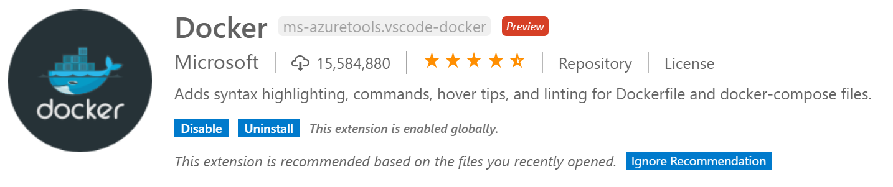
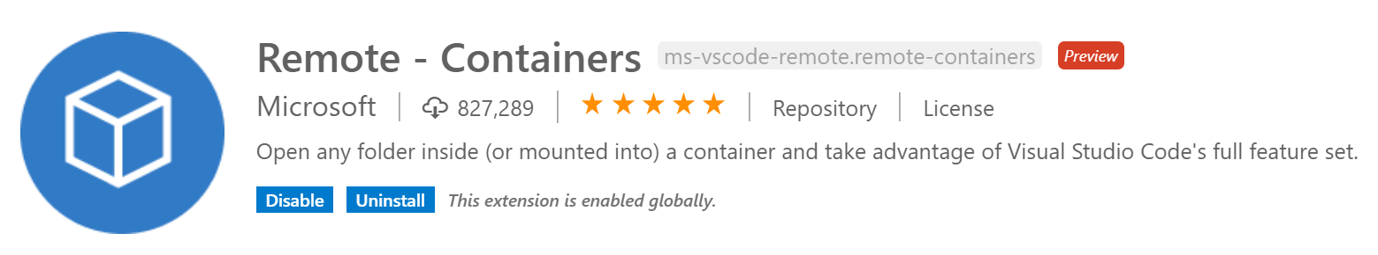
Install Visual Studio Code Extensions
Open the extension activity bar
Install the Docker Extension
Create and manage docker containers from your host machine
Install the Remote-Containers Extension
Allows VS Code to create and run inside of dev containers

Slide 16

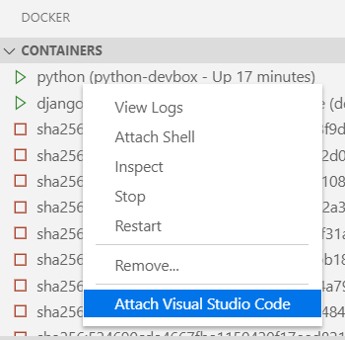
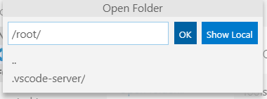
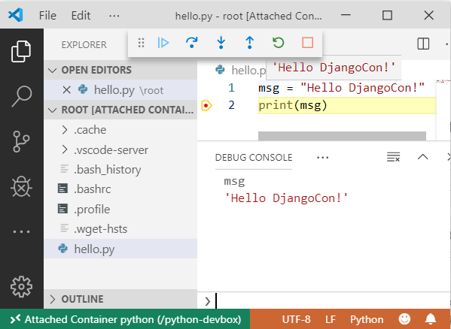
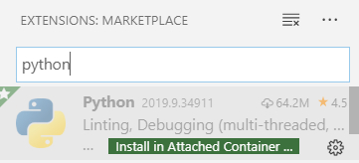
Attach to this container with VS Code!
Open docker activity bar
Right-click -> Attach Visual Studio Code
Install Python extension into the attached container
Open folder and start working!

Slide 17
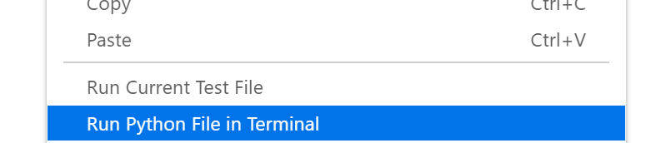
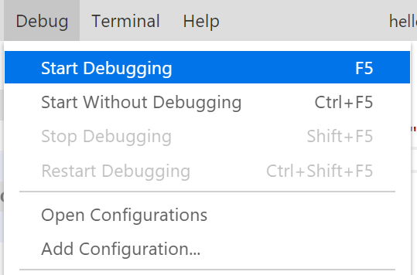
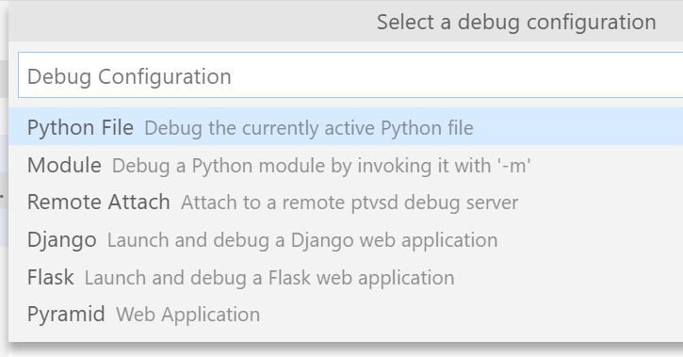
Running and Debugging a Single File
Right-click -> Run Python File in Terminal
Debug > Start Debugging, select Python File

Slide 18
That’s neat! But there’s still problems…
Have to remember all these docker commands
Limited to only command line developer tools (git, pdb, vim)
Code will disappear as soon as the container stops
Can’t access web sites hosted in the container

Slide 19
Creating a new development container with Visual Studio Code

Slide 20
Create a new dev container using VS Code
This is generally how you should set up a dev container project for continued development
Start from pre-configured development containers with runtimes, tools, and volume mapping set up
Uses compose for multi-container development scenarios

Slide 21
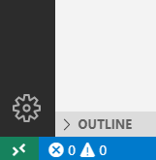
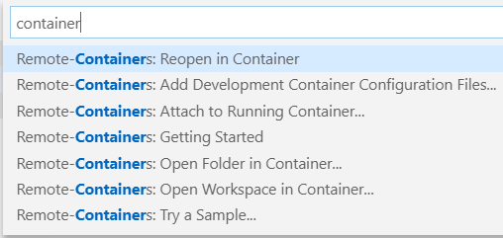
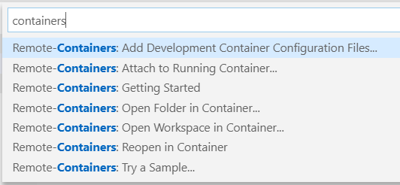
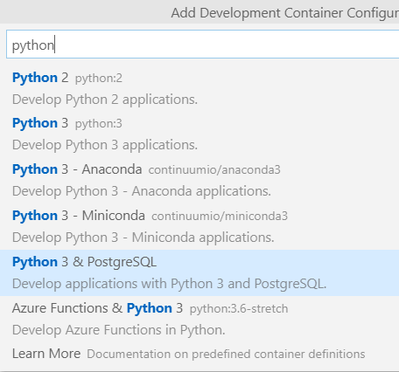
Steps to create a new dev container
mkdir newcontainer && cd newcontainer && code .
Run the Add Development Container Configuration Files… command
To run a command: use Ctrl-Shift-P or Command-Shift-P
Select Python 3 & PostgreSQL

Slide 22
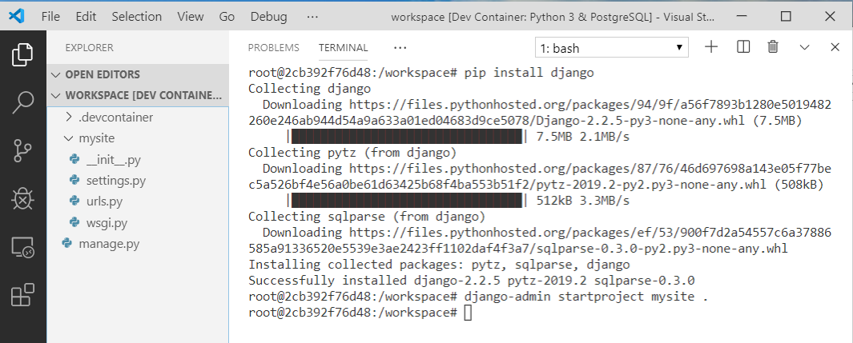
Create a Django app
Open the terminal
pip install Django (and save to requirements.txt)
django-admin startproject mysite

Slide 23
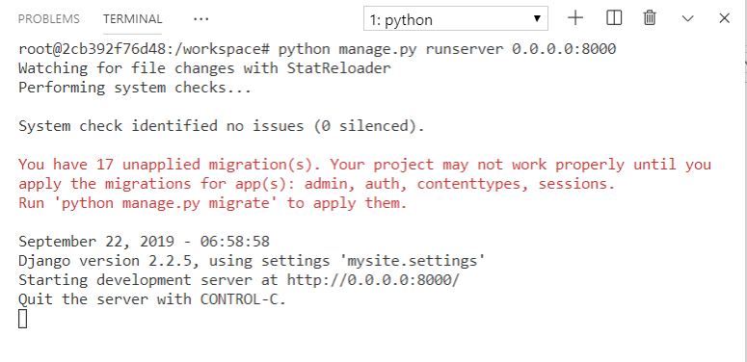
Create a Django app
python manage.py runserver 0.0.0.0:8000

Slide 24


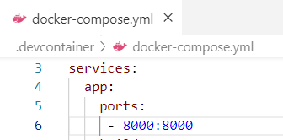
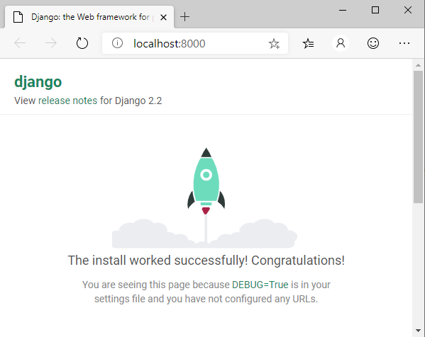
Run the app
Forward port 8000 and browse!
Expose port in devContainer.json or docker-compose.yml for next container rebuild

Slide 25
Setting up git
Outside of the container:
git config --global core.autocrlf false
git config --global user.email "your.email@address"
VS Code copies your global .gitconfig into the container during create
Inside of the container:
git init

Slide 26
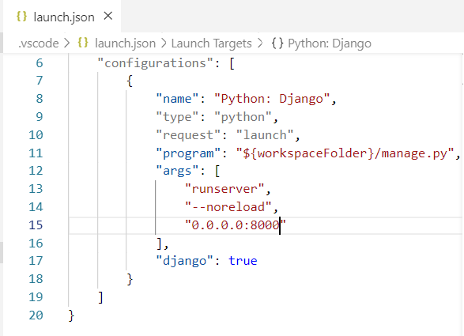

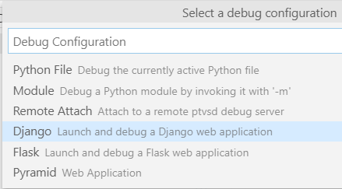
Configure debugger
Add configuration
Add 0.0.0.0:8000 to arguments

Slide 27
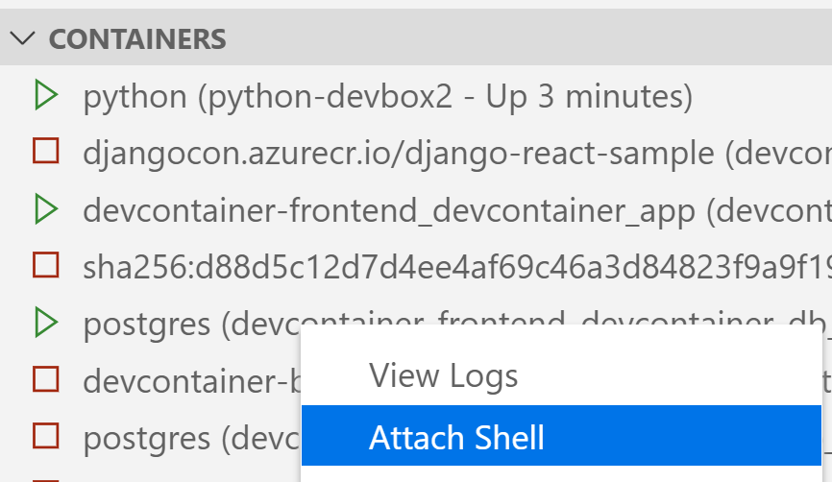
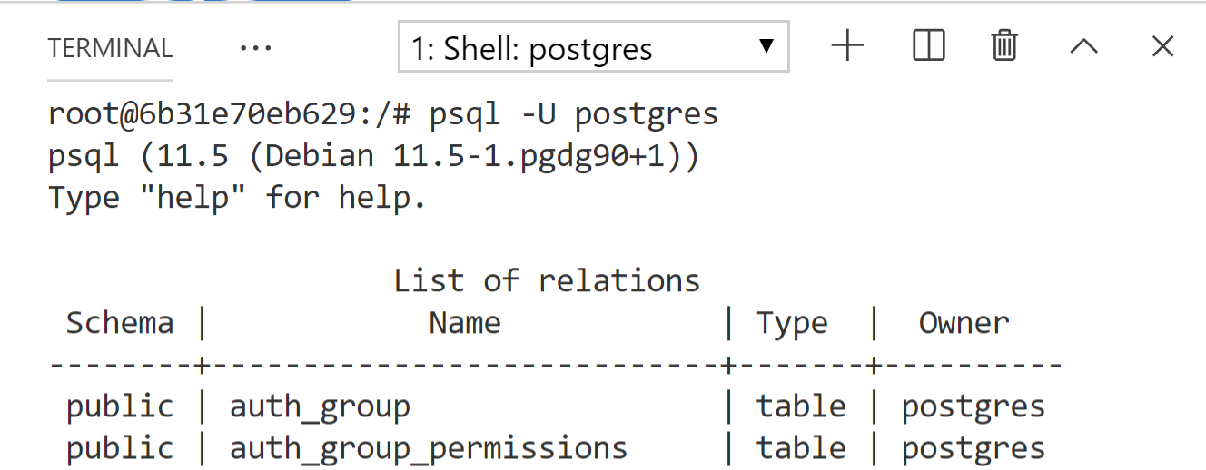
Open a psql command prompt
Attach shell to the postgres container
psql -U postgres

Slide 28
Add REST API backend
Add djangorestframework to requirements.txt
pip install –r requirements.txt
Django-admin startapp backend
Add API code by following the Django REST Framework tutorial:
https://www.django-rest-framework.org/tutorial/quickstart/
Create a super user (and populate the users table):
python manage.py createsuperuser

Slide 29
Add code to serialize users and groups
In backend/serializers.py
from django.contrib.auth.models import User, Group
from rest_framework import serializers
class UserSerializer(serializers.HyperlinkedModelSerializer):
class Meta:
model = User
fields = ['url', 'username', 'email', 'groups']
class GroupSerializer(serializers.HyperlinkedModelSerializer):
class Meta:
model = Group
fields = ['url', 'name']
Source: https://www.django-rest-framework.org/tutorial/quickstart/

Slide 30
Add views that implement the APIs:
In backend/views.py
from django.contrib.auth.models import User, Group
from rest_framework import viewsets, routers
from backend.serializers import UserSerializer, GroupSerializer
class UserViewSet(viewsets.ModelViewSet):
"""
API endpoint that allows users to be viewed or edited.
"""
queryset = User.objects.all().order_by('-date_joined')
serializer_class = UserSerializer
class GroupViewSet(viewsets.ModelViewSet):
"""
API endpoint that allows groups to be viewed or edited.
"""
queryset = Group.objects.all()
serializer_class = GroupSerializer
Source: https://www.django-rest-framework.org/tutorial/quickstart/

Slide 31
Add url routing rules:
Add backend/urls.py:
In mysite/urls.py:
from django.urls import path, include
from rest_framework import routers
from . import views
# create router for backend api
apiRouter = routers.DefaultRouter()
apiRouter.register(r'users', views.UserViewSet)
apiRouter.register(r'groups', views.GroupViewSet)
# urls provided by the backend
urlpatterns = [
path('api-auth/’,
include('rest_framework.urls’,
namespace='rest_framework')),
path('api/', include(apiRouter.urls)),
]
urlpatterns = [
path('admin/', admin.site.urls),
path('', include('backend.urls')),
]
Source*: https://www.django-rest-framework.org/tutorial/quickstart/

Slide 32
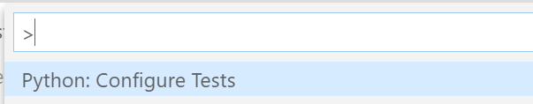
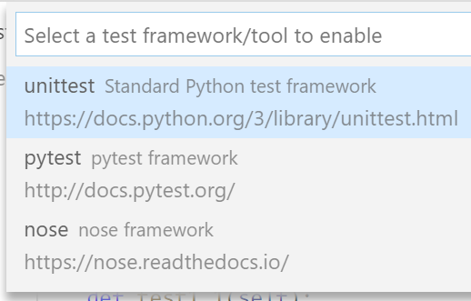
Configure Tests
Run the Python: Configure Tests command

Slide 33
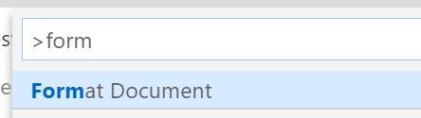
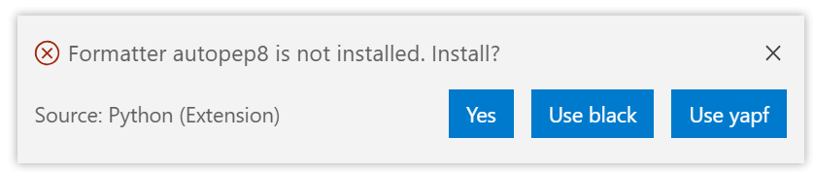
Add a formatter
Run the format document command

Slide 34
Adding a react front-end

Slide 35
Add node to the container
In .devcontainer/Dockerfile, add:
#
# Install node for building front-ends
&& apt-get -y install curl gnupg \
&& curl -sL https://deb.nodesource.com/setup_11.x | bash - \
&& apt-get -y install nodejs \

Slide 36
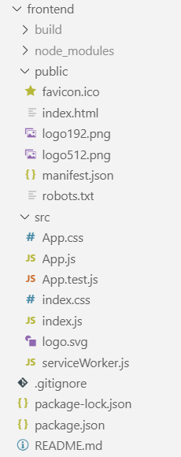
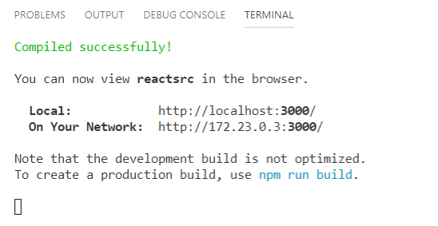
Create a new react app
From workspace root:
npx create-react-app frontend
cd frontend
npm run start

Slide 37


Forward port 3000 for the node development server
Run the Forward Port from Container command:
Add to .devcontainer/docker-compose.yml for next build:
services:
app:
ports:
- 3000:3000

Slide 38
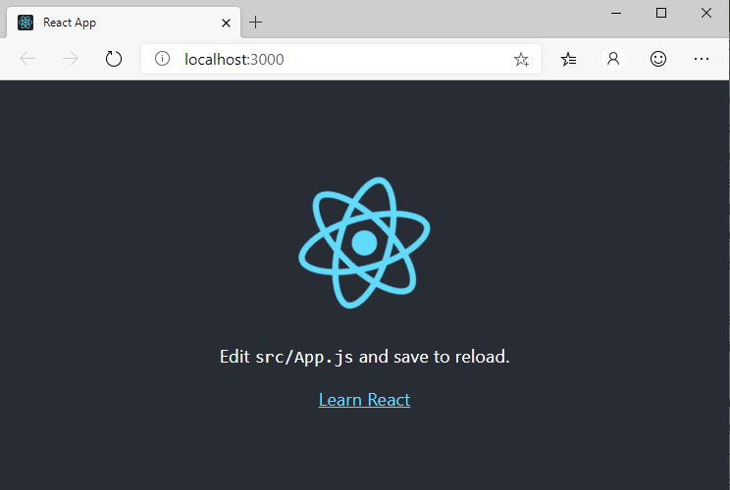
Edit code and reload
Node development server watches for changes and refreshes automatically:

Slide 39
Now let’s call the back-end API!
First add to package.json to proxy back-end calls:
{
…
"proxy": "http://localhost:8000",
…
Browser
Node
Dev Server
/api
Django API

Slide 40
Add some react code in frontend/src/App.js
Create initial state:
Fetch users from the back-end:
Render the list of users:
function App() {
// store users in a new variable
const [users, setUsers] = useState([]);
<h1>Users</h1>
{users.map((user) => <p>
{user.username} {user.email}
</p>)}
useEffect(() => {
let fetchData = async () => {
let response = await fetch('/api/users')
let json = await response.json()
setUsers(json)
}
fetchData()
}, []);

Slide 41
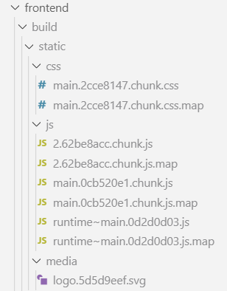
Create a build of the frontend
Build a static build of the front-end using:
npm run build
Generates an optimized version of the output

Slide 42
Add code to render front-end from build folder:
backend/views.py
# View to return the static front-end code
def index(request):
try:
with open(os.path.join(settings.REACT_APP_DIR, 'build', 'index.html')) as f:
return HttpResponse(f.read())
except FileNotFoundError:
return HttpResponse(
"""
Please build the front-end using cd frontend && npm install && npm run build
""",
status=501,
)
Source: https://reactjs.org/docs/create-a-new-react-app.html
https://www.fusionbox.com/blog/detail/create-react-app-and-django/624/

Slide 43
Building it for production

Slide 44

Add production dockerfiles to workspace
Re-open folder locally to leave the dev container
Add Production files: Dockerfile, uwsgi.ini, nginx.conf, docker-compose.yml
Use a .env file to store secrets!

Slide 45
.env file for secrets/connection strings
Environment variables set during run/build – add to .gitignore!
DB_ENGINE=django.db.backends.postgresql
DB_USER=postgres@djangocon
DB_NAME=postgres
DB_HOST=djangocon.postgres.database.azure.com
DB_PASSWORD=< PASSWORD >
# Un-comment to upload static files to Azure storage / use CDN
PUBLIC_URL=https://djangosample.azureedge.net
AZURE_ACCOUNT_NAME=djangosamplestatic
AZURE_ACCOUNT_KEY=< KEY >
AZURE_CONTAINER=static
# Settings for Azure App Service
WEBSITES_PORT=8000

Slide 46
Production Dockerfile
FROM node
WORKDIR /nodebuild
ADD frontend /nodebuild
ADD .env.sample /nodebuild
RUN export $(grep -v '^#' .env.sample | xargs) && npm install && npm run build
FROM tiangolo/uwsgi-nginx
EXPOSE 8000
# Indicate where uwsgi.ini lives
ENV UWSGI_INI uwsgi.ini
WORKDIR /app
# Using pip:
COPY requirements.txt /app
RUN python3 -m pip install -r requirements.txt
ADD . /app
COPY --from=0 /nodebuild/build /app/frontend/build
RUN export $(grep -v '^#' .env.sample | xargs) && python3 manage.py collectstatic --noinput

Slide 47
uwgi.ini
[uwsgi]
chdir = .
module = exampleapp.wsgi:application
uid = 1000
master = true
threads = 2
processes = 4

Slide 48
nginx.conf
user nginx;
worker_processes 1;
error_log /var/log/nginx/error.log warn;
pid /var/run/nginx.pid;
events {
worker_connections 1024;
}
http {
include /etc/nginx/mime.types;
default_type application/octet-stream;
log_format main '$remote_addr - $remote_user [$time_local] "$request" '
'$status $body_bytes_sent "$http_referer" '
'"$http_user_agent" "$http_x_forwarded_for"';
access_log /var/log/nginx/access.log main;
sendfile on;
keepalive_timeout 65;
server {
listen 8000;
location / {
include uwsgi_params;
uwsgi_pass unix:///tmp/uwsgi.sock;
}
location /static {
alias /app/staticfiles;
}
}
}
daemon off;

Slide 49
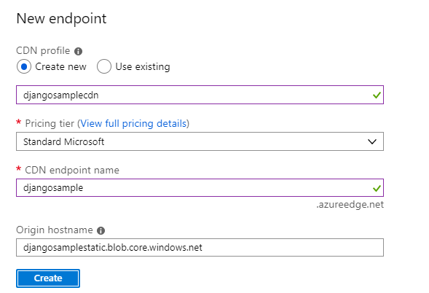
(Optionally) Add a CDN
Create a storage account
Connect it to a CDN
Set the storage variables in .env
In requirements.txt, add
django-storages[azure]
In settings.py:
# Configure django-storages from environment variables if account name is set
if 'AZURE_ACCOUNT_NAME' in os.environ:
DEFAULT_FILE_STORAGE = 'storages.backends.azure_storage.AzureStorage'
STATICFILES_STORAGE = 'storages.backends.azure_storage.AzureStorage'
AZURE_ACCOUNT_NAME=os.environ['AZURE_ACCOUNT_NAME']
AZURE_ACCOUNT_KEY=os.environ['AZURE_ACCOUNT_KEY']
AZURE_CONTAINER=os.environ['AZURE_CONTAINER']

Slide 50
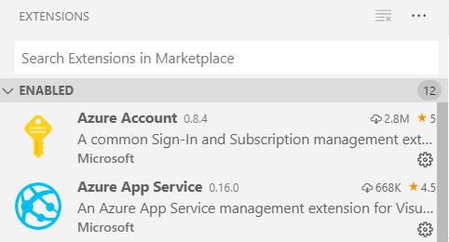
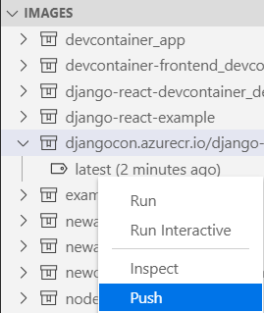
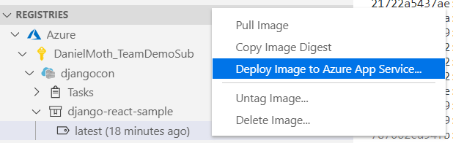
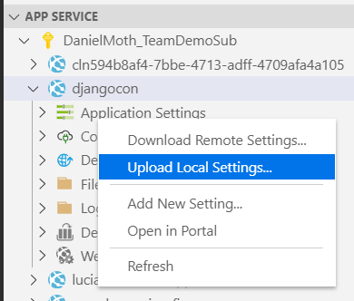
(Bonus) Deploy to Azure
Install the Azure App Service extension
Run the Azure: Sign In command
Push the image to a container registry
Deploy image to Azure App Service
Upload .env file to apply secrets

Slide 51
Steps
Background
Attaching to an existing container
Creating a new development container
Adding a React front-end
Building the production version

Slide 52
Follow us for the latest updates
For information and updates, visit our blog at:
aka.ms/pythonblog
Code + slides: aka.ms/djangocon-devcontainer
Follow us on twitter:
@qubitron
@pythonvscode

