Slide 1

I’M JM PAUL, YOUR BUSINESS PARTNER
LET’S GO AND TALK ABOUT BUSINESS

Slide 2
I’M WORKING IN BUSINESS PROCESSING OUTSOURCING SERVICE FOR ALL OVER 4 YEARS
WHAT SERVICE I OFFERED?
Customer Service Support
Email Support
Live Chat Support
Phone Support
Virtual Assistance
Administrative Support
Social Media Management
Sales Support
Customer Success
CRM Management
WHAT ACCOUNTS THAT I’VE HANDLED?
Telecommunication Account
Travel Account (TripAdvisor)
IT Solutions Account
Social Medias (Engagements Specialist)
Staycation Account

Slide 3

WHAT COMPANY I’VE WORKED FOR? WHY AM I HAVE THIS EXPERTIES?
IGNITED VIRTUAL OUTSOURCING SERVICES COPORATION
At Ignited Virtual Outsourcing Services Corporation, I started as a Customer Care Relations Expert and Outbound Cold Caller, where I was responsible for handling customer inquiries, maintaining positive client relationships, and generating leads through outbound calling. I consistently met productivity and quality targets while developing strong communication, sales, and problem-solving skills.
Because of my performance and ability to support the team, I was promoted to Assistant Team Leader after one year. In this role, I helped manage daily team operations by monitoring attendance, tracking performance, assisting with scheduling, and preparing reports. I also conducted coaching sessions, provided feedback to improve agent performance, handled customer escalations, and served as the first point of support for team members whenever they encountered challenges.
This experience strengthened my leadership, coaching, organizational, and operations management skills. It also taught me how to balance team performance with customer satisfaction while working closely with supervisors and management to achieve operational goals.

Slide 4

WHAT COMPANY I’VE WORKED FOR? WHY AM I HAVE THIS EXPERTIES?
SUTHERLAND GLOBAL SERVICES
At Sutherland Global Services, I was initially hired as a Customer Care Specialist and Sales Expert, where I assisted customers with their concerns, recommended appropriate products and services, and consistently met both sales and customer service performance targets. My role required strong communication, active listening, and the ability to identify customer needs while delivering a positive experience.
After consistently performing well, I was promoted to Team Expert (Subject Matter Expert) after four months. In this position, I became the primary support resource for the team by assisting agents with complex customer concerns, answering process-related questions, and providing real-time floor support. I also worked closely with supervisors by helping monitor team performance, reinforcing company policies and procedures, and coaching team members to improve their productivity and service quality.
This experience enhanced my leadership, coaching, and problem-solving abilities while giving me valuable exposure to team operations and performance management. It also strengthened my ability to support both employees and management in achieving operational and customer service goals.

Slide 5

WHAT COMPANY I’VE WORKED FOR? WHY AM I HAVE THIS EXPERTIES?
QUANTRICS ENTERPRISES INCORPORATED
At Quantrics Enterprises Incorporated, I worked as a Serve to Sell Representative (Billing Trained) and was promoted to Subject Matter Expert (SME) after three months because of my strong performance and product knowledge. Quantrics is a business process outsourcing (BPO) company that provides customer service, sales, billing, and technical support for telecommunications clients.
In this role, I handled customer billing inquiries, resolved account concerns, identified sales opportunities, and ensured a high level of customer satisfaction. As an SME, I supported agents with process-related questions, coached team members, assisted supervisors with performance monitoring, handled escalations, and conducted knowledge-sharing sessions. These responsibilities strengthened my expertise in customer service, billing support, team coaching, operations support, problem-solving, and leadership.

Slide 6

WHAT COMPANY I’VE WORKED FOR? WHY AM I HAVE THIS EXPERTIES?
INTOUCHCX
At IntouchCX Manila, I currently work as a Customer Service Representative handling the Airbnb Home Listings Account. IntouchCX is a global business process outsourcing company that provides customer experience solutions and support services for various international brands.
In my current role, I assist Airbnb hosts and guests by addressing concerns related to home listings, account issues, reservations, policies, and platform-related inquiries. I help ensure a smooth customer experience by providing accurate information, resolving issues efficiently, and following established processes and quality standards.
This role has strengthened my expertise in customer relationship management, problem-solving, platform support, policy adherence, communication, and handling complex customer concerns. It also allows me to develop further operational skills by collaborating with teams, managing multiple cases, and maintaining service excellence in a fast-paced environment.

Slide 7
What is in my roles as Social Media Management?
I’m the of Engagement specialist of Opportunity at Quezon City BPO. On this page, I engaging to applicants wants to apply to other BPO Companies here in Philippines. I got earned some commission to those BPOs wants to have my applicants.
The second one, of my relatives in father side, give me position for Social Media Manager and Ads Manager. I posting some important information in regards with hiring companies here in Manila. Other things, we have our headhunter or physical recruiter outside of the page. I’m also handled their commission in one of the companies they have got an applicant.

Slide 8
I believe I would be a valuable addition to your team as a Social Media Manager because I understand how to turn social media into a powerful tool for brand growth, customer engagement, and sales. I have experience creating strategic content, managing Meta Ads campaigns, analyzing performance metrics, and optimizing campaigns to maximize ROI. I stay up to date with social media trends and platform updates, allowing me to develop creative strategies that keep brands competitive.
Beyond running campaigns, I focus on understanding the target audience, building meaningful engagement, and creating content that drives real business results. I am organized, detail-oriented, and proactive, with the ability to manage multiple projects while meeting deadlines. I am confident in making data-driven decisions, solving problems quickly, and continuously improving campaign performance.
If given the opportunity, I will bring dedication, creativity, and a results-focused mindset to help grow your brand, increase online visibility, generate quality leads, and contribute to the long-term success of your business.
Please note: We are talking about revenue and the calibration of the company. I will take seriously about this job. All the information provided is clear and came from my credentials, backgrounds of expertise.

Slide 9
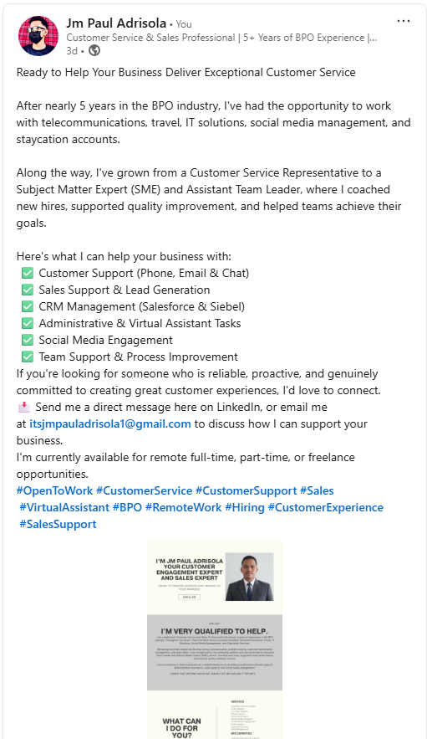
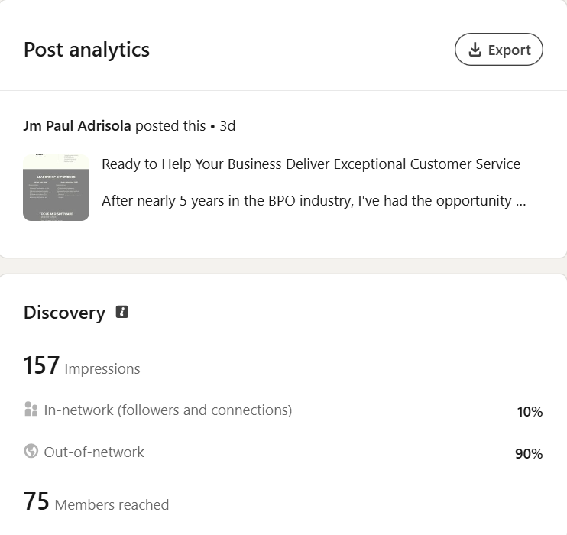
Latest post from LinkedIn:
This is the time that I’m looking for client as Customer Service, Virtual Assistant, and other freelance opportunities related to customer relation management.
Based on LinkedIn Analytics, this post has a 157 impressions it has a insights of 10% of In-network (followers and connections)p and as well as 90% of out-of-network who saw this post. I’ve been using this Linkedin for all over 5 years and I know this is not the perfect number to impress , but this is a thing that I have a couple of things to do the objectives, and responsibilities that I will be hnaflilnh.

Slide 10
What are the tools and software that you expert to use it?
Communication Software:
Microsoft Teams
Google Meet
Slack
Discord
Zoom
Google Drive
Google Workspace
Product Software Software:
Siebel CRM
Salesforce
Monday.com
Canva
Power BI
Capcut
Canva

Slide 11
WHY YOU NEED TO WORK WITH ME?
Nearly 5 years of Customer Service Experience
Leadership experience as Assistant Team Leader and SME
Strong communication and interpersonal skills
Experienced in handling different industries
Fast learner and adaptable
Detail-oriented and reliable
Able to work independently and collaborative

Slide 12
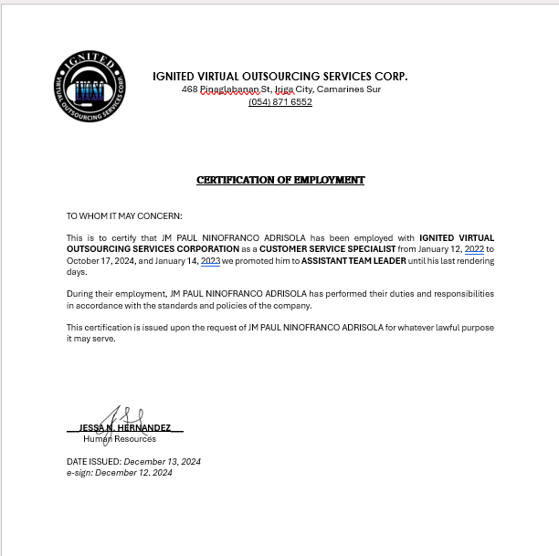
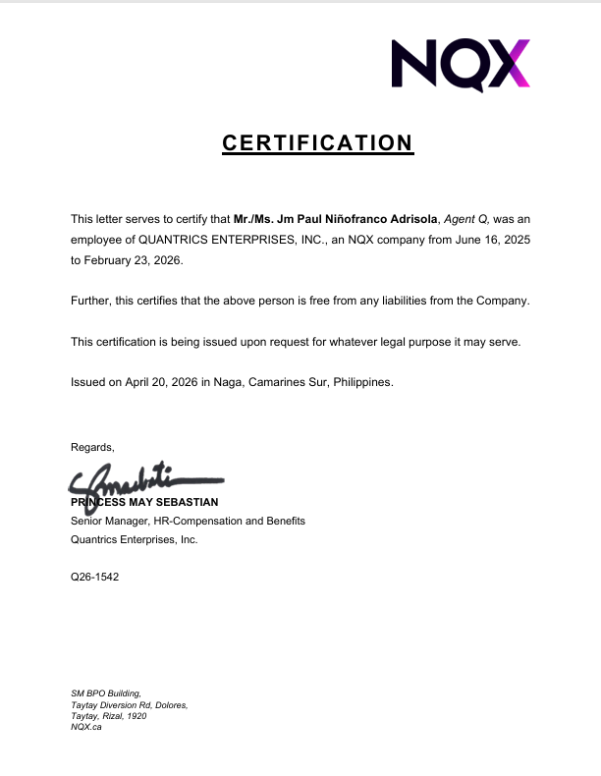
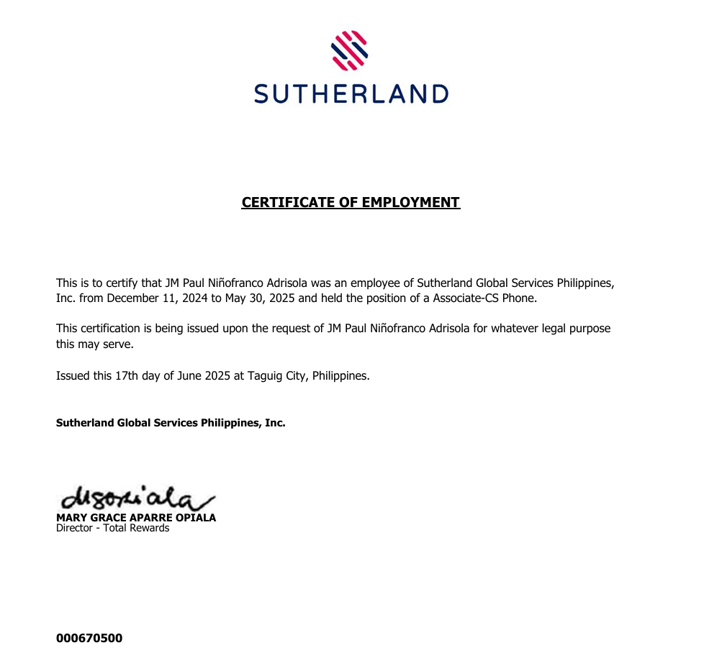
THIS IS MY LEGITIMATE CERTIFICATION OF EMPLOYMENT ALL THE COMPANY I’VE WORKED WITH.

