Slide 1
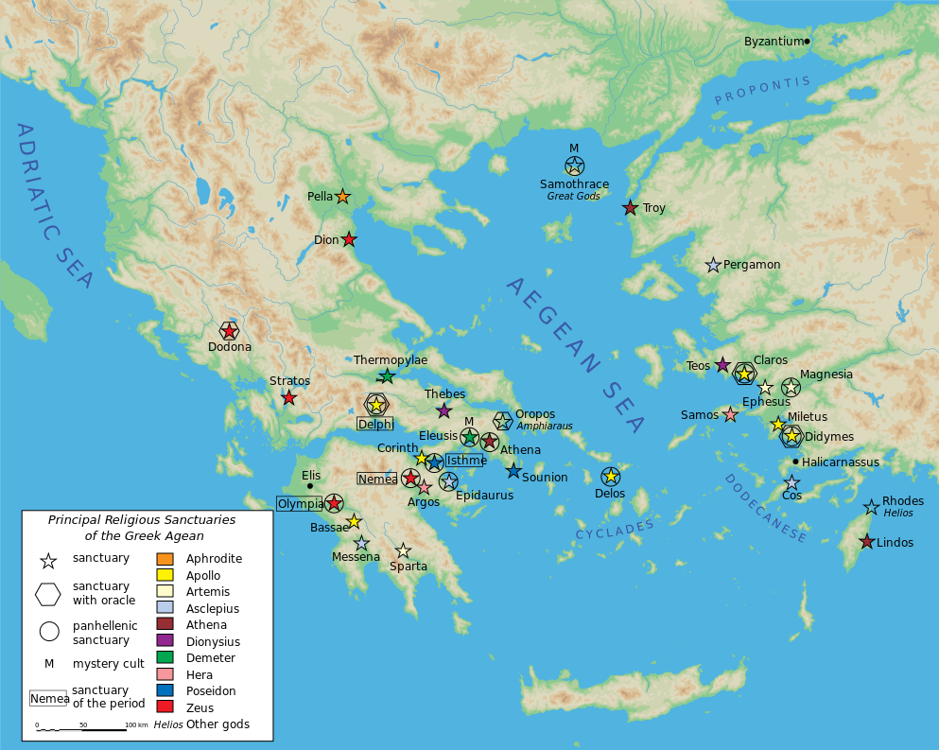
OLYMPIA

Slide 2
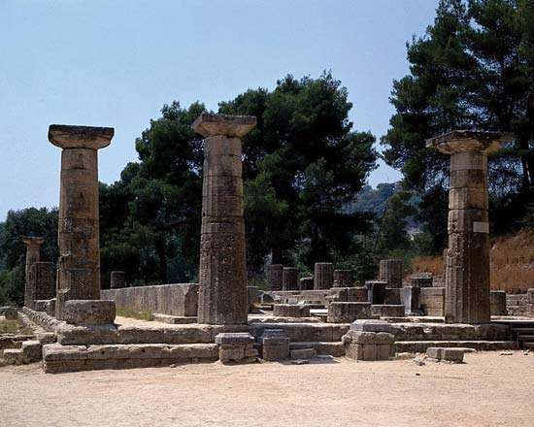
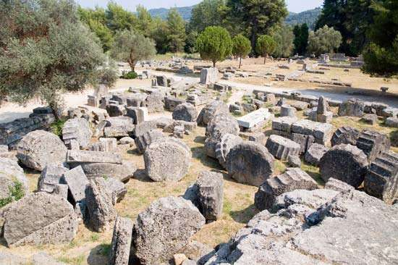
Olympia, a sanctuary of ancient Greece
Temple of Zeus
Temple of Hera

Slide 3
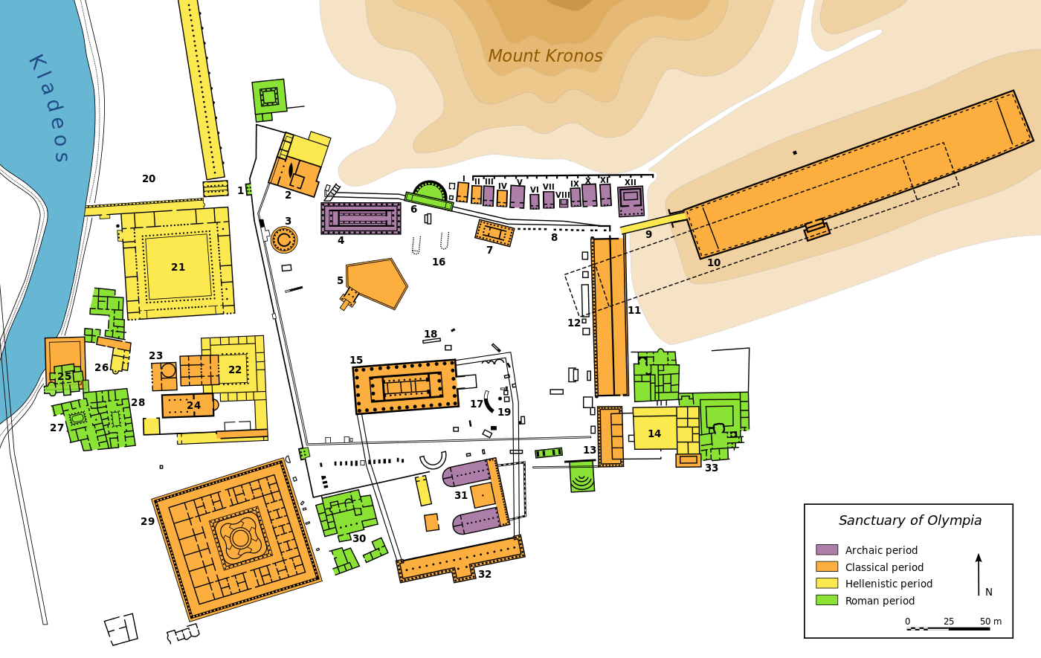
THE SITE

Slide 4
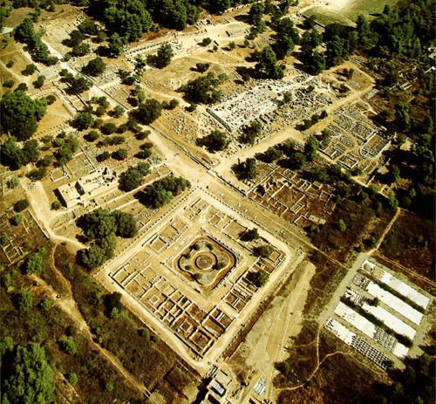

Slide 5
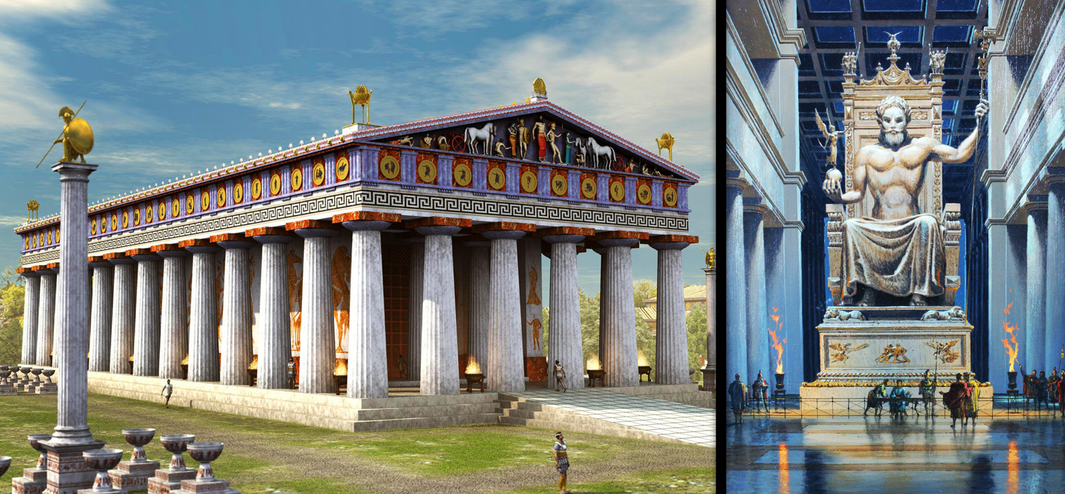
First Excavation – in 1829 – Later Excavations – 1875-1881
Temple of Zeus

Slide 6
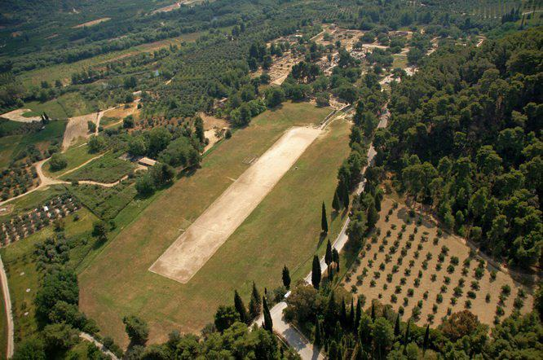
Interrupted by World War II – 1936-1960 – In 1961, Restoration
Stadium

Slide 7
Work Cited
“Olympia, Greece.” Wikipedia, Accessed March 21, 2018. https://en.wikipedia.org/wiki/Olympia,_Greece.
“Olympia.” Encyclopædia Britannica, Accessed March 21, 2018. https://www.britannica.com/place/Olympia-ancient-site-Greece.
Gates, Charles (2003). Ancient cities: the archaeology of urban life in the Ancient Near East and Egypt, Greece and Rome. Psychology Press. p. 234.
“Reviewed Work: Olympia: Its History and Remains by E. Norman Gardiner. PDF.” Accessed March 21,2018. http://www.jstor.org/stable/pdf/290576.pdf?refreqid=excelsior%3Afa2038acbf763e03dd9851fa1e6435ea.

