Slide 1
Gertrude Bell
1868-1926

Slide 2
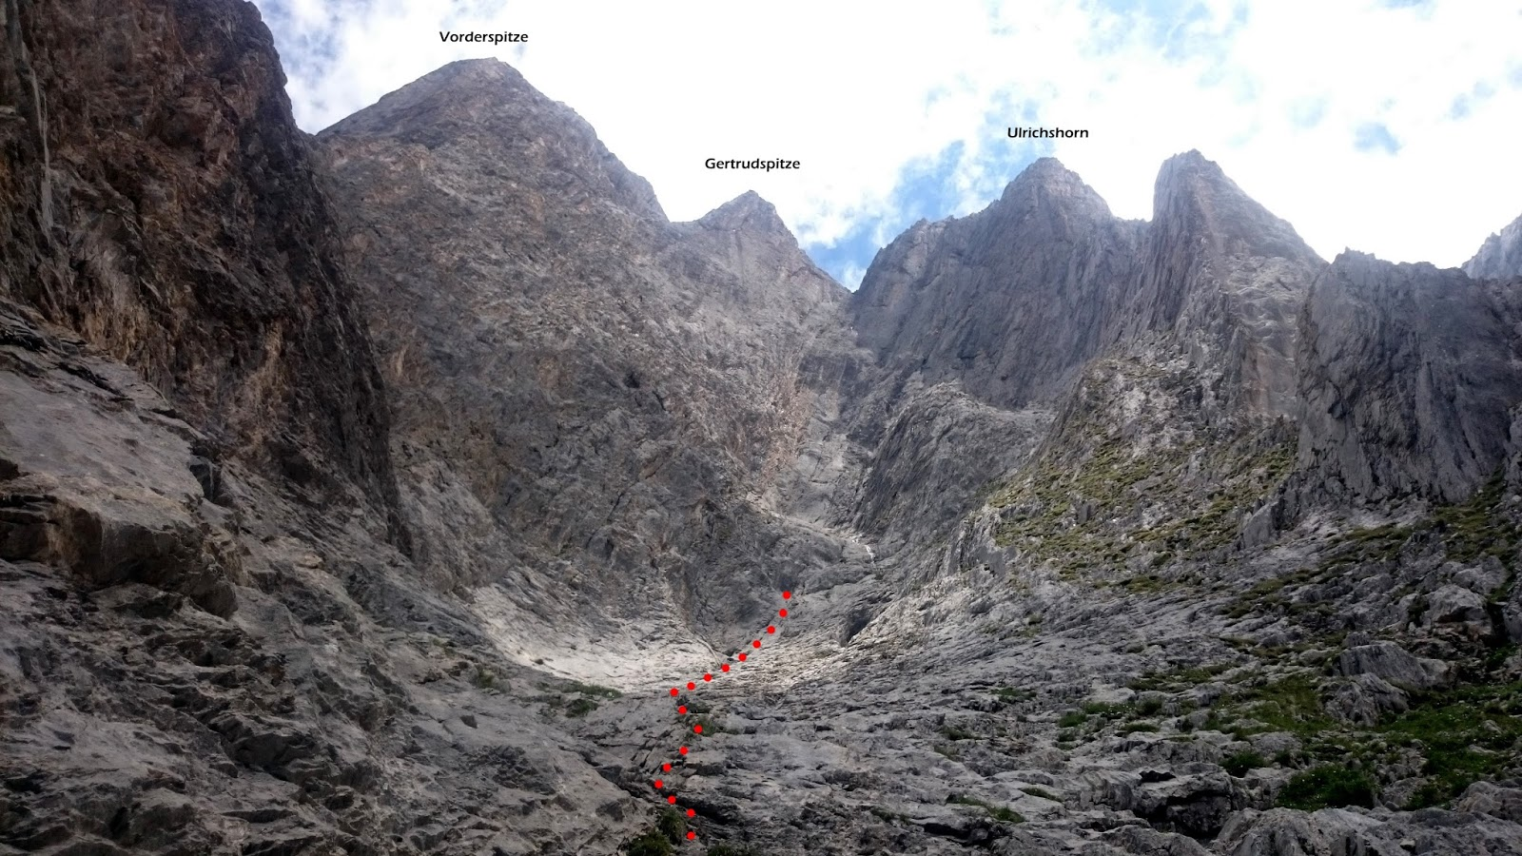
Early Life
Wealthy Industrial Family
Educated
Oxford 1888
Highest Honors
Germany

Slide 3
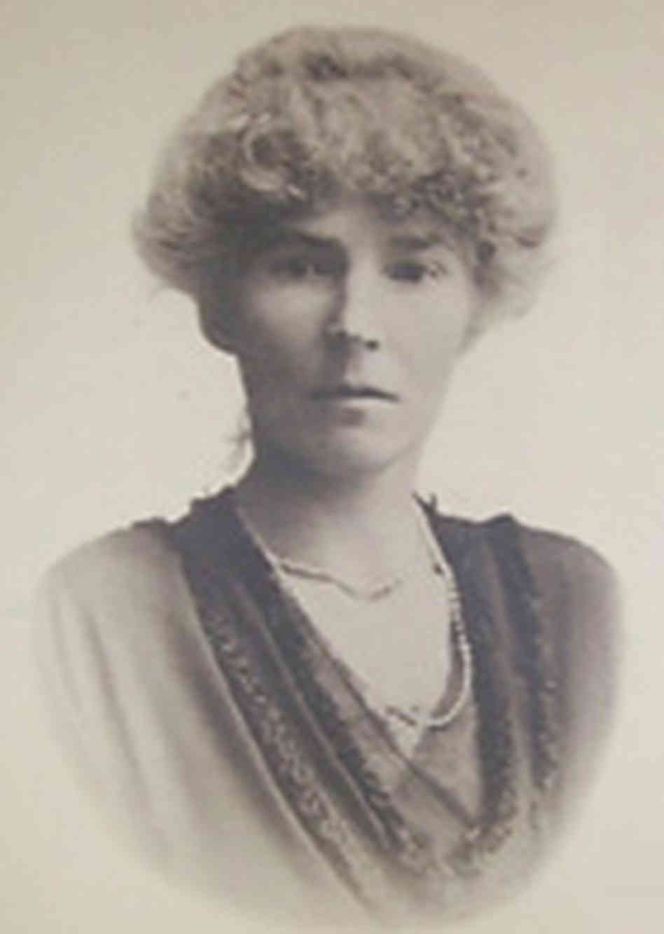
Awarded Archeologist
Royal Geographical Society
“For her important explorations and travels in Asia Minor, Syria, Arabia and on the Euphrates”
Books
Photography
Excavations

Slide 4
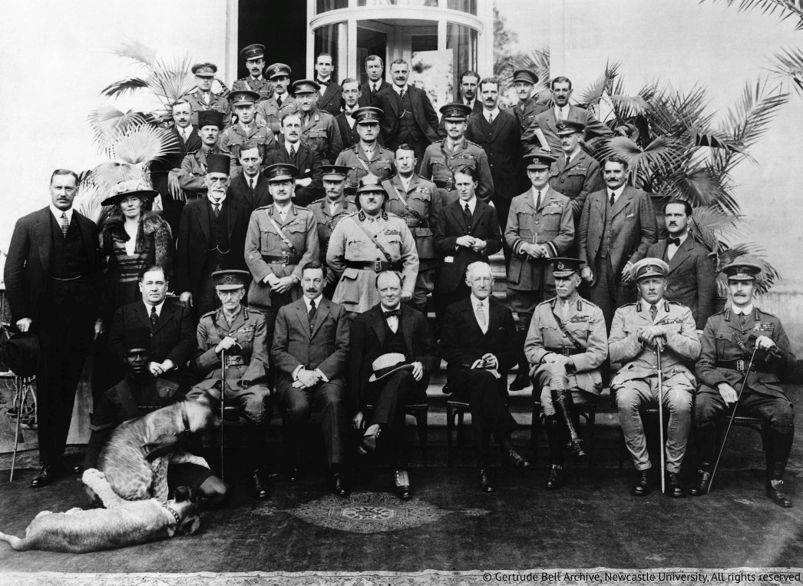
Influential
WW1
Honorary Director of Antiquities
Museum

Slide 5
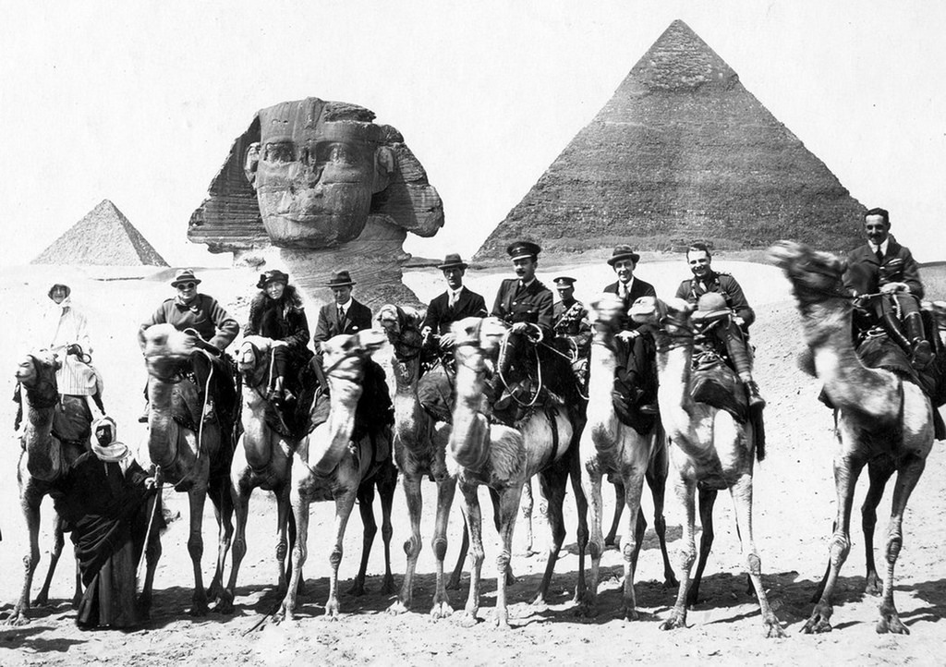
“Honorary Man”
Political Connections
Education
8 languages
Middle East
Only Local Men
Political Position

Slide 6
