Slide 1
Theodor Mommsen
(1817–1903)

Slide 2
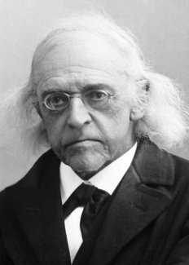
Early Life
Born in Garding, Schleswig
University of Kiel – 1838-1843
Received Masters and Doctorate Degrees
Research Scholarship - 3 Years in Italy

Slide 3
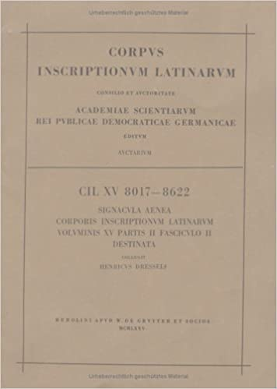
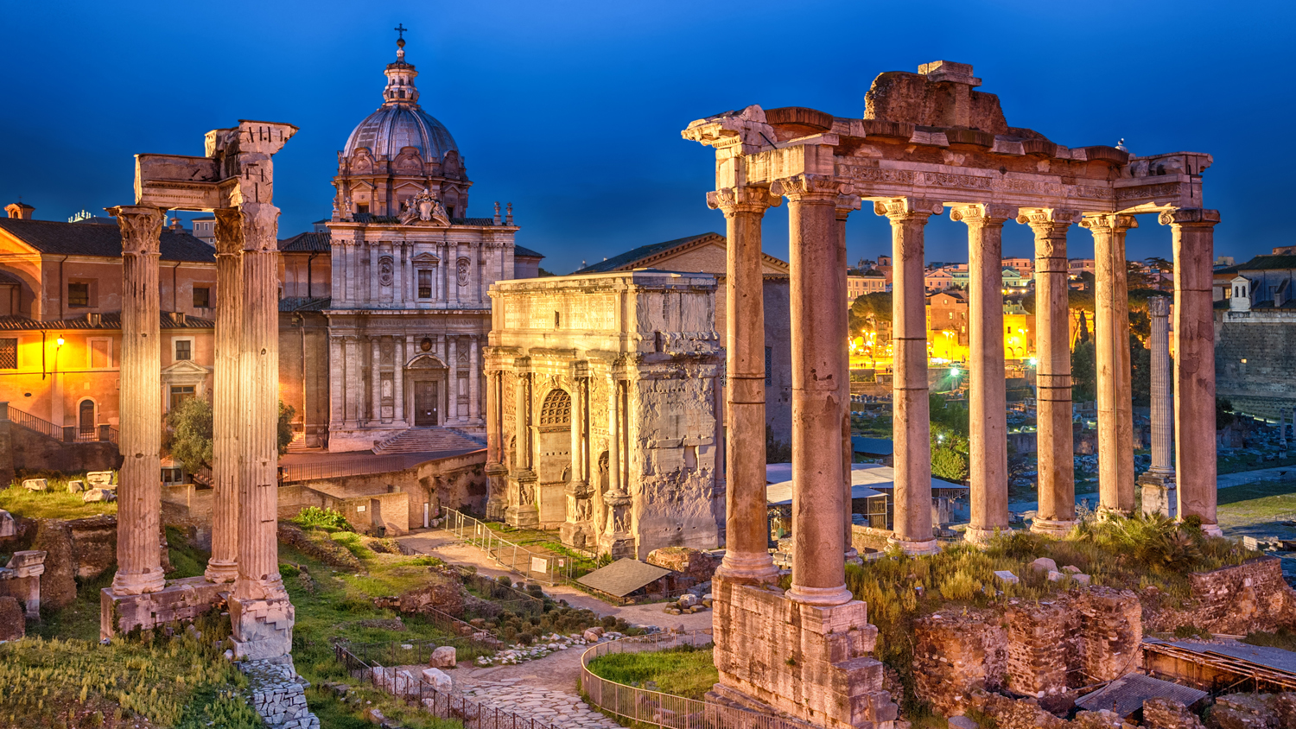
Italy 1844-1847
Archaeological Institute in Rome
Corpus Inscriptionum Latinarum
Master of Epigraphy

Slide 4
Politics
Returning Home
Working
Mommsen left Italy in 1847
Schleswig – Under Rule of Danish King
Liberal Ideologies
Met his wife, Marie Reimer 1854
Editorship Schleswig-Holsterinishe Zeitung
Professorship in Civil Law at the University of Leipzig 1848
Remained Active Politician
Professorship in Prussia at University of Breslau 1854

Slide 5
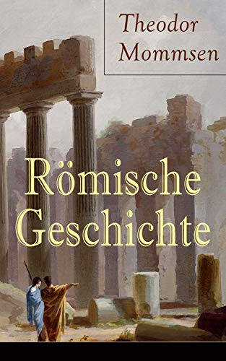
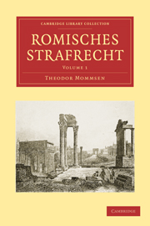
Later Works
Römische Geschichte (“Roman Constitutional Law”)
3 Volumes between 1871-1888
Römisches Strafrecht (“Roman Criminal Law”)
1899

Slide 6
Works Cited
https://www.britannica.com/biography/Theodor-Mommsen
https://www.nobelprize.org/prizes/literature/1902/mommsen/biographical/
https://www.livius.org/articles/person/mommsen/

