Slide 1
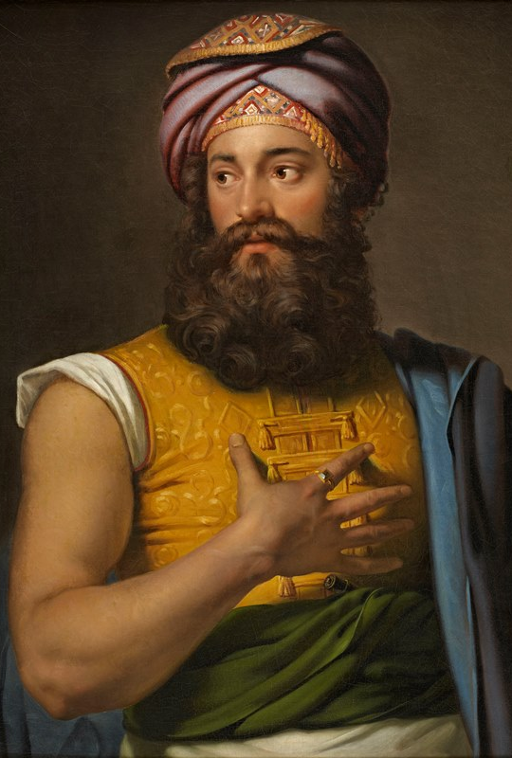
Giovanni Belzoni
(1778- 1823)

Slide 2
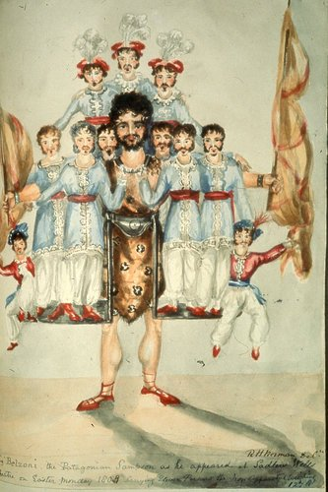
Beginnings
Belzoni spent his early years traveling and working an array of odd jobs:
He worked as a barber, studied hydraulics, sold water fountains, and traveled Europe as a circus strongman
“The Great Belzoni”

Slide 3
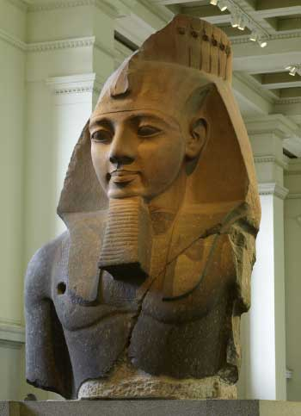
Beginnings
Cairo- Muhammad Ali Pasha
Failed to sell mechanized water pump
British Museum
Trying to move a bust of Ramses II
Hired by British General Consul- Henry Salt

Slide 4
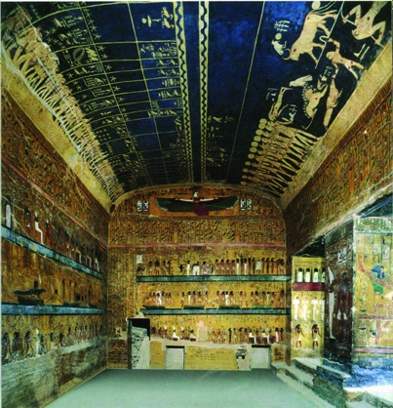
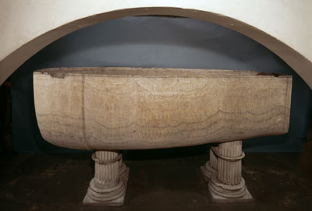
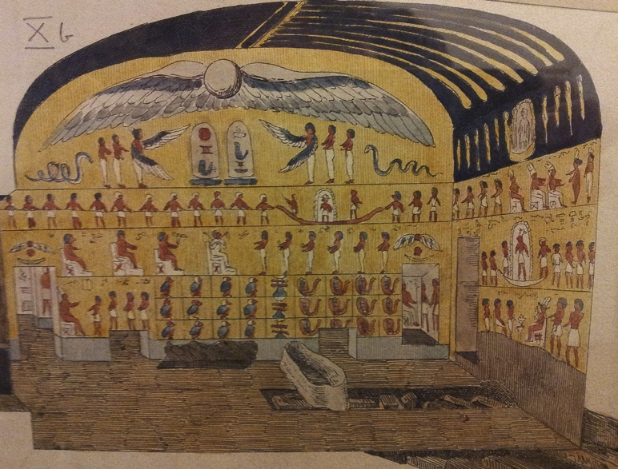
Accomplishments
First to enter pyramid of Khafre, opened burial chamber of Seti I in the Valley of Kings, and acquired papyri scrolls for European collectors
Methods
Antiquarianism
No formal training
Circus-: Levers and weights
Illustrations and journals

Slide 5
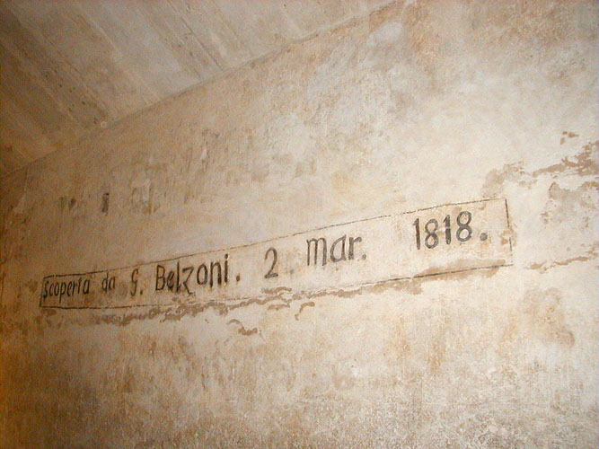
“… I sought a resting place, [...] but when my weight bore on the body of an Egyptian, it crushed like a bandbox. I naturally had to recourse to my hands to sustain my weight, but they found no better support; so that I sunk altogether among broken mummies [...] which raised such dust as kept me motionless for a quarter of an hour [...] and every step I took I crushed a mummy in some part or another...”
Narrative of Operation and Recent Discoveries in Eygpt and Nubia- Giovanni Belzoni

Slide 6
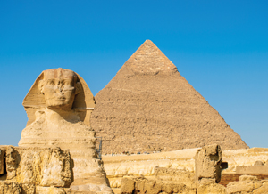
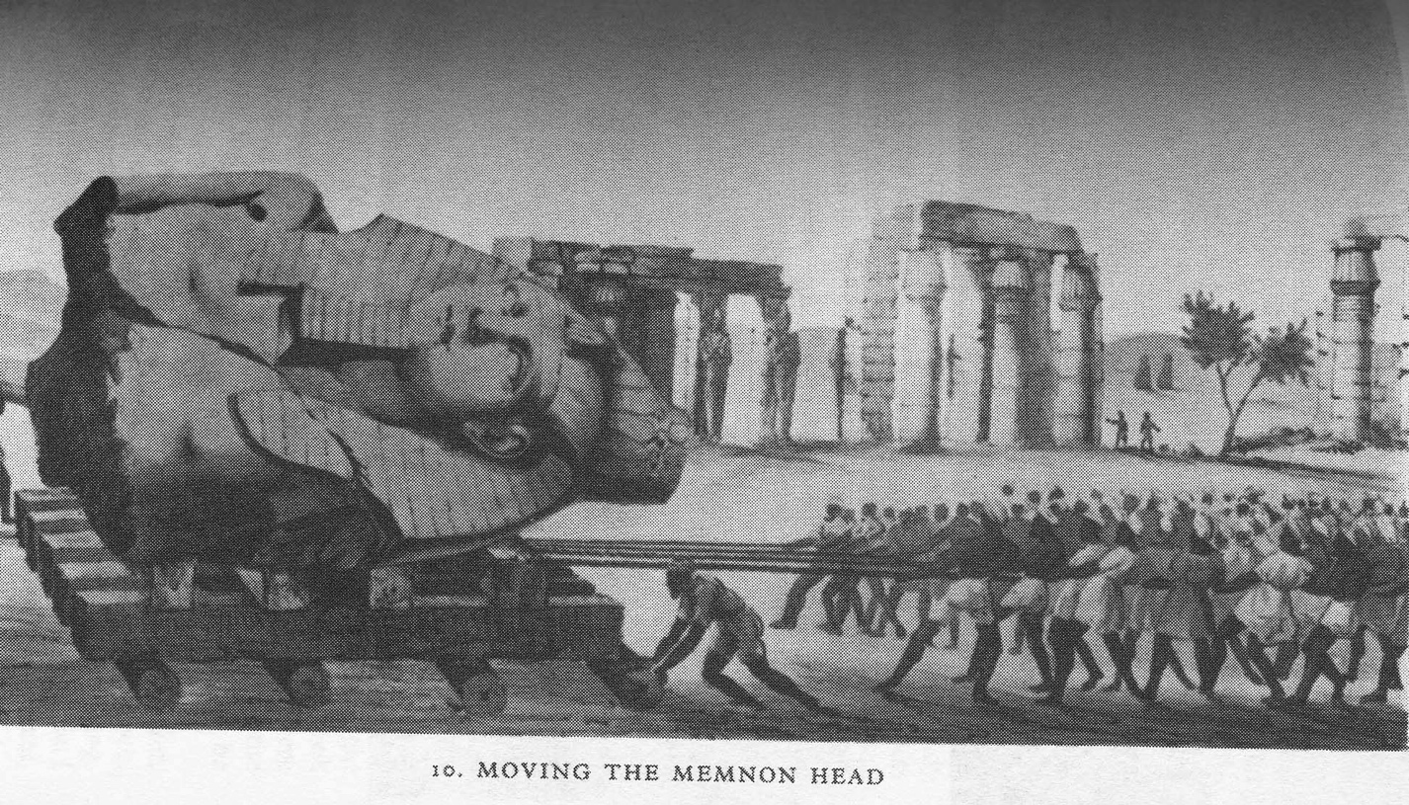
Works Cited
“Tomb Robber by the Nile.” Eyewitness to Discovery, by Brian Fagan, Oxford University Press, 1996, pp. 75–78.
“Giovanni Battista Belzoni.” Encyclopedia of Global Archeology, by Chelsea Colwell-Pasch, Flinders University of South Australia, pp. 1-3.

