Slide 1
Satellites and Plato
Using GIS to see the effects of ideas
Kass Mattingly

Slide 2
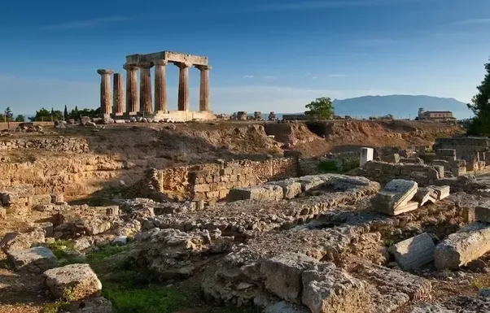
Greek City Planning

Slide 3
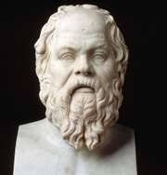
Plato’s Perfect City
Isolated
Fortified acropolis
City divided into 12 sections
Ring wall

Slide 4
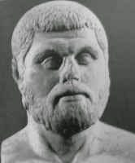
Hippodamian Cities
Grid Layout
Wide Streets
Cross at right angles
Central Agora

Slide 5

What is GIS?
Geographic Information System(s)
Space Archaeology!
More than bird’s eye view

Slide 6
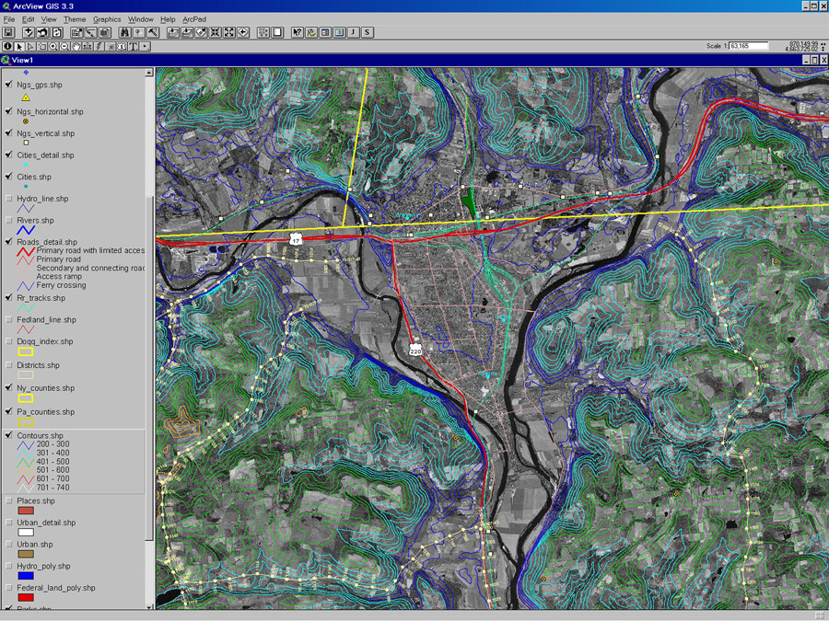

Slide 7
Bibliography
Cahill, N. 2002. April 10. Household and City Organization at Olynthus. Yale University Press.
“Hippodamus of Miletus.” Wikipedia. 16 April, 2018. Web.
Lahanas, Michael. “Town (or Urban) Planning in ancient Greece.” Hellenica World. 16 April, 2018. Web.
“Make Your Own Maps of Corinth and Greece.” The American School of Classical Studies at Athens. 16 April, 2018. Web.
Plato. and Lee, H. (1974). The Republic. Harmondsworth: Penguin.
Stergiou, Margarita. “What if Ancient Greeks had GIS Technology?” GIS Lounge. 13 November, 2013. 16 April, 2018. Web.

