Slide 1
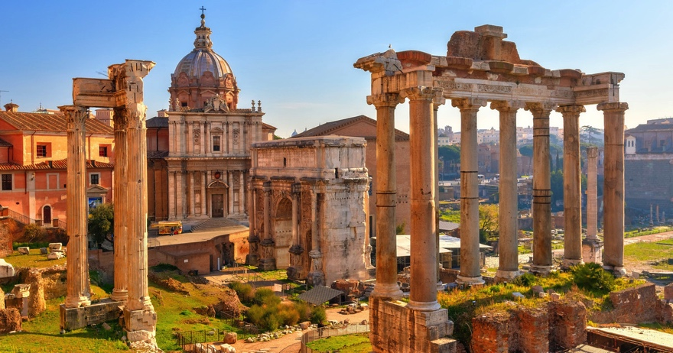
Roman Forum

Slide 2
Forum
-Central square of ancient Rome
- Contained most important political institutions of the city
- Council buildings, temples, market
Large shift in appearance n the Late Republic (2nd- 3rd c. BCE)
- Forum served very different needs of the community

Slide 3
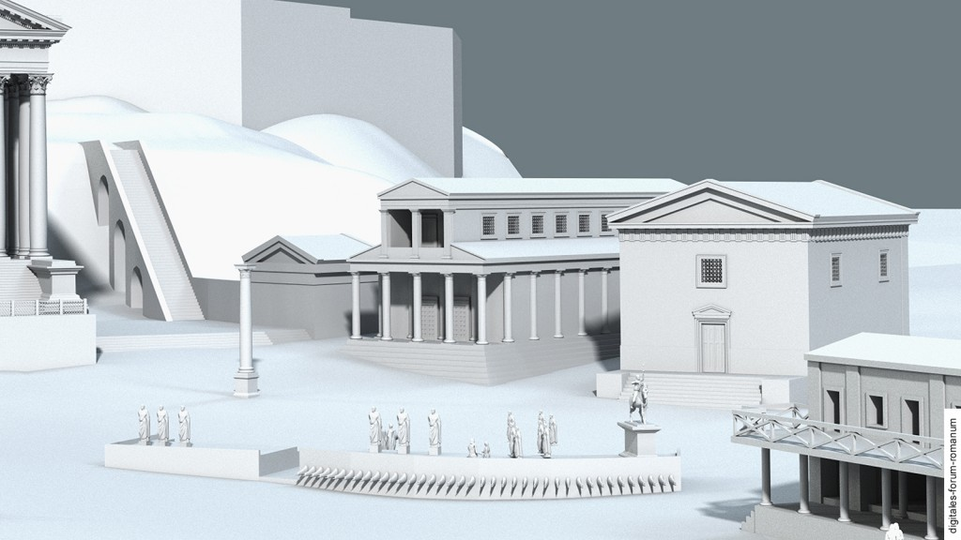
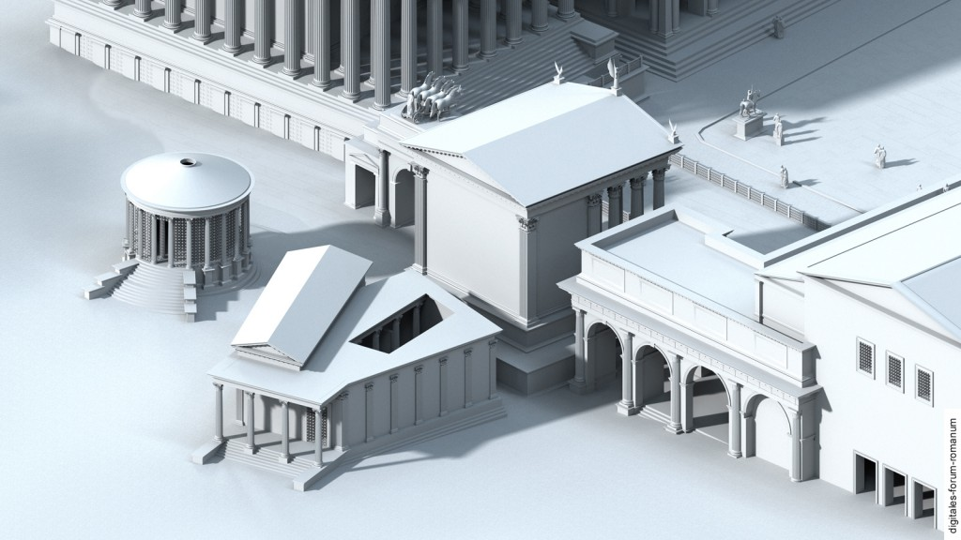
Civic Buildings
Basilica-
Regia-

Slide 4
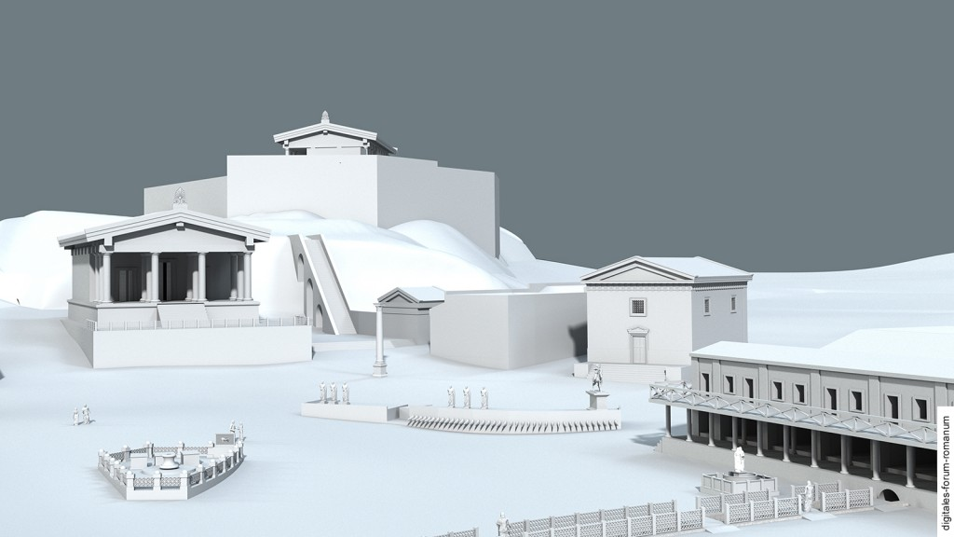
Civic Buildings
Curia-
Comitium-
Tabernae-

Slide 5
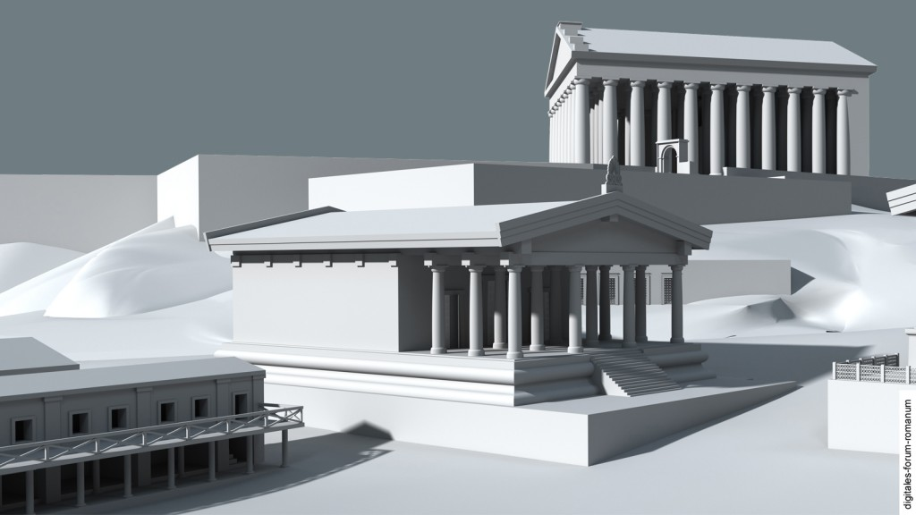
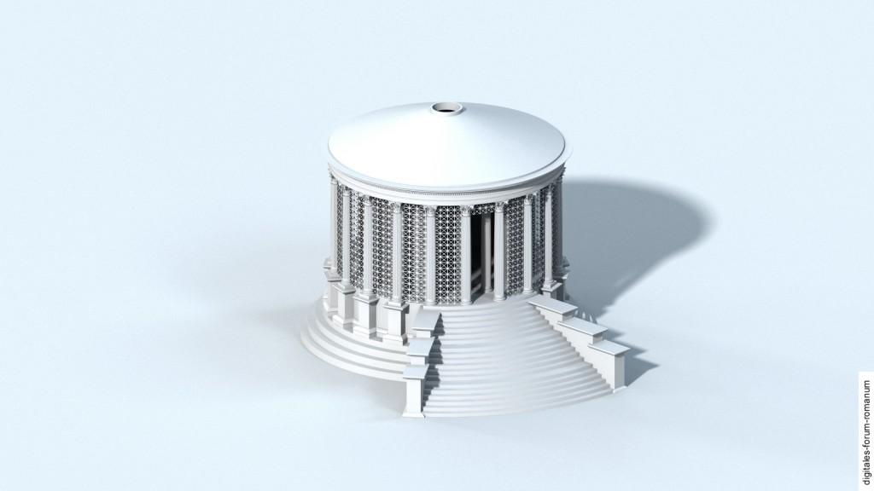
Religious Buildings
Temple of Saturn
Temple of Vesta

Slide 6
Works Cited
Digital Forum Romanum:
http://www.digitales-forum-romanum.de/

