Slide 1
Site: Olympia
Michael Malatesta

Slide 2
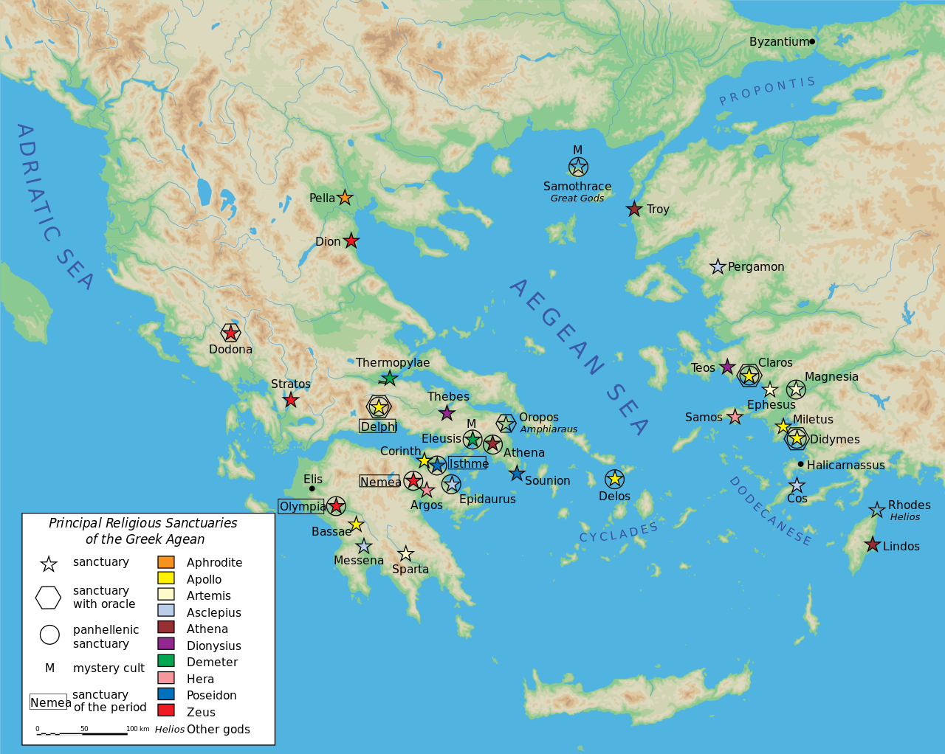
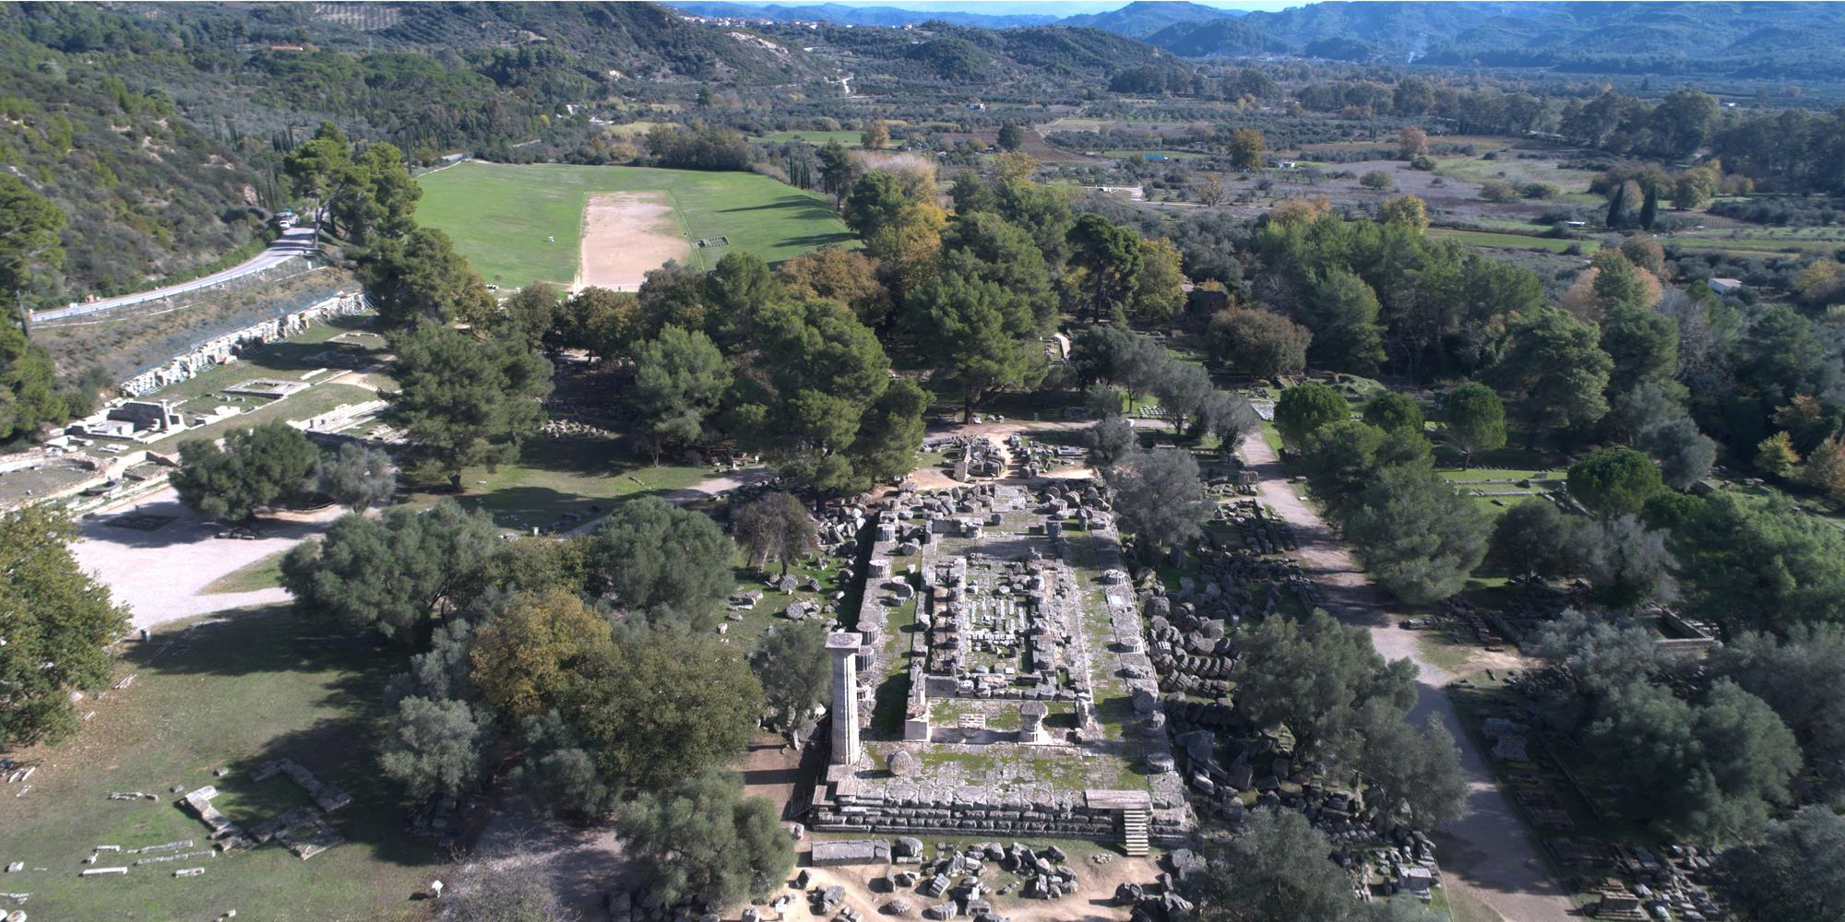
Where is Olympia?

Slide 3
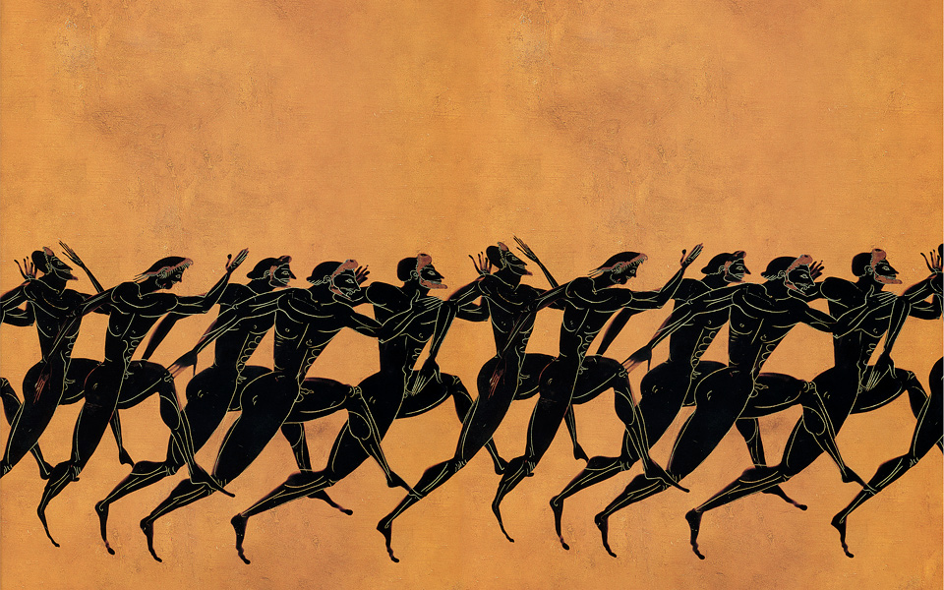
Background About Olympia
Sanctuary site for the God, Zeus
Sporting events were originally held here as funerals
The Ancient Olympics took place here
Starting around 776 B.C.
First thought to be habited between 1900 B.C and 1600 B.C.

Slide 4
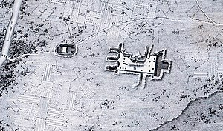
Olympia’s discovery
Thought to be lost due to river flooding and/or tsunamis
Some areas buried over 8 meters of dirt
Officially rediscovered in 1766 by Richard Chandler
Was not excavated until 1829 by the French “Expédition Scientifique de Morée”, led by Abel Blouet
They discovered the main site and the Temple of Zeus
Map of the first archaeological excavations in Olympia in May 1829

Slide 5
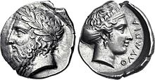
Excavation site
First major excavation was in 1875
The German government gave Ernst Curtius full access
Approximately 14,000 items were discovered
In 1952 there was an excavation on the southeast section
140 bronze and ceramic objects found
Terracotta roof tiles
In 1984 the site focused on the Prytaneion and Pelopion

Slide 6
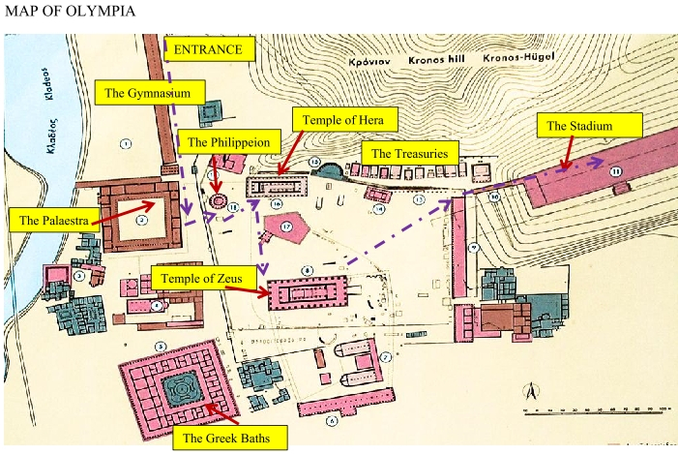

Slide 7
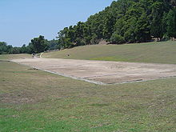
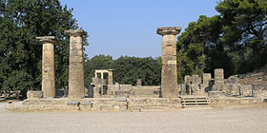
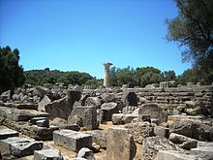
Major Discoveries
Ruins of the Temple of Zeus
Ruins of the Temple of Hera
Original Stadium Location

Slide 8
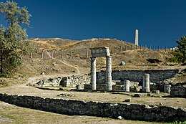
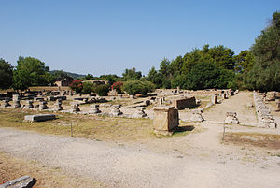
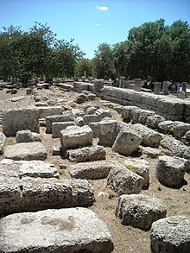
Major Discoveries
Location of the Gymnasium
(Where athletes trained)
Prytaneion
(Location where officials met)
Leonidaion
(Athlete Lodging)

Slide 9
Bibliography
Google Images
“Olympia.” n.d. Ancient History Encyclopedia. Accessed February 24, 2021. https://www.ancient.eu/Olympia/.
“Olympia, Greece.” 2021. In Wikipedia. https://en.wikipedia.org/w/index.php?title=Olympia,_Greece&oldid=1007986466.
“Olympia Hypothesis: Tsunamis Buried the Cult Site on the Peloponnese.” n.d. ScienceDaily. Accessed February 24, 2021. https://www.sciencedaily.com/releases/2011/07/110710204240.htm.
“The Ancient Games: Not so Rosy.” 2016. Greece Is. August 9, 2016. https://www.greece-is.com/ancient-games-not-rosy/.

Slide 10
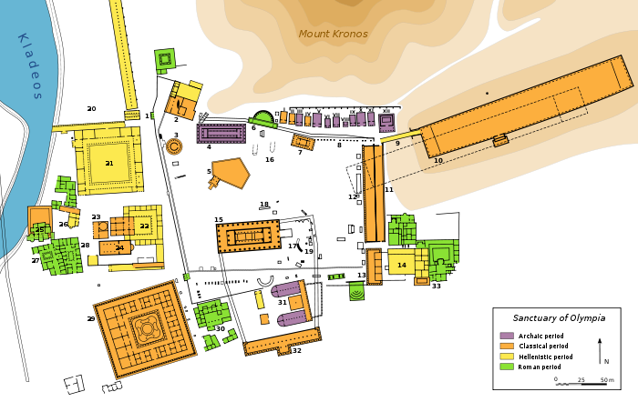
More Detailed Olympia Site Plan

Slide 11
Site Legend
1. | Northwest Propylon | 12. | Building of Ptolemy II and Arsinoe II | 23. | Heroon
2. | Prytaneion | 13. | Hestia stoa | 24. | Pheidias' workshop and paleochristian basilica
3. | Philippeion | 14. | Hellenistic building | 25. | Baths of Kladeos
4. | Temple of Hera | 15. | Temple of Zeus | 26. | Greek baths
5. | Pelopion | 16. | Altar of Zeus | 27. | Hostels
6. | Nymphaeum of Herodes Atticus | 17. | Ex-voto of Achaeans | 28.
7. | Metroon | 18. | Ex-voto of Mikythos | 29. | Leonidaion
8. | Treasuries | 19. | Nike of Paeonius | 30. | South baths
9. | Crypt (arched way to the stadium) | 20. | Gymnasion | 31. | Bouleuterion
10. | Stadium | 21. | Palaestra | 32. | South stoa
11. | Echo Stoa | 22. | Theokoleon | 33. | Villa of Nero

