Slide 1
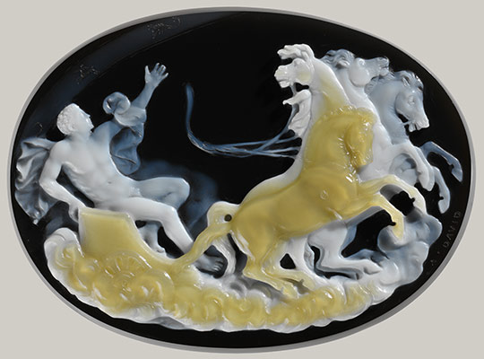
Cameos

Slide 2
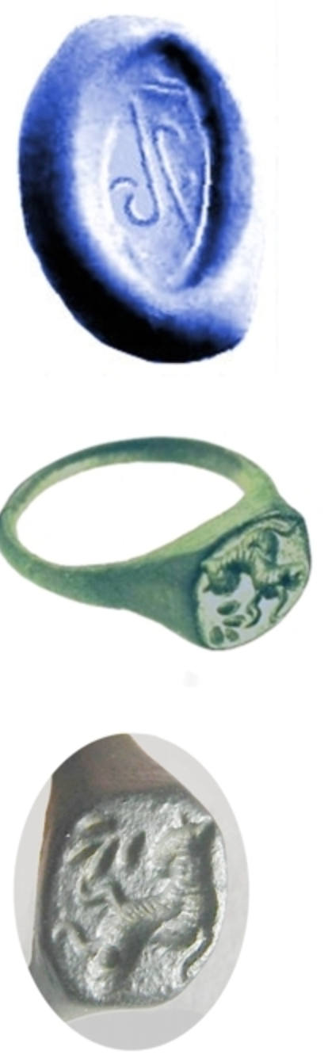
Brief HISTORY
Origins- Mesopotamia
-Hellenistic Greeks adopted the technique and expanded the art form
-Intaglios- Initial cameos carved as negative images
Used as seals
As time went on, the Greeks began carving positive, or raised, image cameos.
subject matter of classical cameos constitutes both mythology and daily life
cameos document an array of gods, goddesses, common, and political figures

Slide 3
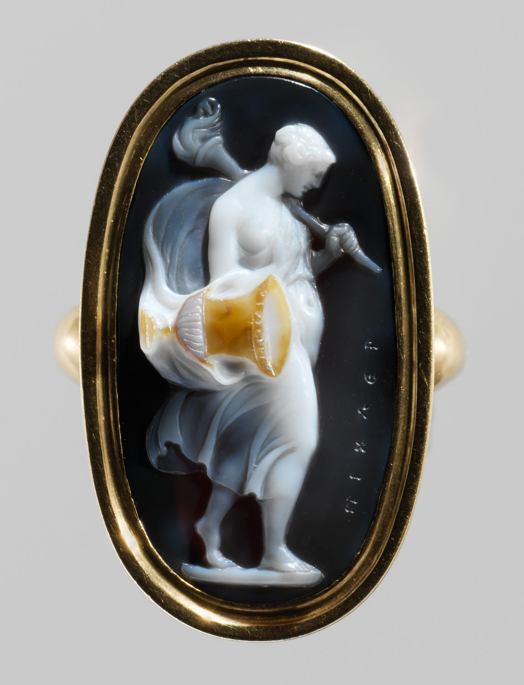
Functions of Cameos
-In the ancient world, the primary function of cameos was to serve as seals
-Seals were used as a type of security device
-placed on documents and even above rooms or compartments that held valuables
could not physically prevent robbery they still served as a deterrent because of what they symbolized
- Many believed seals held protective power, and breaking a seal held severe consequences

Slide 4
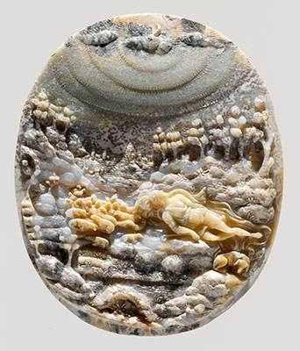
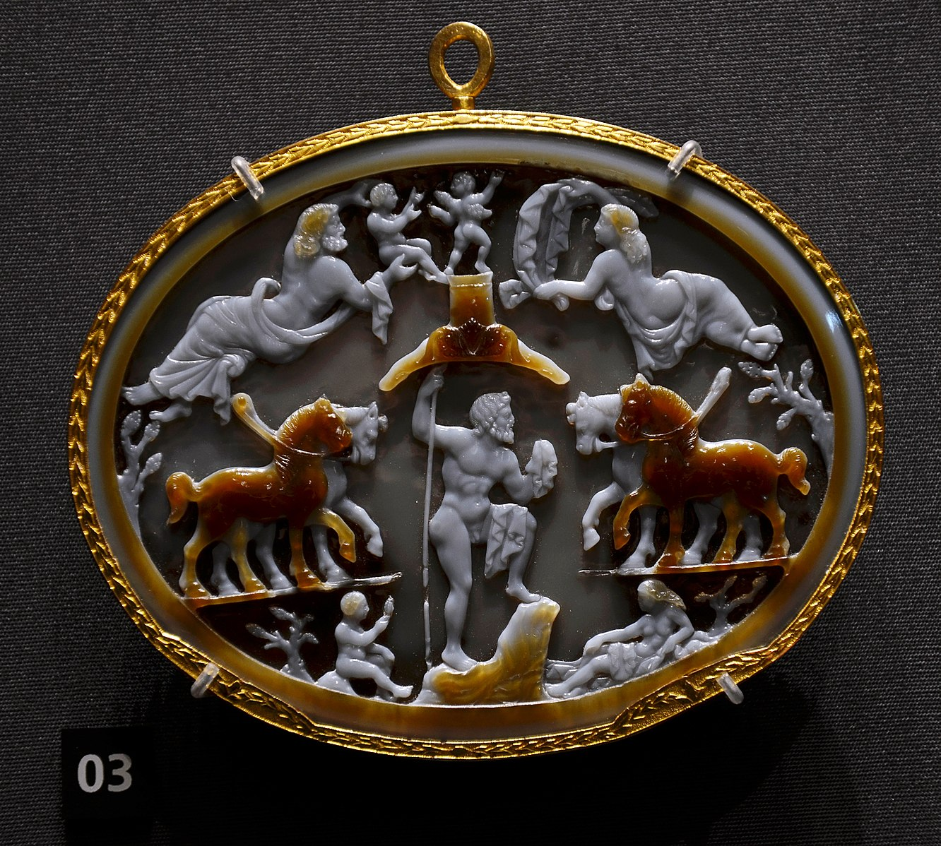
Carving & Polishing
Cameos were produced from a variety of semiprecious stones:
onyx, agate, and jasper as well as glass and shell
Stones were carved by using abrasive powders and hand-drills
The drill was not used to cut the stone itself but to rub the abrasive powders into its surface
Since polishing tend to destroy detail, a cameo needed to be repeatedly finished and polished
Cameo engravers would often work in layers, carving fine details atop a polished layer and then polishing the details

Slide 5
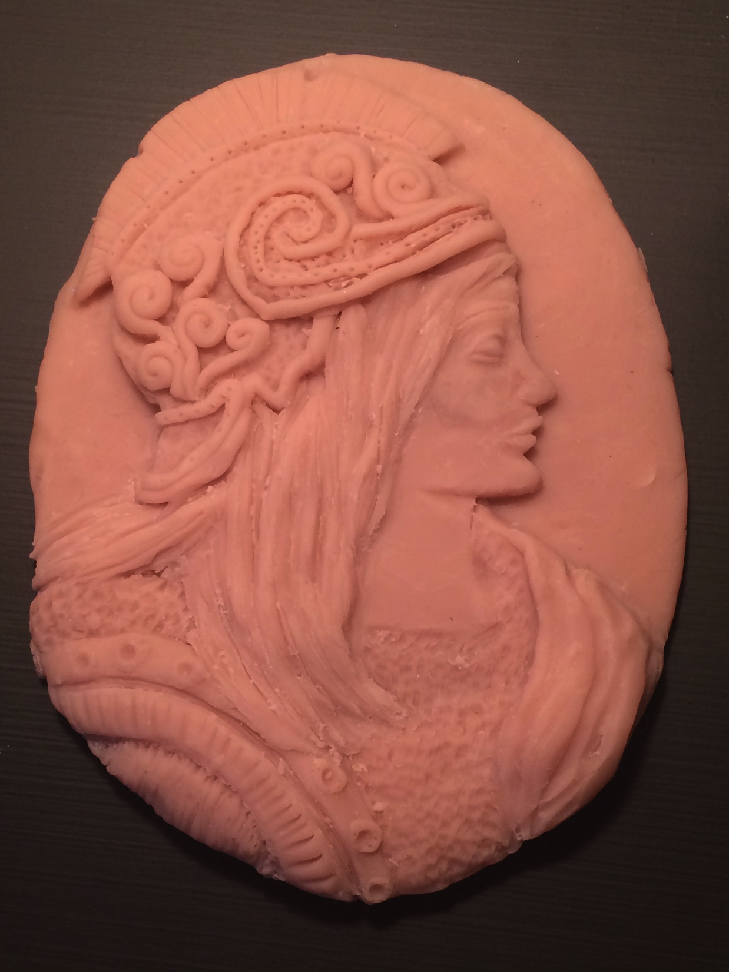
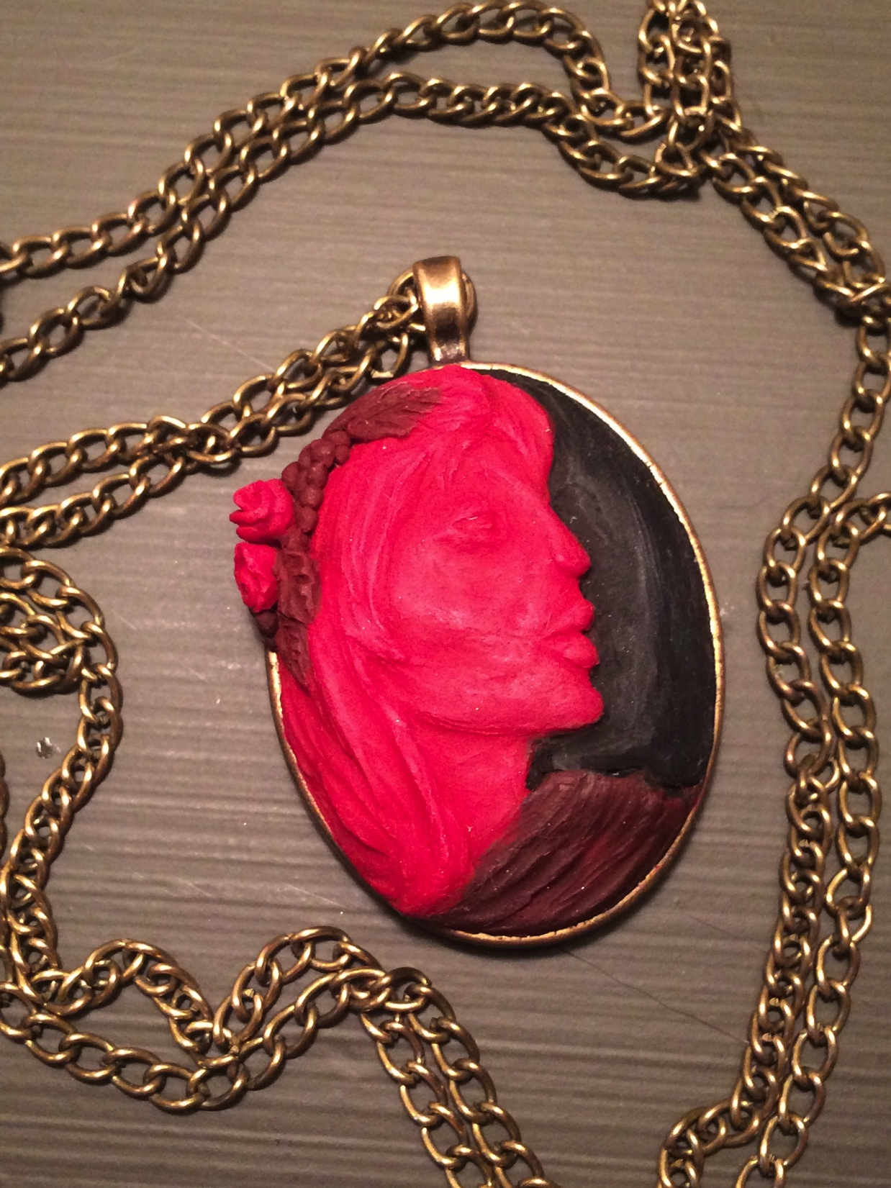
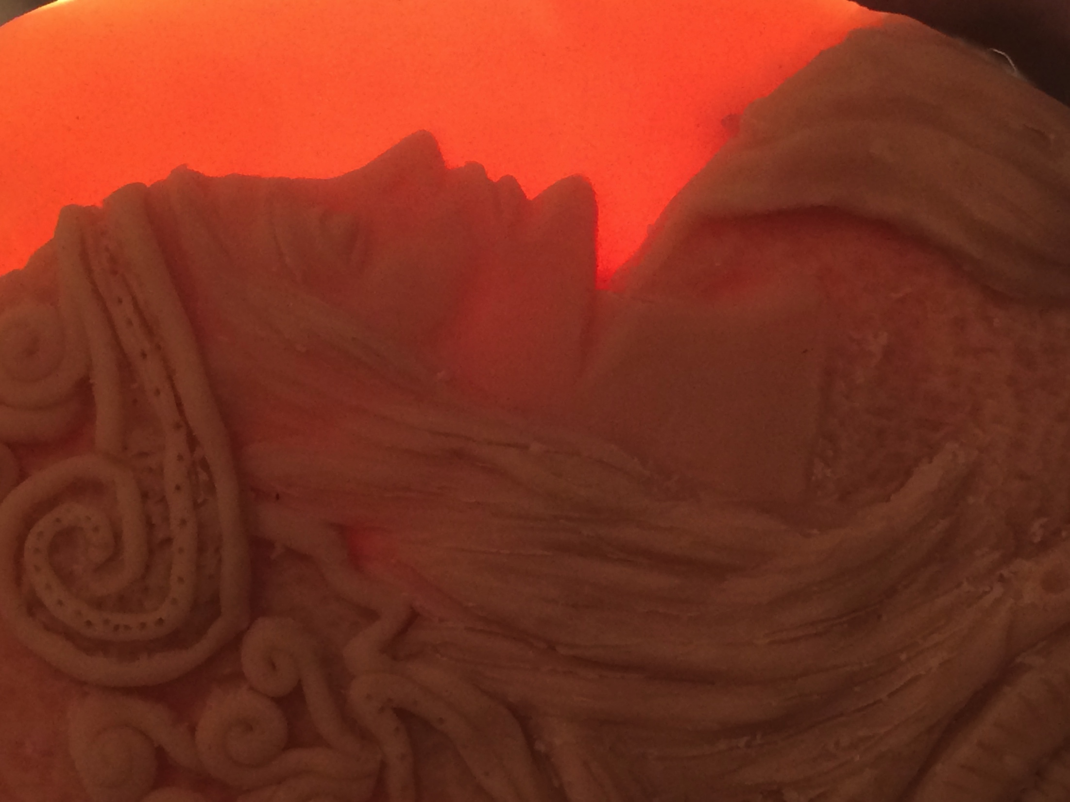

Slide 6
Works Cited
[1] Draper, James David. (2008) “Cameo Appearances.” Heilbrunn Timeline of Art History. New York: The Metropolitan Museum of Art. https://www.metmuseum.org/toah/hd/came/hd_came.htm
[2] Sturm, Robert. (2014). “Cameos from Ancient Greece and Rome: Small but Precious Treasures.” Deposits Magazine. Vol 40. 44-46.
[3] Richter, Gisela M. A. (1920). Catalogue of Engraved Gems of the Classical Style.
New York: The Metropolitan Museum of Art.
[4] Jackson, Donald. “Roman Gallery of Locks and Seals” http://romanlocks.com/Seal%20Boxes.htm
[5] Davenport, Cyril. (1900). Cameos. New York: Macmillan Co.
[6] Booth, A. (1800). Illustrated Catalogue of Gems, Cameos & Amber. Oxford University.
[7] https://commons.wikimedia.org/

