Slide 1
Polychromy in the Ancient World
Olivia Darveau

Slide 2
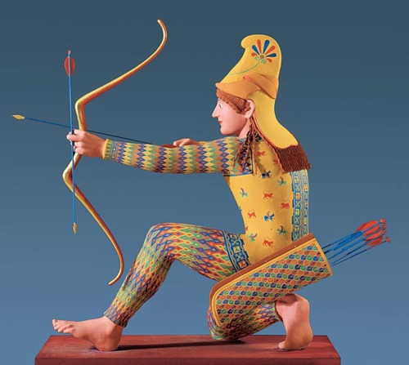
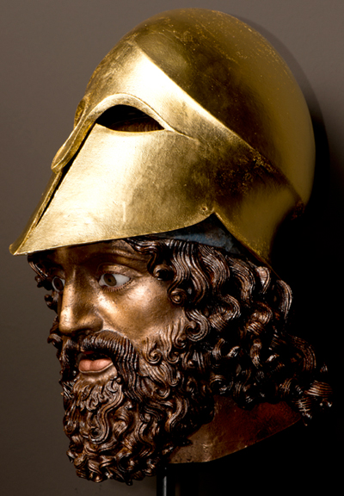
Ancient use of color
All marble was painted
Seen as incomplete
Painted skin tones
Some bronze sculptures had multiple colors
Lifelike in Classical and Hellenistic periods

Slide 3
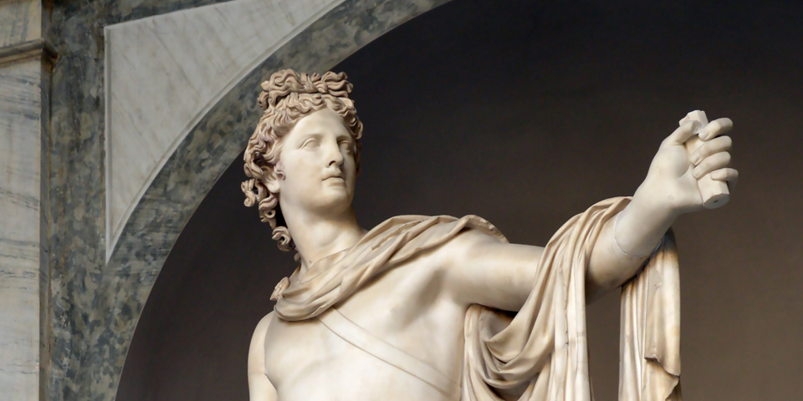
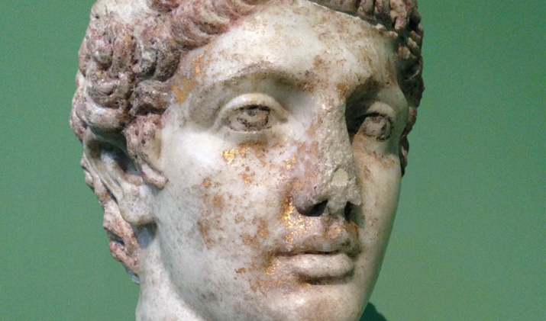
Modern perceptions
Origins in the Renaissance
Ancient world is monochrome
Eliminates vitality of past
Influences perceptions of purity
Some racist ideas

Slide 4
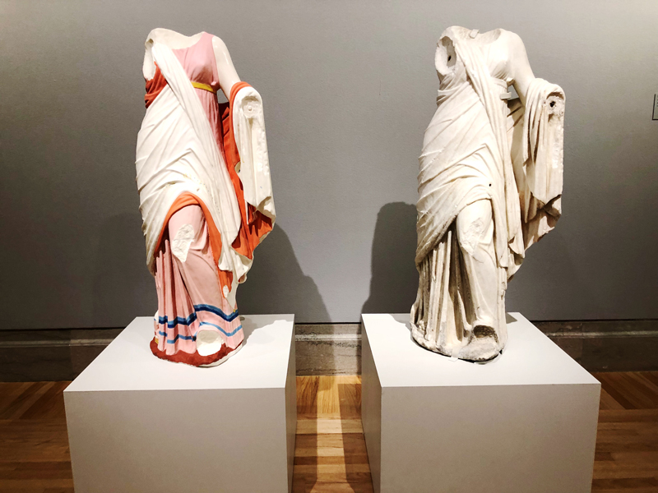
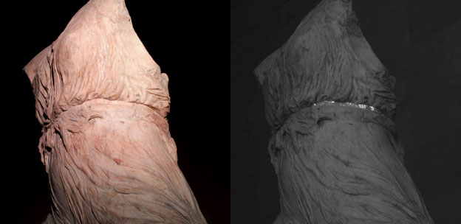
Techniques to Rediscover Color
Raking light
References in text
Tests to detect remaining pigments
Make reconstructions in plaster

Slide 5
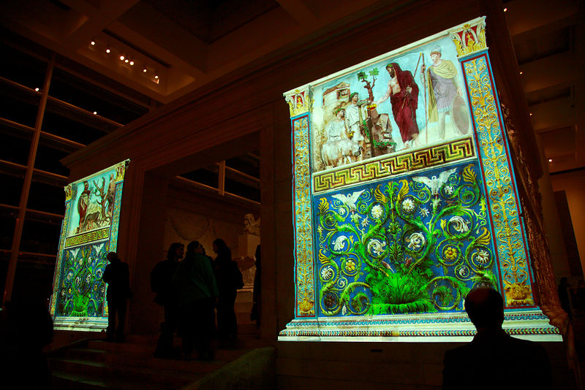
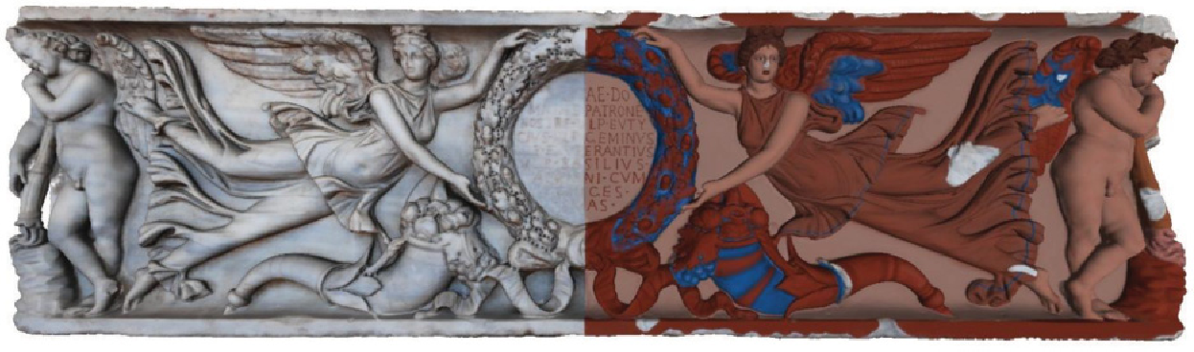
Modern efforts and exhibits
New museum exhibits
Brinkman’s comparisons
Digital imagery to recreate color

Slide 6
Bibliography
Bond, Sarah. “Whitewashing Ancient Statues: Whiteness, Racism And Color In The Ancient World.” Forbes. Accessed April 17, 2018. https://www.forbes.com/sites/drsarahbond/2017/04/27/whitewashing-ancient-statues-whiteness-racism-and-color-in-the-ancient-world/.
Bradley, Mark. “The Importance of Colour on Ancient Marble Sculpture.” Art History 32, no. 3 (June 2009): 427–57. https://doi.org/10.1111/j.1467-8365.2009.00666.x.
Brinkmann, Vinzenz, editor. Koch-Brinkmann, Ulrike, Calif ) Legion of Honor (San Francisco, and organizer,. Gods in Color: Polychromy in the Ancient World / Dreyfus, Ren�e, ; Editor. San Francisco : Fine Arts Museums of San Francisco, Legion of Honor ; Munich ; New York : DelMonico Books, Prestel, 2017.
“Classicist Finds Herself the Target of Online Threats after Article on Ancient Statues.” Accessed April 17, 2018. https://www.insidehighered.com/news/2017/06/19/classicist-finds-herself-target-online-threats-after-article-ancient-statues.
Gurewitsch, Matthew. “True Colors.” Smithsonian 39, no. 4 (July 2008): 66–72.
sarahemilybond. “The Argument Made By The Absence: On Whiteness, Polychromy, And Diversity In Classics.” History From Below (blog), April 30, 2017. https://sarahemilybond.com/2017/04/30/the-argument-made-by-the-absence-on-whiteness-polychromy-and-diversity-in-classics/.
Siotto, Eliana, Marco Callieri, Matteo Dellepiane, and Roberto Scopigno. “Ancient Polychromy: Study and Virtual Reconstruction Using Open Source Tools.” ACM JOURNAL ON COMPUTING AND CULTURAL HERITAGE 8, no. 3 (May 2015).
Siotto, Eliana, Matteo Dellepiane, Marco Callieri, Roberto Scopigno, Corrado Gratziu, Alessandra Moscato, Lucia Burgio, Stefano Legnaioli, Giulia Lorenzetti, and Vincenzo Palleschi. “A Multidisciplinary Approach for the Study and the Virtual Reconstruction of the Ancient Polychromy of Roman Sarcophagi.” JOURNAL OF CULTURAL HERITAGE 16, no. 3 (June 2015): 307–14.

