Slide 1
They Making and Re-Use of Ancient Coins
Rae Brickey

Slide 2
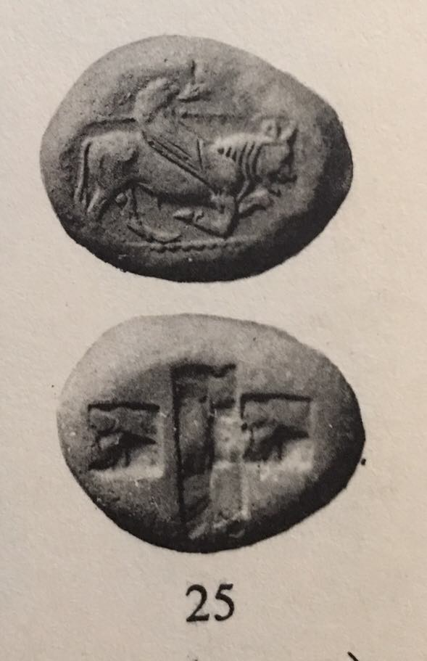
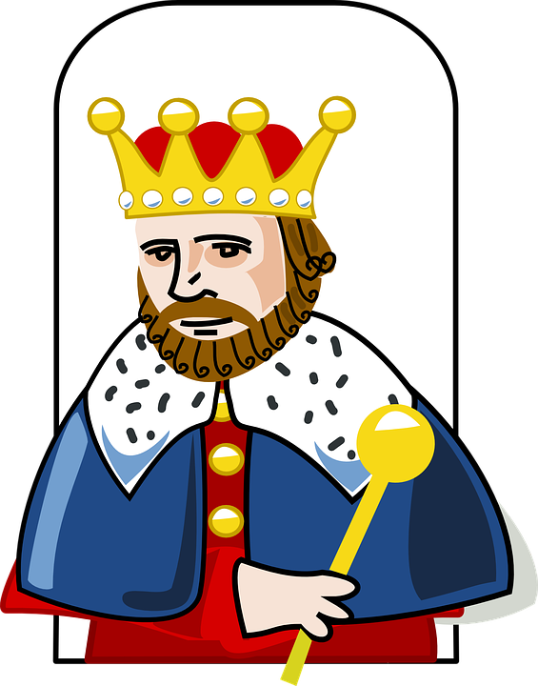

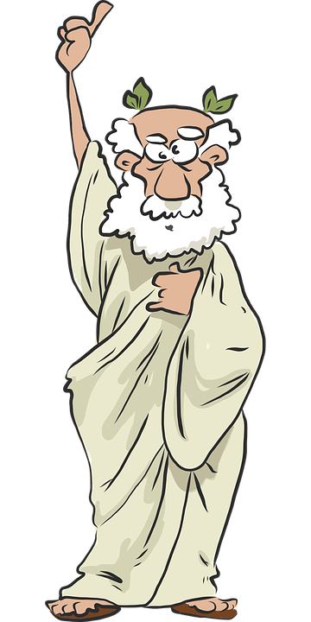
Lydia

Slide 3
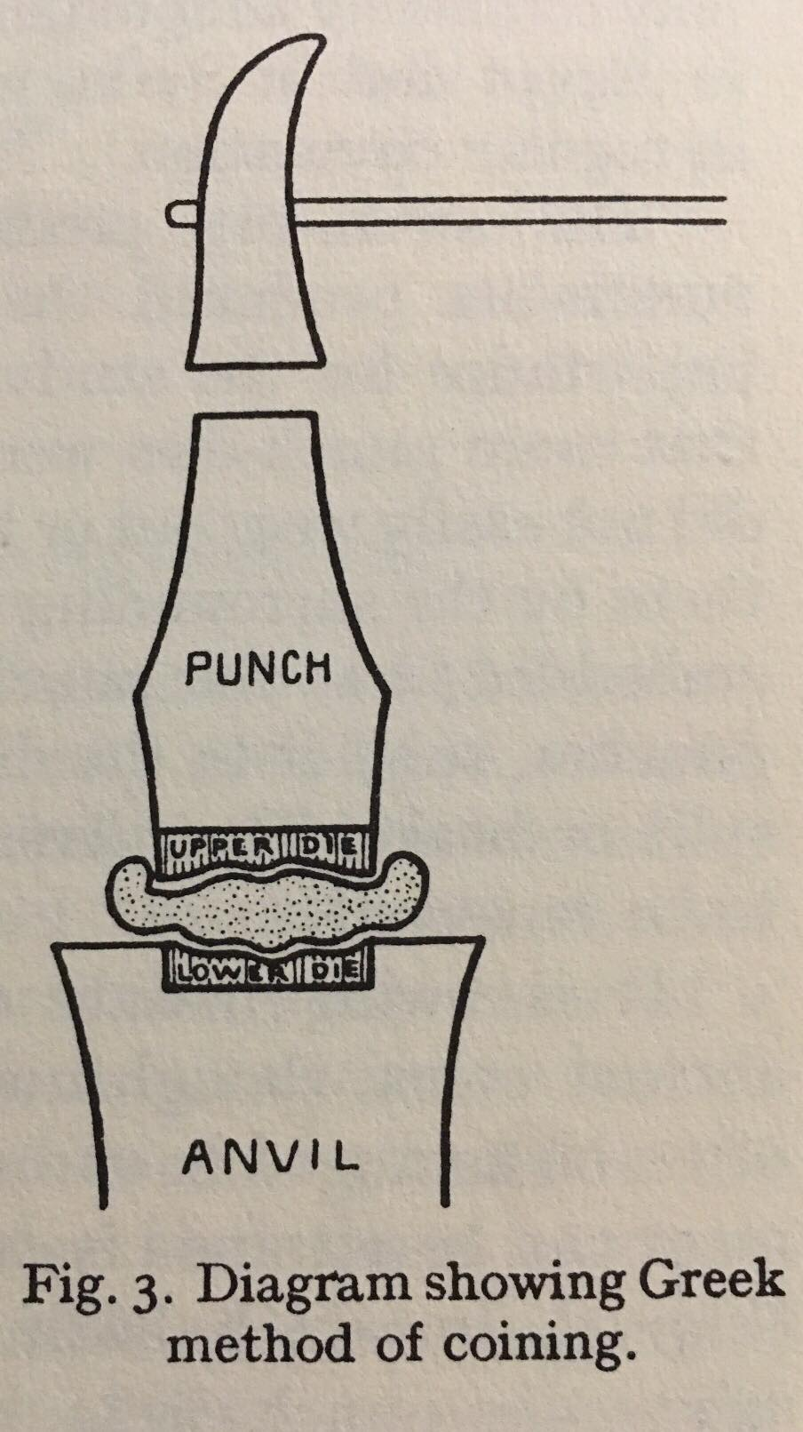
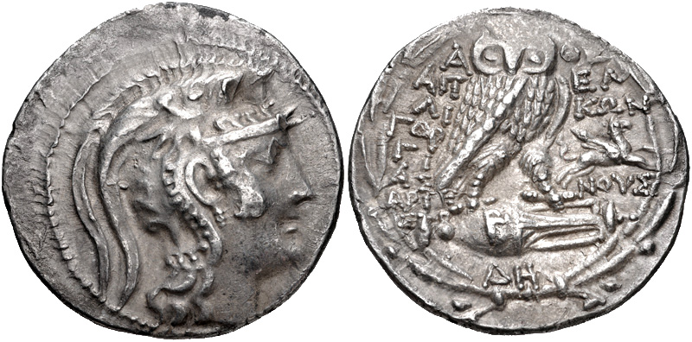
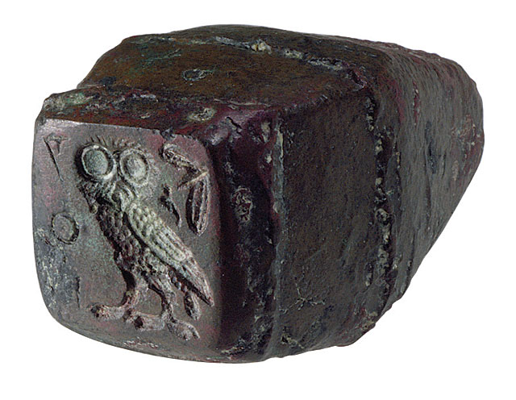
Greece

Slide 4

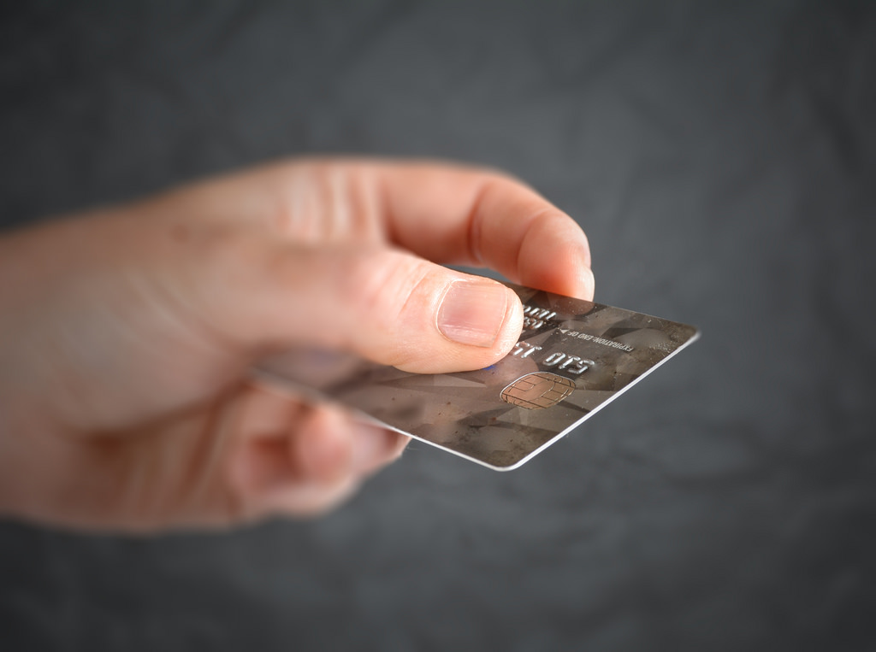
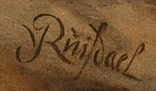
Names in the Coins

Slide 5
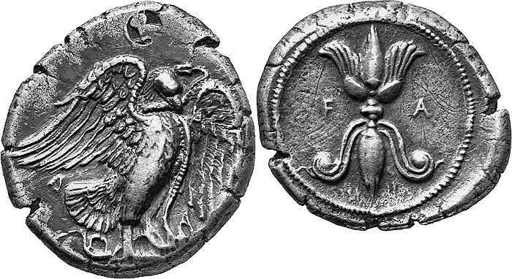
Re-Use

Slide 6
Gardner, Percy. Archaeology and the Types of Greek Coins. Argonaut Inc., Publishers, 1965.
Howgego, Christopher. Ancient History from Coins. Routledge, 1995.
Kraay, Colin. Archaic and Classical Greek Coins. University of California Press, 1976.
Seltman, Charles. Greek Coins. Bradford and Dickens, 1960.

